Slide 1
MOOCs and the Liberal Arts: Wesleyan's Coursera Experience
Consortium of Liberal Arts Colleges Conference College of the Holy Cross June 25-27, 2013

Slide 2
To join or not to join… and when?
President Roth is an explorer, values learning by doing
Add the Liberal Arts perspective
Increase global awareness of Wesleyan
Strengthen connections with alumni
Give prospective students a taste of Wesleyan faculty
Summer decision presented challenges with respect to faculty consultation; announcement was made at first faculty meeting (9/18) and Coursera announcement was released on 9/19.
Faculty response was mixed, but has evolved interestingly

Slide 3
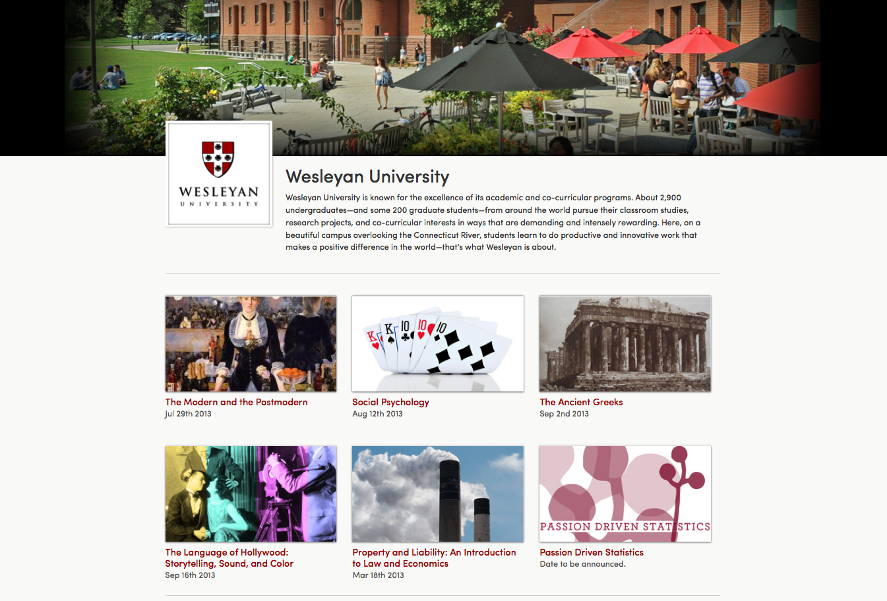

Slide 4
 | ITS Videographer and Production Assistance | DIY Videography and Production
ITS Coursera Platform Assistance | “The Modern and the Postmodern” by Michael Roth “The Ancient Greeks” by Andrew Szegedy-Maszak “Property and Liability” by Richard Adelstein | “The Language of Hollywood” by Scott Higgins “Social Psychology” by Scott Plous
DIY Coursera Platform | Zilch. * | “Passion Driven Statistics” by Lisa Dierker’s
* Maybe because the platform makes video production look like child’s play.

Slide 5
Copyrights and MOOCs
©
$
Non-profits vs. For-profits
Campus subscriptions don’t include MOOC students.
Claims of fair use may be defensible, sometimes even for heavily commercialized use.
Open nature of courses makes weak fair use claims riskier (Coursera courses close in 3rd week).
Bottom-line: Fair use considerations are not so different
Notes:
Imagine the licensing when you have to increase your FTE by 80,000!

Slide 6
“Is this transformative?”
©
?

Slide 7
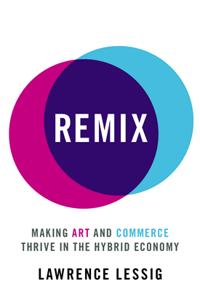
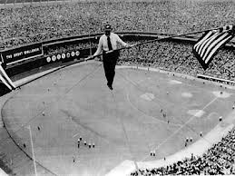
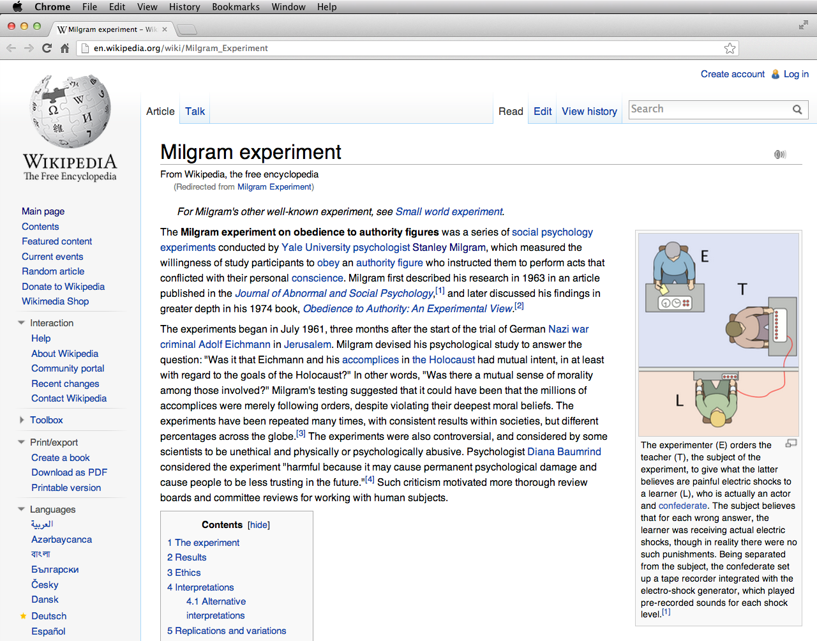
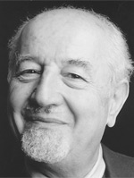
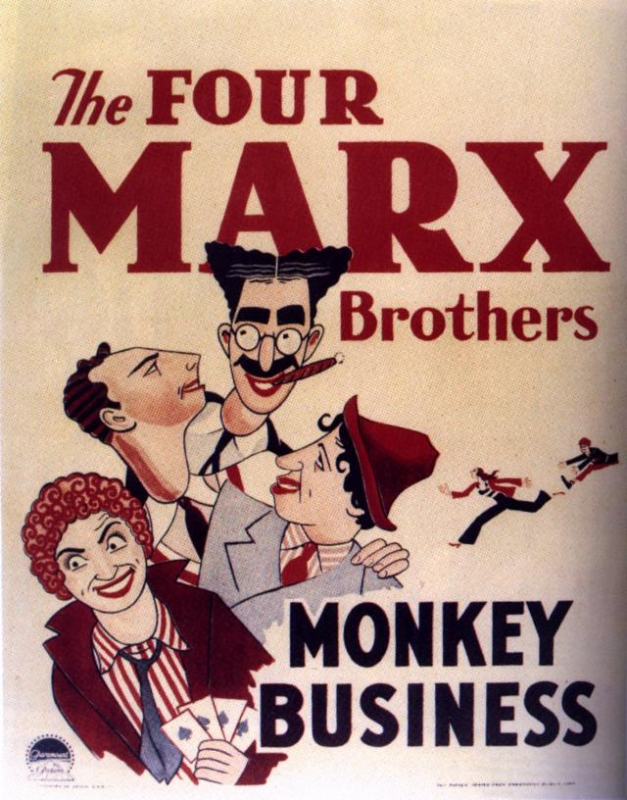
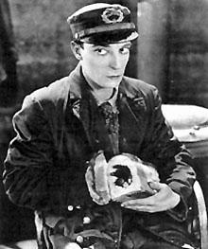
Star Trek “transporter” noise
Screenshots
Movie posters & stills
Silent film movie clip
Yale Law faculty photo
Book covers
AP Images
Museum images
A record label
Notes:
Issues with old movies: what have you copied? The original release? A remastered release? Was there an original soundtrack (vs. silent movie), but does the version you have include sound? Who added the sound? Etc.

Slide 8
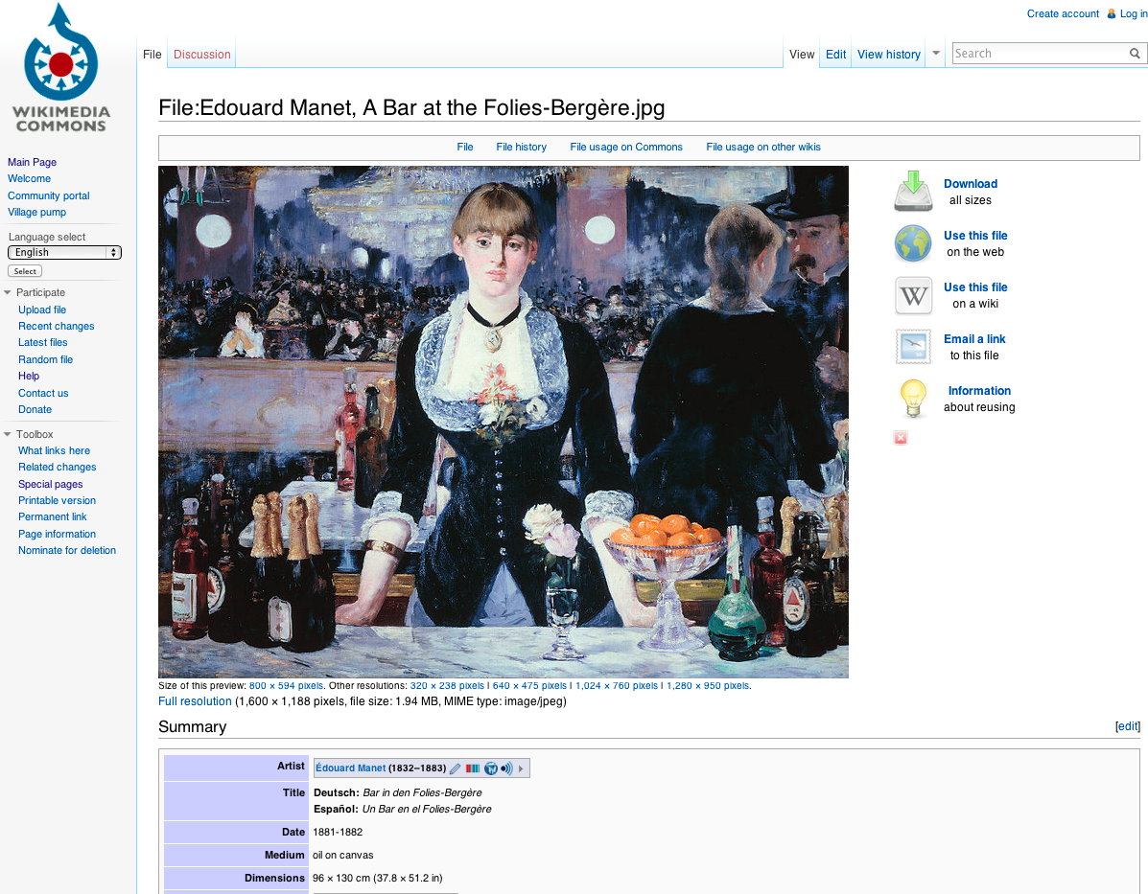
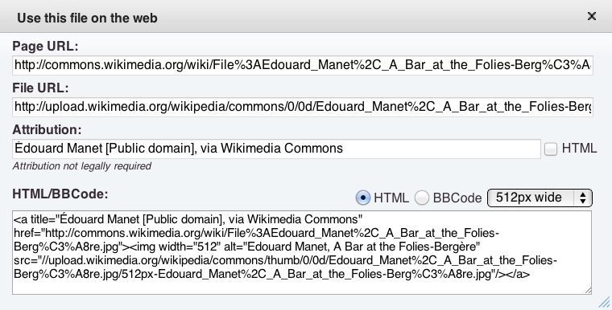
Wikimedia Commons

Slide 9
Corporate Sponsorships

Slide 10
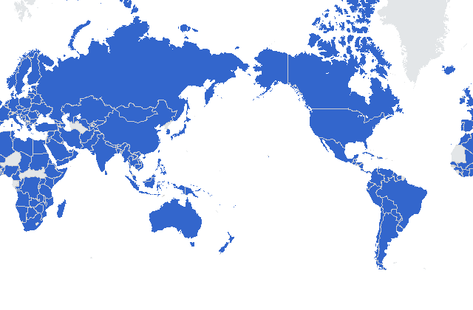
171 countries
median age 25-34 yrs
33% reside in USA
57.2 % female (57.2%)
62% native language not English
28% have had less than 2 years of college
72% have a Bachelor’s or beyond
84.6% use a pc
90% would take another Wesleyan Coursera course

Slide 11
Additional Findings
70% believe that their Coursera course was equivalent to a college-level classes they have taken.
93% rate the course and teaching as good or outstanding.
34% rate peer interactions as good or outstanding.
54% hold a more favorable or stronger (vs. weaker) opinion of Wesleyan as a result of their experience
Top 5 countries with > 100 respondents to report greatest improvement in opinion of Wesleyan are Mexico, Columbia, India, the Philippines, Brazil

Slide 12
The Media & Social Media
The old paradigm was pay to play. Now you get back what you authentically put in. You’ve got to be willing to play to play.
-Alex Bogusky, Founder CP+B

Slide 13
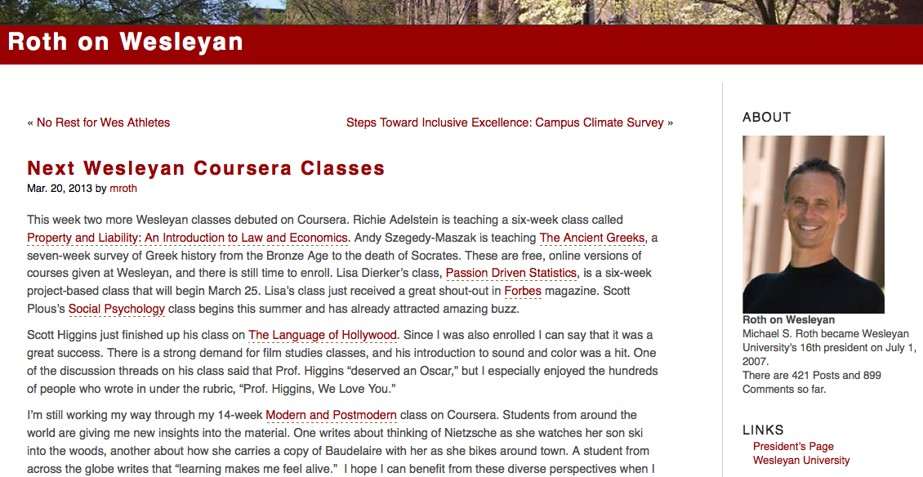
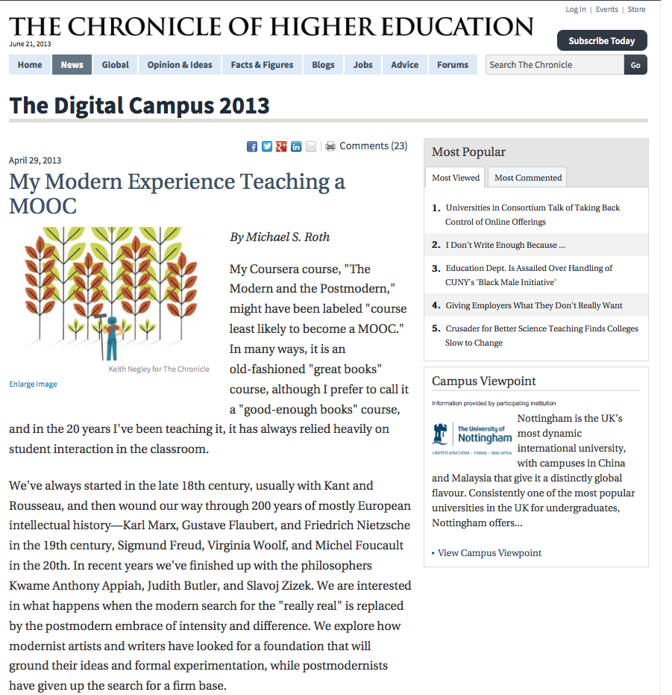
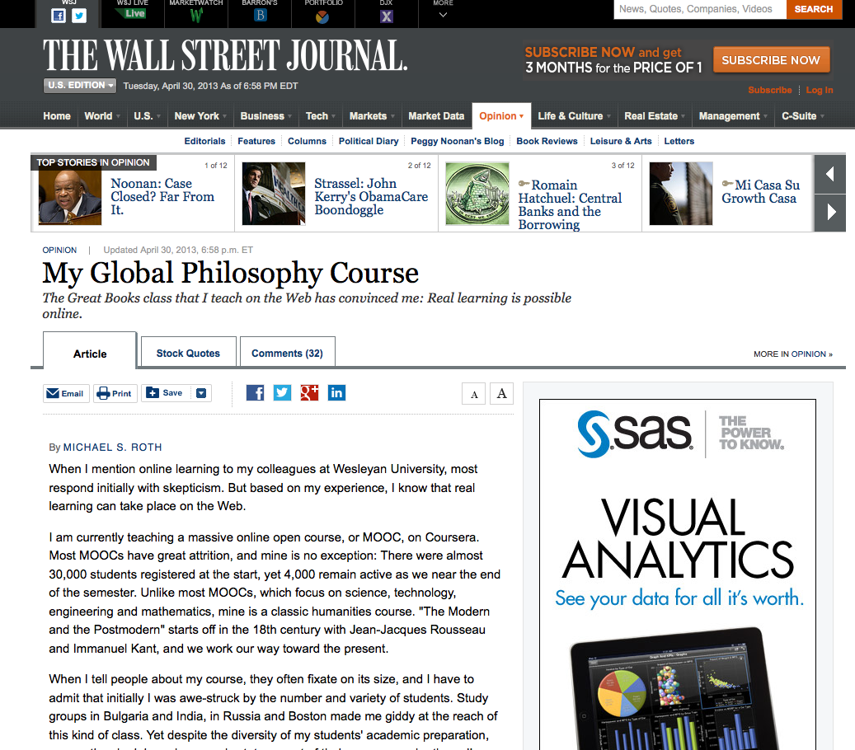
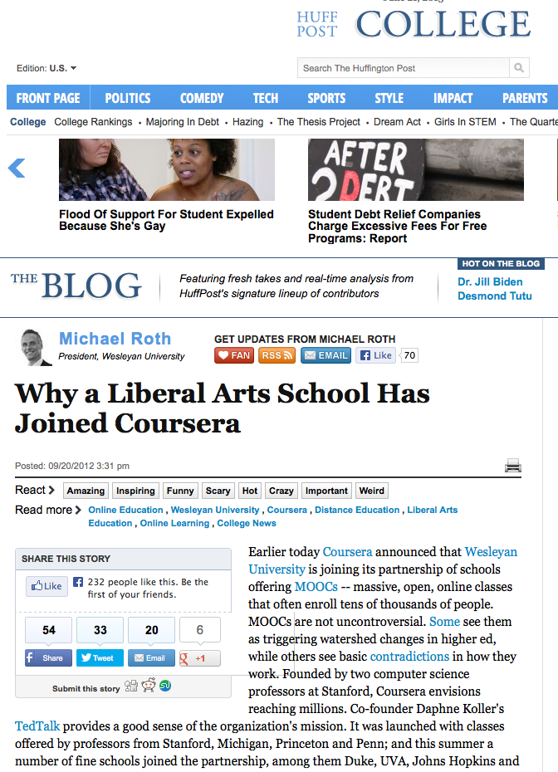
Roth on MOOCs

Slide 14
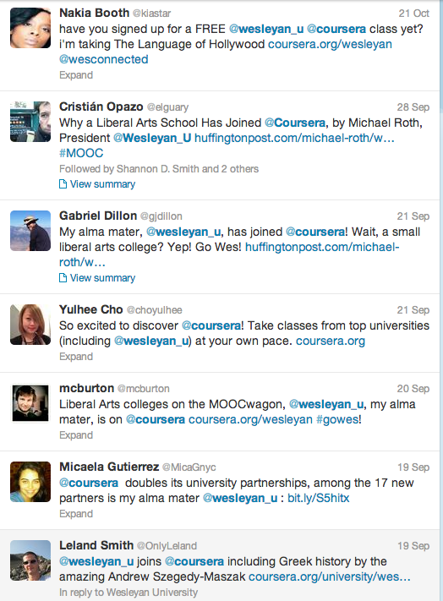
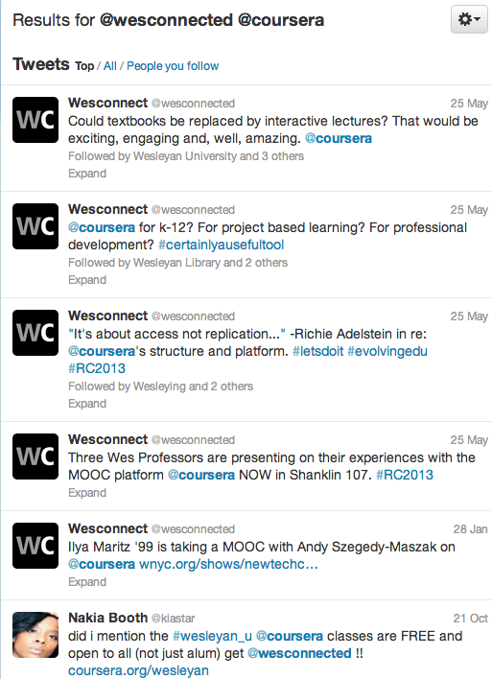
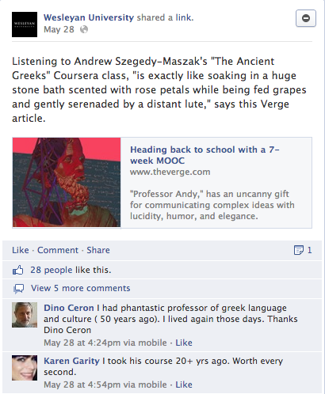
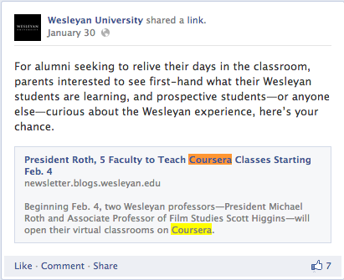
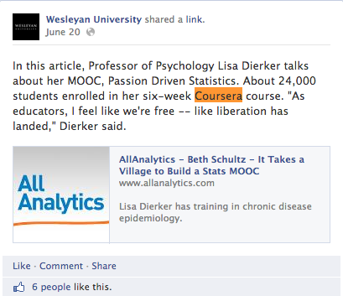

Slide 15
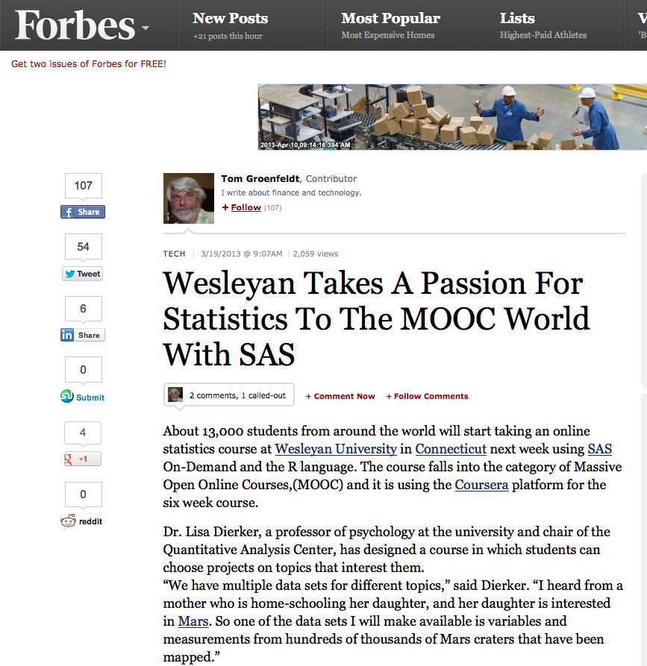
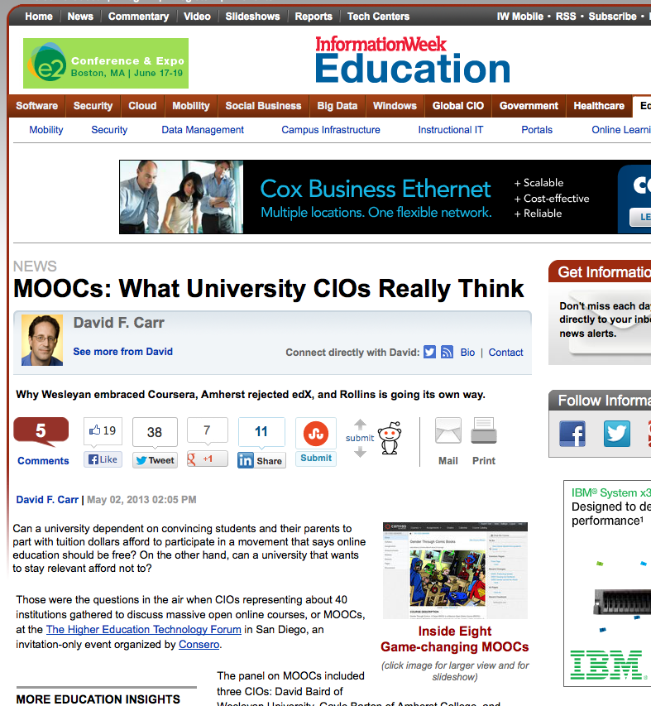
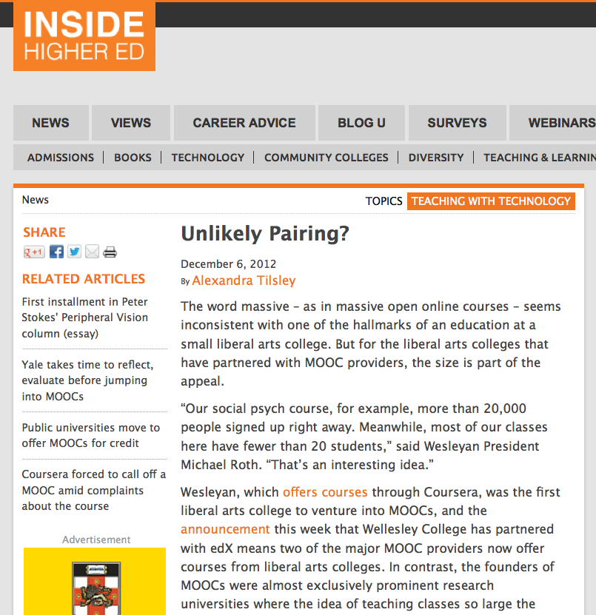
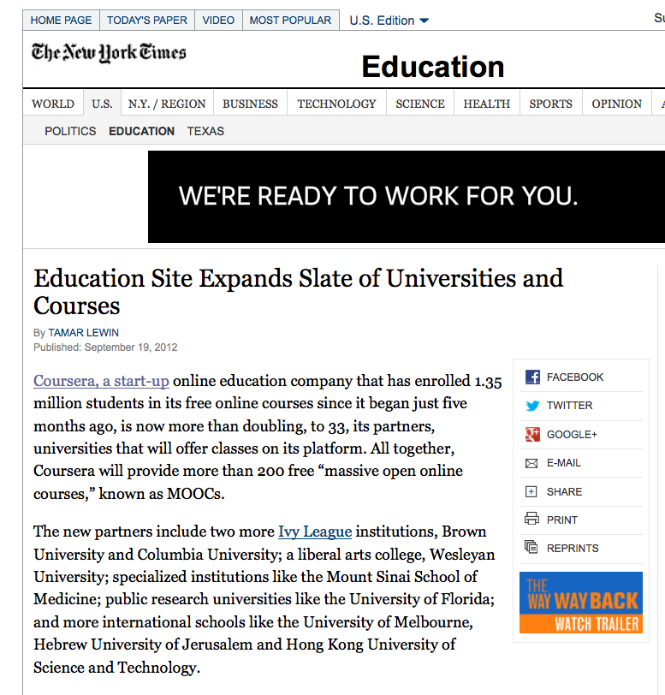

Slide 16
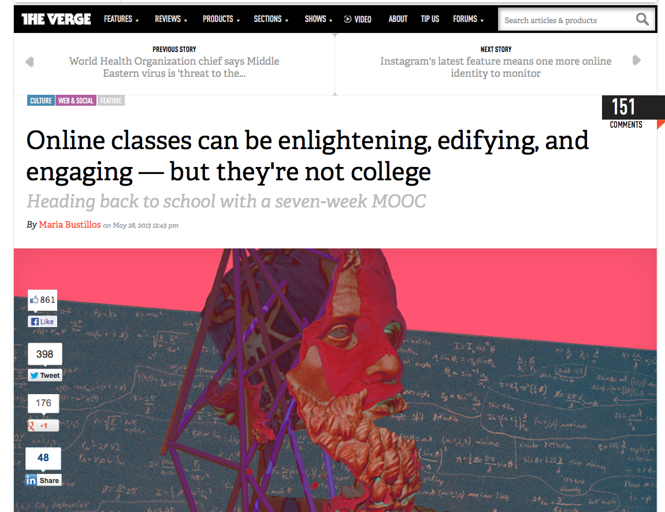
…as many a glowing recommendation (complete with chili pepper) on RateMyProfessor.com will attest, listening to the voice of Andrew Szegedy-Maszak is exactly like soaking in a huge stone bath scented with rose petals while being fed grapes and gently serenaded by a distant lute.

Slide 17
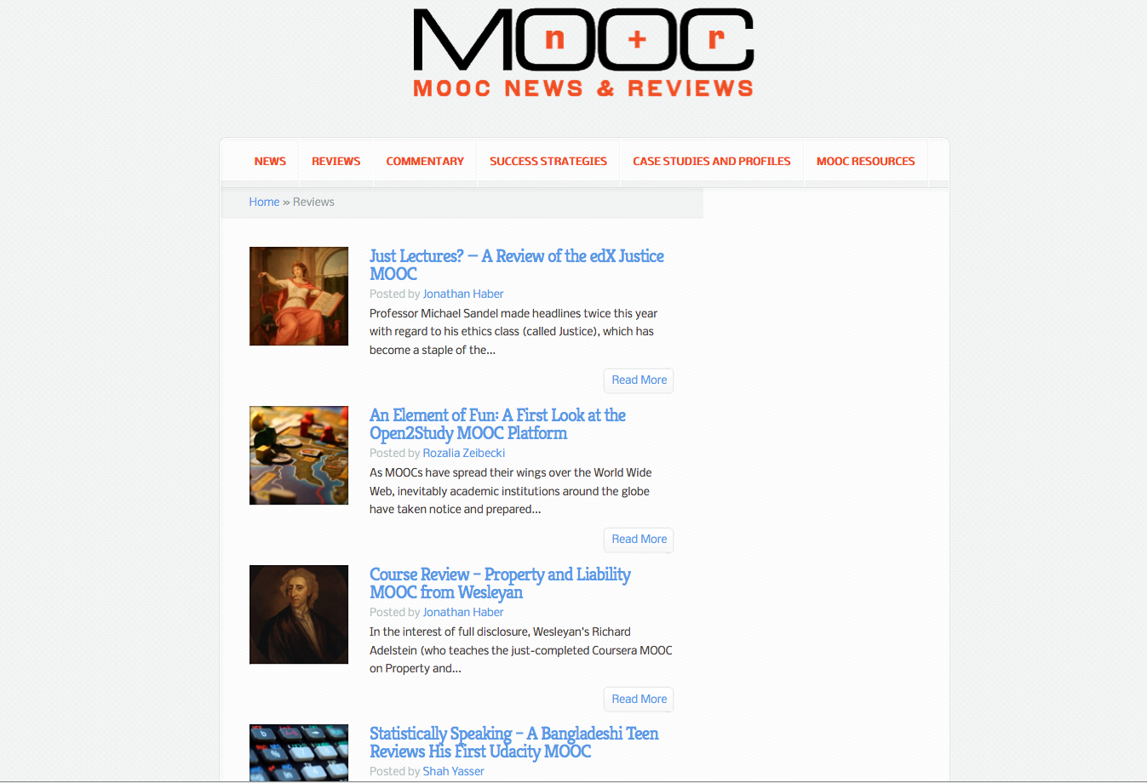

Slide 18
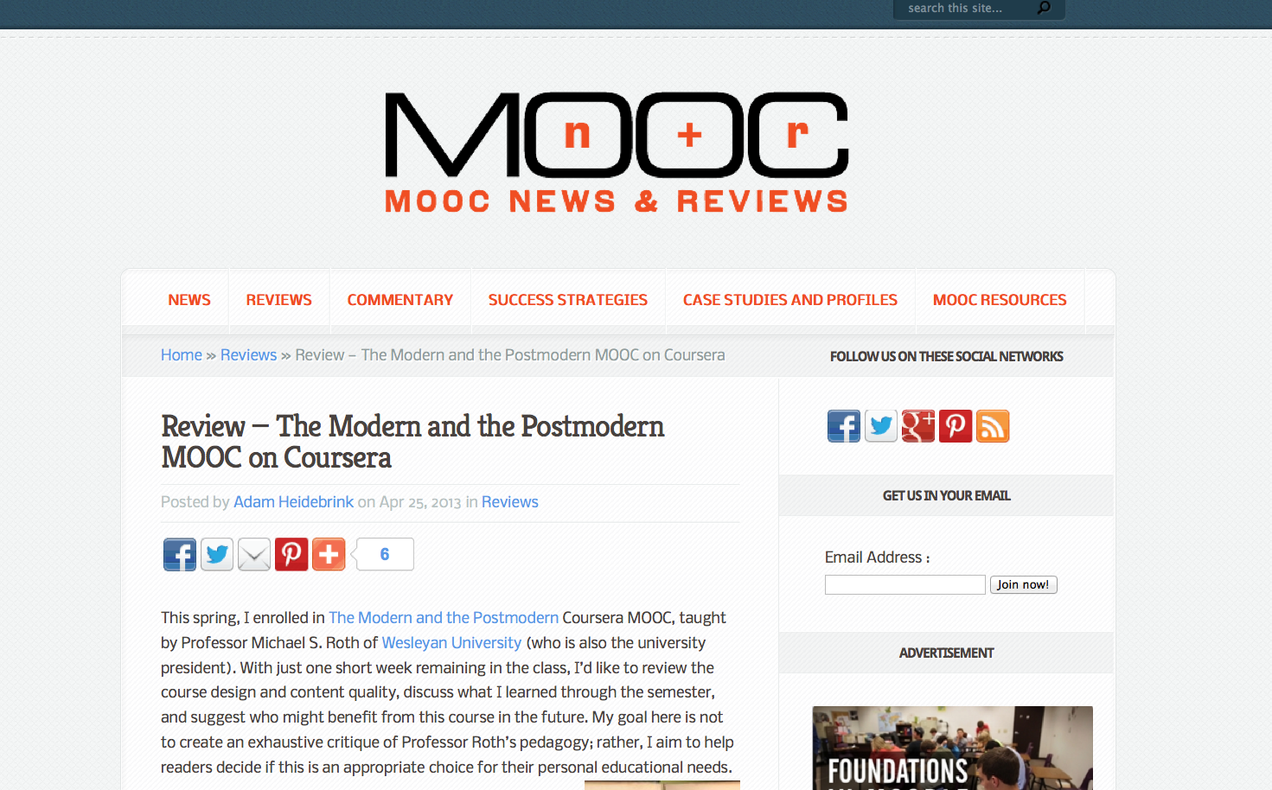
Overall, I found this MOOC comparable to an upper level undergraduate course in literature (which, in fact, was my undergraduate degree, so I have taken many classes quite similar to this one, varying only in theme). By the end, I attended nearly fifteen hours of lectures, read approximately a dozen full-length texts, and produced over twenty pages of essay writing.

Slide 19
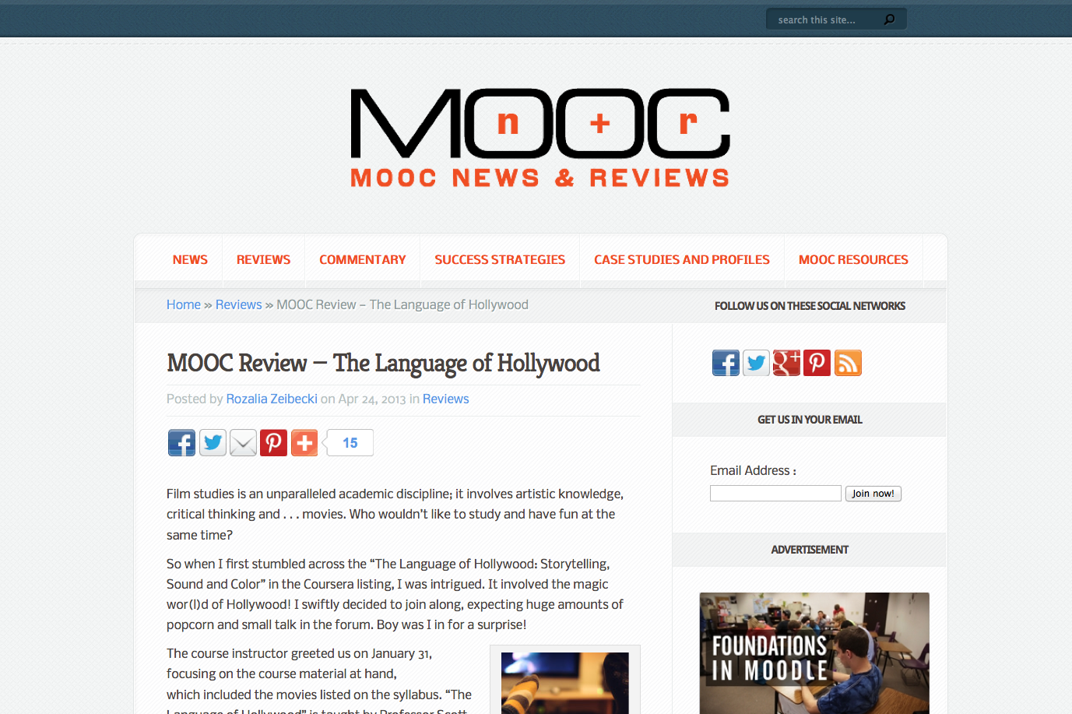
All MOOC students at some point exclaim “I am doing this for the experience.” I am not sure if they always mean it, but in this case it must have been sincere. I cannot begin to describe the pleasure of discovering Hollywood’s past. The vibrations that were felt as we went behind the curtain of these cinematic gems were staggering. Honestly, the quiz never mattered for me in this MOOC course; the journey was reward enough.

Slide 20
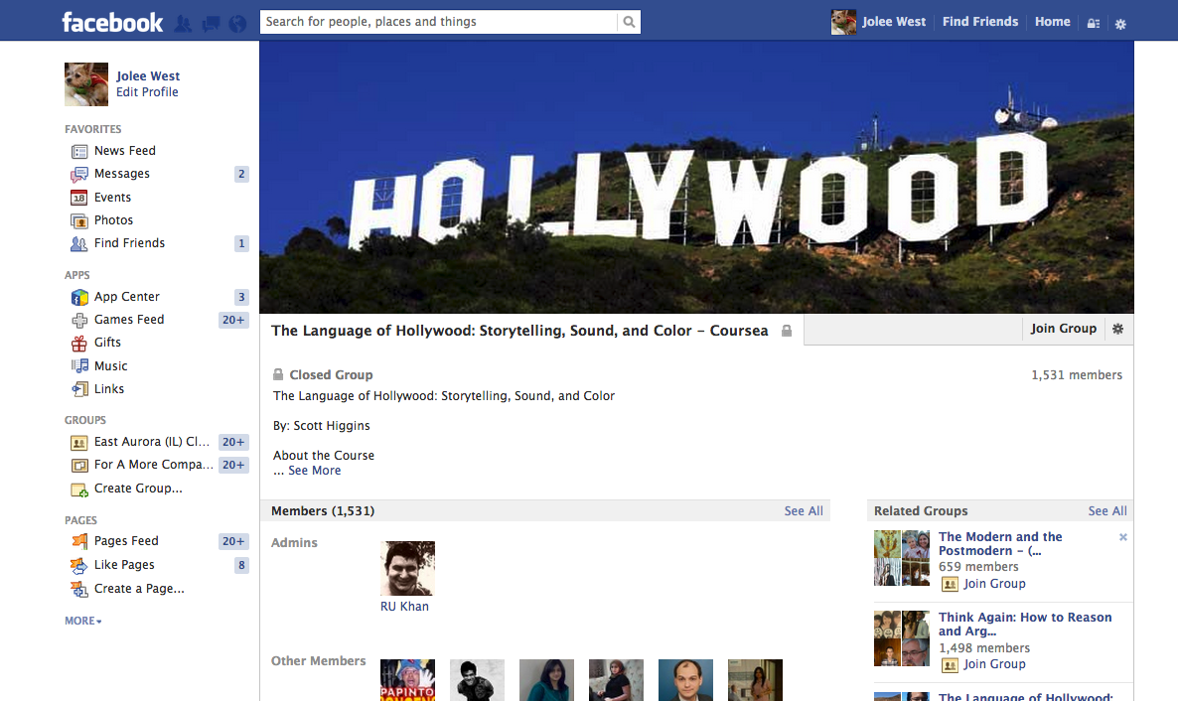
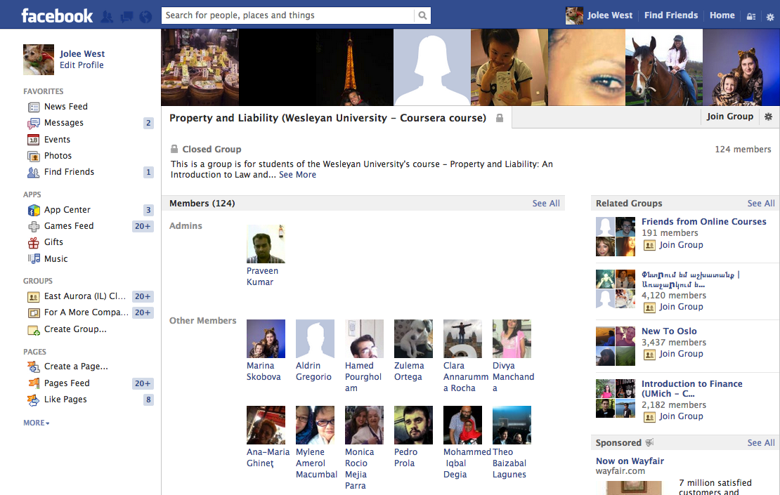
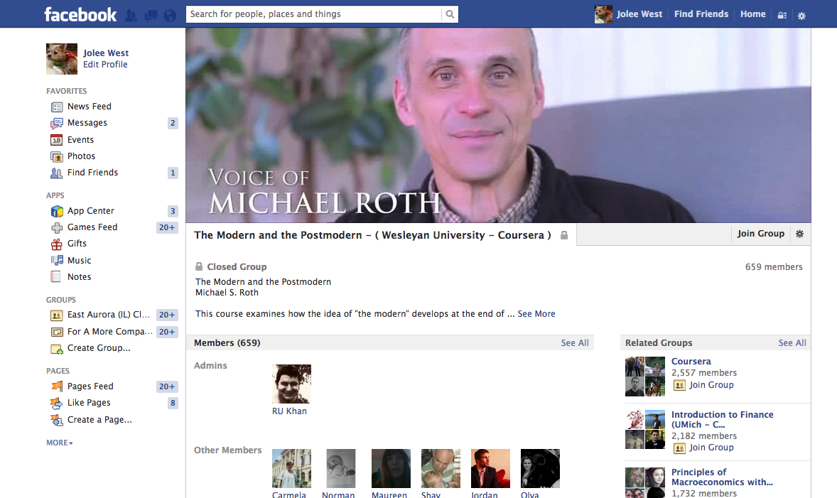
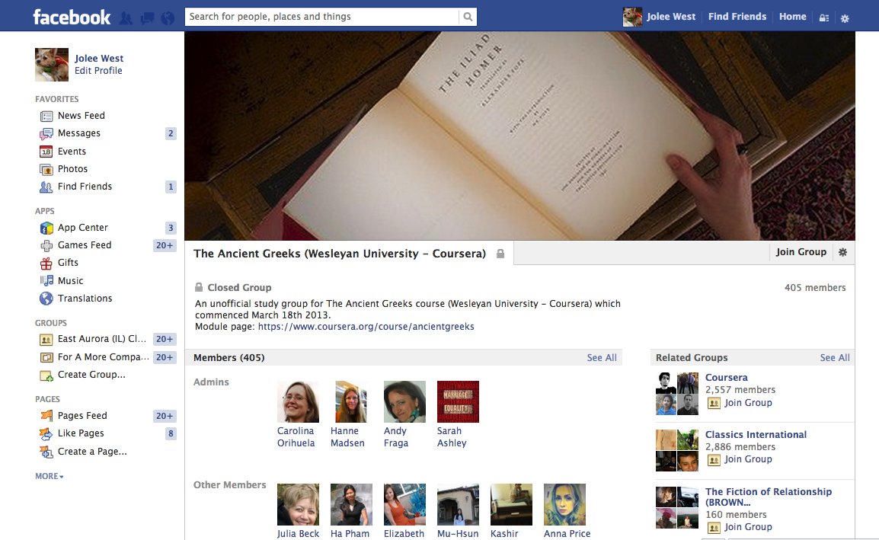

Slide 21
Reaction and Response
Controversy → buzz → discussion
Increased interest in flipped classes and blended learning
Re-purposing Coursera content
Re-running Coursera courses

Slide 22
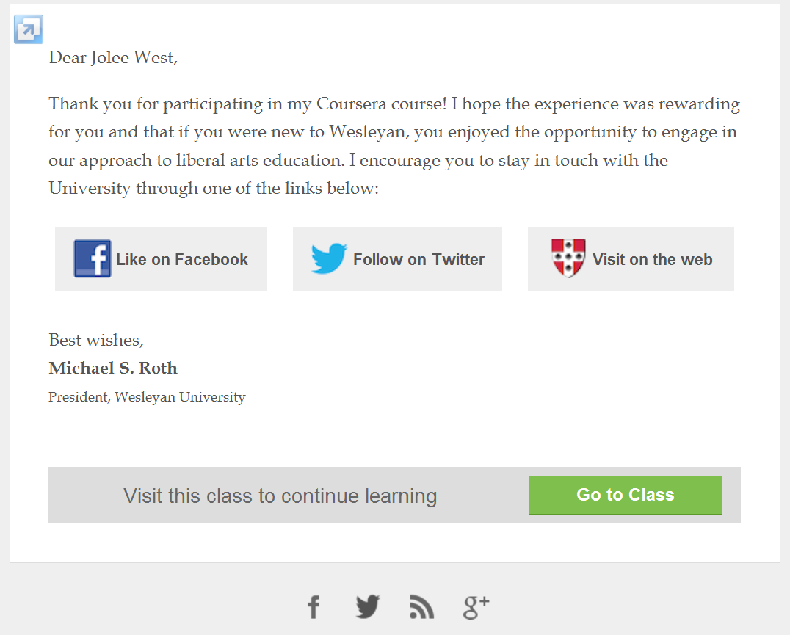
Thanks!

