Slide 1
About This Class
Different – emphasis not only on learning isolated processes but also on integration.
Very biophysical and mathematical (be sure to learn formulas and do homework in a timely manner).

Slide 2
Expectations
Time – 9-10 hours a week outside in preparation for each class and in doing assignments.
I have designed class time to be spent on topics that you indicate are unclear from reading. We hopefully will spend much time discussing the material.

Slide 3
General Approaches
Materialism
Reductionism and emergence
Mechanistic Approach
Adaptational/Evolutionary Approach

Slide 4
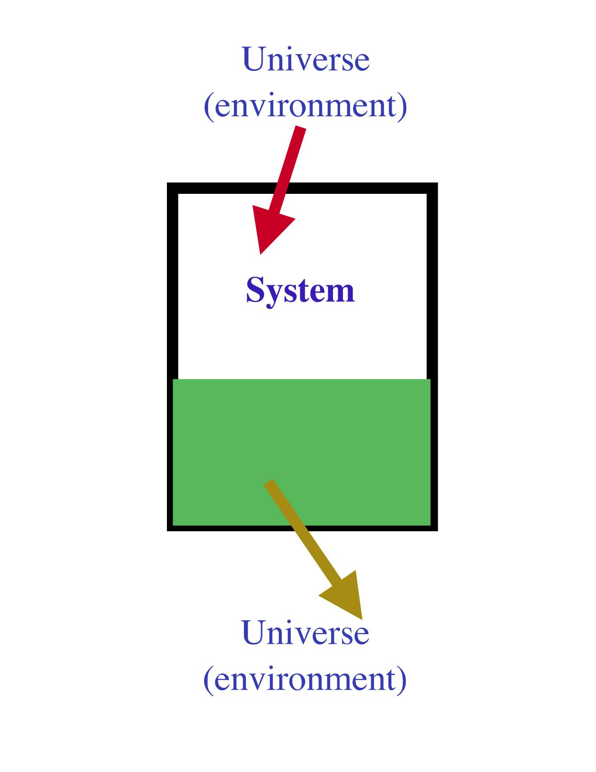
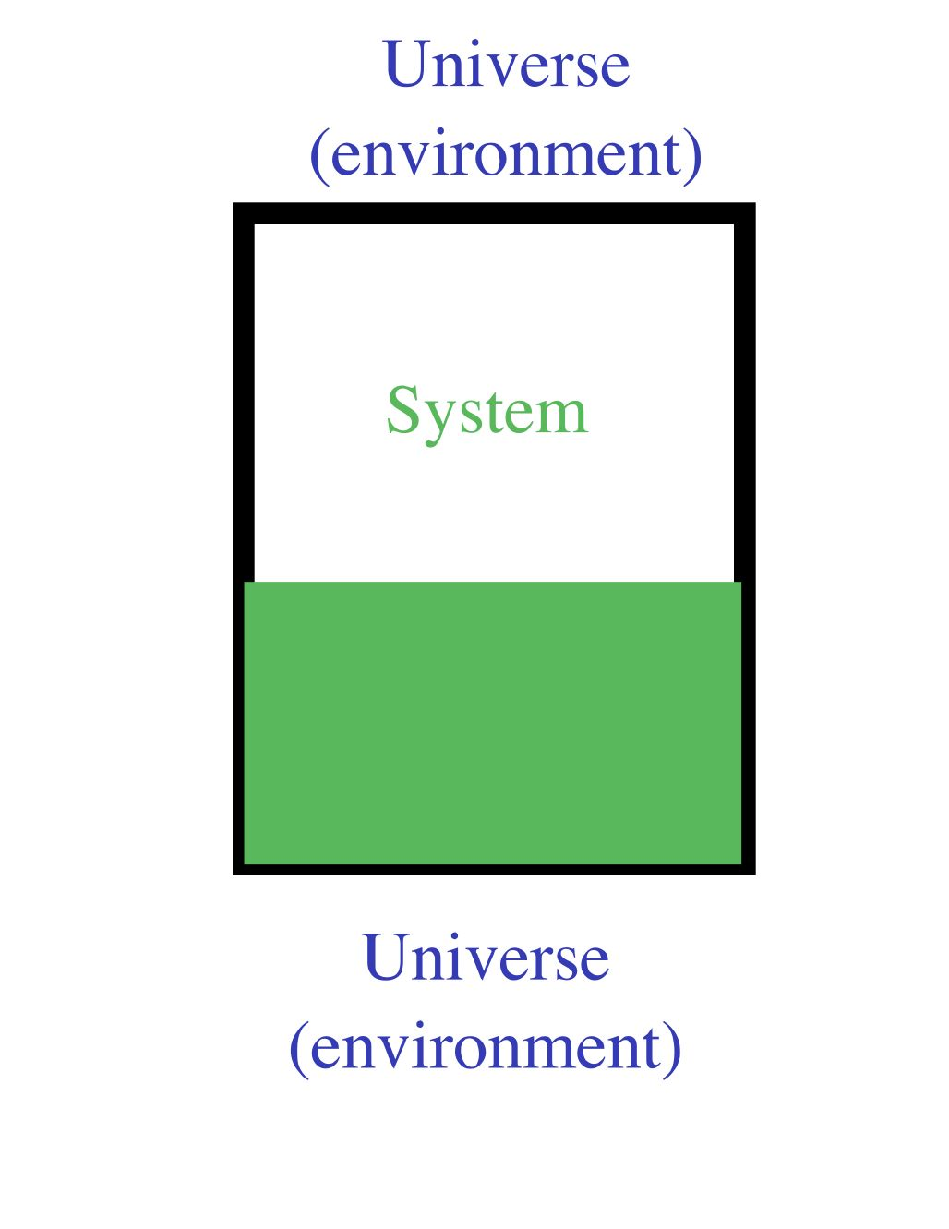
Closed vs. Opened Systems

Slide 5
A Model of an Open System
The quantity (Q) (level) of the variable is set by the relative rates of flow in and out.
The flux ( ) is the rate material or energy moves through the system

Slide 6
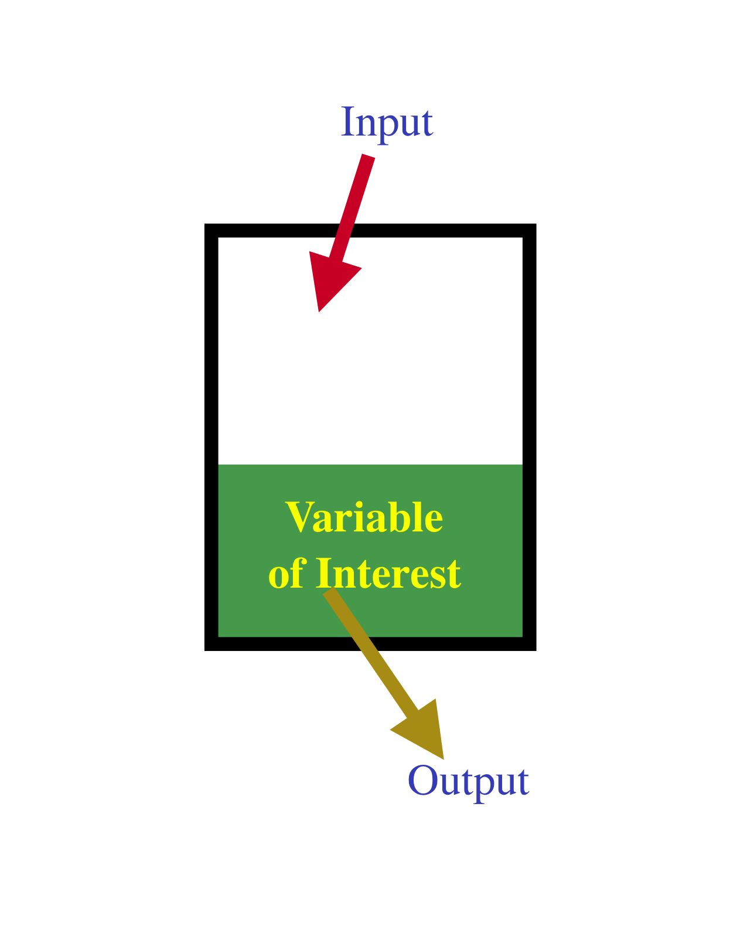
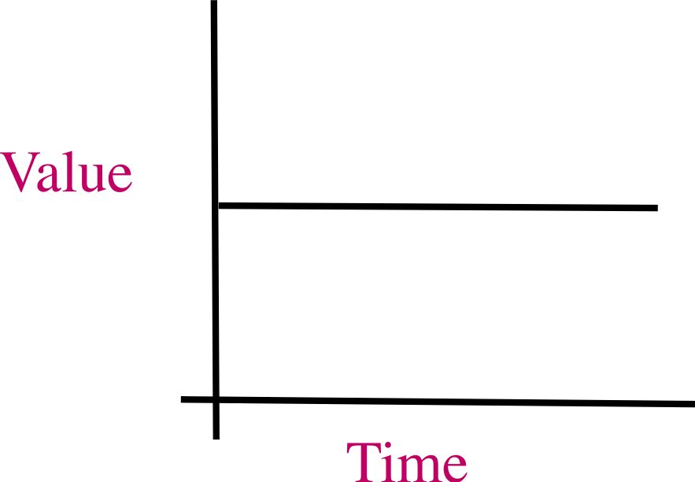
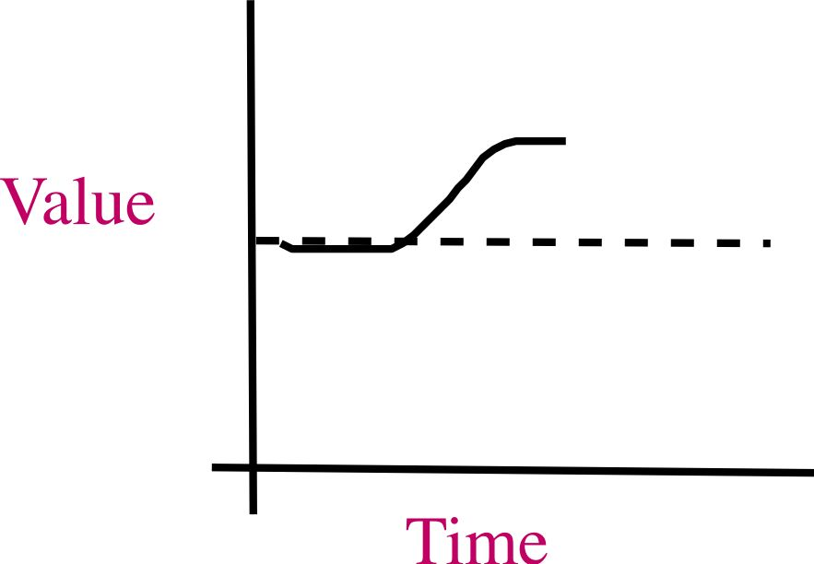
Open System and Steady and Non-Steady States

Slide 7
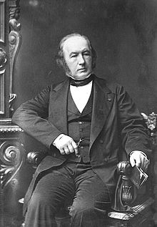
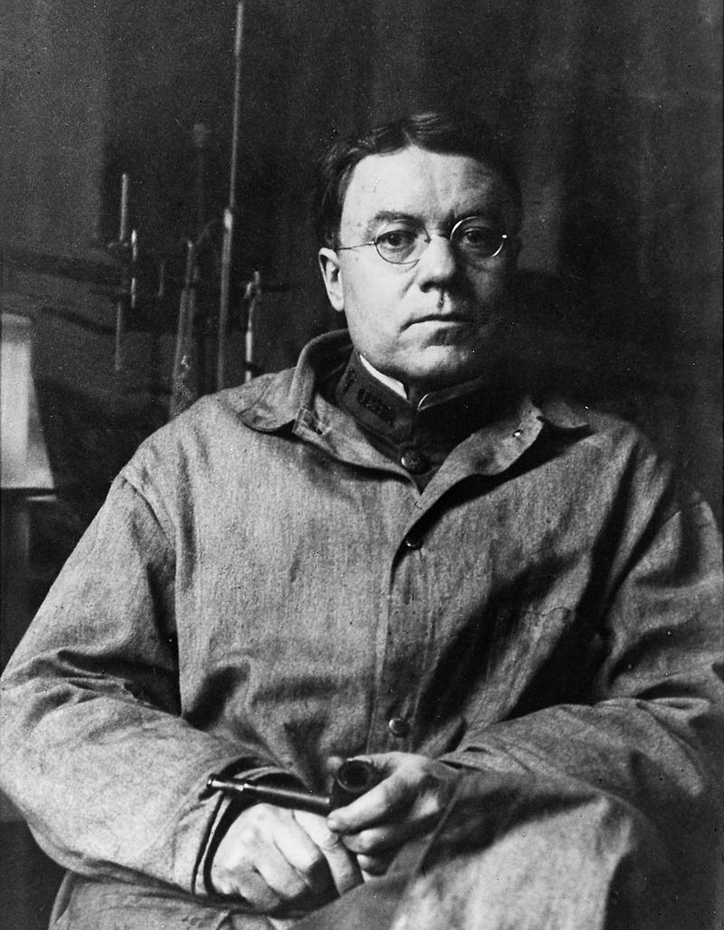
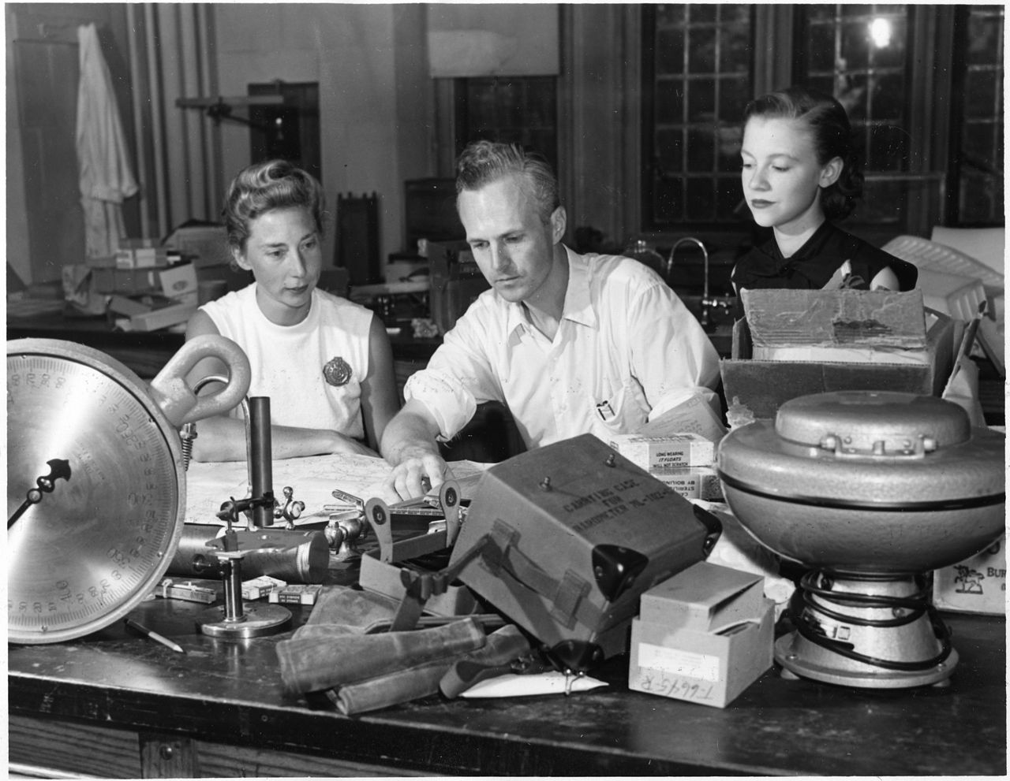
Regulation
en.wikipedia.org
en.wikipedia.org
en.wikipedia.org
The central organizing idea in physiology
A general model for the study of regulation (and other processes):
Notes:
Click on the two photos for brief biographies and additional information on homeostasis.

Slide 8
A simple investigation of regulation on a whole-animal basis
The importance of equilibration

Slide 9
Graphical Representation of Regulation and Conformity

Slide 10
Additional Patterns
Notes:
10

Slide 11
The Homeostasis Concept
Notes:
11

Slide 12
Buffering and Equilibration
What is buffering?
Any non-control system factor that tends to minimize the size of a disturbance.
e.g., thermal buffers and resistance to thermal traps.

Slide 13
Negative and Positive Feedback Systems
Notes:
13

Slide 14
Elements of a Negative Feedback System
Notes:
14

Slide 15
Room Temperature Control Example
Notes:
15

Slide 16
Control in On-Off Systems
Notes:
16

Slide 17
Proportional Control
Notes:
17

