Slide 1
Cell-to-Cell Communication
Synapse Types:
Electrical -- may be directional
-- probably not important computationally
Chemical
-- classical model is that they transmit information uni-directionally (not strictly correct)

Slide 2
Nicotinic Neuromuscular Junction (NNMJ)
At junction between motor neuron and muscle cell.
Optimized for high likelihood of conduction

Slide 3
Behavior of the Post-synaptic Membrane Following ACH Binding

Slide 4
Summary of Observations
We see that the reversal potential for a typical neuron is when E_{m} ≅ -16 mV.
Note that this is above the Nernst (reversal) potential for K⁺ and Cl⁻ and below that of Na⁺
Can theory shed some light?

Slide 5
The Chord Conductance Equation
The Chord conductance equation: i_{m} = i_{K+} + i _{Na+} + i _{Cl-}
At steady-state (dV/dt=0): i_{m} = 0

Slide 6
Ionic Currents and E_{m}
At stead-state, i_{m} = 0 and dE_{m}/dt = 0
Remember that: i_{ion} = G_{ion} * ΔE
Let’s assume that only Na⁺ and K⁺ matter in an EPSP at the NNMJ. Substituting into the chord conductance equation:
Re-arranging and solving for E_{m}:
Notes:
0=(Em-Ek)*GK + (Em-ENa)*GNa
0 = EM*GK-EK*GK + EM*GNa – ENa*GNa
0=EM*GK + EM*GNa – EK*GK - ENa*GNa
0=EM*(GK + GNa) – EK*GK - ENa*GNa
EM*(GK + GNa) = EK*GK + ENa*GNa
EM = EK*GK/*(GK + GNa) + ENa*GNa/*(GK + GNa)

Slide 7
The Chord Conductance -- What if G_{Na+} equals G_{K+}?
One possibility is that the ACH gated channel are not specific to univalent positive ions (K⁺ and Na⁺) -- that both would pass equally well through the gate.
If this is true, then G_{Na+} = G_{K+} = 1
The chord conductance equation solves to:

Slide 8
Prediction – If G_{Na+} = G_{K+} …
The peak depolarization of the post synaptic membrane should be the average of the equilibrium potentials for the ions involved
-- the predicted value for Na+ and K+ with equal conductance matches the actual empirical evidence.

Slide 9
Behavior of the Post-synaptic Membrane Following ACH Binding

Slide 10
Neural computation

Slide 11
No Summation

Slide 12
Spatial Summation

Slide 13
Temporal Summation

Slide 14
Inhibition

Slide 15
Peripheral Nervous Systems
Somatic
Sensory (afferent) - kinesthetic senses, peripheral sensors for temperature, etc.
Motor (efferent)
Autonomic
Sensory
Effector -- Sympathetic and Parasympathetic

Slide 16
Gross Morphology
Somatic effector -- synapses at the spinal root and effector or sensor. One cell from one end to the other.
Autonomic effectors-- "chain" -- two cells between CNS and effector.
Connections between cell #1 and #2 occur in the autonomic ganglia.
Pre-ganglionic and post-ganglionic axons (neurons)
Parasympathetic -- ganglion is near the CNS, Sympathetic -- ganglion at some distance

Slide 17
Pharmacology
Pre-ganglionic axons are all cholinergic
receptor is a type of nicotinic receptor (+)
In the parasympathetic, post-ganglionic axons are also cholinergic but the receptors are all muscarinic.
In the sympathetic, the post-ganglionic axons are adrenergic and the receptors are alpha and beta receptors

Slide 18
Sympathetic Post-ganglionic NT
NT for sympathetic -- Norepinephrine (NE)
α₁ and α₂ receptors.
a₂ receptors are usually pre-synaptic
Hormone for sympathetic is from the adrenal medulla
(a ganglion) -- it is epinephrine (E).
The main receptors for E are called β receptors of which there are several subtypes (these are given numbers).

Slide 19
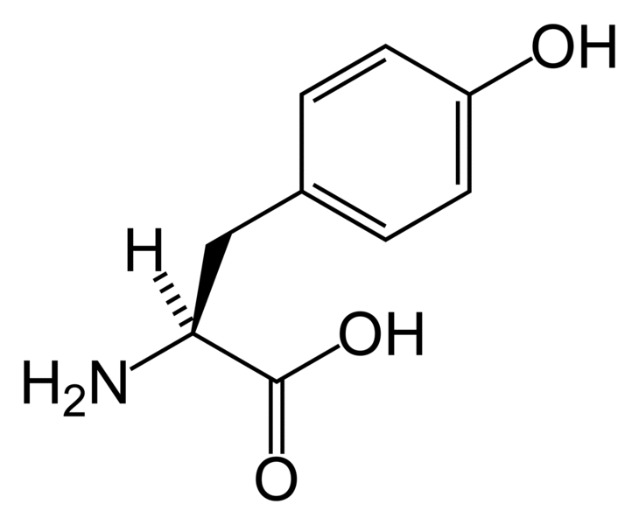
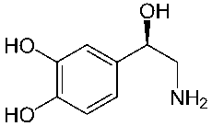
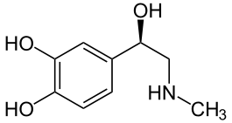
Catecholamines
-- these are NTs that are derivatives of tyrosine:
Norepinephrine (NE)
Epinephrine (E)
Dopamine
All images http://en.wikipedia.org/

Slide 20
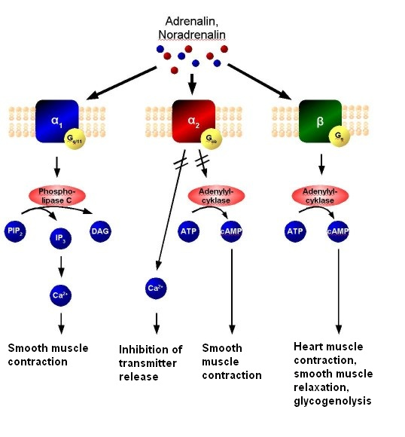
Actions of Catecholamine Receptors
http://en.wikipedia.org

Slide 21
Autonomic Receptors, Agonists, and Antagonists

Slide 22
Autonomic Responses in Different Tissues

