Slide 1
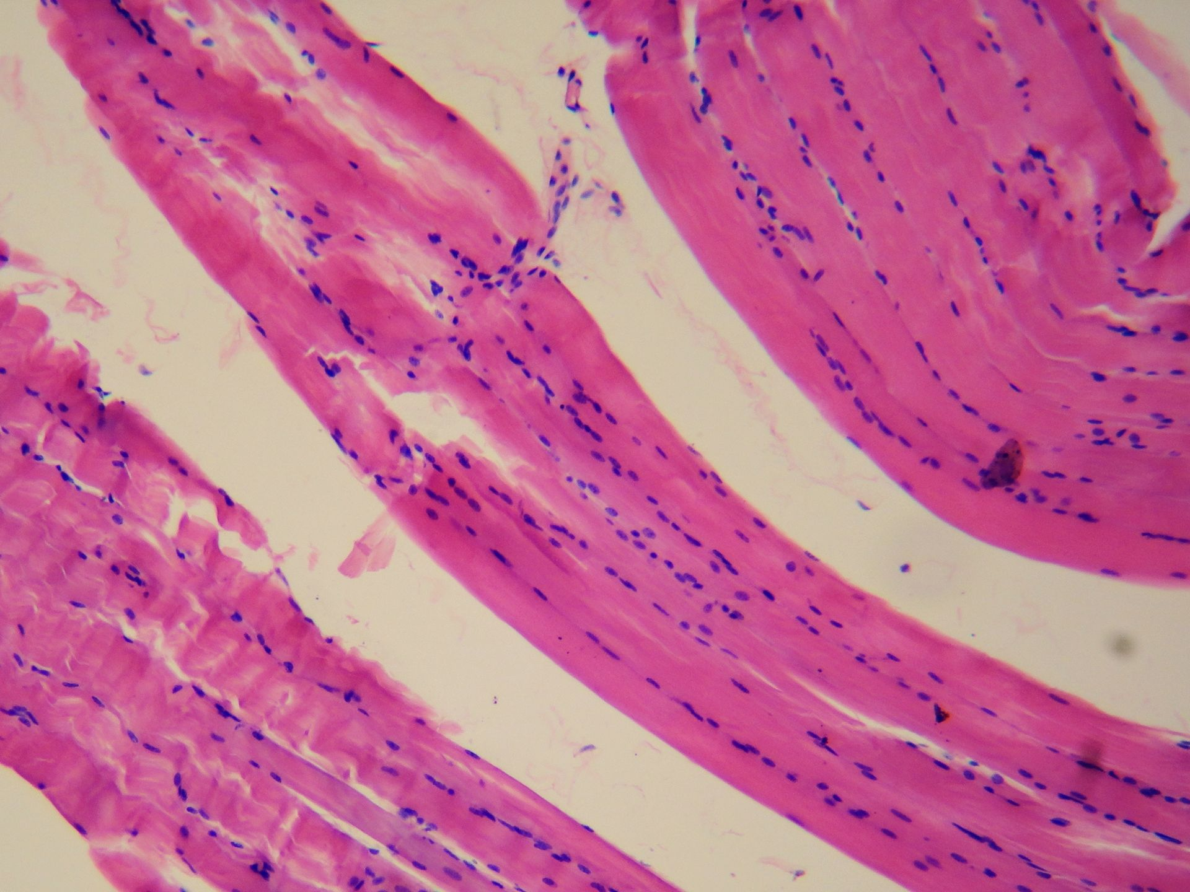
General Shape of a Smooth Muscle Cell
"Smooth muscle tissue" by Juan Carlos Fonseca Mata - Own work. Licensed under CC BY-SA 4.0 via Commons - https://commons.wikimedia.org/wiki/File:Smooth_muscle_tissue.jpg#/media/File:Smooth_muscle_tissue.jpg

Slide 2
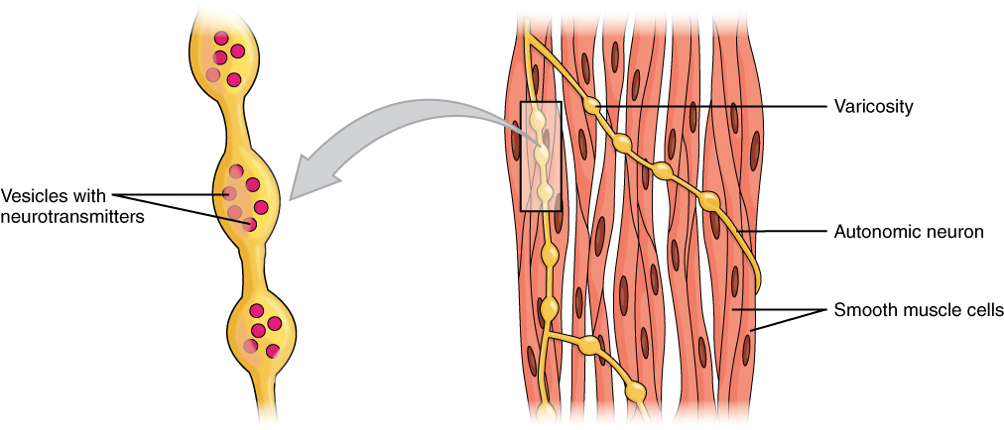
Smooth Muscle Motor Units?
"1029 Smooth Muscle Motor Units" by OpenStax College - Anatomy & Physiology, Connexions Web site. http://cnx.org/content/col11496/1.6/, Jun 19, 2013.. Licensed under CC BY 3.0 via Commons - https://commons.wikimedia.org/wiki/File:1029_Smooth_Muscle_Motor_Units.jpg#/media/File:1029_Smooth_Muscle_Motor_Units.jpg

Slide 3
Contraction Patterns in Smooth Muscles
Phasic (quick, SkMus-like) and tonic contractions

Slide 4
EC Coupling in Smooth Muscle

Slide 5
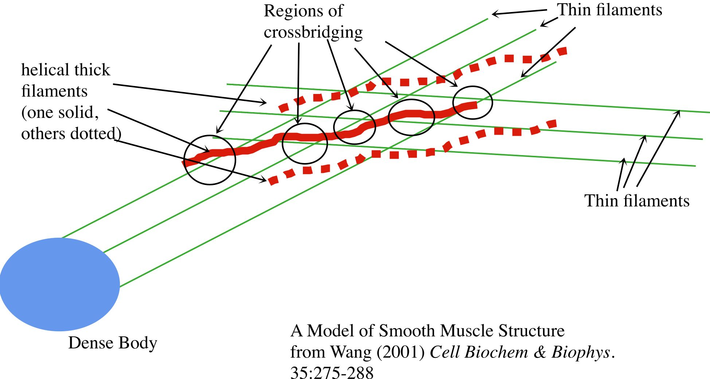
Thin and Thick Filament Arrangements in Smooth Muscle

Slide 6
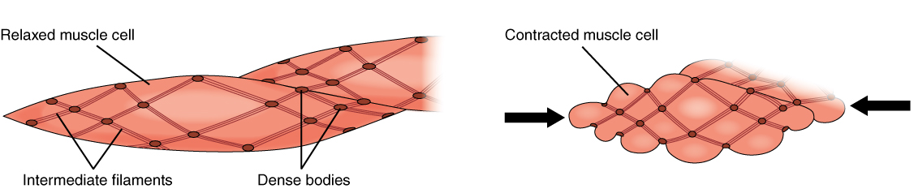
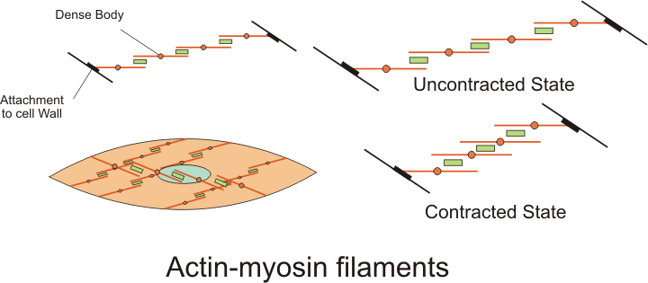
Contraction in Smooth Muscle -- Overview
"1028 Smooth Muscle Contraction" by OpenStax College - Anatomy & Physiology, Connexions Web site. http://cnx.org/content/col11496/1.6/, Jun 19, 2013.. Licensed under CC BY 3.0 via Commons - https://commons.wikimedia.org/wiki/File:1028_Smooth_Muscle_Contraction.jpg#/media/File:1028_Smooth_Muscle_Contraction.jpg
"Actin myosin filaments" by Boumphreyfr - Own work. Licensed under CC BY-SA 3.0 via Commons - https://commons.wikimedia.org/wiki/File:Actin_myosin_filaments.png#/media/File:Actin_myosin_filaments.png

Slide 7
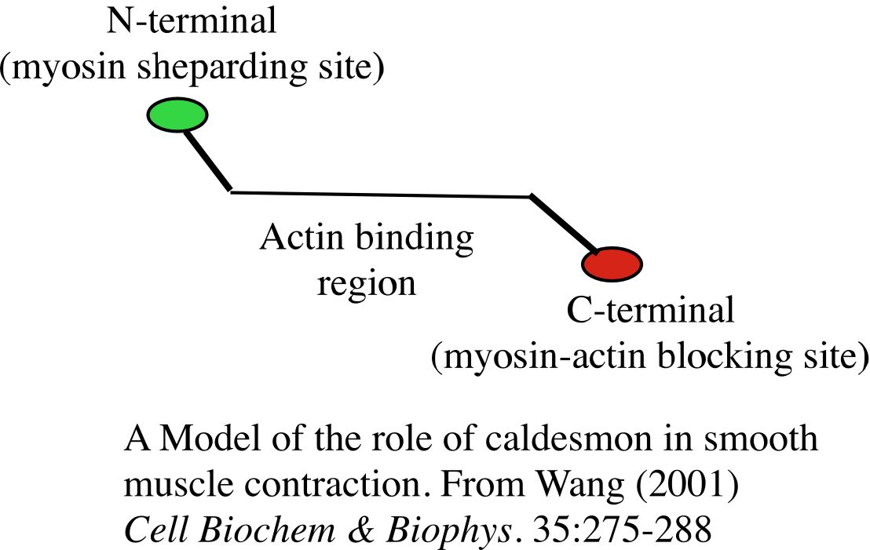
Caldesmon

Slide 8
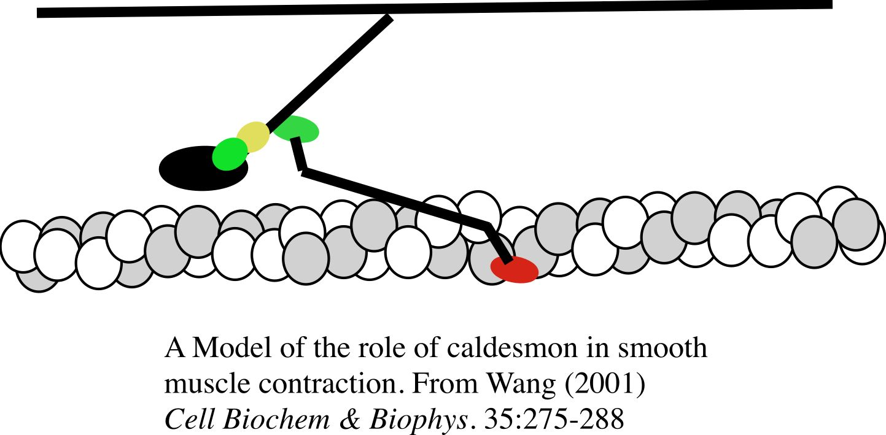
Caldesmon In Relaxed Fibers

Slide 9
Regulation of Smooth Muscle Contraction
Thick Filament Regulation (on myosin light chain):
-- Modulation by MLCK/MLCP
-- Other Mechanisms
Thin Filament Regulation (?):
-- Does caldesmon have a regulatory role?
-- Other mechanisms

Slide 10
Calcium and the Control of MLCK Leading to Control of the Myosin Light Chain

Slide 11
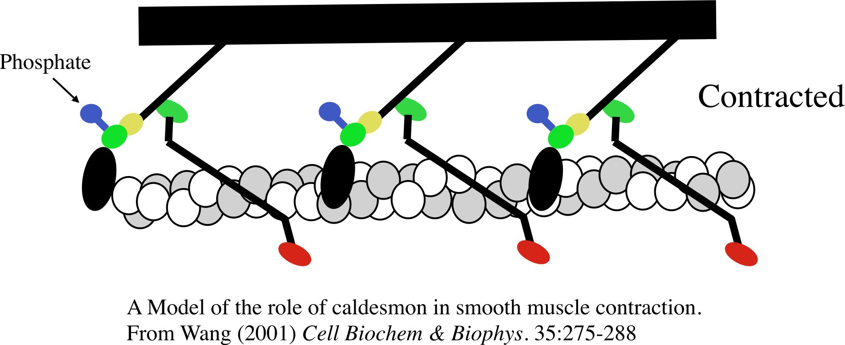
Contracted Smooth Muscle

Slide 12
There is Always a Reverse Process:
MLCP phosphatase is inhibited by a Ca⁺⁺ dependent pathway (but in any case, its maximum activity is lower than MLCK)

Slide 13
SM Contraction and Relaxation: Ca⁺⁺ and the Regulation of Phosphorylation of the Myosin Light Chain

Slide 14
Regulation via the PKC Pathway
PKC = protein kinase C
DAG
(diacyl glycerol)
PLC = phospholipase C

Slide 15
Latch Mechanism?

