Slide 1
Schematic of the Mammalian Circulation

Slide 2
Pumps
Positive and negative pressure operation
Hearts and accessory pumps

Slide 3
Valves: Devices for Unidirectional Flow
Opened
Closed

Slide 4
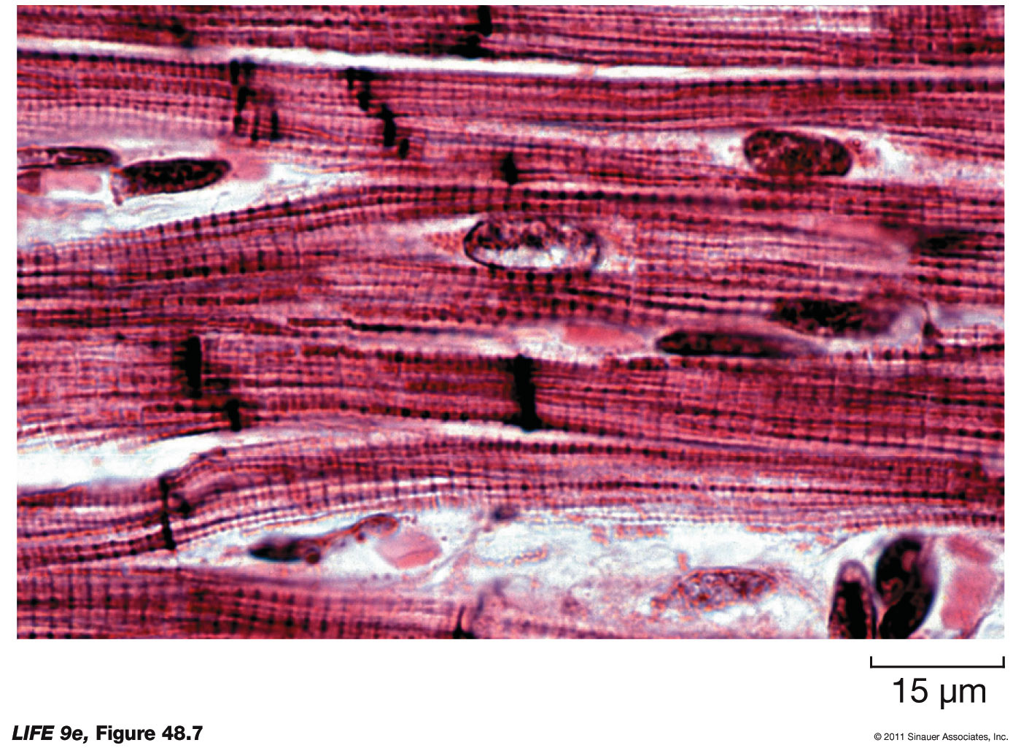
Functional Aspects of Hearts
Force generation (“myocardium”)
Directionality (valves)
Coordination

Slide 5
Myocardial and Nodal Cell Potentials

Slide 6
Preferential Bioelectrical Pathways

Slide 7
EC Coupling in the Myocardium

Slide 8
Atrial Conduction

Slide 9
The AV Node

Slide 10
Ventricular Conduction

