Slide 1
Surface Tension

Slide 2
Compliance Curve

Slide 3
Review -- Muscle Elastic and Active Forces

Slide 4
Static Measurement of Compliance Curves

Slide 5
The Compliance of an Air-Filled Lung

Slide 6
The Compliance of a Saline-Filled Lung

Slide 7
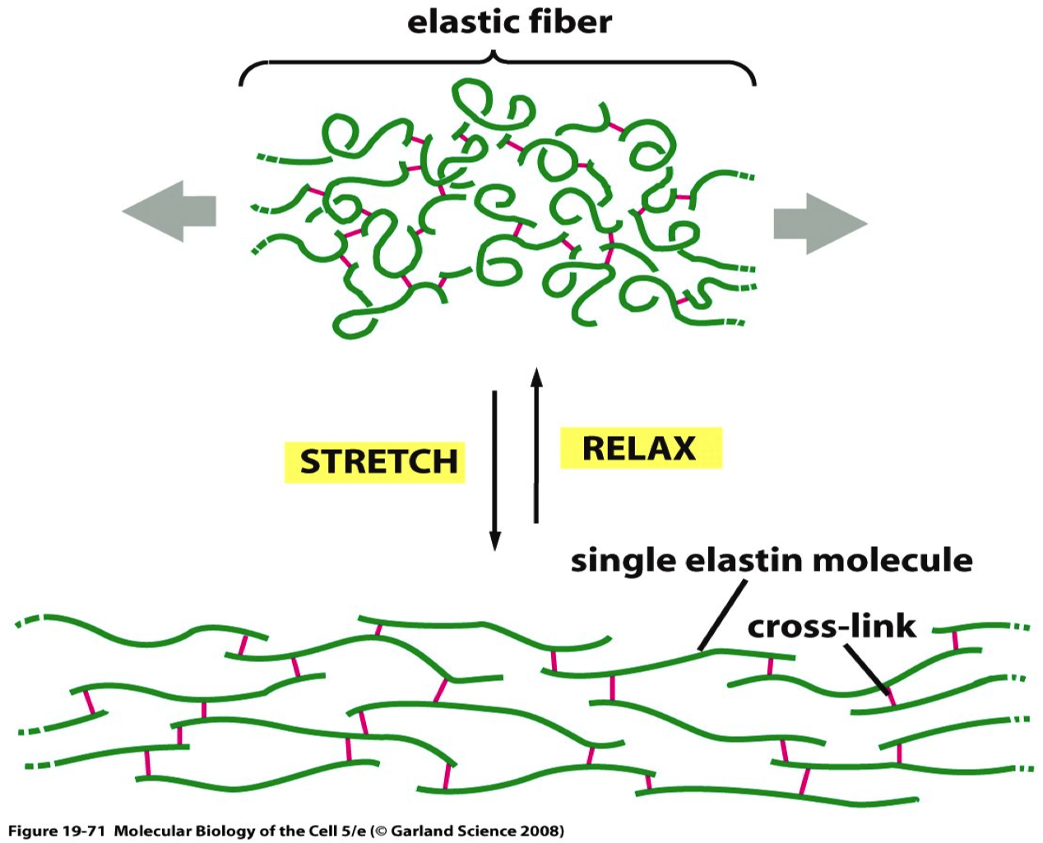
Tissue Elastance in the Lung

Slide 8
Compliance of the Lung In Different Disease States

Slide 9
A Device for Measuring Surface Tension

Slide 10
Compliance of Alveolar Fluid and Saline

Slide 11
Schematic of a Pulmonary Surfactant Molecule

Slide 12
The Effect of Surface Area on Surfactant Density

Slide 13
The Dynamic Effects of Breathing on Surfactant Distribution

Slide 14
The Law of Laplace with Respect to Bubbles
The tension is due to various elastic forces!

Slide 15
The Law of Laplace and Lungs w/o Pulmonary Surfactant
Since the tension is mainly surface tension, if it is constant, then…

Slide 16
The Elastic Properties of the Respiratory System
This is a topic of some difficulty to many but in fact, there is not much to it. We will use the same principles that we have learned earlier regarding the equality of opposing forces at static conditions.
We will use what we learn about respiratory system elasticity to understand the volumes of air found in the respiratory system and to understand the dynamic aspects of breathing.

Slide 17
Respiratory Volumes

Slide 18
The Recoil Concept
For static conditions:
Note the convention in this case that recoil forces are seen as always having a sign opposite to applied force, thus:

Slide 19
Recoil With Volumes
If we think about containers with elastic walls (such as the lungs and the chest cavity) these must also have recoils. Since they are volumes, we can deal with the recoils as pressures instead of forces.
At equilibrium (i.e., where dV/dt = 0) the pressures tending to distort a container from V₀ must be exactly balanced by the tendency of the container to rebound elastically:

Slide 20
Recoil and Internal and External Forces: V₀

Slide 21
Recoil and Internal and External Forces: V > V₀

Slide 22
Recoil and Internal and External Forces: V < V₀

Slide 23
Elastic Equations for the Respiratory System
1.
2.
3.
4.

Slide 24
Graphical Representation of Recoil Pressure/Volume Relations

Slide 25
Lung Recoil

Slide 26
Respiratory System Recoil

Slide 27
Thoracic Recoil

Slide 28
Respiratory System Recoil

Slide 29
Recoil Graphs, compared

Slide 30
Spring Model of the Respiratory System

Slide 32
Resistance and Flow in Newtonian Fluids

Slide 33
Respiratory Dynamics

Slide 34
Airway Resistance in Successive Bronchiolar Generations

Slide 35
Factors that Alter Airway Resistance

Slide 36
Resistance as a Function of Lung Volume

Slide 37
Flow Rates at Different Lung Volumes

Slide 38
Flow Loops

Slide 39
Distribution of Air at Different Lung Volumes

