Slide 1
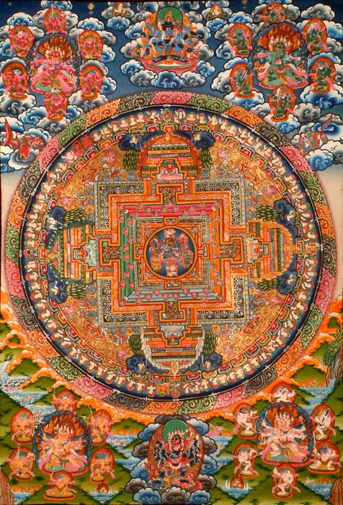
Mandalas and Yantras circles of compassion

Slide 2
Outline of a Mandala

Slide 3
A Yantra is a type of mandala that is more geometric

Slide 4
Mandalas are made for a spiritual purpose. The act of creating a Mandala is transformative for the maker and for the world.

Slide 5
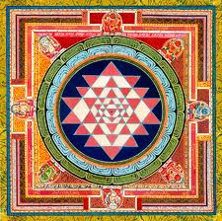
The five colors
1. White Vairocana delusion/wisdom
2. Yellow Ratnasambhava pride/equity
3 Red Amitabha attachment/discernment
4 Green Amoghassidhi jealousy/accomplishmnet
5 Blue Akshobhya anger/ peaceful wisdom
The quadrants of the Mandala are typically divided into isoceles triangles of color,
including 4 of the above 5.

Slide 6
Think of mandala colors as jeweltones. Look for the 4 gates leading to the center…and imagine pulling the center up..to form a 3d image

Slide 7
IMAGINE!

Slide 8
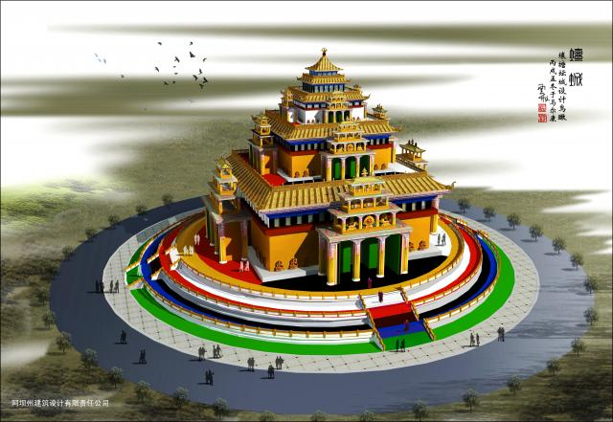
The form
A mandala is typically a circle within a square.The square structure has 4 “gates” . The gates represent loving kindness, compassion, sympathy and equity. There are concentric circles with images facing in towards the center.
Imagine that you enter through one of the gates and work your way to the center.
Imagine that the mandala , although flat, represents a 3D reality that you can enter!

Slide 9
Your Mandala does not have to be traditional

Slide 10
Yantras are like mandalas in some ways. They are geometric and often have a more simple look.

Slide 11
Yantra or mandala? What do you think?

Slide 12
Your assignment: choose an intention: a day where you say only nice things, a day where you help at least one person
Choose your intention | Create a symbol to represent the deed
Write the date for putting your intention into action on the back of your paper | Draw your symbol in the center of your mandala

