Slide 1
Civil Disobedience 19th Century to 21st Century
Elizabeth Thompson
Framingham High School
2011

Slide 2
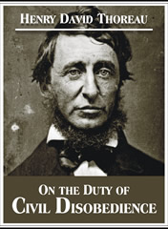
Definition
The concept of civil disobedience originates from Thoreau’s 1849 essay
Civil disobedience – a refusal to obey governmental laws as a form of nonviolent protest
Based on the title of the
essay, how does Thoreau
view the necessity of civil
disobedience?

Slide 3
Origins of “Civil Disobedience”
Timeline
1839 Thoreau is added to Concord tax rolls
1840 Thoreau added to tax rolls for First Parish Church and asks that his name is removed as he refuses to pay
1842 Thoreau stops paying poll tax
1846 July 24 or 25 Thoreau is arrested for refusing to pay taxes and spends one night in jail until an anonymous donor pays his tax
Why does Thoreau refuse to pay taxes?
The US has just entered into a conflict with Mexico, he disagrees with the conflict, and he, therefore, does not want his money to fund military aggression
He is also an abolitionist and does not want his tax dollars to fund a government that supports slavery

Slide 4
What Happens During that Night in Jail?
Thoreau contemplates the nature and necessity of his non-violent protest and delivers lectures about his experience in January and February of 1848
The content of these lectures is converted into the essay “Resistance to Civil Government”
Elizabeth Peabody publishes the essay in The Aesthetic Papers May 1849
The View from Thoreau’s Cell

Slide 5
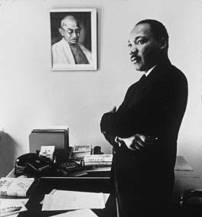
Thoreau’s Impact
Thoreau’s essay has a significant impact on two internationally reknown advocates of non-violence
Mohandas Gandhi
Martin Luther King Jr.

Slide 6
Thoreau/Gandhi Connections
“Many years ago, there lived in America a great man named Henry David Thoreau. His writings are read and pondered over by millions of people… Much importance is attached to his writings because Thoreau himself was a man who practised what he preached. Impelled by a sense of duty, he wrote much against his own country, America. He considered it a great sin that the Americans held many persons in the bond of slavery. He did not rest content with saying this, but took all other necessary steps to put a stop to this trade. One of the steps consisted in not paying any taxes to the State in which the slave trade was being carried on. He was imprisoned when he stopped paying the taxes due from him. The thoughts which occurred to him during his imprisonment were boldly original.
[From Gandhi. Indian Opinion. Quoted in M.V. Kamath. The United States and India1776-1976. Washington, D.C.: Embassy of India, 1976. 65.]

Slide 7
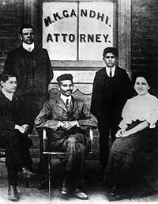
Satyagraha
Definition
Satyagraha = grasping the truth
One seeks insight and truth within oppression by looking inward to inhabit a non-violent state of mind engaging in self-scrutiny
This transcends civil disobedience as it is more than just one act but a practice in daily living
Origins
Begins in South Africa with Gandhi leading Indian residents in protest for civil rights against the discriminatory policies of the Transvaal government in 1906

Slide 8
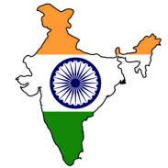
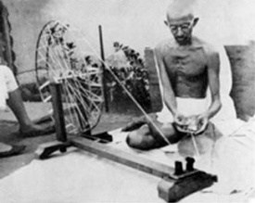
Satyagraha in India
Highlights of Gandhi’s Involvement in the Struggle for Indian Independence
1921 Gandhi becomes leader of the Indian National Congress in order to protect the rights of Indian nationals under British rule and ultimately to achieve Swaraj or self-rule
As party leader he organizes a campaign of non-cooperation with the British Government which includes a boycott against British imports. He even begins spinning his own thread
March 10, 1922 Gandhi is arrested for sedition (inciting rebellion) and is sentenced to 6 years imprisonment
1924 Gandhi is released from prison and months later initiates a three week fast to call his followers to remain on the path of non-violent resistance

Slide 9
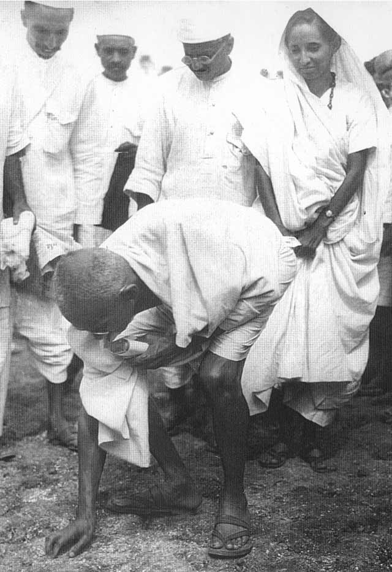
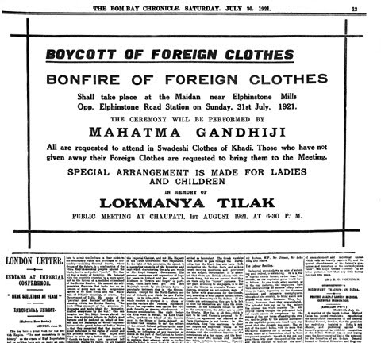
Salt March
Sign for non-cooperation bonfire

Slide 10
Satyagraha in India
March 1930 Initiates protest on British salt tax and marches 241 miles to make his own salt with thousands of citizens following
In response the British government imprisons over 60,000 people
The following year Gandhi negotiates a truce and calls of non-cooperation with the Gandhi-Irwin Pact
September 1932 initiates a fast to protest the segregation of untouchables
August 1942 launches Quit India Movement on the heels of WWII to compel the British to withdraw from India, and the British respond by imprisoning the leadership of the Indian National Congress
January 30, 1948 Gandhi is shot in Delhi en route to a prayer meeting

Slide 11
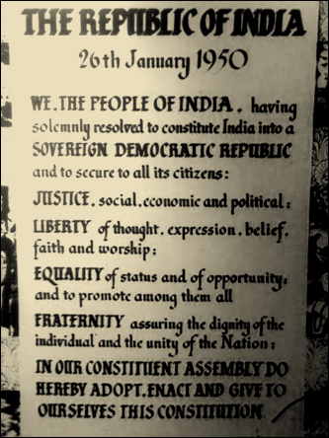
Satyagraha in India
January 26, 1950 India forms constitution and becomes a republic

Slide 12
Comparison
Based on what you have learned about Gandhi’s leadership in the struggle for independence, what comparisons can you draw to Dr. King and the Civil Rights Movement?
Think about:
Commitment to non-violence
Political tactics
Personal sacrifices

Slide 13
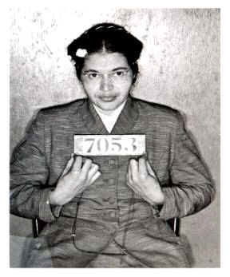
Dr. King
Highlights in the Work of Dr. King
December 1955 began the Montgomery Bus Boycott following the arrest of Rosa Parks

Slide 14
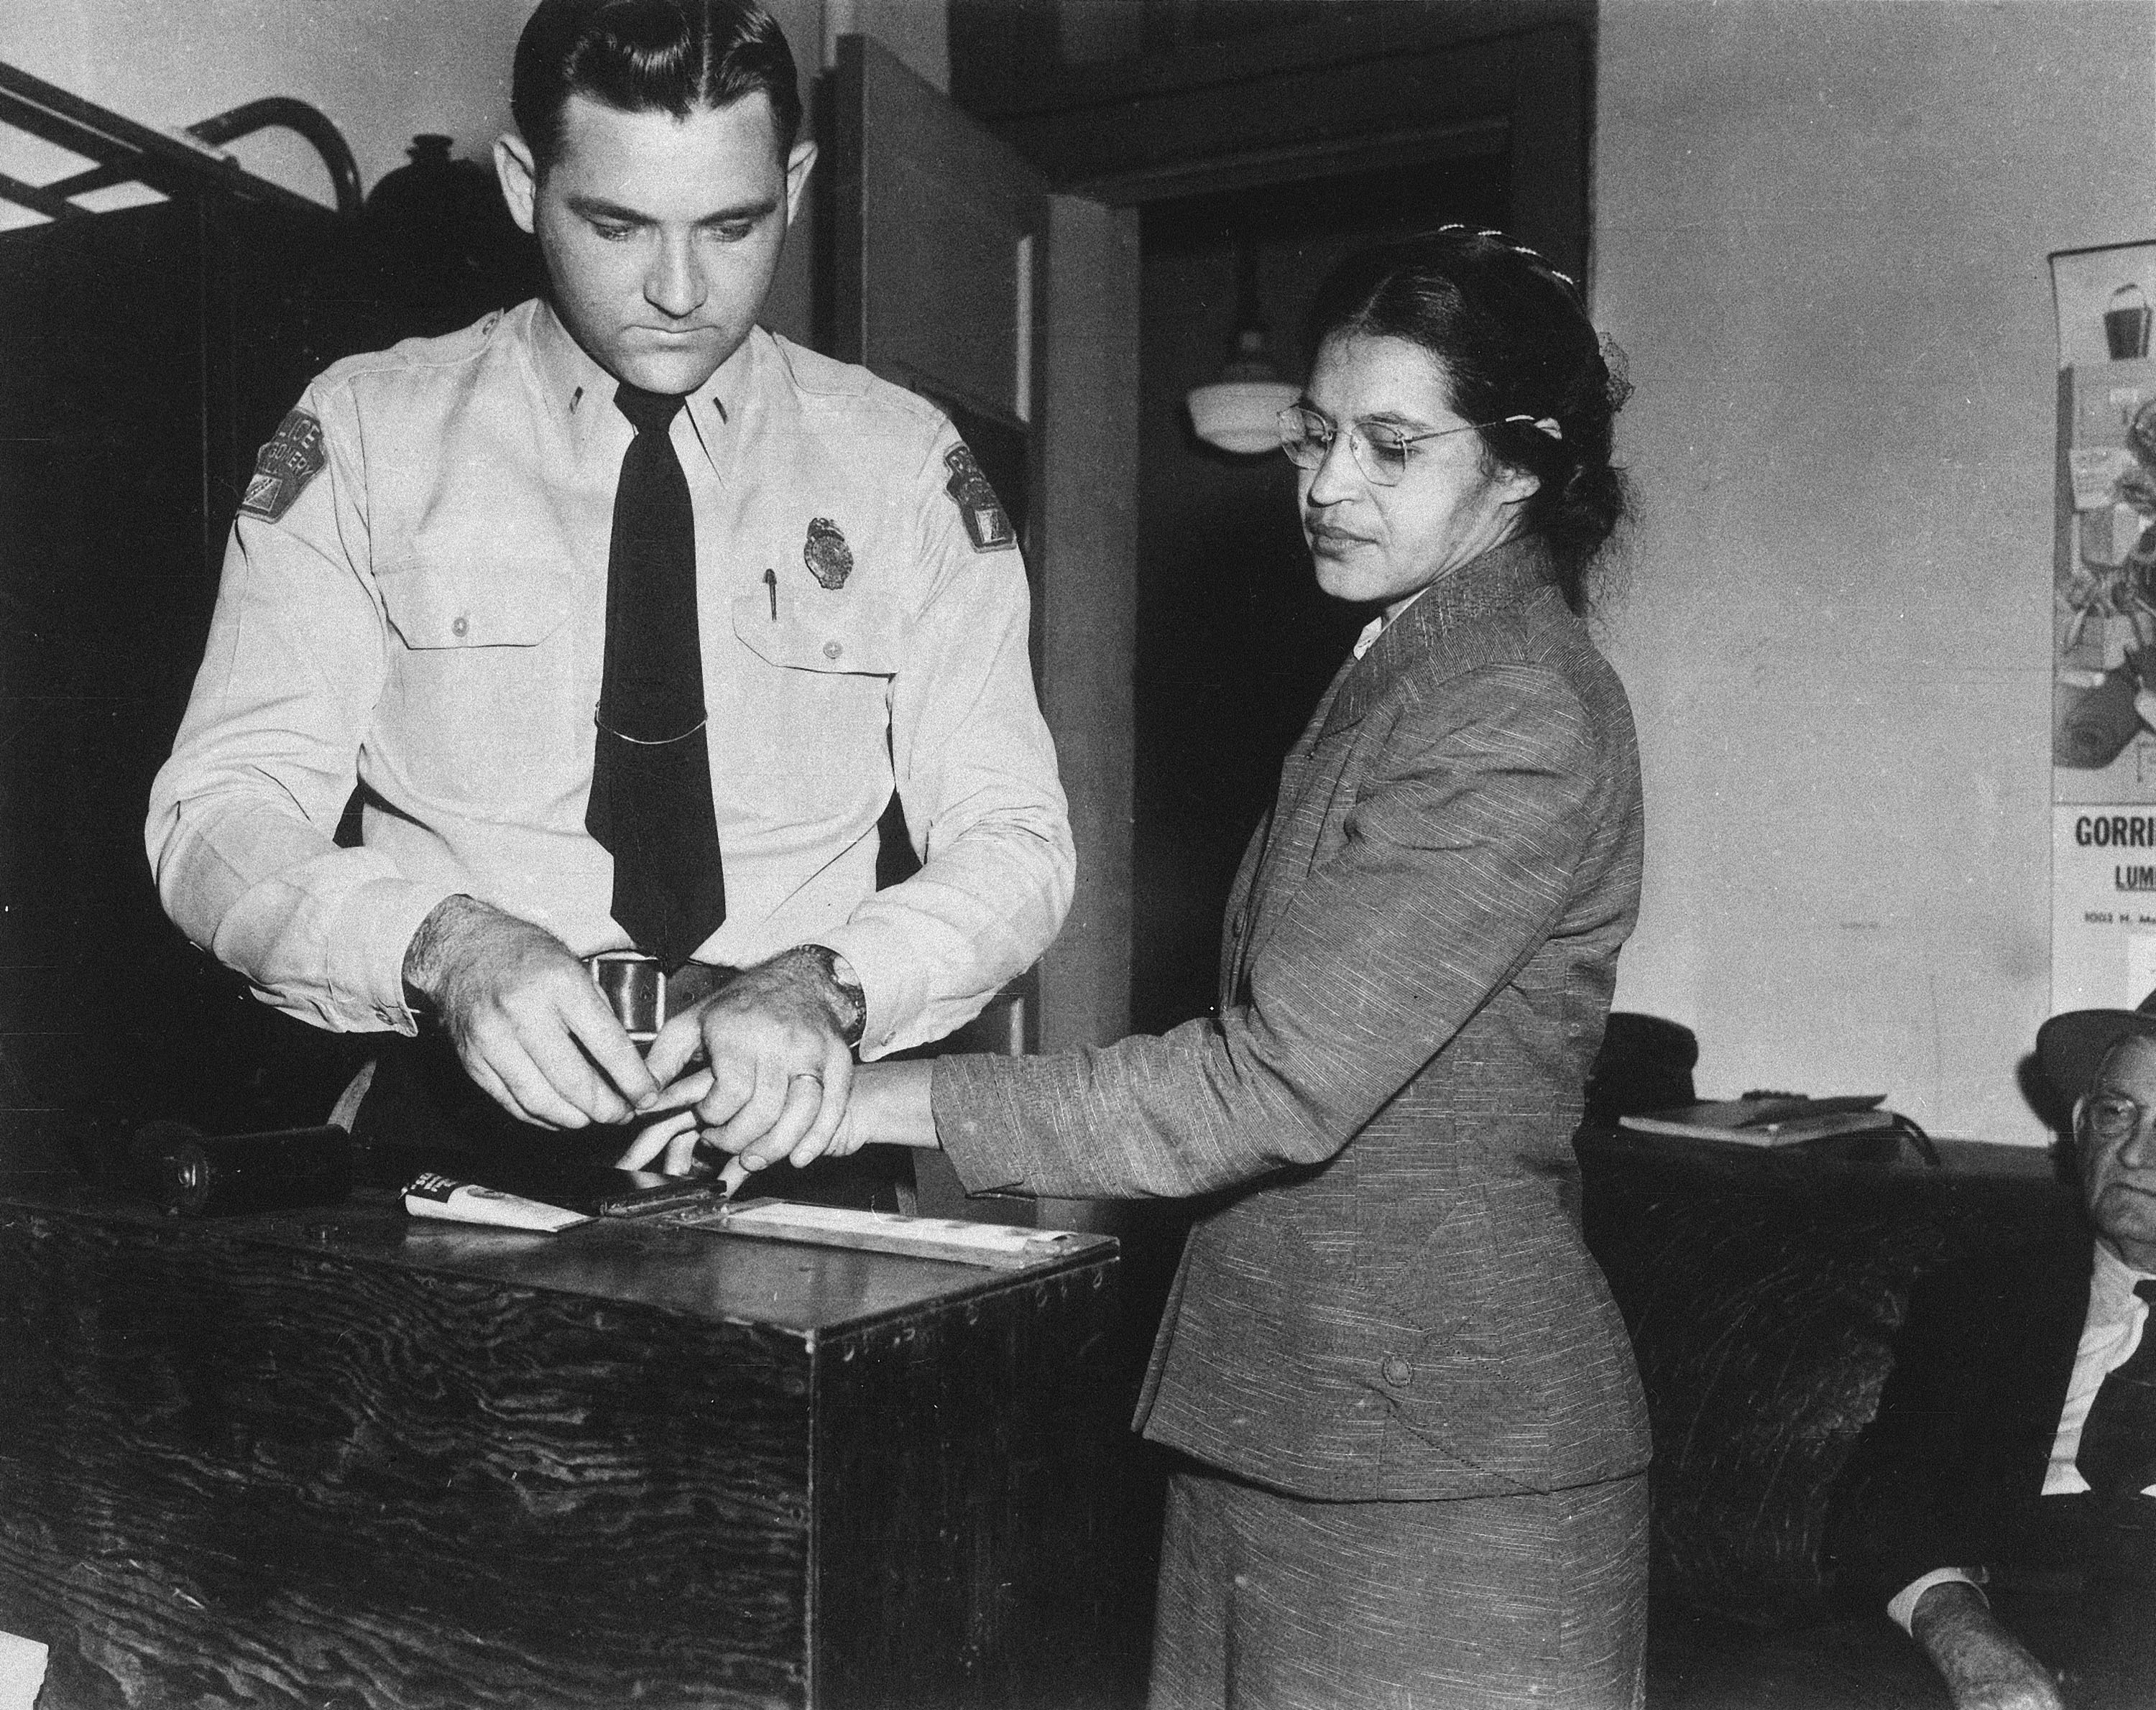
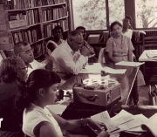
Civil Disobedience in Practice
Some who practice civil disobedience undergo training to deliberately break laws and ensure that they show no resistance if confronted by authorities
The Truth about Rosa Parks
Parks worked as a secretary in the NAACP chapter in Montgomery
Parks was trained to engage in civil disobedience at the Highlander Folk School in July of 1955
Parks was specifically chosen to engage in her heroic act of civil disobedience
Rosa Parks
Montgomery, Alabama
December 1, 1955
Rosa Parks
Highlander Center
1955

Slide 15
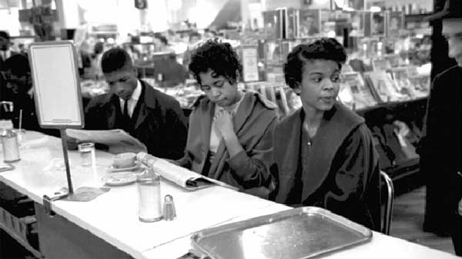
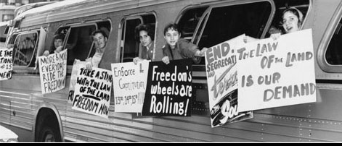
Highlights in the Work of Dr. King
February 1960 marked the start of the sit-in movement in Greensboro, NC and spreads throughout the South
Southern “Freedom
Riders” both black and
white continue this non-
violent protest as a sign of unity

Slide 16
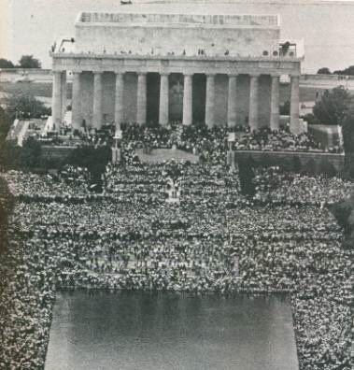
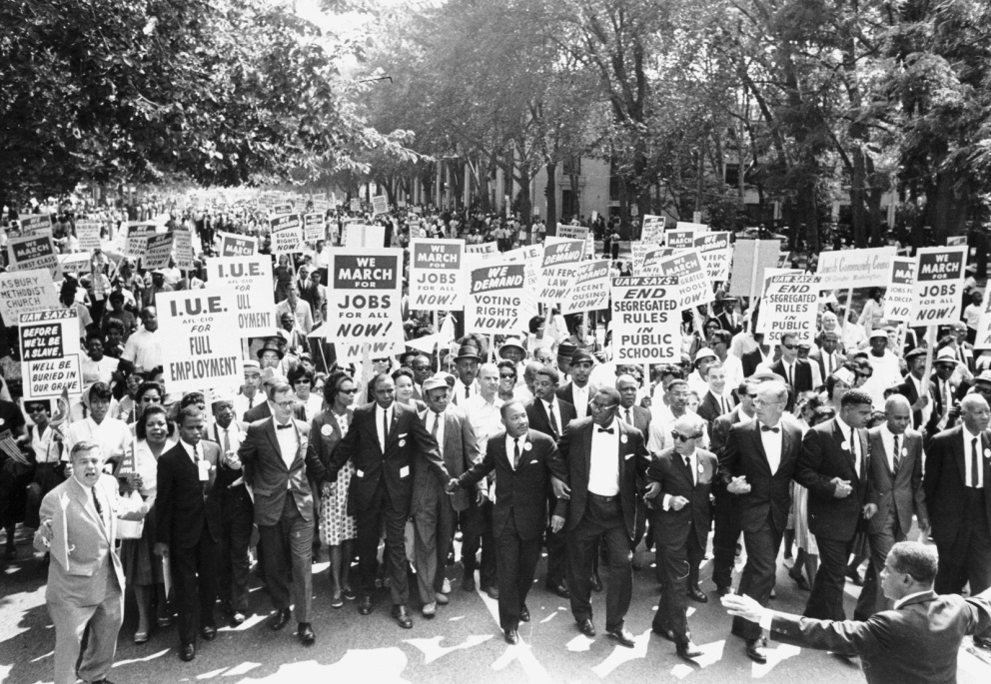
Highlights in the Work of Dr. King
August 27, 1963 King delivered the “Let Freedom Ring” speech during the historic March on Washington with over 250,000 people in attendance
http://www.mlkonline.net/video-i-have-a-dream-speech.html

Slide 17
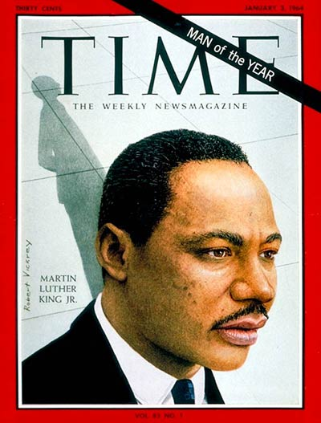
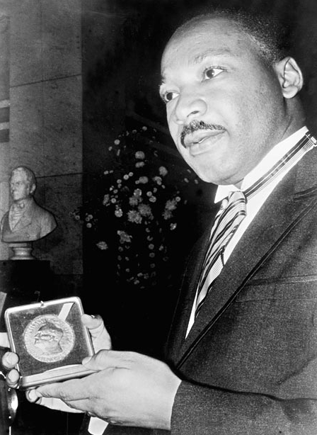
Highlights in the Work of Dr. King
1964
1st African-American to be named Time’s “Man of the Year”
Wins the Nobel Peace Prize as the youngest person to win the award

Slide 18
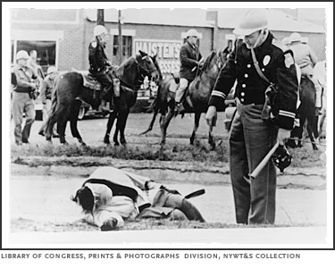
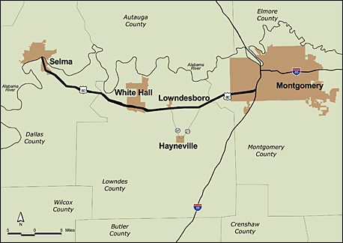
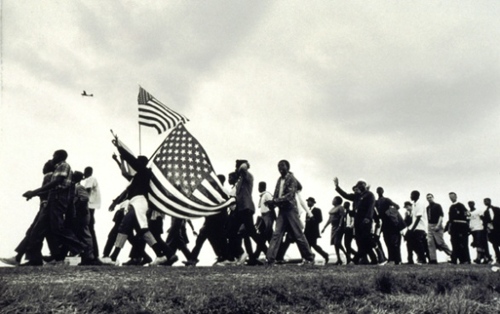
Highlights in the Work of Dr. King
March 1965 King organizes a 47 mile march from Selma to Montgomery to demand voting rights for blacks in Alabama

Slide 19
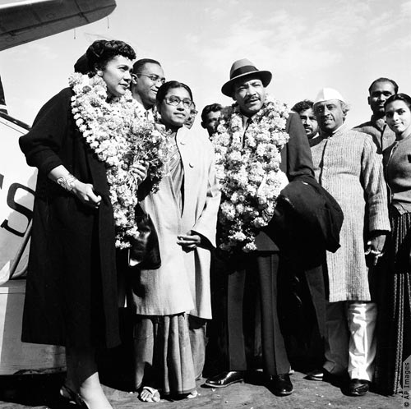
King & Gandhi Connections
1959 Dr. King visits Delhi to study satyagraha
Upon arrival he states, “To other countries I may go as a tourist, but to India I come as a pilgrim.”

Slide 20
Civil Disobedience from the20th to the 21st Century
Since the publication of this work in 1849, the practice of civil disobedience (sometimes known as non-violent resistance or non-violent direct action) has been used around the world as a form of protest in the following social movements:
Labor
Peace
Civil Rights
Women’s Rights
Anti-Globalization
Environmental Preservation
Gay Rights
Immigrant Rights

Slide 21
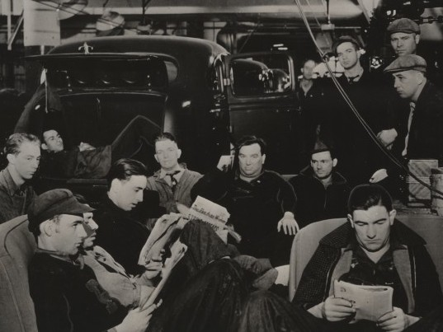
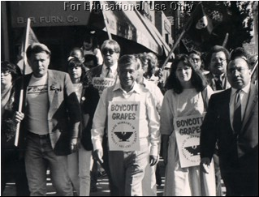
Flint Sit Down Strike 1937
UFW Grape Boycott March
California
~1969

Slide 22
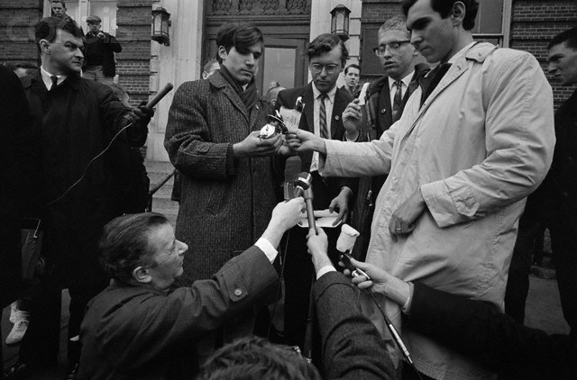
Draft Card Burning
Morgantown, VA
1966

Slide 23
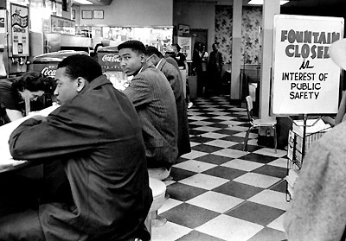
Lunch Counter Sit-In
Nashville
1960

Slide 24
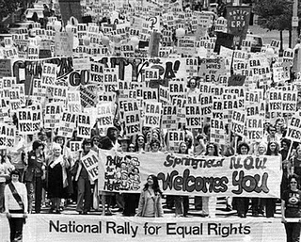
ERA Amendment Rally
Washington, DC
1972

Slide 25
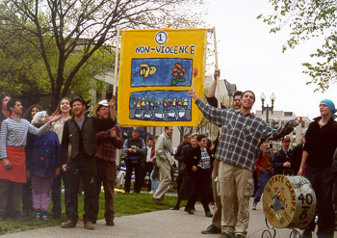
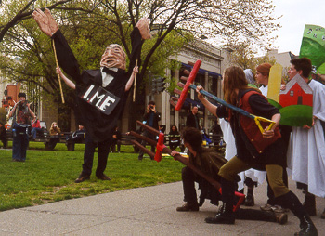
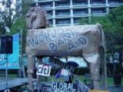
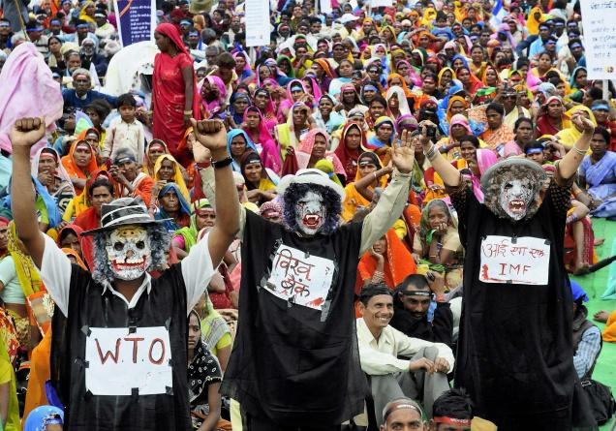
Anti-Globalization Rally
Washington, DC
April 2000
Anti-WTO Rally
Madhya Pradesh, India
2010

Slide 26
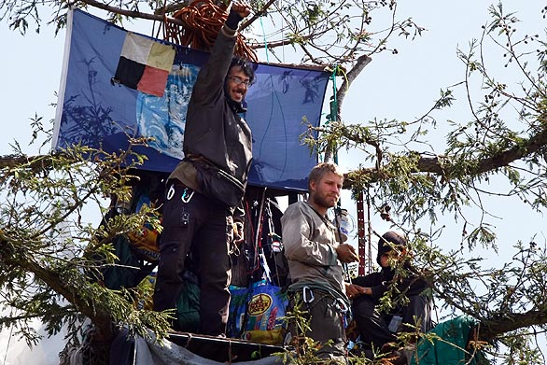
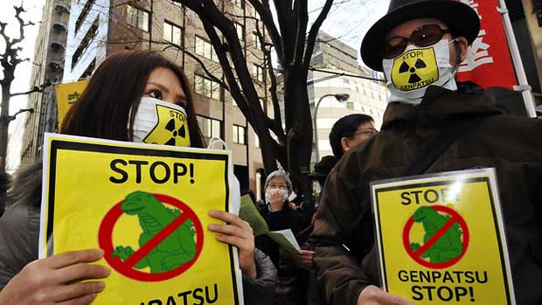
Tree Sitters
Berkeley, CA
2008
Nuclear Dumping Protest
Tokyo, Japan
April 2011

Slide 27
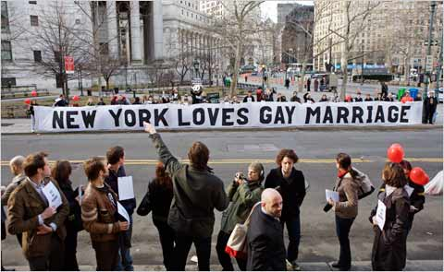
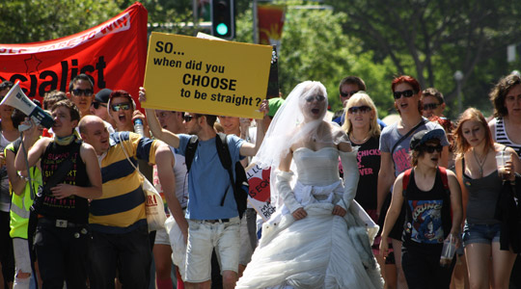
Marriage Rights Rally
New York, New York
June 2011
Prop 8 Rally
San Francisco, CA
November, 2008
Marriage Rights Rally
Sydney, Australia
November 2010

Slide 28
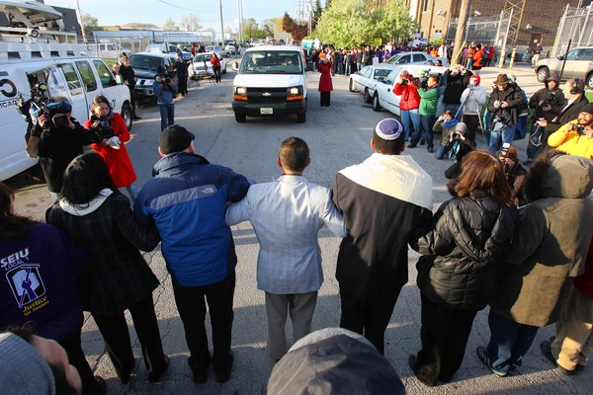
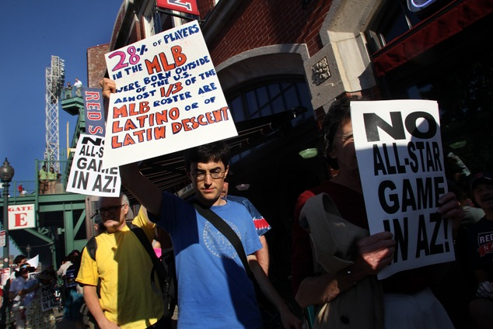
Protest Against Arizona Immigration Reform
Chicago, Illinois
April, 2010
Rally Against Arizona Immigration Law
Fenway Park, Boston
April, 2010

