Slide 1

Looking East: Evidence of Hindu and Buddhist Thought in the works of H.D. Thoreau
Elizabeth Thompson
Framingham High School
2011

Slide 2
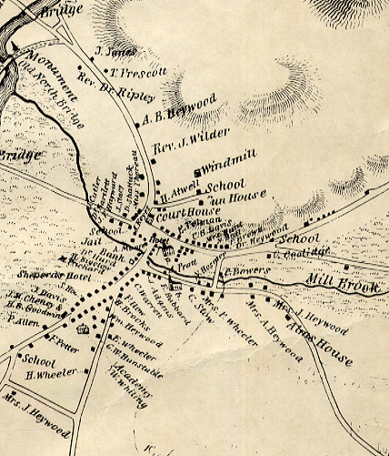

Transcendentalism
Circa 1830 Thoreau and Ralph Waldo Emerson were at the forefront of the creation Transcendentalism, a spiritual, political, and intellectual movement in Concord, MA
Concord 1830

Slide 3
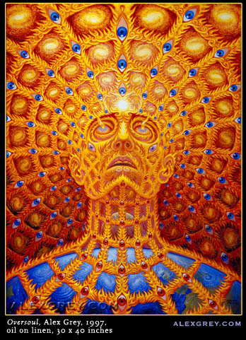
Why?
The founders of the movement were looking for religious, social, political, and intellectual reform
  Religious Reform
  Transcendentalists disagreed with the doctrine of the Protestant/Unitarian churches
  Formed new religious identity that placed the relationship with spirituality in the hands of the individual rather than a priest or text with the idea that one should search inward to seek the divine
  Believed that all humans are divine
  Introduced the concept of the “Over-Soul” to the US
    Over-Soul = a universal truth or guiding force for
    the universe

Slide 4
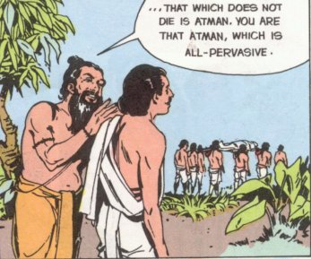
The Over-Soul
The over-soul is linked to the Hindu and Buddhist concept of atman
  Atman can be translated to mean “soul” or “inner self” or “essence” and in both Hindu and Buddhist practice one must look inward and acquire deep knowledge of the atman in order to reach enlightenment

Slide 5

The Divinity of Nature
With Transcendentalism also came a shift in the perception of the natural world
In this time of Manifest Destiny, the overriding belief was that the natural world could and should be “civilized” or dominated by man
Transcendentalists, however, believed in the harmony of all beings, for the divine existed in nature
Thoreau and Emerson are seen as among
the first American writers to articulate this
“nature worship”

Slide 6

The Divinity of Nature & Moral Precepts
The first of the Buddhist Moral Precepts which applies to both laity and spiritual practitioners is that one “should not destroy life intentionally”
Therefore, in the Buddhist tradition all forms of life, including those in the natural world, are to be protected
This precept connects to the Transcendental reverence for nature

Slide 7
Political & Social Reform
Transcendentalists were non-conformists who sought change in all areas of life
Bronson Alcott (father of Little Women author Louisa May Alcott) in particular sought to change traditional educational methods to create more experiential, student-centered learning environments
All founders of the movement were abolitionists who worked to end slavery individually and politically
Socially the group experimented with unconventional means of daily living
  Thoreau conducted his 2 year experiment of simple living at Walden Pond
  Members of the movement also explored communal living at Brook Farm in Roxbury, MA and the Fruitlands in Harvard, MA

Slide 8
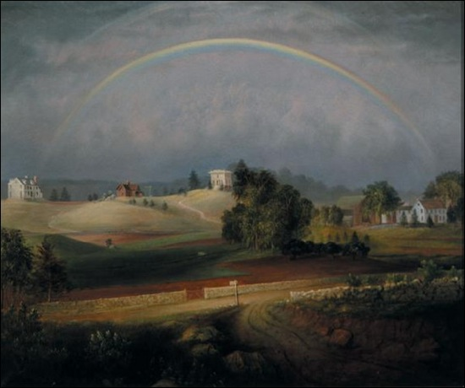
Brook Farm

Slide 9
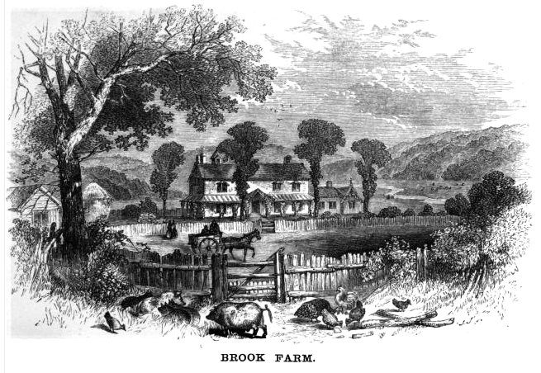
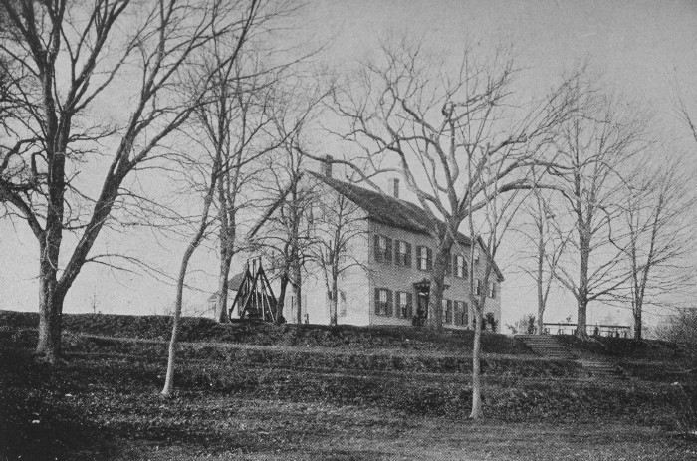
Brook Farm

Slide 10
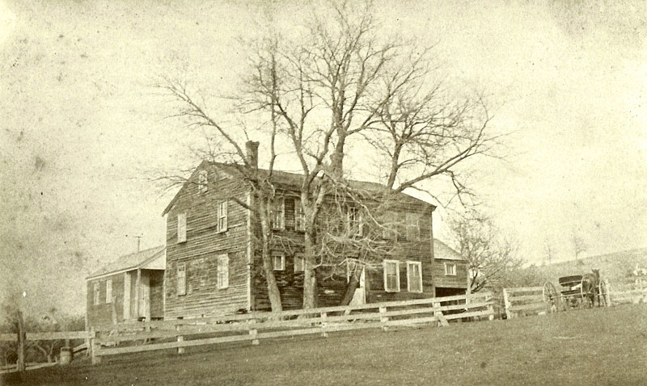
Fruitlands

Slide 11
Utopian Communities
While likely unaware of the connections, both communities adopted elements of the Buddhist monastic lifestyle
Brook Farm
Fruitlands
Founded April 1841
Housed a large group that never exceeded 100 occupants
Focused on communal living, shared agrarian labor, and education
Attempted to extinguish class distinctions
Founded June 1843
Housed a small group of about 12 people
Focused on eliminating trade and outside influences, abstinence, vegan diet and lifestyle, and humane (animal free) farming

Slide 12
Thoreau and Eastern Religious Study
“’To some extent and at rare intervals, even I am a yogi’”
  H.D. Thoreau 1849
“Thus it appears that the sweltering inhabitants of Charleston and New Orleans, of Madras and Bombay and Calcutta, drink at my well. In the morning I bathe my intellect in the stupendous and cosmogonal
philosophy of the Bhagvat Geeta…” – H.D. Thoreau, Walden
“The pure Walden water is mingled with the sacred water of
the Ganges” – H.D. Thoreau, Walden

Slide 13
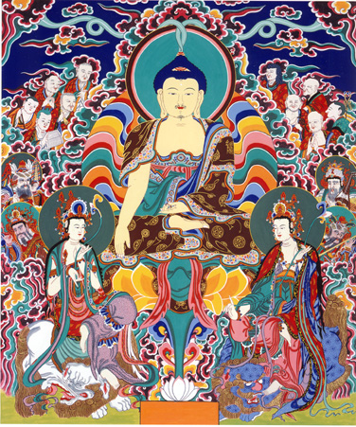
Thoreau and Eastern Religious Study
1844 Thoreau writes and publishes an English translation of a French language excerpt of Lotus Sutra
  The Lotus Sutra tells of the Buddha’s explanation that he is but one deity among many who can exist simultaneously throughout the universe
  This Sutra then leads followers to worship not only the human Buddha but also other enlightened beings called “future Buddhas” or Bodhisttvas
This translation in concert with lectures on Buddhism by Edward Elbridge Salisbury is considered to be America’s entrance into Buddhism

Slide 14
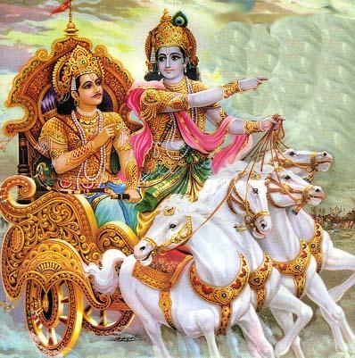
Thoreau and Eastern Religious Study
In 1846 during the Walden experiment, Thoreau studied Emerson’s copy of Charles Wilkins’ 1785 translation of The Bagdad Gita
The Bhagavad Gita is an addition to the Hindu epic The Mahabharata
The text centers around Krishna explaining the tenets of Hinduism to a young prince, Arjun

Slide 15
Connections Between The Gita and Walden
The Flute
In the chapter entitled “Higher Laws” Thoreau tells of a Yankee Farmer sitting down after a long days work on the farm. In the distance he hears the sound of a flute. This music eases the farmer and distracts him from the worries of the farm and the noise of the street. He then hears a voice that states, “Why do you stay here and live this mean moiling life, when a glorious existence is possible for you?”
  This tale of the celestial flute music easing the farmer alludes to the God Krishna and his flute

Slide 16
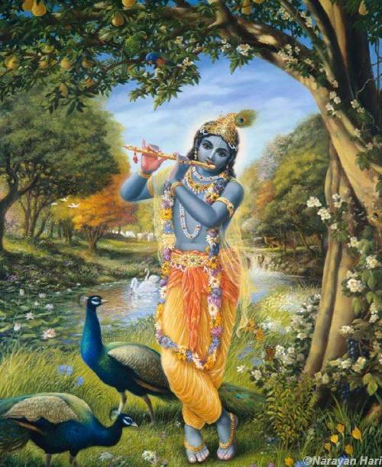

Slide 17
Connections Between The Gita and Walden
Symbol of the Upside-Down Tree
Bhagavad Gita
Walden
Describes an inverted tree as seen through a body of water with roots above and branches below
The branches and leaves are representative of the material world and the roots are the spiritual realm
“The Pond”
Of a tree growing in the water “it stood twelve to fifteen rods from the shore, where the water was thirty or forty feet deep…he was surprised to find that it was wrong end upward, with the stumps of the branches pointing down, and the small end firmly fastened in the sandy bottom.”

Slide 18


Slide 19
Connections Between The Gita and Walden
The Field
Bhagavad Gita
Walden
The 13th Song of the Bhagavad Gita is “The Knower of the Field” explains the connection between the earth and the material world
“The field contains the great elements,/ individuality, understanding,/unmanifest nature…”
By tending to the field one gains knowledge both material and spiritual
In “The Bean Field” Thoreau explains that he is “determined to know beans”
In this chapter Thoreau reflects on the process of overpowering nature in order to make the earth grow beans instead of weeds
He also reflects on the manner in which his daily labor leads him to appreciate the natural wonders around him
As Thoreau comes to “know beans” he also gains knowledge of the material and spiritual worlds

Slide 20
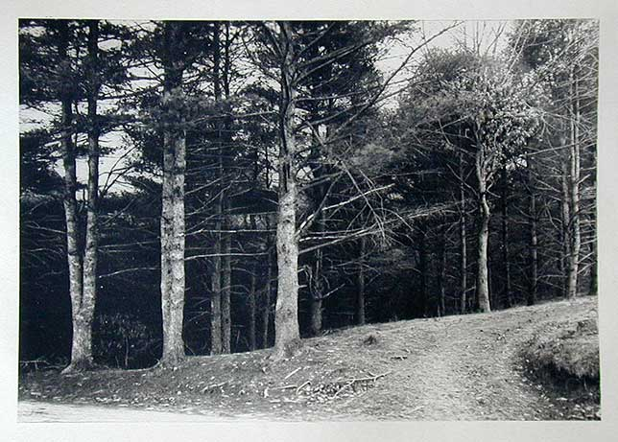
Site of Thoreau’s Bean Field

Slide 21
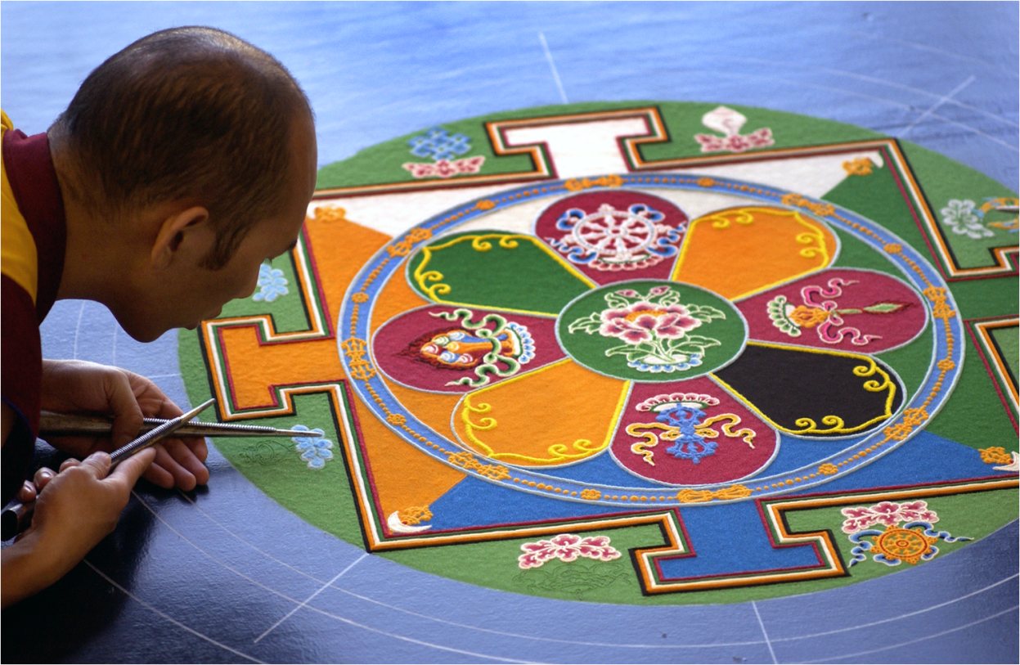
Connections between Walden and Buddhism
Impermanence
Among the core doctrines of Buddhism is a belief that all is impermanent, for all that is created is interdependent
  For example, in order for a cupcake to exist it requires ingredients (butter, sugar, eggs, flour, etc), a baker to combine the ingredients, an oven to heat the ingredients, air to cool

Slide 22
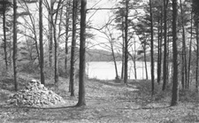
Connections between Walden and Buddhism
Impermanence
Thoreau points to an understanding of interconnectivity and impermanence as he explains his departure from Walden Pond
  “I left the woods for as good a reason as I went there. Perhaps it seemed to be that I had several more lives to live, and could not spare any more time for that one.”

Slide 23
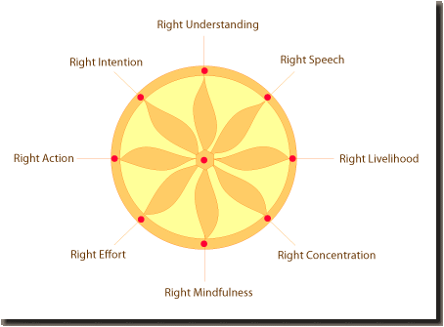
Connections between Walden and Buddhism
The Four Noble Truths
Life is suffering
The cause of suffering is desire
Removing desire removes suffering
The eight fold path is a means to conquering desire

Slide 24
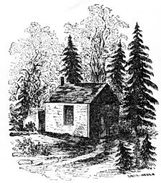
Connections between Walden and Buddhism
In Walden Thoreau makes a clear declaration that the absence of want of desire will lead to personal and spiritual fulfillment
  “The mass of men lead lives of quiet desperation”
    It is desire which leads to this life of desperation
“Our life is frittered away by detail…Simplicity, simplicity, simplicity!
His work in Walden, then, is to address the
means to conquer desire

Slide 25


Connections between Walden and Buddhism
Wake Up!
Buddha = One who has awakened
In Walden Thoreau call his readers to
  awaken: “We must learn to reawaken
  and keep ourselves awake, not by
  mechanical aids, but by an infinite expectation of the dawn….”

Slide 26
Works Referenced
Esposito, John L., Darrell J. Fasching, and Todd Thornton Lewis. World Religions Today. 2nd ed. New York: Oxford UP, 2006. Print.
Freidrich, Paul. The Gita within Walden. Albany: State University of New York Press, 2008. Print.
Gura, Philip F. American Transcendentalism: A History. New York: Hill and Wang, 2007. Print.
Thoreau, Henry David. Walden. New York, Penguin INC, 1980. Print.
Tweed, Thomas. The American Encounter with Buddhism 1844-1912: Victorian Culture and the Limits of Dissent. Bloomington: Indiana University Press, 1992. Print.
Wayne, Tiffany K. Encyclopedia of Transcendentalism. New York: Facts on File, 2006. Print

