Slide 1
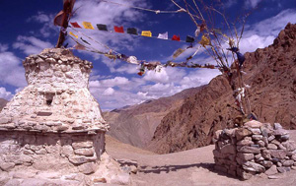
Case Studies: Himalaya: Indo-Tibetan Contact Zone
A Guided Student Research Project

Slide 2
Himalaya: Indo-Tibetan Contact Zone: Overview
In this project students will undertake certain "case studies", researching the actual practice of adherents in specific geographic and cultural settings. You are to examine the culture of your chosen setting with regard to religious practices we have discussed. Specifically, you will focus on the categories of worship and ritual practices (puja), festivals, the arts and pilgrimage sites of the region.

Slide 3
Procedure
Each of the four groups will be given:
A movie specific to your region
A core text specific to your region
Additional suggested readings and sites specific to your region
Each group is to give a presentation to the class in which each of the categories of worship and ritual practices (puja), festivals, the arts and pilgrimage sites are discussed reflective of the religious practices of the specific regions

Slide 4
Procedure continued
You are to make all decisions regarding your presentation ( its format and style)
It should absolutely be thorough
It should absolutely reflect the work of all in the group
It absolutely should be completely ready to present on the due date

Slide 5
Villages or regions
Deoprayag, Uttarakhand, India
Kathmandu Valley, Nepal
Melemchi, Nepal
Ladakh, Jammu and Kashmir, India

