Slide 1
IV. Pilgrimage Destinations in the Himalayas

Slide 2
Buddhist Tradition centered in the Buddha’s life
In his last journey before dying at 80, he directly prescribed pilgrimage to the great events in his life for monks and householders

Slide 3
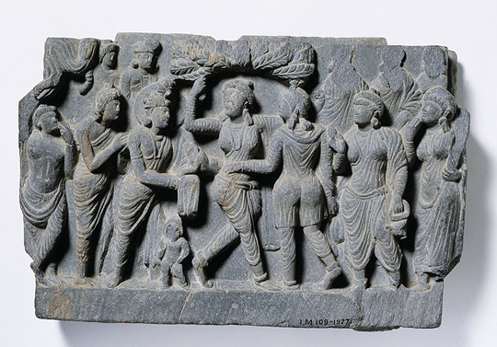
The Eight Great Sites for Pilgrimage I

Slide 4
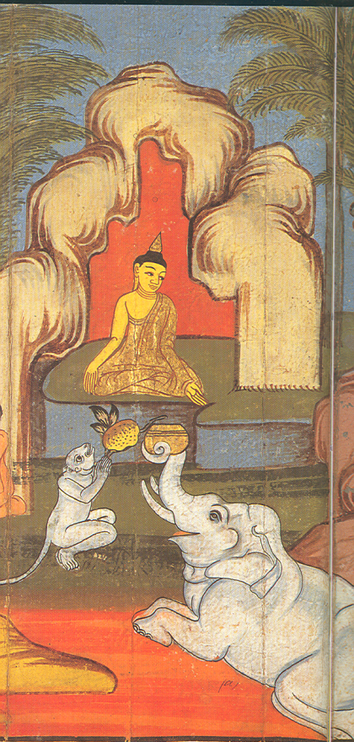
The Eight Great Sites for Pilgrimage II

Slide 5
Sangha as eremitic tradition in origin.......
But ends up with settled monastic life as dominant lifestyle of sangha
Movement through territory, and to visit sites associated with Buddha typical: practice of monastic pilgrimage begins in first centuries

Slide 6
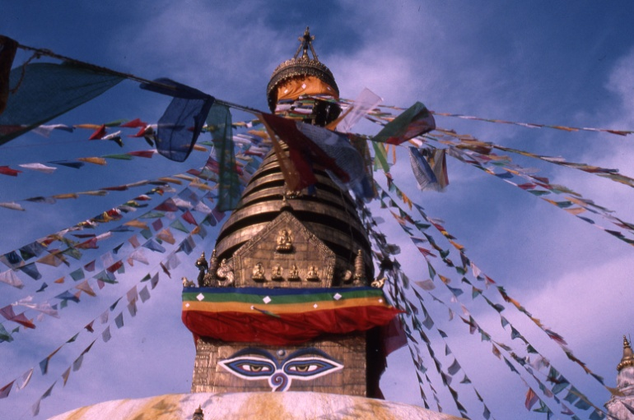
Nepal: Svayambhu

Slide 7
Jokhang (Lhasa, Tibet)

Slide 8
Potala: Dalai Lama (and other tulkus)

Slide 9
Tsari: Crystal Mountain [SE Tibet]

Slide 10
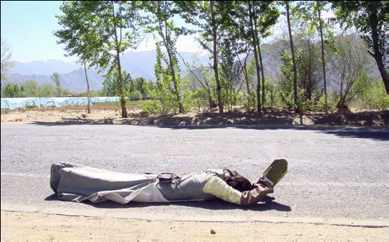
Kailash

Slide 11
The True Pilgrimage: Exterior Journey ......
Or Interior Quest?

Slide 12
V. Comparative Reflections

Slide 13
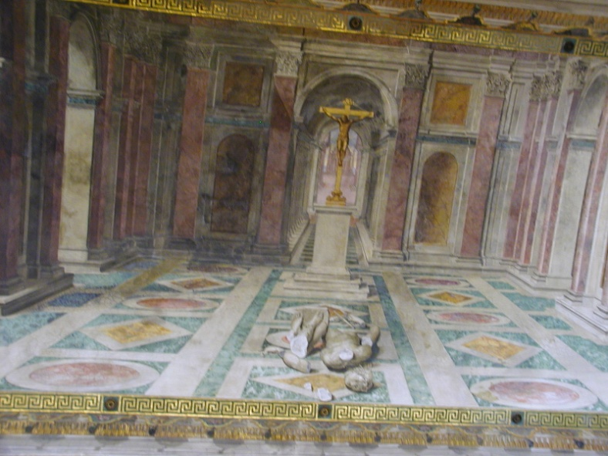
...“Spiritual Conquest”
Pilgrimage and .....

Slide 14
Buddhist Spiritual Conquest

Slide 15
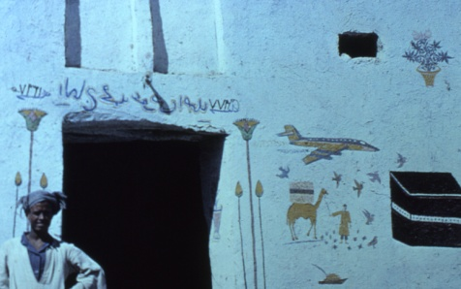
Anthropology of Pilgrimage
Healing and Pragmatic Blessings
Community of pilgrim group
Facing adventure and danger with faith
Exercise

Slide 16
Tourist/Pilgrim: a Real Distinction ?

Slide 17
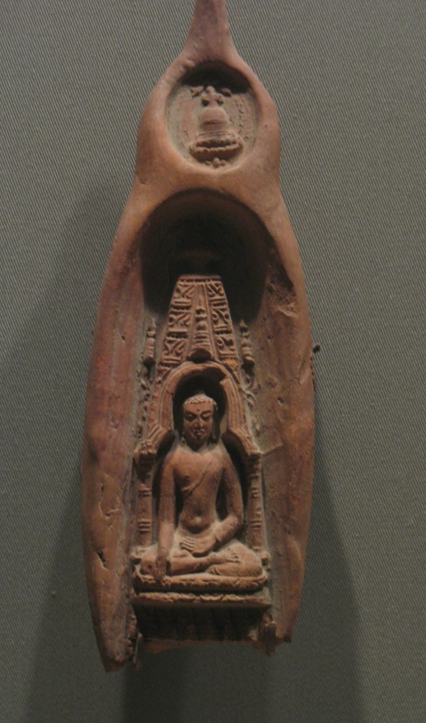
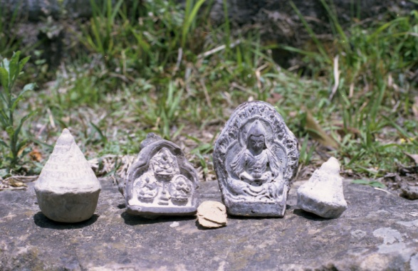
Returning Home with the “Sacred Traces”

Slide 18
The Sacred Center relocated...
Bodh Gaya, Site of Enlightenment
Decline of Buddhism, 1192
Pagan, Burma
Beijing, China

Slide 19
Frontier of Buddhist holy land: Kathmandu Valley Maha Bodhi temple model [Patan]
Ayutthaya, Thailand

Slide 20
Texts produced for and from Pilgrimage

Slide 21
Merchants and Buddhism

Slide 22
Confluence of Circumambulatory Route and Market in Lhasa

Slide 23
New Pilgrimage Traditions Emerging [Tourism/economics and Religion]

Slide 24
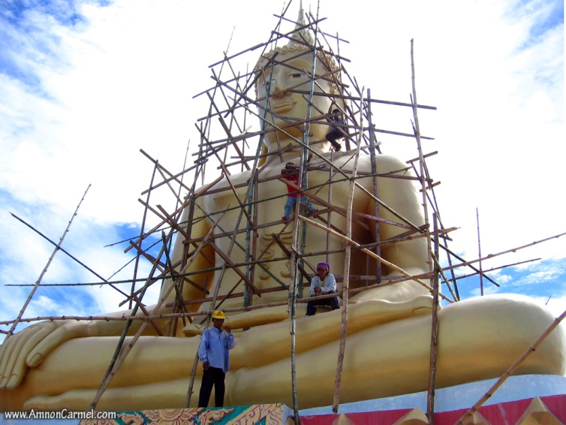
Global Buddhist Pilgrimage Today: Big Buddhas

Slide 25
Conclusions
Pilgrimage is not an exotic, or peripheral category of phenomena in the history of religions
Connection to the “spiritual conquest” of world religions over indigenous traditions
It has directed the development of economics underwriting Buddhism, Islam, and Christianity
led to increased ritual specialization
connected civilizations
led to important textual production
provided a channel for profound spiritual experiences
Continues to shape the modernization of world religions

