Slide 1
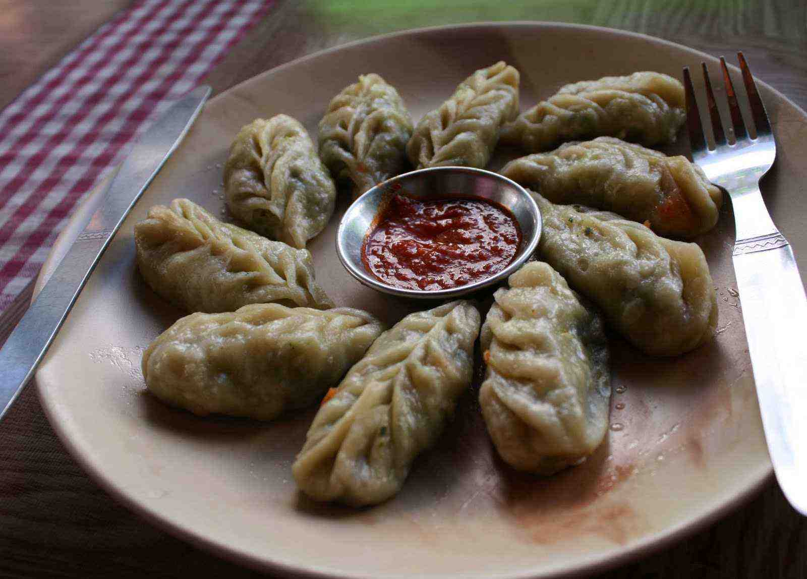
Kashmir Momos

Slide 2
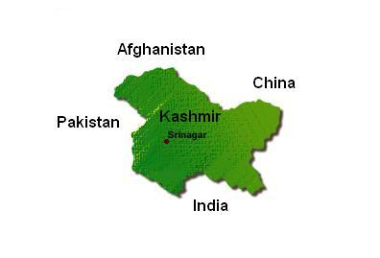
Geography

Slide 3
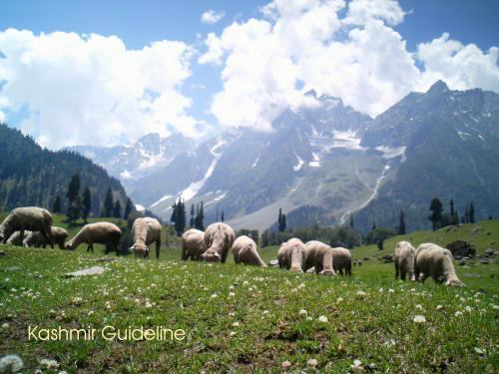
Lush Valleys Allows for Fertile Farming

Slide 4
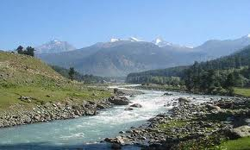
Sufficient Source of Water for Farming

Slide 5
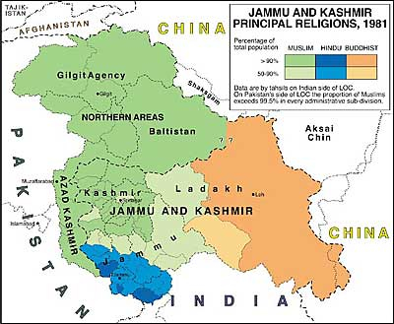
Religions and its Effects Upon the Cuisine

Slide 6
Historical Influences Upon the Cuisine
Central Asia,
Persia,
Middle East
Afghanistan.

Slide 7
History
INFLUENCES
Kashmiri cuisine (has evolved over hundreds of years. The first major influence was the food of the Kashmiri Pandits, the Hindus of the valley.
The cuisine was then influenced by the cultures which arrived with the invasion of Kashmir by the Timur from the region of modern Uzbekistan.
Subsequently, Kashmir and its food has been strongly influenced by the cuisines of Central Asia, Persia, Middle East and Afghanistan.
The most notable ingredient in Kashmir cuisine is mutton, of which there are over 30 varieties.
Also to be noted are Balti curries, popular in the United Kingdom for their exotic tastes, that have spread from the Baltistan region of Pakistan-

Slide 8
Prevailing Flavors
Sweet 'Basmati' rice cooked in clarified butter (Ghi), milk and water, along with dry fruits, saffron, spices and other condiments, is a favorite dessert of Kashmiri Pandits.
Fruit stews and custards etc., are also served as desserts.
In hot weather, ice-creams or some other sweets are enjoyed.

Slide 9
Prevailing Flavors
Sweet and tart Apples,
Pears, Apricots, Plums, Peaches, Cherries
Walnuts and Almonds
Crab-apples, Loquats, Chestnuts, Nectarines, Quinces, Grapes, Mulberries, Strawberries, Cranberries, Raspberries, Black-Berries and many other wild-grown Berries almost all varieties of fruit,
Fruits, naturally, form a good part of Kashmiri diet. Here many fruits are also cooked and turned into delectable dishes. Many fruits are also preserved by canning or by pickling.
Water-Chestnuts, Musk and Water Melons, Cucumbers, tuber, root and leafy vegetables are grown abundantly.

Slide 10
Prevailing Flavors of Kashmir Pandit Cuisine
Pandit means a highly leamed Brahmin (scholars, teachers, fire priests)
Yogurt
Oils
Spices as such turmeric,
avoid onion, garlic, tomatoes, and chicken. Unlike Kashmiri Muslim cuisine, it does not include many minced meat dishes.
Equally vegetarian and non-vegetarian

Slide 11
Prevailing Flavors of Vegetarian Cuisine
Indian Cheese in yoghurt base gravy seasoned with turmeric
Indian Cheese, cooked in oil and Kashmiri spices, without yoghurt and seasoned with chili peppers whole potatoes cooked in a spicy sauce with generous amounts of chili pepper powder
Lotus Stem in a yoghurt base
Kohlrabi, generally stewed
Lotus root slices in stewed spinach
Eggplant cooked in a tangy spicy curry
Large cut turnips in a delicately flavored kidney bean curry

Slide 12
Muslim Non-Vegetarian Cuisine
Spicy lamb curry
Lamb curry in a yoghurt turmeric base
Cooked lamb meat balls
Potatoes with meat
Yoghurt based meat dish delicately flavored with cardamom and bay leaves
Roasted rib chops
Offal of the lamb, either the liver or the kidney
Fish, cooked with Radish

Slide 13
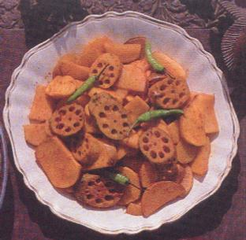
Lotus Root
by ShyamRaniKilam and S. Kilam S. Kaul

Slide 14
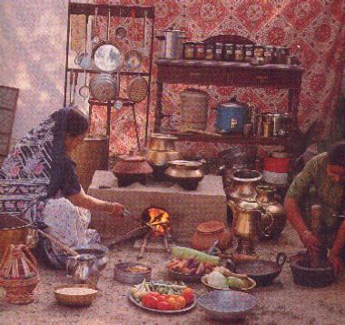
Kashmiri Kitchen
ShyamRaniKilam and S. S

Slide 15
Culinary Etiquette
Big metallic plates, generally made of stainless steel, are used for eating.
Eating with right hand fingers and thumb is common.
Service is usually done by cooks, friends and family members. To relish the Dishes individually, and make the cuisine an enjoyable one, different preparations are not mixed while eating, and service is done in a somewhat course-wise style. Each dish, with its particular flavor and delicacy, is relished and appreciated separately at a time.
Green Tea without milk, is served generally after and even before a Dinner.

Slide 16
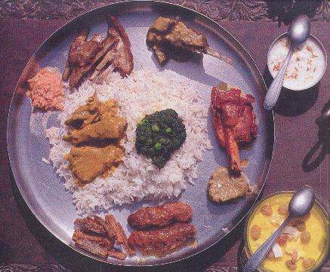
A Typical Meal
by ShyamRaniKilam and S. S. KaulKilam

Slide 17
Culinary Etiquette
Main traditional do’s and don’t’s
Each person eats on a separate plate.
Eating of stale food is prohibited, and is to be avoided.
Putting Katoris of vegetables etc. inside the eating plate (Thali) is prohibited.
Water for drinking is always kept near the diner. In fact, before every main meal a little water is taken in the form of an Achman with a prayer. Without the tumbler touching the lips, water is poured into the mouth from a little distance while drinking.

Slide 18
Culinary Etiquette
One cannot touch the unused food articles, or bowls containing the food, with the hand with which one is eating.
Fruits and green vegetables have to be thoroughly washed before being eaten. Even the knives etc. have to be scrubbed before using.
Food is eaten while sitting on floor, while eating plates etc. are placed on clay washed wet floor or on a clean sheet, preferably woolen.
Washing of hands and mouth, before and after eating any food, is a must.

Slide 19
Culinary Etiquette
One cannot leave the eating place before the plates (Thalis) etc. are removed and the place is cleaned.
Eating meals in good light, preferably after sunrise and before sunset, is a directive.
'Fasts' (Brat) on certain days of every week and every month and on certain days of a year, are recommended, for spiritual and physical welfare.
Talking during eating is thought unwise.
Short prayers, before and after taking main meals, are to be offered.
Before eating always some food is set apart, as a 'Vishnu Arpari ', portion, to be used for serving an Atithiie., an unannounced guest or a hungry person or an animal.

Slide 20
Culinary Etiquette
Use of aluminium utensils is not recommended. Brass or bronze or terracotta utensils are used for cooking. Bronze Thalis for eating food, and bronze cups for drinking tea, were common. To clean bronze it is scrubbed with ashes. For brassware wet clay is used for scrubbing and cleaning. Copper utensils are mainly used for Puja. Silver tea-cups and tumblers etc. are used by aristocracy.
One can serve food only after he or she washes his or her hands. Any food touched by unclean hands cannot be served or eaten. Even food touched with the hand with which one has been eating cannot be served to other people.
One cannot transfer any portion of his food, which the person has been eating, to another person's plate.
Meat eating, and use of intoxicants, are Tamsik and are considered to retard spiritual growth and physical welfare.

Slide 21
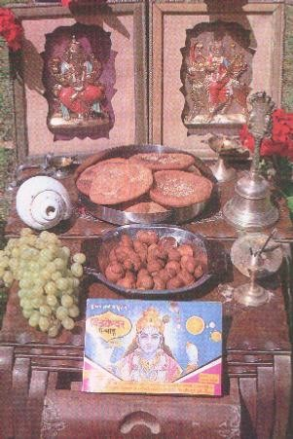
Culinary Etiquette

Slide 22
Culinary Etiquette
The meal begins with a ritual washing of hands at a basin called the tash-t-nari, which is taken around by attendants.
Then the tramis arrive, heaped with rice, quartered by four seekhkababs and contains four pieces of methi korma, one tabakmaaz, one safedmurg, one zafranimurg, and the first few courses. Curd and chutney are served separately in small earthen pots. As each trami is completed, it is removed, and a new one brought in, until the dinner has run its course.
Seven dishes are a must for these occasions-- Rista, Rogan Josh, TabakMaaz, Daniwal Korma, AabGosht, Marchwangan Korma and Gushtaba. The meal ends with the Gushtaba.

