Slide 1
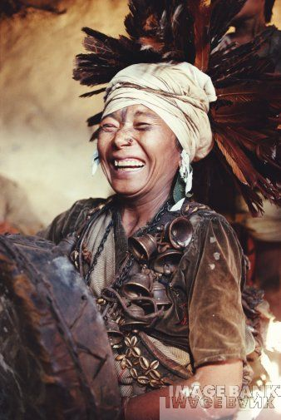
The Bon religion
Pre-Buddhist Shaman religion
http://www.gettyimages.com/detail/200421408-001/The-Image-Bank
July 27, 2011

Slide 2
Features of Bon religion
Shamans or priests who go into a trance in order to communicate with supernatural entities. Shamans can be women or men.
Animal sacrifices.
900-page manual describing 100 rituals.
Rituals are sacred but also casual, fun & entertaining.
Most rituals are for protection for
Crops
Prosperity
Health

Slide 3
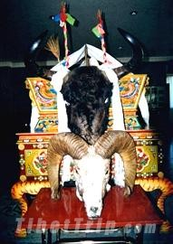
Bon is practiced in some remote, rural villages
Elements of it were incorporated into Tibetan Buddhism.
http://www.bing.com/images/search?q=Bon+religion+Tibet&view=detail&id=0FA351552712F7927165ED847B6F4EBA534D8BB3&first=181&FORM=IDFRIR July 27, 2011

Slide 4
Watch selected video segments about Kham Magar rituals on YouTube
http://www.youtube.com/watch?v=3XX3w3sz_To
http://www.youtube.com/watch?v=wxQDWenfVEc

