Slide 1
Buddhism
Ms. Susan M. Pojer Horace Greeley H.S. Chappaqua, NY
www.pptpalooza.net/PPTs/GlobalStudies/Buddhism.ppt July 15, 2011
Modified by N. Power

Slide 2
Buddhism in the Subcontinent

Slide 3
The essence of Buddhism
The “middle way of wisdom and compassion.”
2,500 year old tradition.
The 3 jewels of Buddhism:
Buddha, the teacher.
Dharma, the teachings.
Sangha, the community.

Slide 4
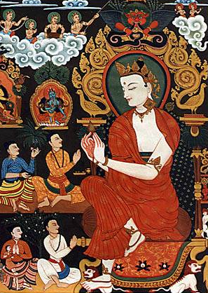
Siddhartha Gautama
(563-483 BCE)
The historical Buddha, or Shakyamuni Buddha
Born in NE India
Raised in great luxury to be a king.
At 29 he rejected his luxurious life to seek enlightenment and the source of suffering.

Slide 5
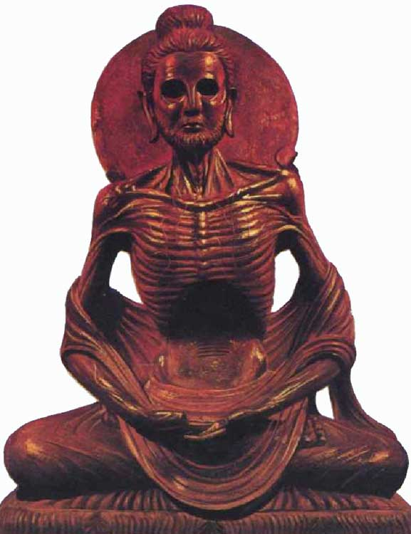
Lived a strict, ascetic life for 6 yrs.
http://www.bing.com/images/search?q=shakyamuni+buddha&view=detail&id=CA6783CE858E491045B9D660975B31CA7664FE53&first=0&FORM=IDFRIR July 15, 2011

Slide 6
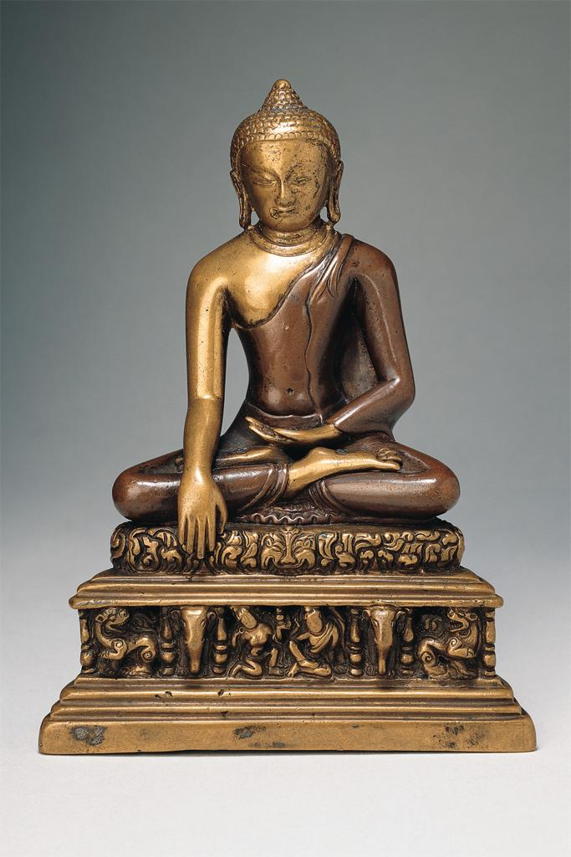
Rejecting this extreme, sat in meditation under a bodhi tree, and found nirvana.
Became “The Enlightened One,” at 35.

Slide 7
What is the fundamental cause of all suffering?
Desire!
Therefore, extinguish the self.

Slide 8
Four Noble Truths
There is suffering in the world. To live is to suffer. (Dukkha)

Slide 9
Four Noble Truths
The cause of suffering is self-centered desire and attachments. (Tanha)

Slide 10
Four Noble Truths
The solution is to eliminate desire and attachments. (Nirvana = “extinction”)

Slide 11
Four Noble Truths
To reach nirvana, one must follow the Eightfold Path.

Slide 12
Eightfold Path
Nirvana
The union with the ultimate spiritual reality.
Escape from the cycle of rebirth.

Slide 13
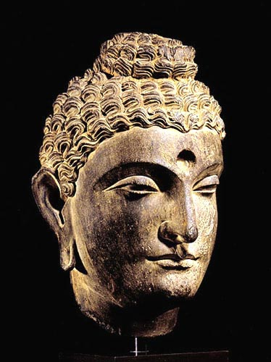
Buddha’s head:
Pakistan

Slide 14
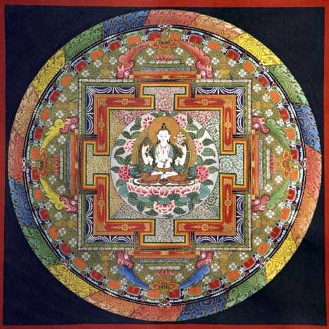
Mandala: Wheel of Life Motif

Slide 15
Types of Buddhism in the Himalayas
Theravada Buddhism
Mahayana Buddhism
Tibetan Buddhism

Slide 16
Theravada Buddhism
The oldest school of Buddhism.
The “Way of the Elders” or the “Small Vehicle.”
Found in southeast Asia, including Burma (Myanmar).
The monastic life is the best way to achieve nirvana.
Focus on wisdom and meditation.
Goal is to become a “Buddha,” or “Enlightened One.”

Slide 17
Mahayana Buddhism
Seek guidance from Boddhisatvas, enlightened beings who choose to return to the world to help people.
Goal: The enlightenment of all humanity through self-sacrifice of those enlightened few.
Focus on lay people, not just monks, reaching enlightenment.

Slide 18
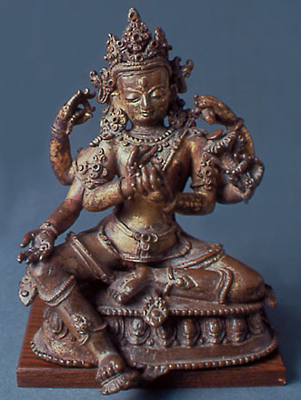
Seated Boddhisatva – 16c Bhutan

Slide 19
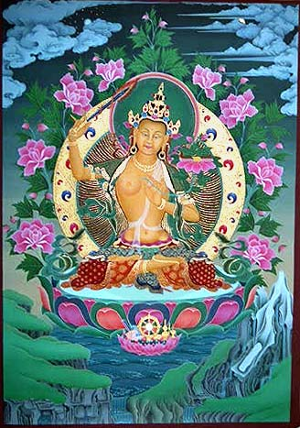
bodhisattva

Slide 20
Bodhisattva
An enlightened being who chose to return to the world to help other beings instead of staying in Nirvana.
Prominent in Tibetan Buddhism.
The most commonly revered bhodisattva in Tibet is Avalokiteshvara.

Slide 21
Tibetan Buddhism
A specialized form of Mahayana.
Also called Tantric, Vajrayana or the
Diamond Vehicle. Tantric refers to scriptures that describe rituals.
Focus on Boddhisatvas who help lay people.
Involves chants and rituals.
Rituals include a bell and a vajra.
Traditionally, monks & lamas are men, not women.

Slide 22
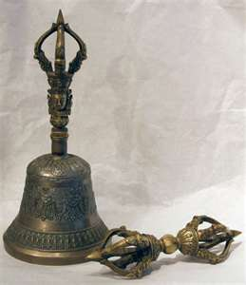
The bell symbolizes wisdom and the vajra symbolizes a thunderbolt and an indestructible substance.
http://www.bing.com/images/search?q=vajra&FORM=BIFD
July 27, 2011

Slide 23
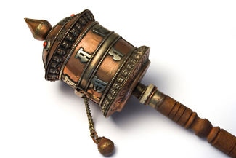
Tibetans also use rosaries, prayer wheels and prayer flags to pray.
http://www.bing.com/images/search?q=Tibet+prayer+wheel&view=detail&id=33E2BAF0215C573EA69B41268FF203FA38B4E4AA&first=211&FORM=IDFRIR July 27, 2011

Slide 24
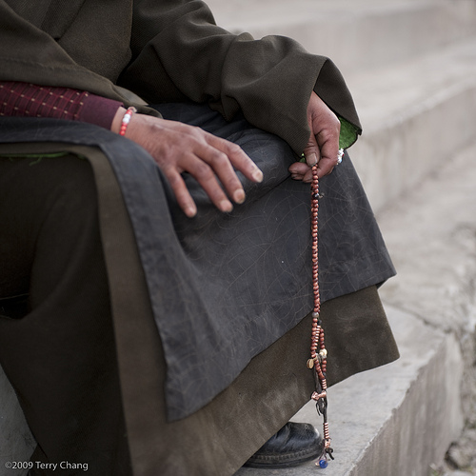
Next slide: http://www.bing.com/images/search?q=Tibet+prayer+flags&view=detail&id=A5C717F611AE65758793061556158697FE68AD3F&first=0&FORM=IDFRIR July 27, 2011
http://www.bing.com/images/search?q=Tibetan+rosary&view=detail&id=2D62F594F717AA020FEC2D62F594F717AA020FEC&first=0
July 27, 2011

Slide 25
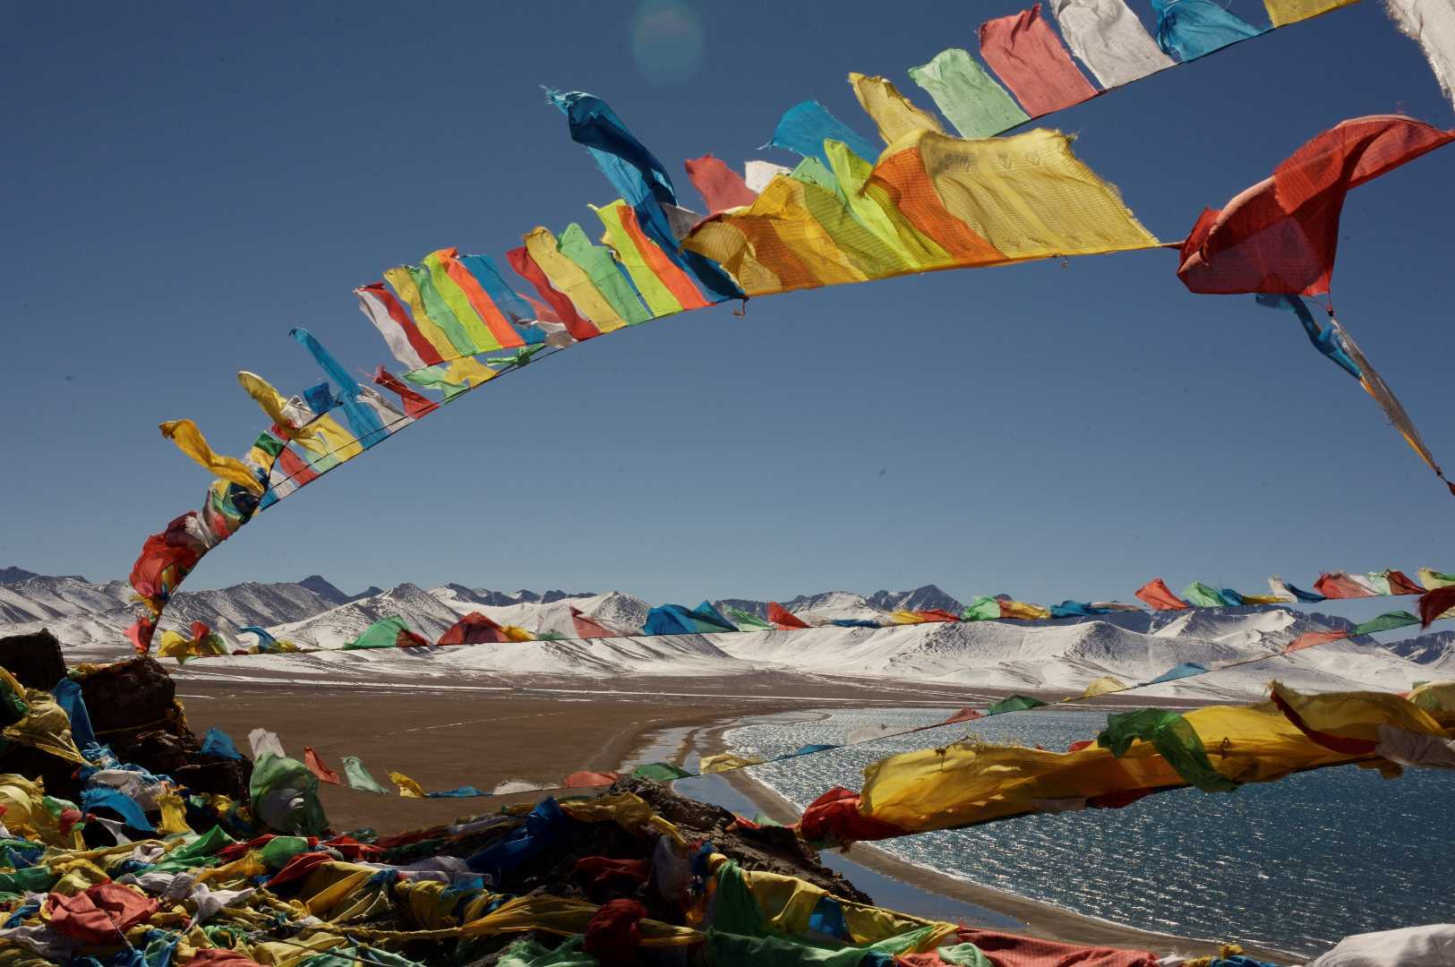

Slide 26
Activity: make prayer flags
Divide students into small groups.
Each group gets the same size piece of cloth but in different colors.
The students design and decorate their flag with a prayers of gratitude and/or requests. They may include pictures.
Glue all the flags to a string and hang the flags in the classroom or outside.

Slide 27
funerals
Two ways to free the deceased:
Cremation
Sky burial
In sky burial, the flesh is cut off of the and vultures come and take the flesh

Slide 28
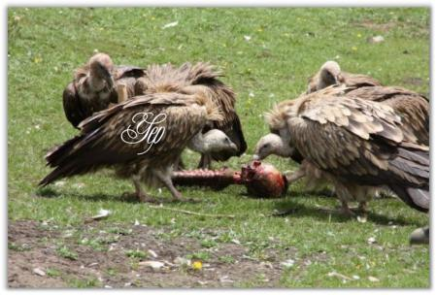
Sky Burial
http://www.bing.com/images/search?q=Tibet+%22sky+burial%22&view=detail&id=EEE30981859FA886BAC3EE4F9F43F9676BF2D01C&first=0 July 28, 2011

Slide 29
The
14th Dalai Lama

Slide 30
Watch the film
“Unmistaken Child’

Slide 31
stupas
Objects of a special shape that contain relics of the Buddha or famous lamas
Range in size from fitting in the palm of your hand to large buildings

Slide 32
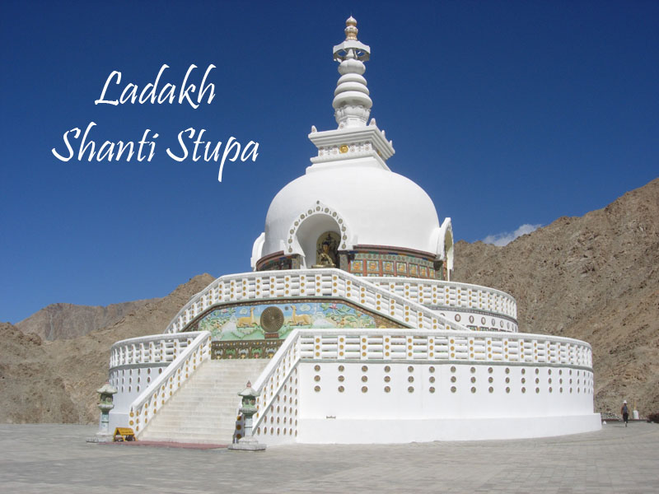
http://www.bing.com/images/search?q=stupa&view=detail&id=C4FEC524ECA1E09B6C864CB5236DDC06A5E59BD8&first=31&FORM=IDFRIR July 27, 2011

Slide 33
Activity: make stupas using stupa molds, clay and rice.
Order stupa molds from:
http://www.tibetanspirit.com/shopdisplayproducts.asp_Q_id_E_166_A_cat_E_Tsa+Tsa+Molds_A_catid_E_136_A_maincat_E_Ritual+Items

Slide 34
Directions for making stupas
Rub oil into the inside of the stupa mold.
Fill the mold with clay and then turn the clay inside the mold until it spins smoothly.
Insert a grain of rice into the bottom.
Remove the clay from the mold by sticking clay on the end and pulling the clay out.

