Slide 1
Encountering the Sacred
Art and Ritual in Himalayan Buddhism
Dina Bangdel
Department of Art History
Virginia Commonwealth University
(Modified by Nancy Power)

Slide 2
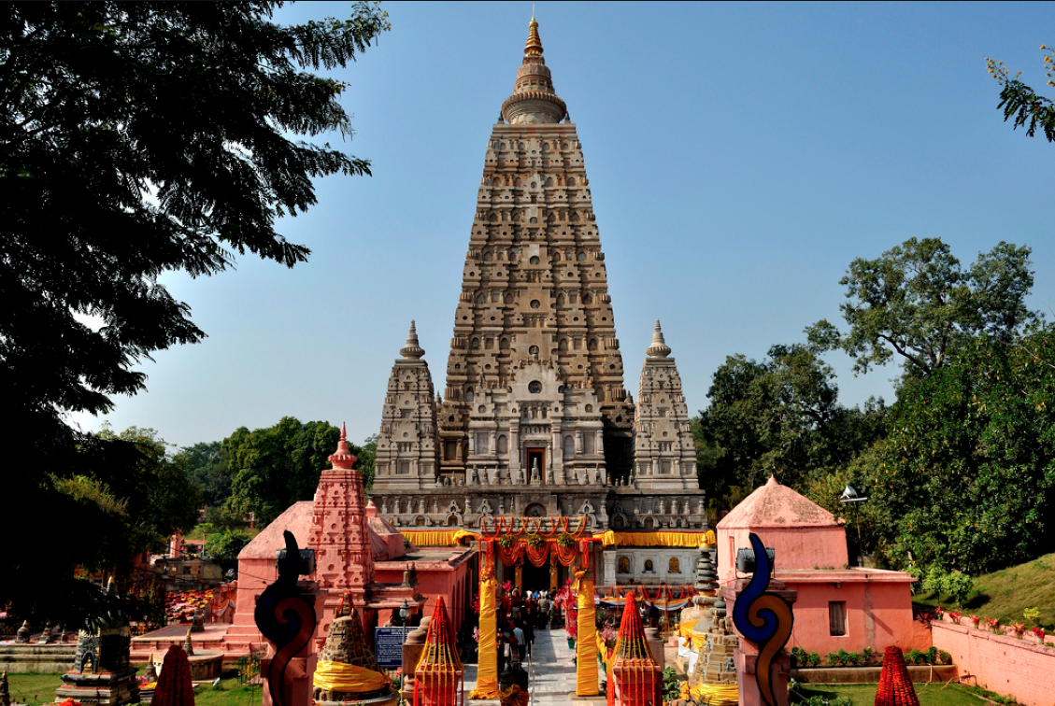
Notes:
I begin at Bodhgaya, the most sacred of the sites for the 400 millions Buddhists in the world: this is the place of the Buddha’s enlightenement.
In the hot central plains of India, it is the most sacred place of pilgrimage for the 400 million Buddhists in the world.
The structure is called a “stupa.”

Slide 3
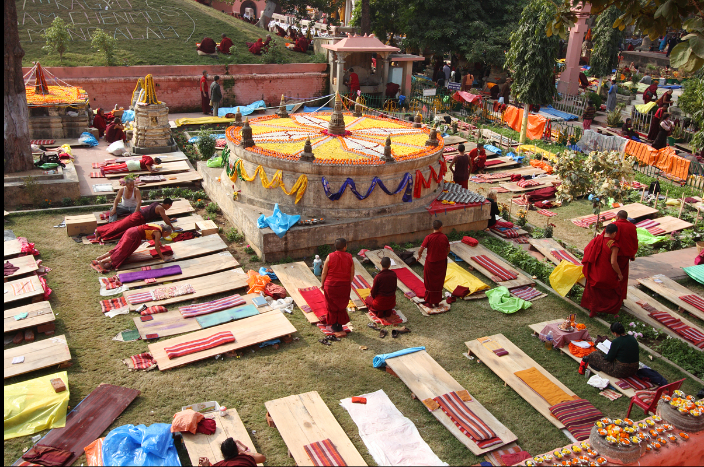
Notes:
Each year, especially during the winter months, millions of pilgrims come to Bodhgaya, and perform prostrations as an act of veneration and also gaining merit not for only oneself but for all sentient beings. As you see here, Tibetan monks will perform 100,000 prostrations during the months they reside here.

Slide 4
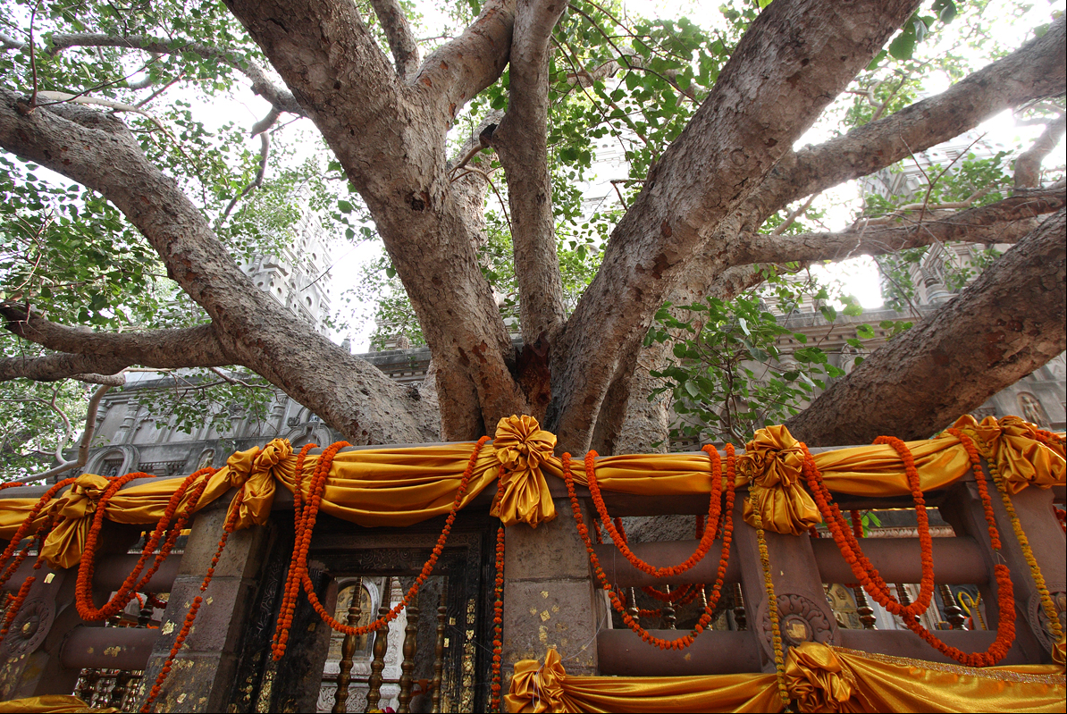
Notes:
More specifically, it is the tree that is the focal point of veneration, as the secondary relic related to the holy person: that is the Buddha Shakyamuni. It is precisely on this spot that he attained enlightenment, from an ordinary mortal to the Buddha in his spiritual journey of self transformation in the 5th century BCE. (Is this the same tree under which the Buddha sat?)

Slide 5
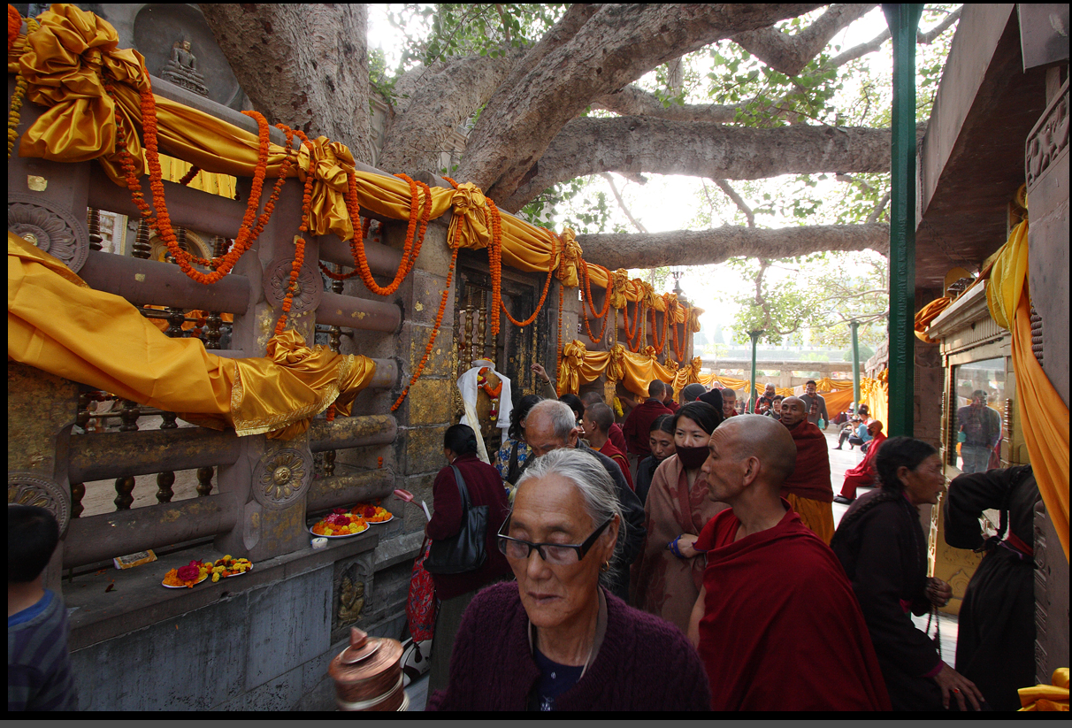
PUJA : “Honoring”
Notes:
Here we find the eternal reminders of the acts of veneration in Buddhism: The acts of veneration are through circumambulation around the tree, making offerings, touch, and most importantly, the notion of darshan, making eye contact with the image of Buddha. (Which activities here are the same as in Hinduism?)

Slide 6
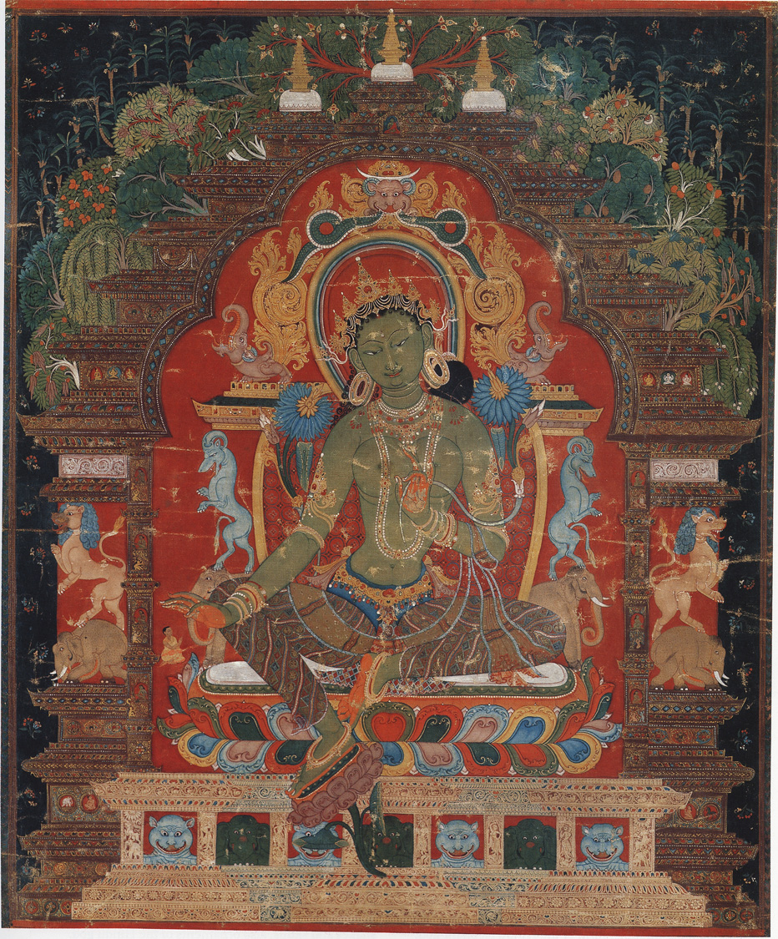
1. The Study of Himalayan Art
Style
Iconography / Iconology
Function
* Artist
* Authority (text / priest / teacher)
* Donor

Slide 7
Art as Tool for explaining the Buddhist teachings:
Through NARRATIVE STORIES
Through ICONOGRAPHIC FORMS – THEMES
Note: usually the donor/sponsor/patron is identified in the art, but not the artist.

Slide 8
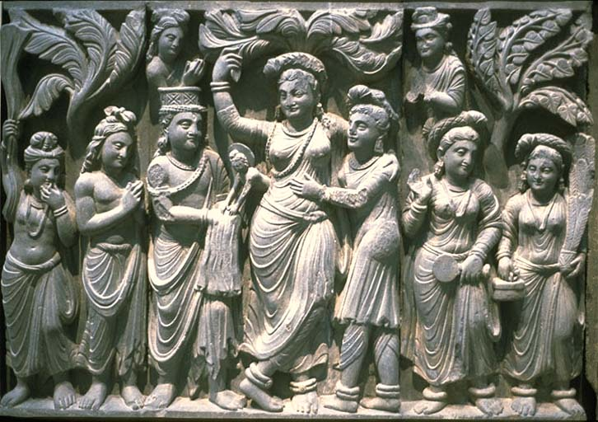
Birth of the Buddha, Ca. 2ndc. CE. Kushana Period
Notes:
Buddhist art tells stories.
Art is crucial to Buddhist practice, for meditation and for honoring buddhas.
Buddha is born out of the side of his mother, who is holding onto a tree.

Slide 9
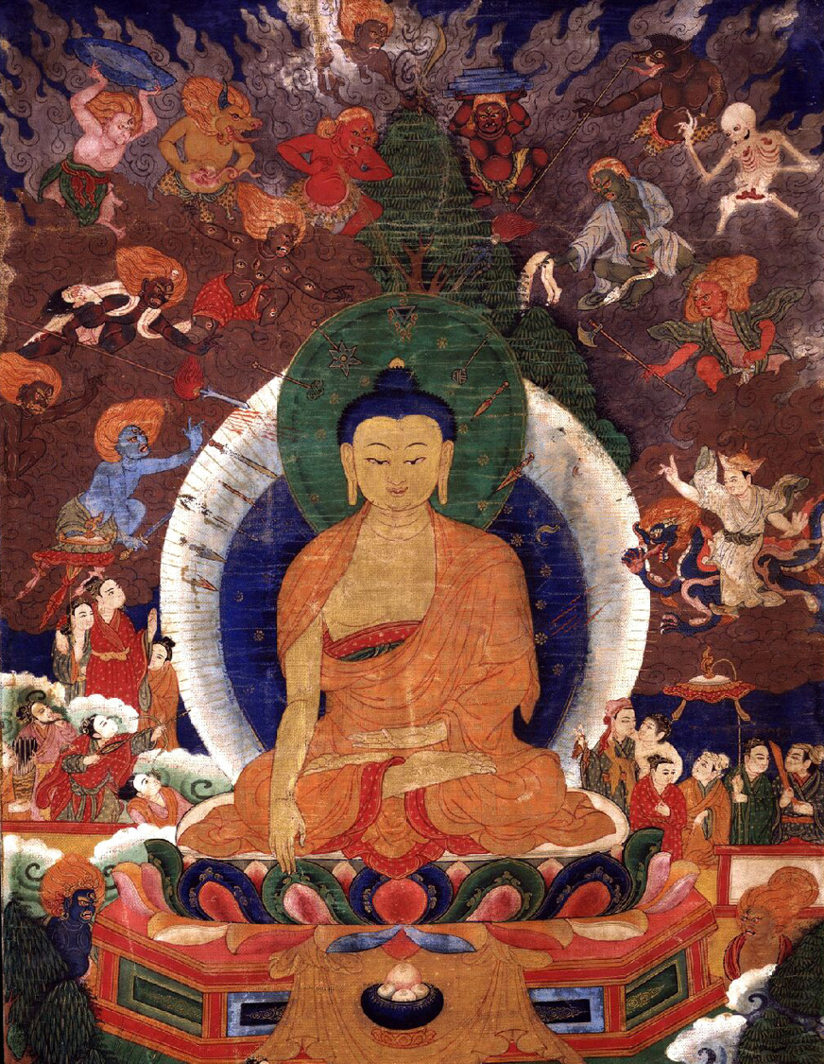
Notes:
Shakyamuni:As Gautama sat in deep meditation, Mara, Lord of Illusion, perceiving that his power was about to be broken, rushed to distract him from his purpose. He touched the earth, calling the Earth Goddess to bear witness to his countless lifetimes of virtue that had led him to this place of enlightenment. When the earth shook, confirming the truth of Gautama’s words, Mara unleashed his army of demons. In the epic battle that ensued, Gautama’s wisdom broke through the veils of ignorance and illusions.
Touching the earth is one of 8 mudras, or hand gestures, shown in images of Buddha.

Slide 10
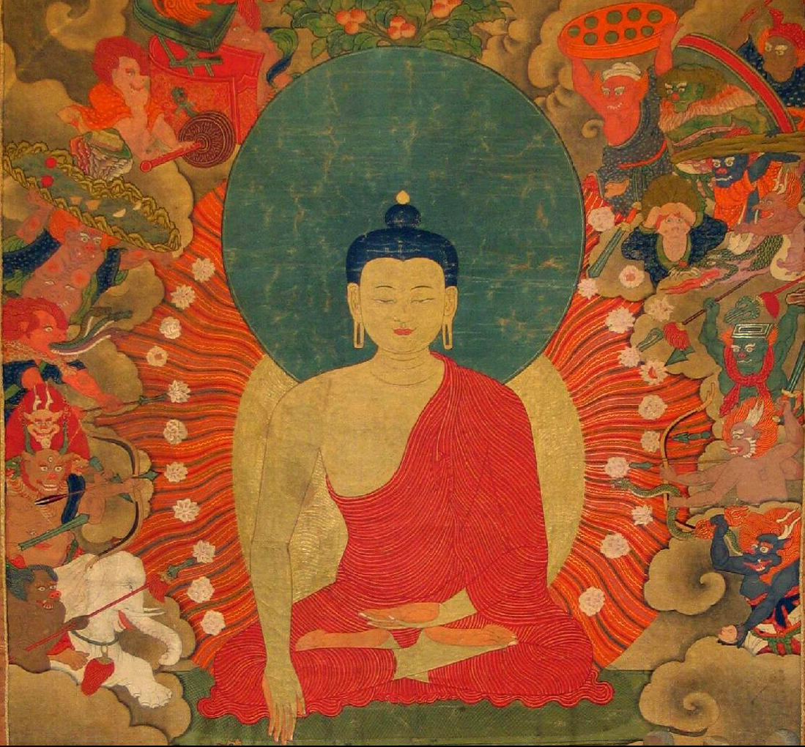
Notes:
The power of his compassion transformed the demons’ weapons into flowers and Mara and all his forces fled in disarray.

Slide 11
The Buddha
Ca. 15thc.
Nepal
Notes:
It is the idea of self-transformation, following the example that this enlightened individual that is the goal of Buddhism: that each one of us has the potentiality to become a “BUDDHA” – one who has awakened, understood the truth of the existence. It is the art that explains the core beliefs of Buddhism, but more importantly, it is the art within the context of ritual/faith that vivifies and makes it real for the invidividual. In the most elemental of terms Buddhist art is a narrative, a symbolic language to understand the goals of Buddhism. The story begins with his birth as a prince, born in southern Nepal and his giving up the material pleasures to seek enlightenment.

Slide 12
Knot of
knowledge
swirl between eyebrows
Elongated
earlobes
Rings around neck
Simple
monk’s robe
Earth Touching
gesture
The Buddha
Lotus seat
Lion throne
Notes:
It is the idea of self-transformation, following the example that this enlightened individual that is the goal of Buddhism: that each one of us has the potentiality to become a “BUDDHA” – one who has awakened, understood the truth of the existence. It is the art that explains the core beliefs of Buddhism, but more importantly, it is the art within the context of ritual/faith that vivifies and makes it real for the invidividual. In the most elemental of terms Buddhist art is a narrative, a symbolic language to understand the goals of Buddhism. The story begins with his birth as a prince, born in southern Nepal and his giving up the material pleasures to seek a life

Slide 13
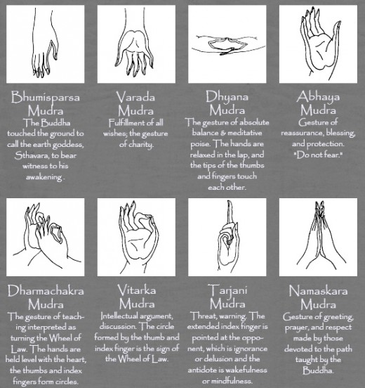
The 8 mudras (hand gestures) shown in Buddha images
(Practice each one)
http://s3.hubimg.com/u/4695246_f520.jpg
July 28, 2011

Slide 14
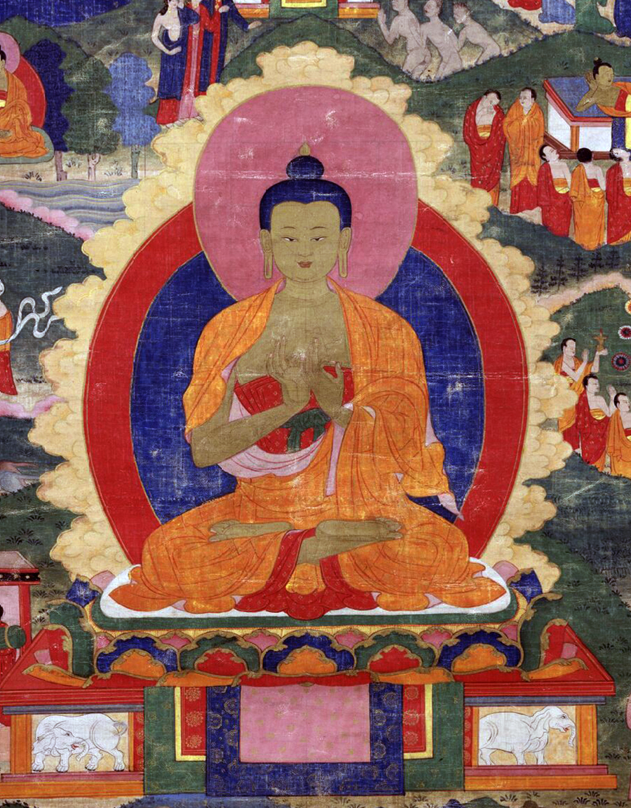
Teaching gesture
Notes:
This wonderful painting depicts the cult of the relic that is the core of Buddhist pilgrimage. That is, when the Buddha died, his bodily relics (ash, hair, bones) were distributed and established as stupas.

Slide 15
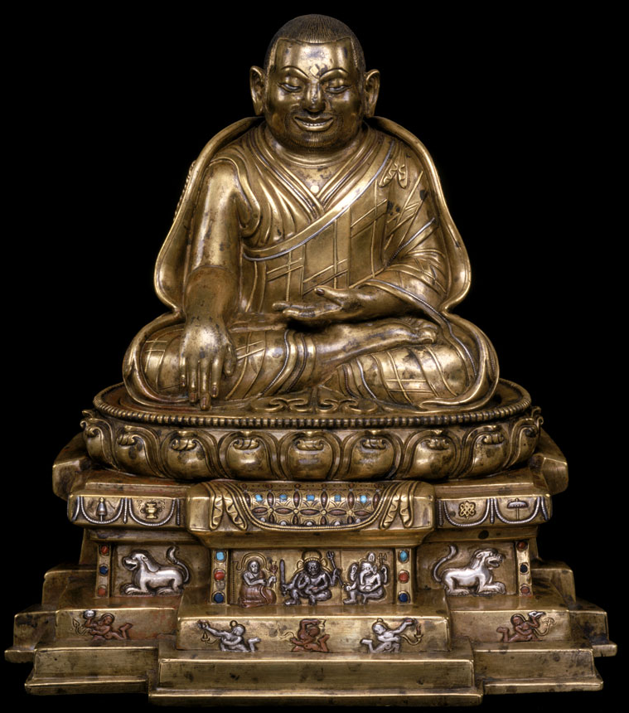
Reading the
Iconography
Earth-touching
gesture
Lama RinchenGon
Tibet Teacher
15thc.
Lotus seat
Lion throne

Slide 16
How does art explain enlightenment?
Enlightenment = Wisdom and Compassion
Symbolic Language of Religious Art:
Gesture, color, form (wrathful or pacific)

Slide 17
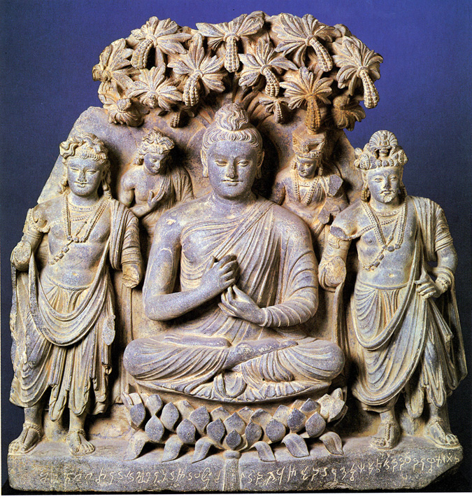
Compassion
Wisdom
Buddha Flanked by Bodhisattvas of Wisdom and Compassion, 2nd c. CE
Enlightenment Symbolized

Slide 18
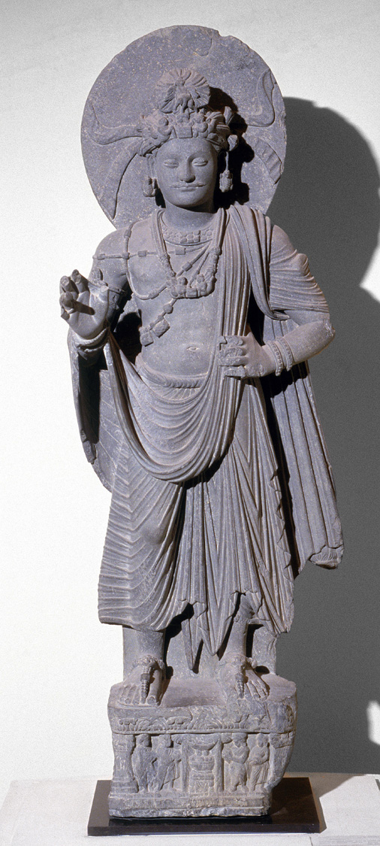
Circle
Of
Light
Long Hair
Jewelry
Urna
(“wool”)
Gesture (mudra)
Teaching
Princely robes
No, this is a bhodisattva.
Is this an image of Buddha?

Slide 19
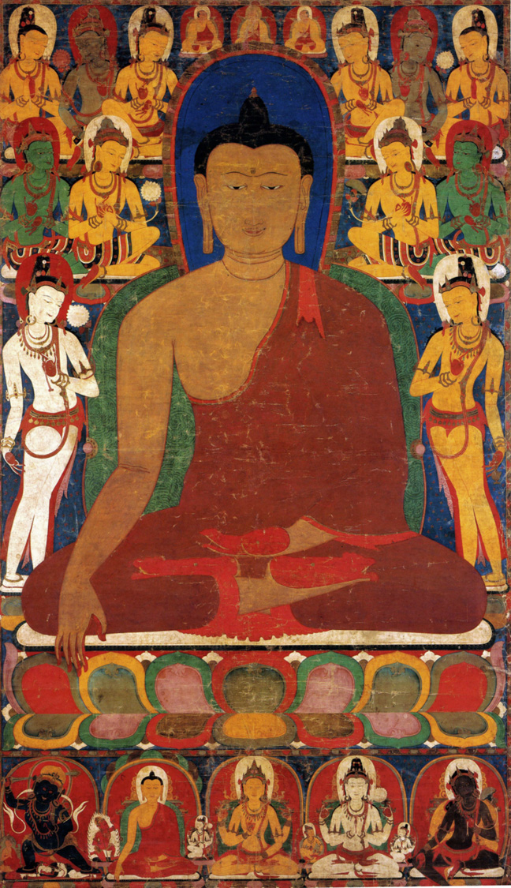
READING THE
PAINTING
Is this the Buddha?
Yes, flanked by the
Bodhisattvas of
Wisdom and
Compassion
Ca. 13th century,
Tibet

Slide 20
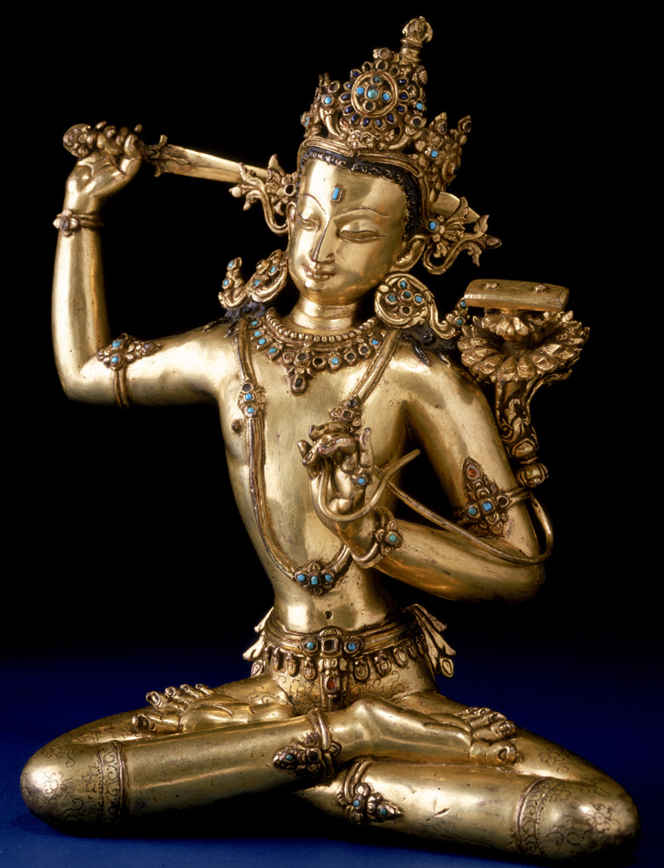
Sword
Buddha or Bhodisattva?
Book
. Manjusri
Bodhisattva of
Wisdom

Slide 21
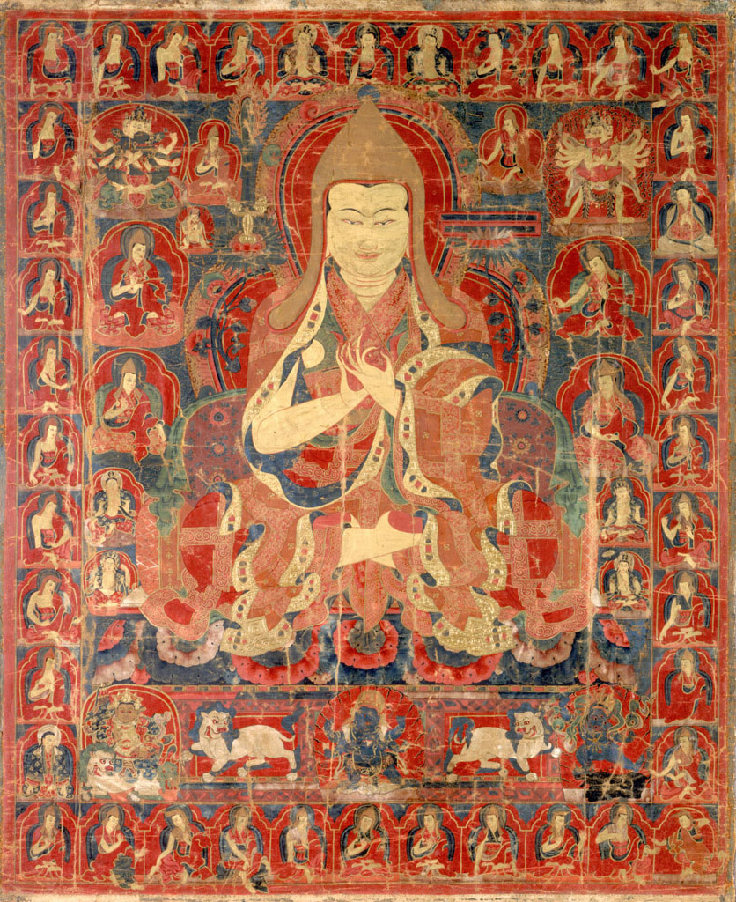
READING THE
ICONOGRAPHY
Buddha?
Which gesture is shown?
Each surrounding figure has significance, too.
Tsongkhapa (1357−1419)
Tibet
Ca. 16th century

Slide 22
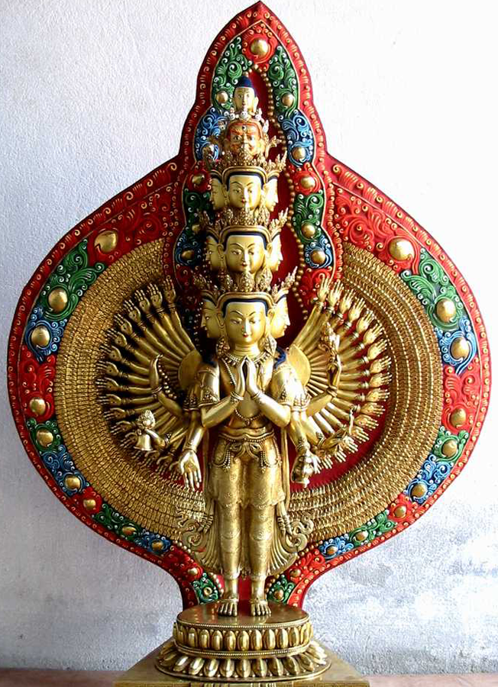
Bodhisattva of
Compassion
How many arms?
How many heads?
Why so many?

Slide 23
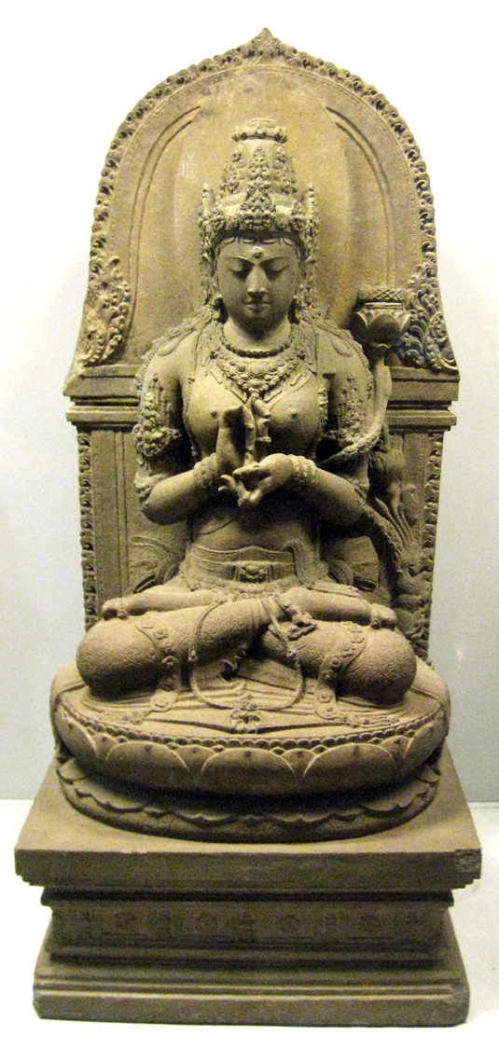
Representing WISDOM
Goddess Perfection of
Wisdom
Gesture of teaching
BOOK

Slide 24
Jataka Stories
Previous Lives of the Buddha
Narrative Stories as Teaching
Monkey Jataka

Slide 25
The Great-Hearted Monkey Jataka
(Have the students take turns reading aloud)
By the side of River Ganges, high on the mountains there lived about eighty thousand monkeys along with their giant monkey king. And by the side of the clear gushing water stood a tall shady tree bearing big beautiful juicy golden fruits commonly called mangoes.
All the monkeys just loved these mangoes and ate them off almost as soon as they had ripened, which was a good thing, since their wise giant king had warned them not to let a single juicy fruit fall into the river. Because if the current carried even one of these fruits down the river to the land where the men lived, they would surely come in search of this delicious fruit and destroy the peace in the land of the monkeys.

Slide 26
It so happened that a branch of this tree hung low over the river and a mango that was hidden behind an ant's nest ripened and fell off without anyone's notice. It was taken down south by the rapid flow of the river and reached the city of Benaras.
One fine morning while King Brahmadutta of Benaras was bathing in the river between two nets, a couple of fishermen found a bright golden fruit caught in the mesh of the net. Very excited, they took it to show the King.

Slide 27
The King examined the fruit carefully and asked where it had come from and what it was called. The fishermen did not know much about it but guessed that it must have flowed down the river from the valleys of the far-flung Himalayas.
He then asked them to cut the mango and tasted a slice. It was delicious! He shared the rest of it with his ministers and Queen, who all loved its divine flavor.
A few days passed, but the King could not get this exotic fruit out of his mind. He could not work, rest or sleep for want of some more. Finally he could bear it no longer and set sail in search of it. He organized a fleet of rafts and sailed up the river, accompanied by his men and a few fishermen.

Slide 28
Many days and many nights went by and they passed many valleys until they finally came to the one where the mango tree stood. Mission accomplished, the King was delighted and began enjoying the mangoes to his heart's content. Finally, that night, the King lay down to sleep under the mango tree while his faithful soldiers stood guard. Fires were lit on either side for protection against wild animals.
In the middle of the night when the guards had dozed off to sleep, the monkeys came and finished off all the mangoes that were left on the tree. The King awoke with all the noise and ordered his guards to shoot at the monkeys so that they could feast on monkey flesh along with the mangoes.

Slide 29
On hearing this, the monkeys trembled with fear and escaped to inform their King. They told him what had happened and he promised to save them. But for that he had to come up with a plan.
So he climbed up the tree and swung across the river with the help of a branch. He found a bamboo shoot which he measured and cut carefully, and then tied one end of it around his waist. The other end he tied around a tree trunk. He had decided to leap back to the mango tree and help the rest of the monkeys across over the bridge that he had made with the help of the bamboo shoot.
But alas . . . he had not taken into account the portion that he had tied around his waist. So when the monkey king sprang back into the mango grove he was just able to cling to a branch of the mango tree. He quickly summoned his monkeys to climb over his back and onto the reed in order to escape to the other side. In this way, eighty thousand monkeys climbed over his back one by one and made it to safety.

Slide 30
But unfortunately there was one evil monkey who hated his leader and wanted to destroy him. His name was Devadutta. This mean monkey purposely jumped hard over his poor king's back and broke it, while he himself escaped to the other bank.
King Brahmadutta, who had been awake for awhile, had observed this whole episode. He felt extremely sorry for the monkey king and asked his men to help lower him to the ground. He then had him gently bathed and wrapped in a soft yellow cloth and asked him why he had sacrificed himself for his tribe. The great monkey answered that as he was their guide and chief, they were his children and it was his sacred duty to protect them. He had absolutely no regrets as he had ensured their safety. He also went on to say that the King should always be mindful of his subjects' welfare even at the cost of his own. Saying this, the monkey king died, at peace with himself.

Slide 31
King Brahmadutta had learnt a great deal that day. He ordered his men to organize a funeral fit for a king. He then built a shrine in the monkey king's memory where he offered flowers and lit candles and incense.
On returning to Benaras, he built another shrine there and asked his people to pay homage to this great soul. He always remembered the last words of the monkey king and ruled his subjects with wisdom and compassion. The people in his kingdom were eternally grateful to the great-hearted monkey.
http://www.indiaparenting.com/stories/84_800/the-great-hearted-monkey.html July 28, 2011

Slide 32
Activity
Tell the monkey jataka and show sample art (next 3 slides).
Divide students into groups of 3 or 4.
Give each group a jataka story to read.
Each group creates a piece of art or drama to present the story to the other students.
For each presentation, discuss the moral or purpose of the story.

Slide 33
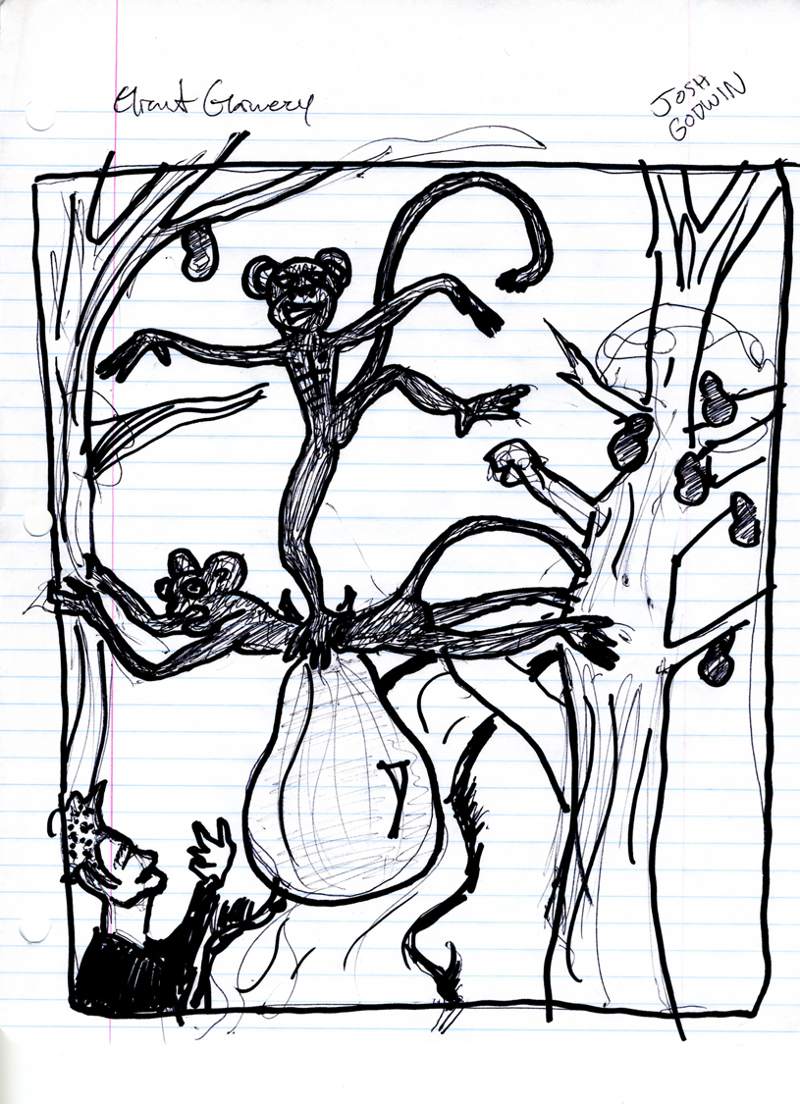

Slide 34
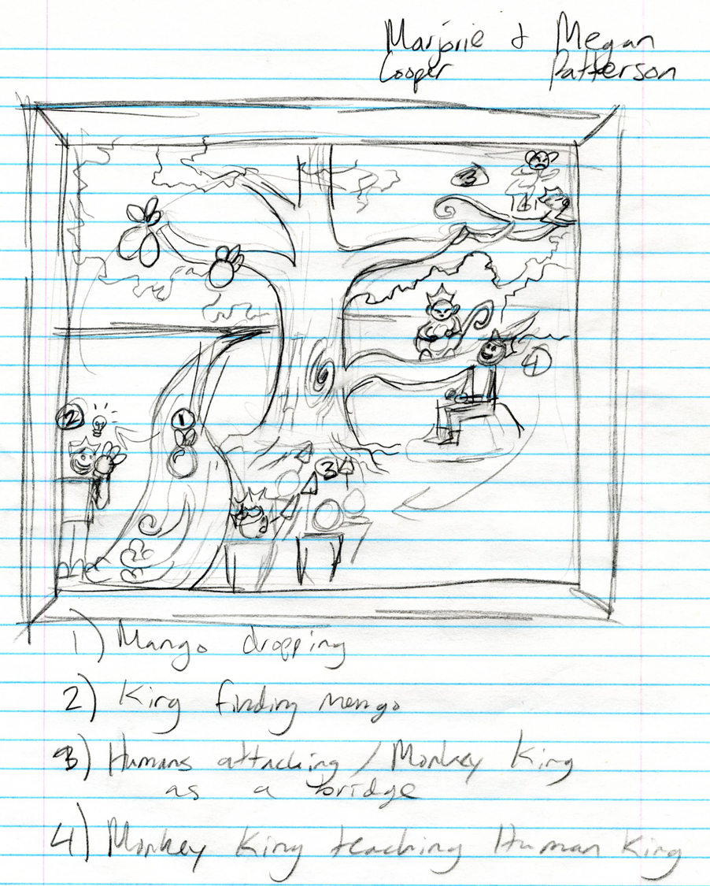

Slide 35
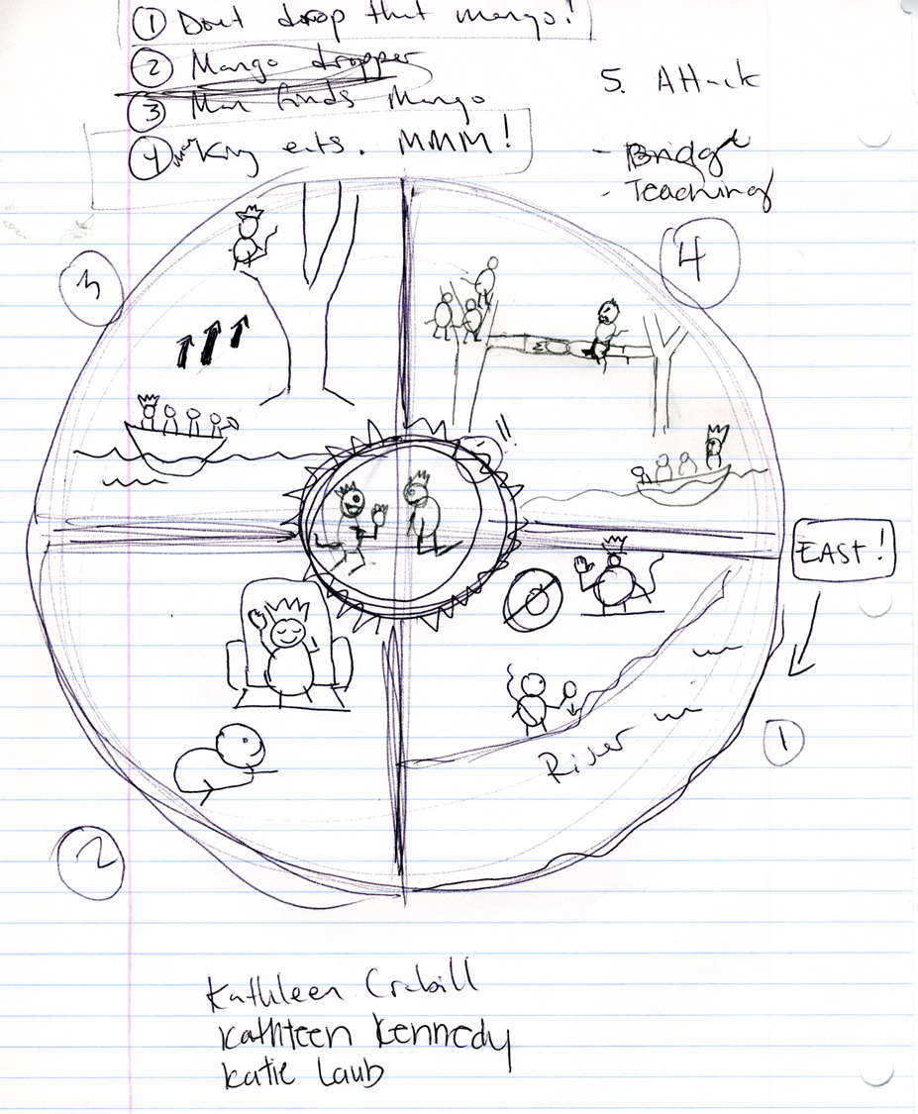

Slide 36
Notes:
Monkey jataka sculpture

Slide 37
Himalayan Buddhism: Nepal, Tibet, Bhutan, Mongolia Tantric Buddhism Vajrayana (Diamond Path)

Slide 38
Notes:
"Among this people, too, you find the best enchanters and astrologers that exist in all that quarter of the world; they perform such extraordinary marvels and sorceries by diabolic art,"

Slide 39
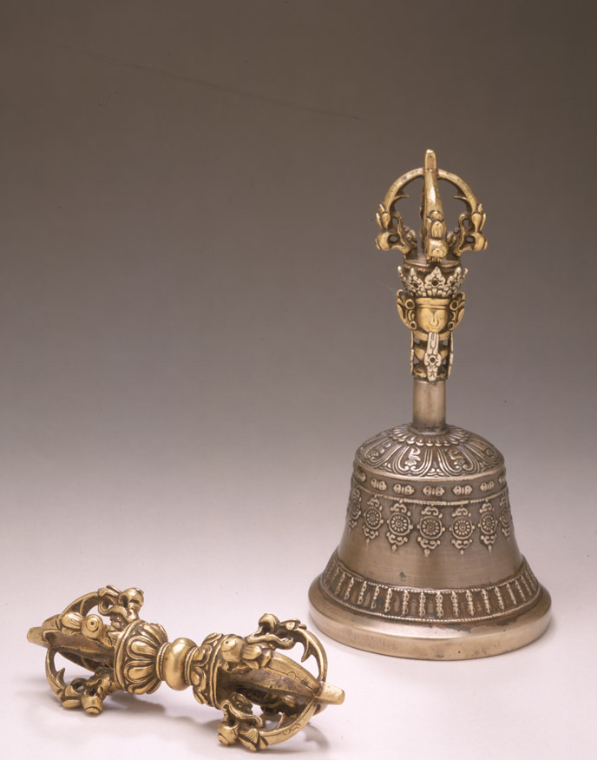
Vajra
&
Bell
METAPHOR
Language of symbols

Slide 40
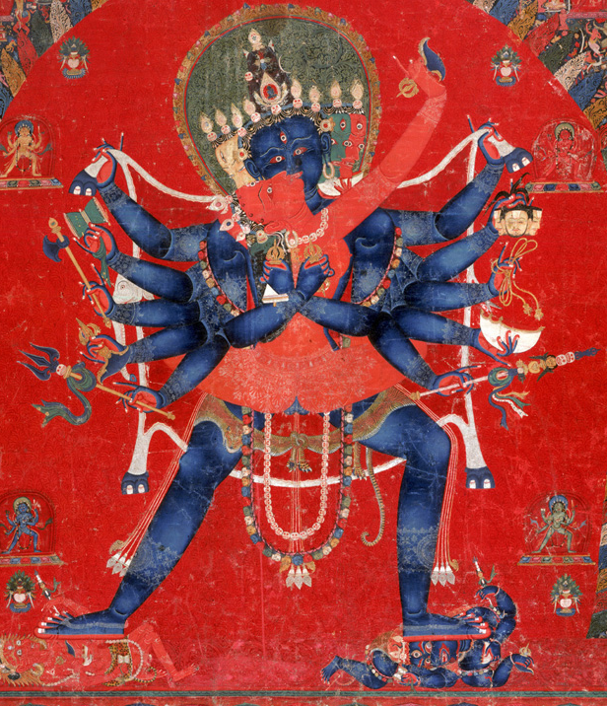
Notes:
Wisdom (female) & compassion (male)

Slide 41
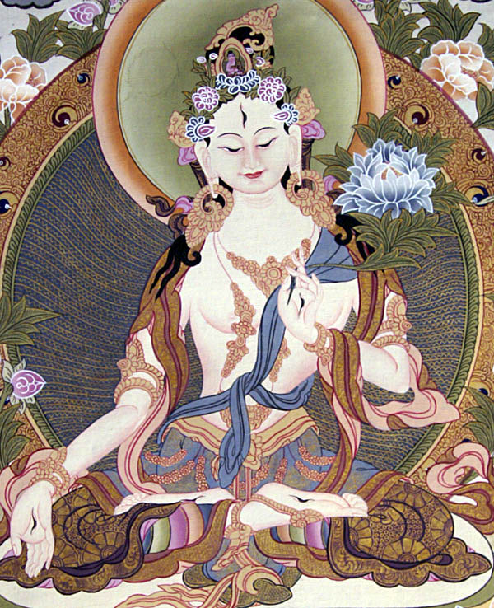
The all compassionate White Tara, with one face and two arms.
Her right hand holds a blue lotus. Youthful, she is adorned with all the marks of a Buddha and is endowed with seven eyes.

Slide 42
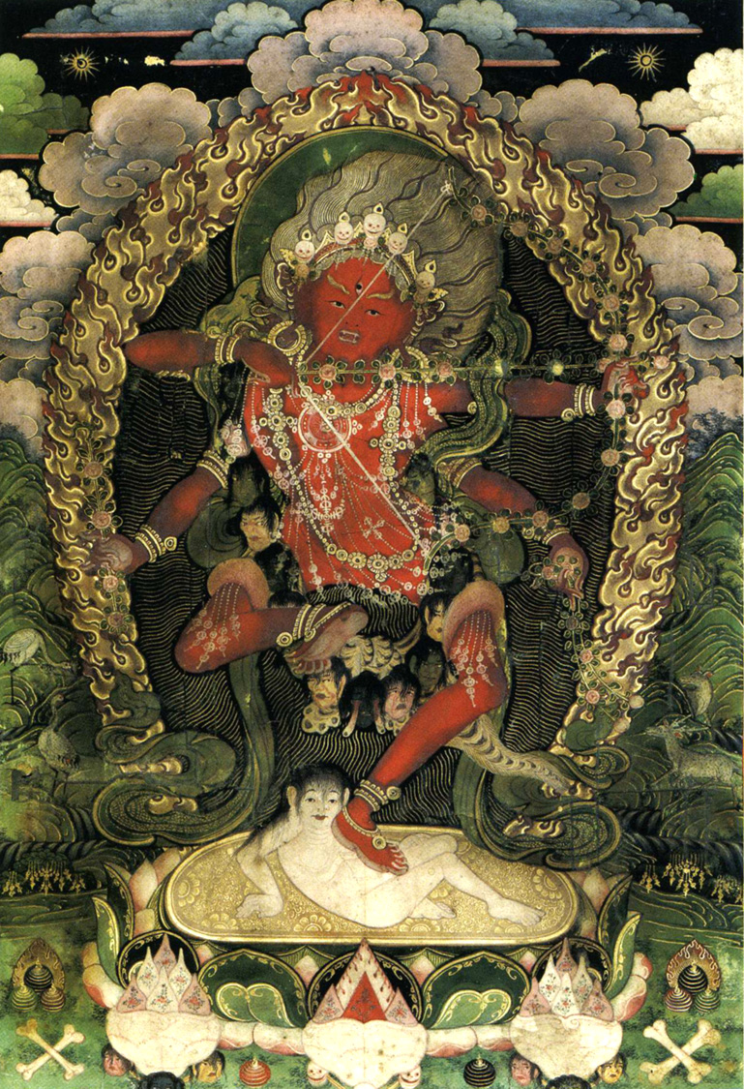
Scary images are to scare away evil or to scare an individual into avoiding bad actions.

Slide 43
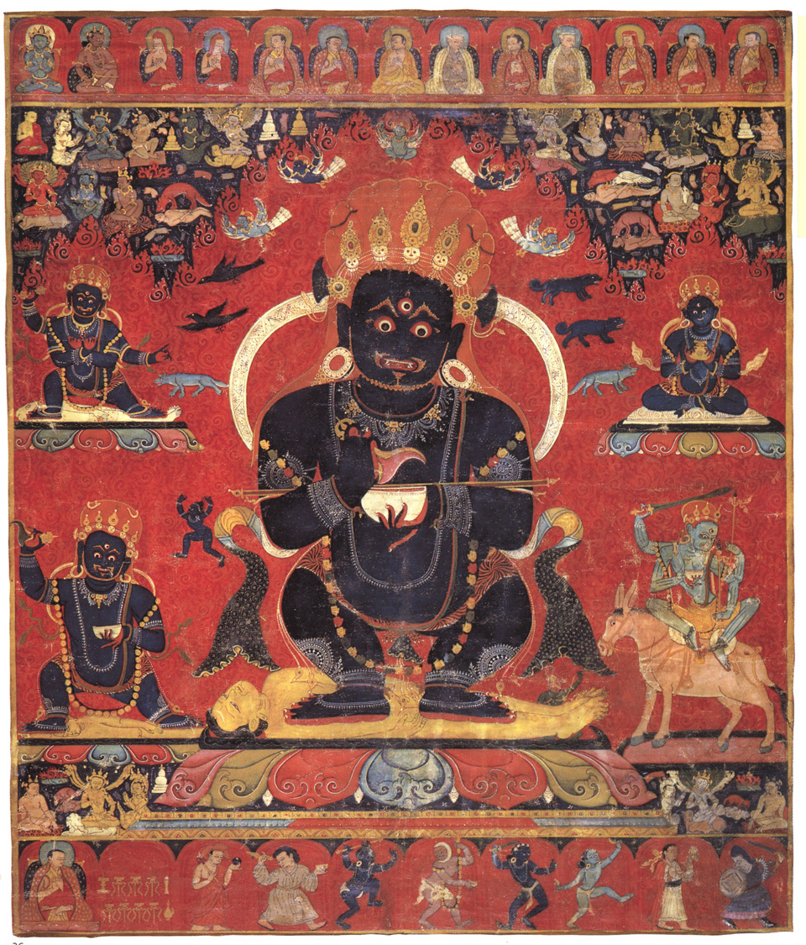
Notes:
Bodhissattva of COMPASSION: form of compassion WRATHFUL

Slide 44
ART AND PRACTICE
1. Mudra: gestures : Body
2. Mantra: Speech (om mani padme hum)
3. Mandala (“circle”): meditational tool

Slide 45
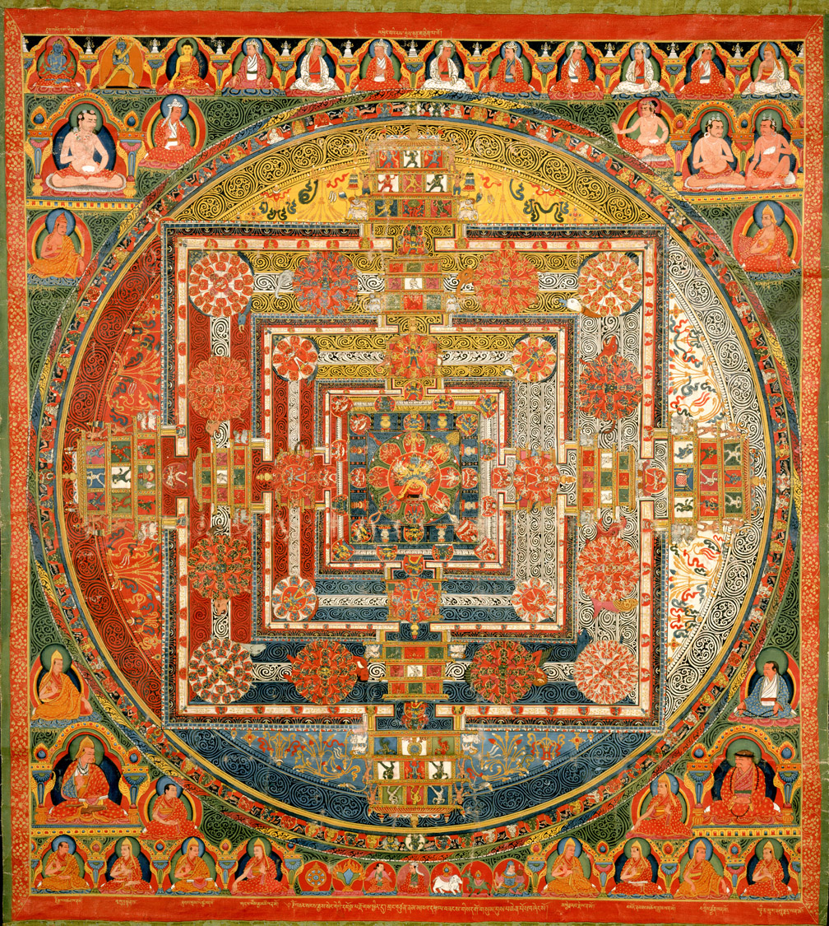
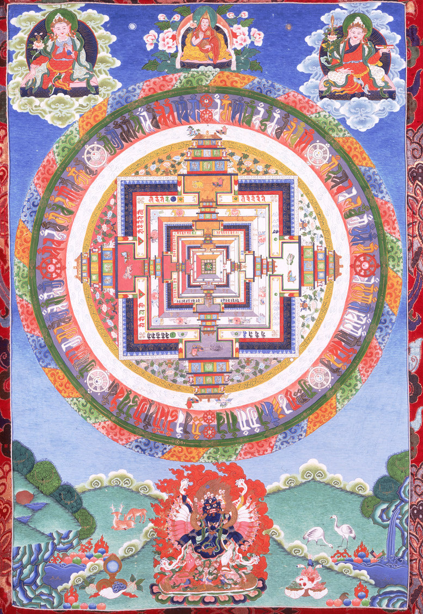
What do mandalas have in common?

Slide 46
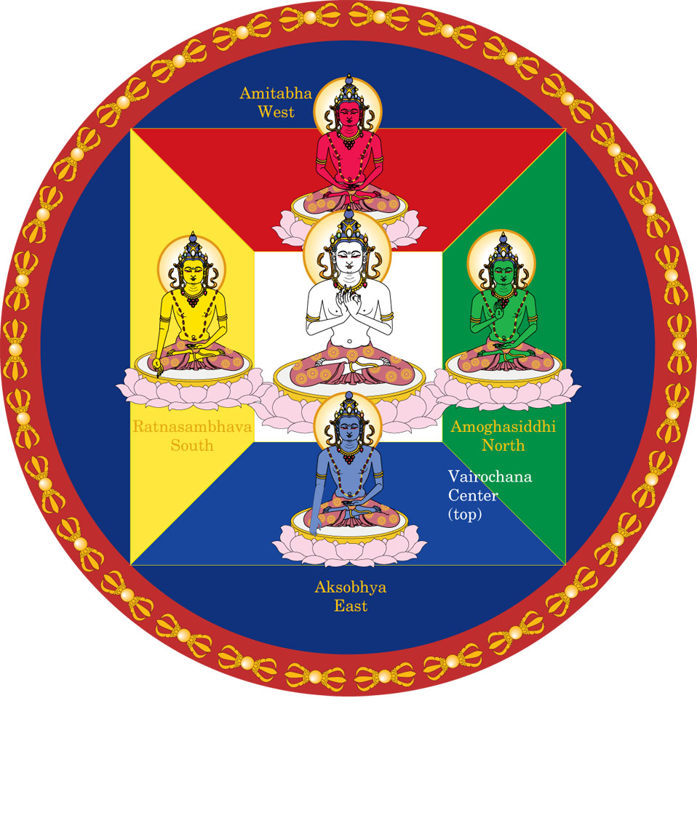
Mandala of the Five
Buddhas
These Buddhas
Illustrate the process
Of Enlightenment

Slide 47
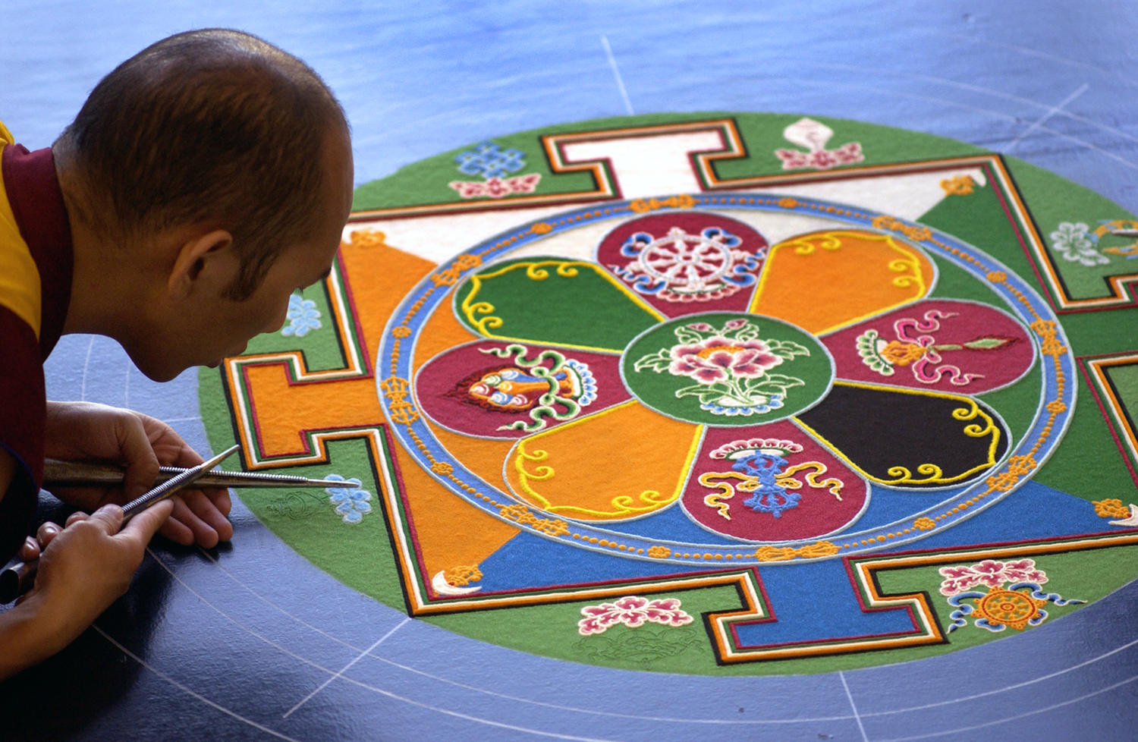
Notes:
Temporary mandala made of colored sand.

Slide 48
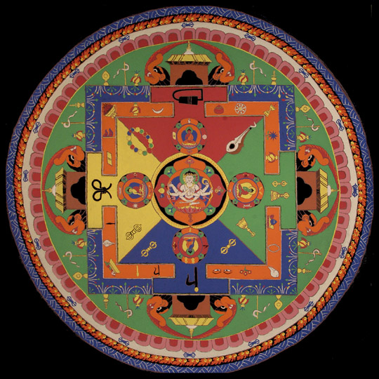
Notes:
completed sand mandala

Slide 49
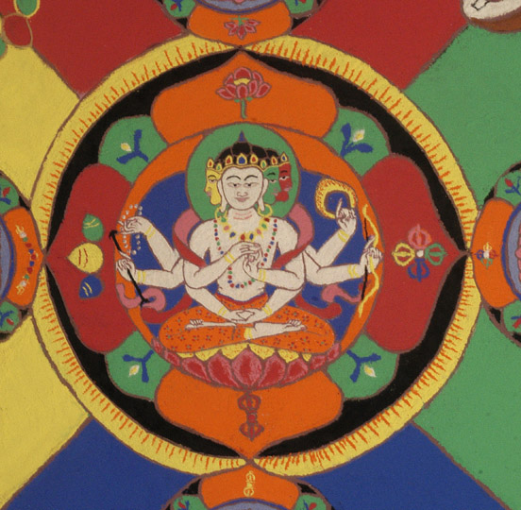

Slide 50
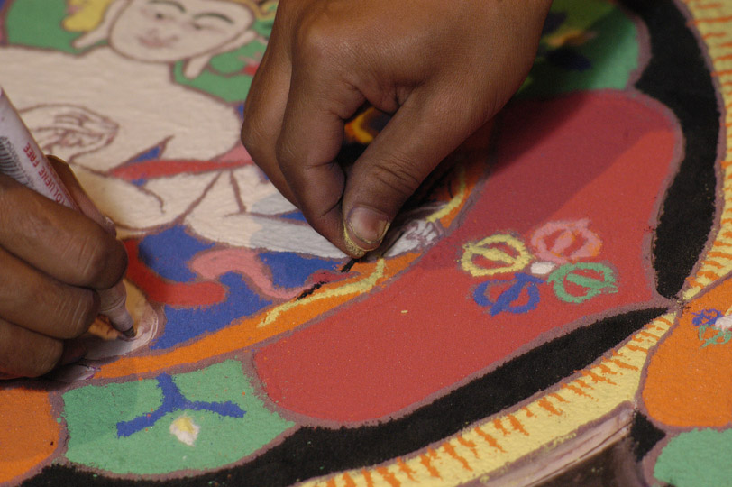

Slide 51
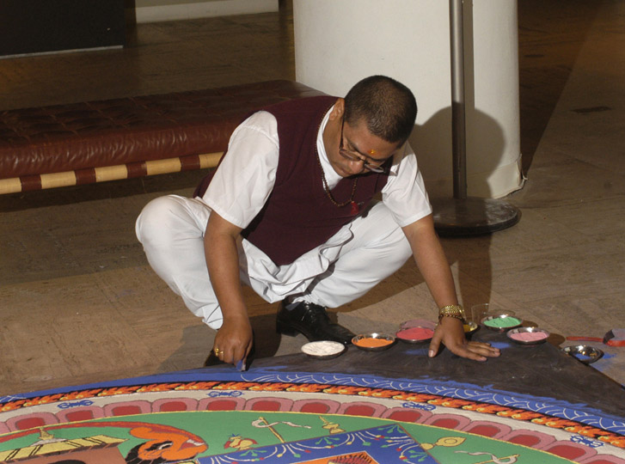

Slide 52
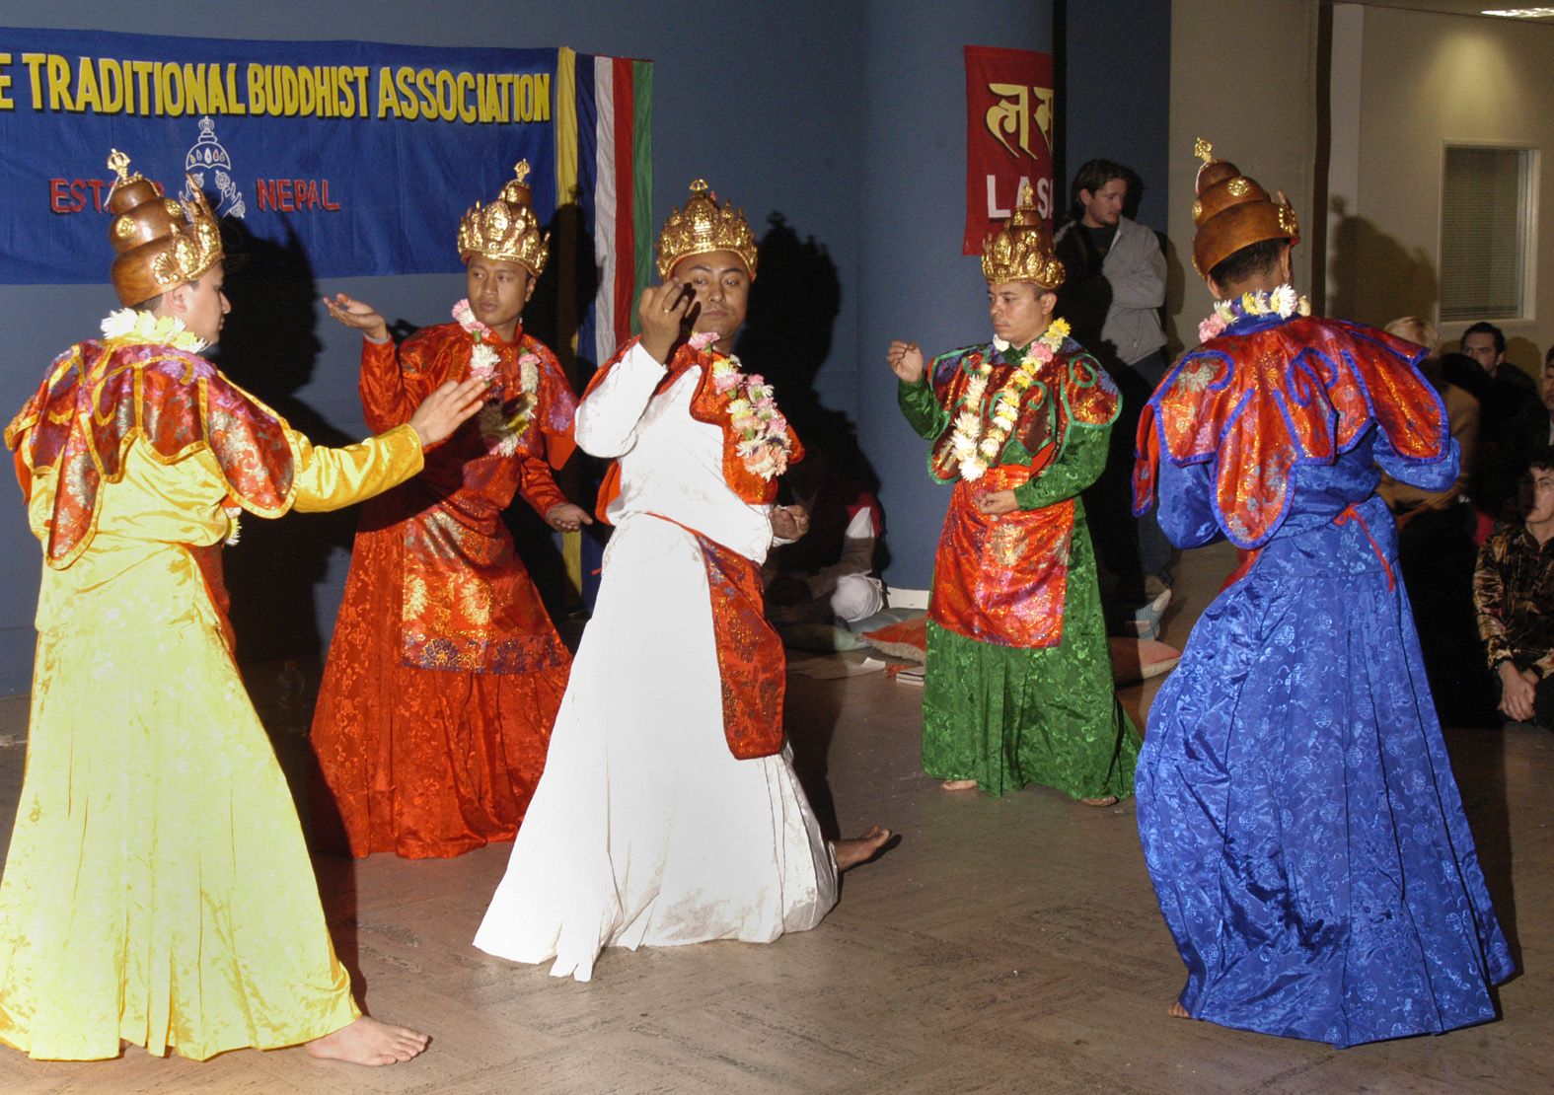

Slide 53
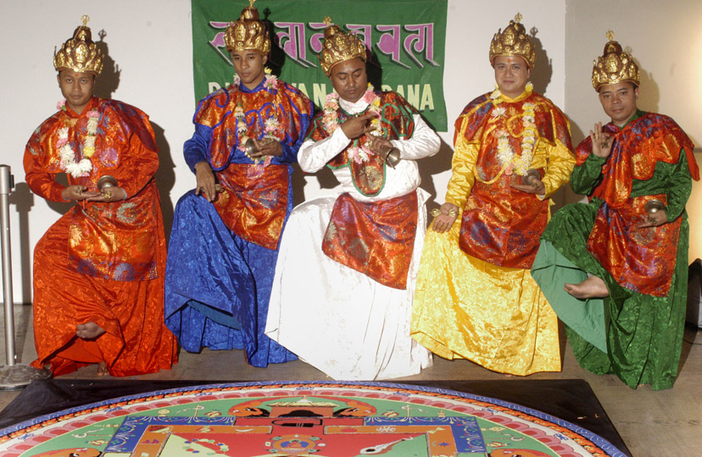

Slide 54
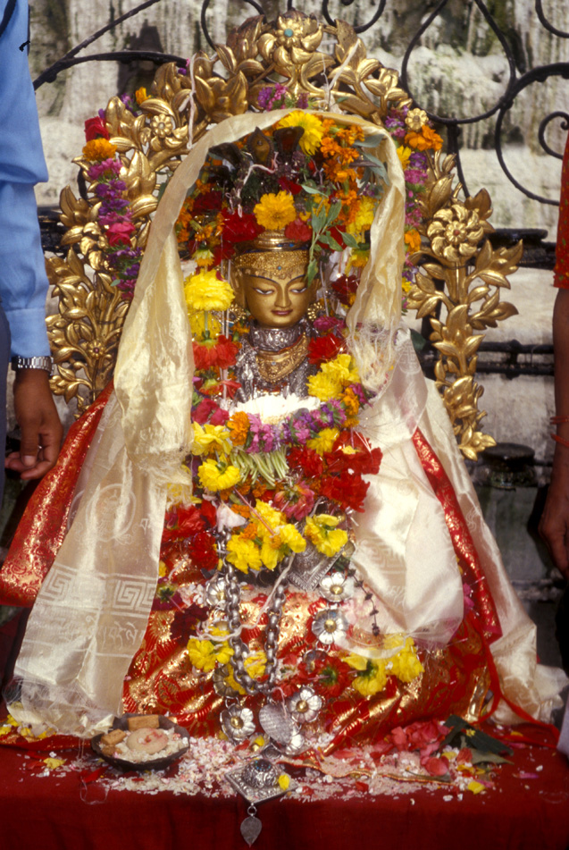
Art object to Divine object
Notes:
In museums, the statues are sterile but in Buddhist and Hindu countries, they are clothed and decorated, and butter and sometimes animal blood are poured on them. The statues are washed frequently and once a year or so they are taken down and refinished. The idols are not idle!

Slide 55
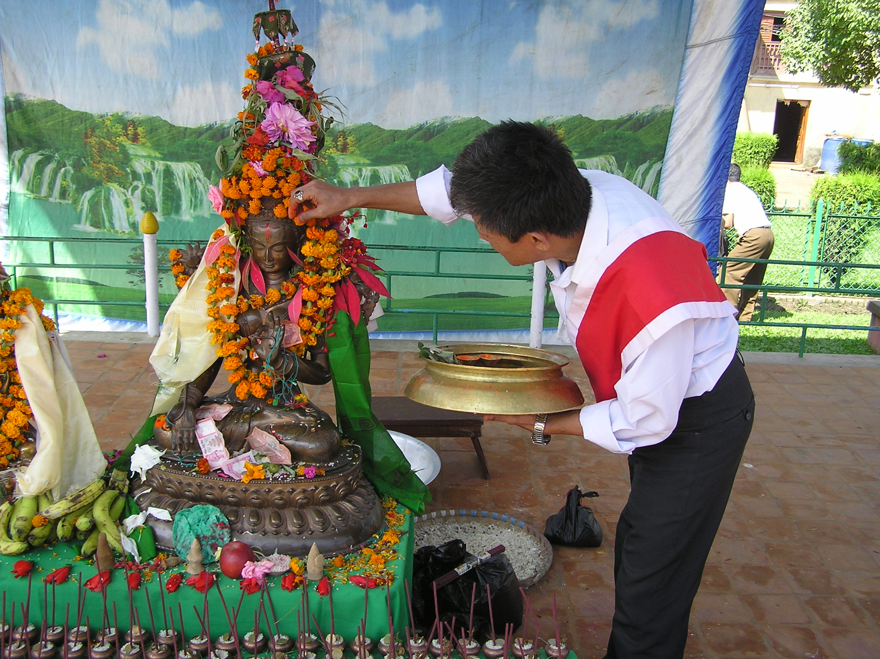
Notes:
55
55

Slide 56
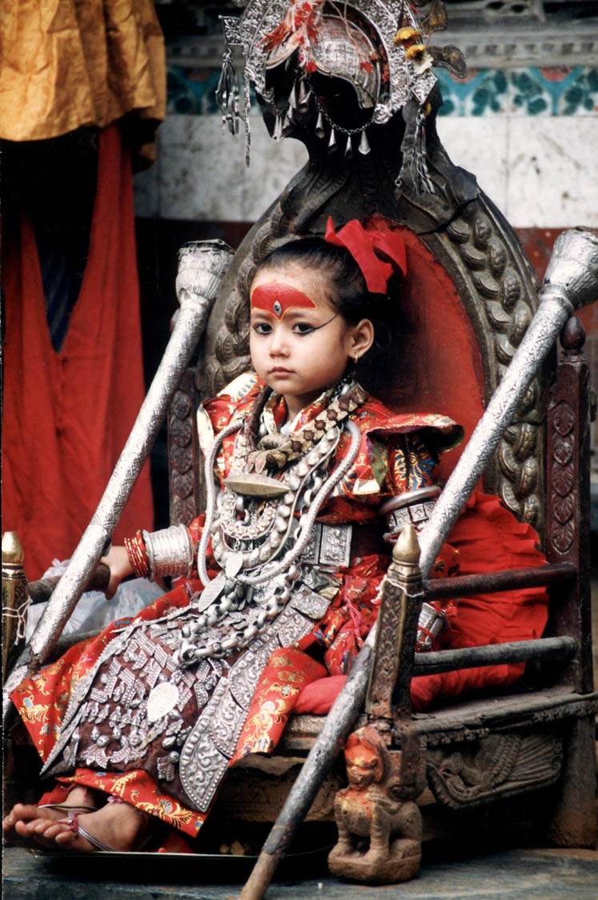
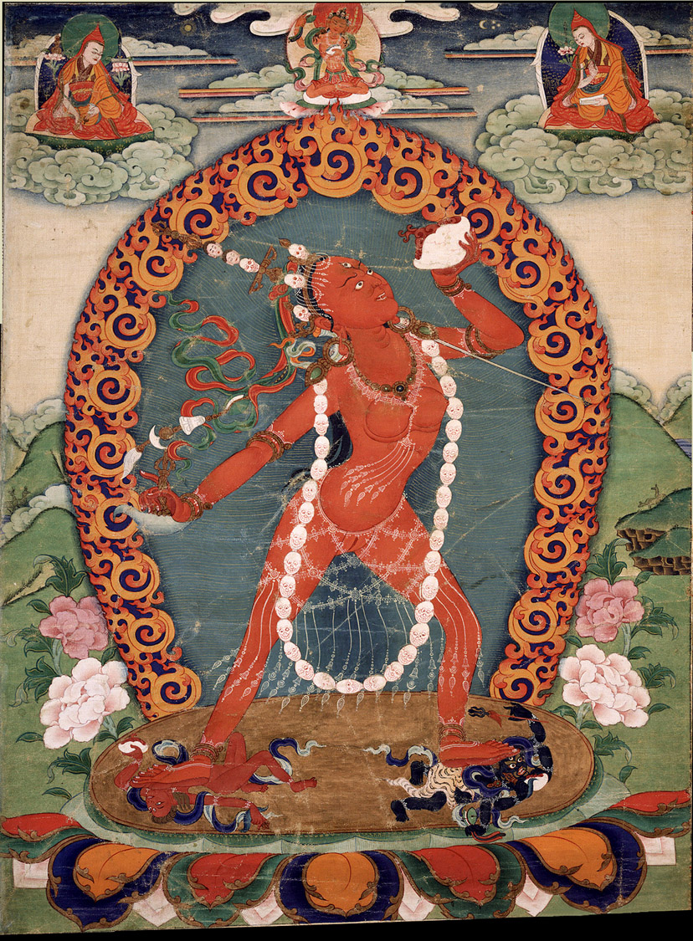
Kumari,
Notes:
Living goddess. She gets to be a normal child when she is not participating in a ritual.

Slide 57
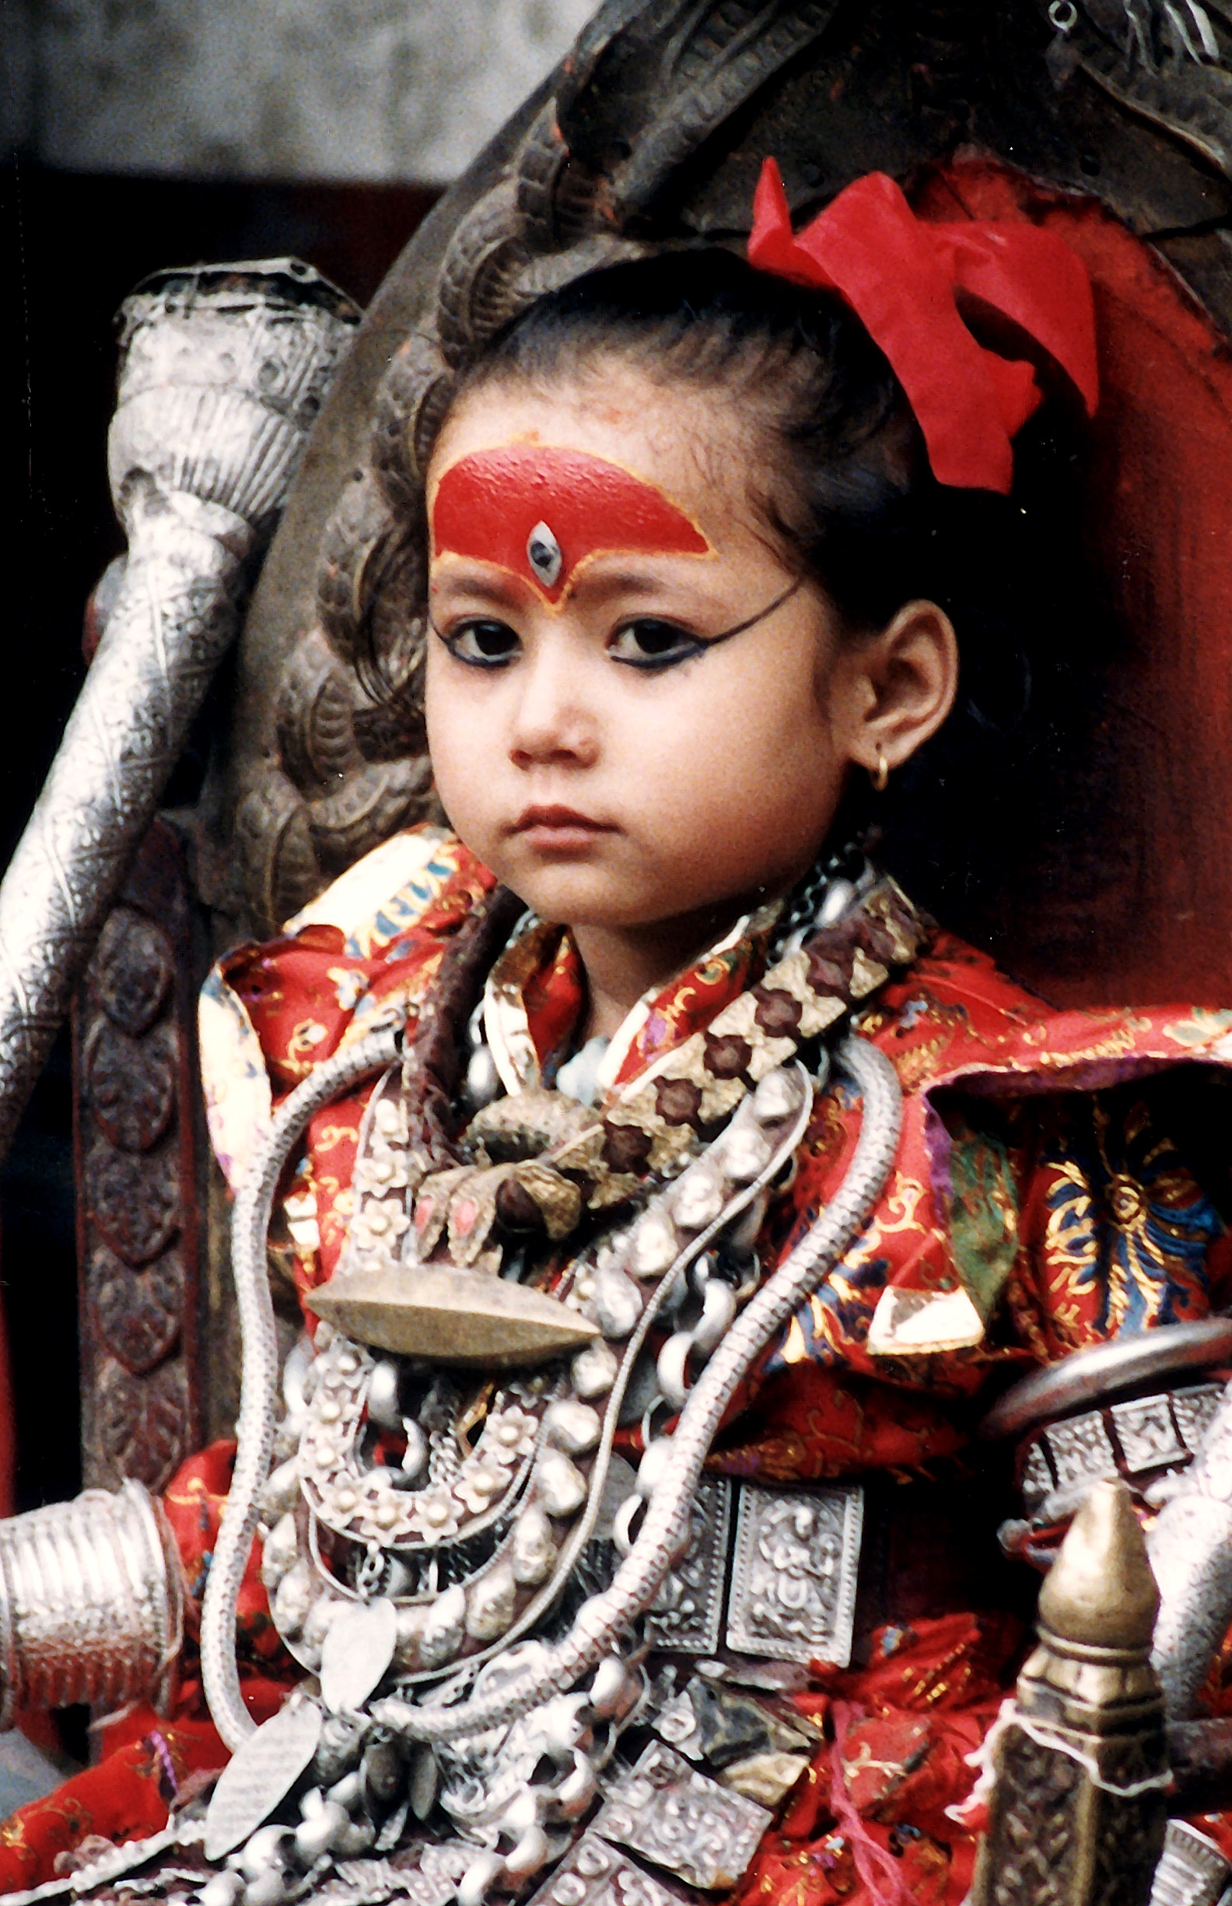
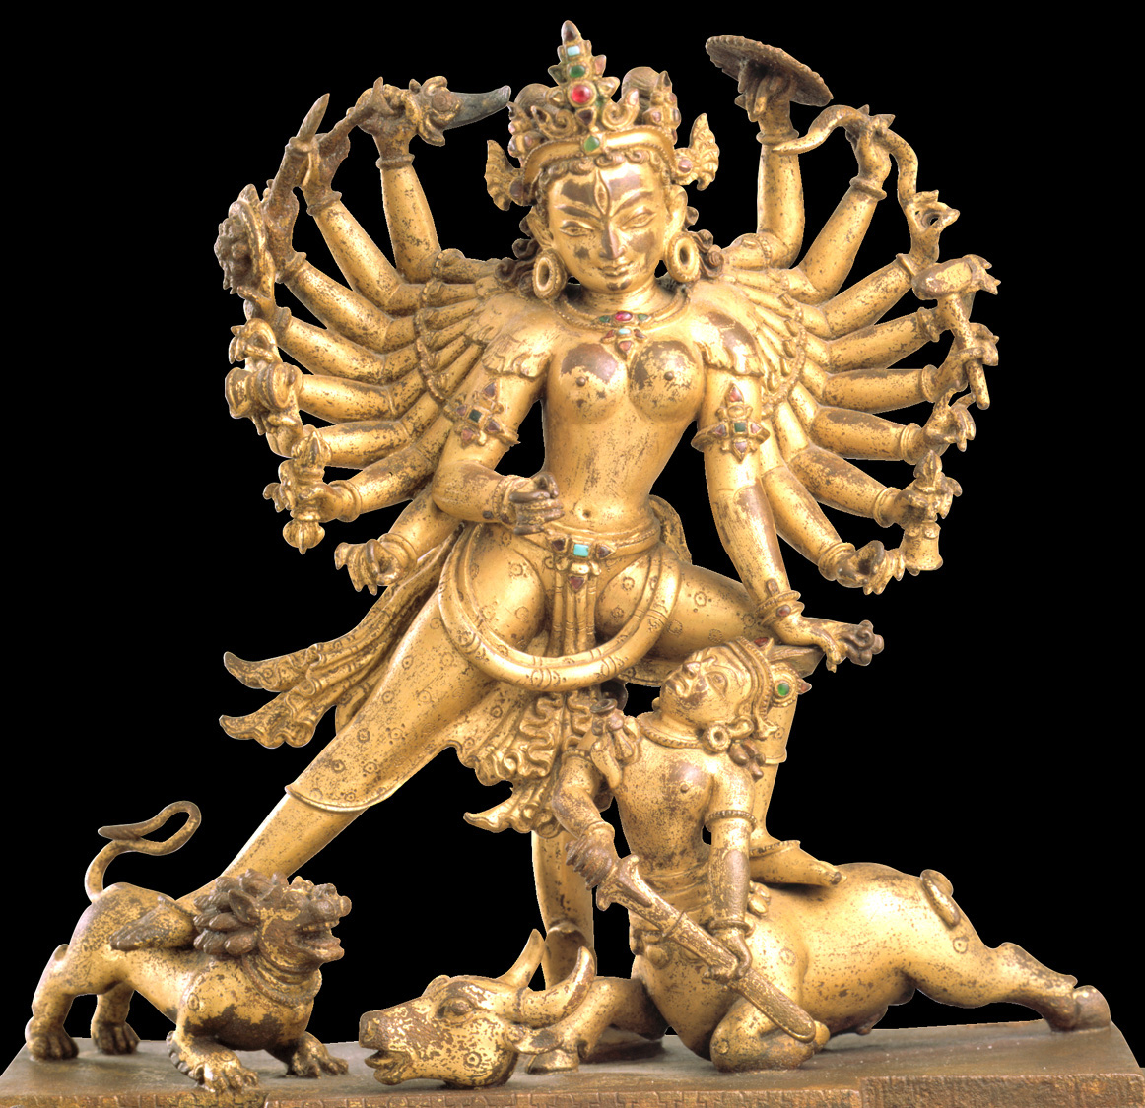

Slide 58
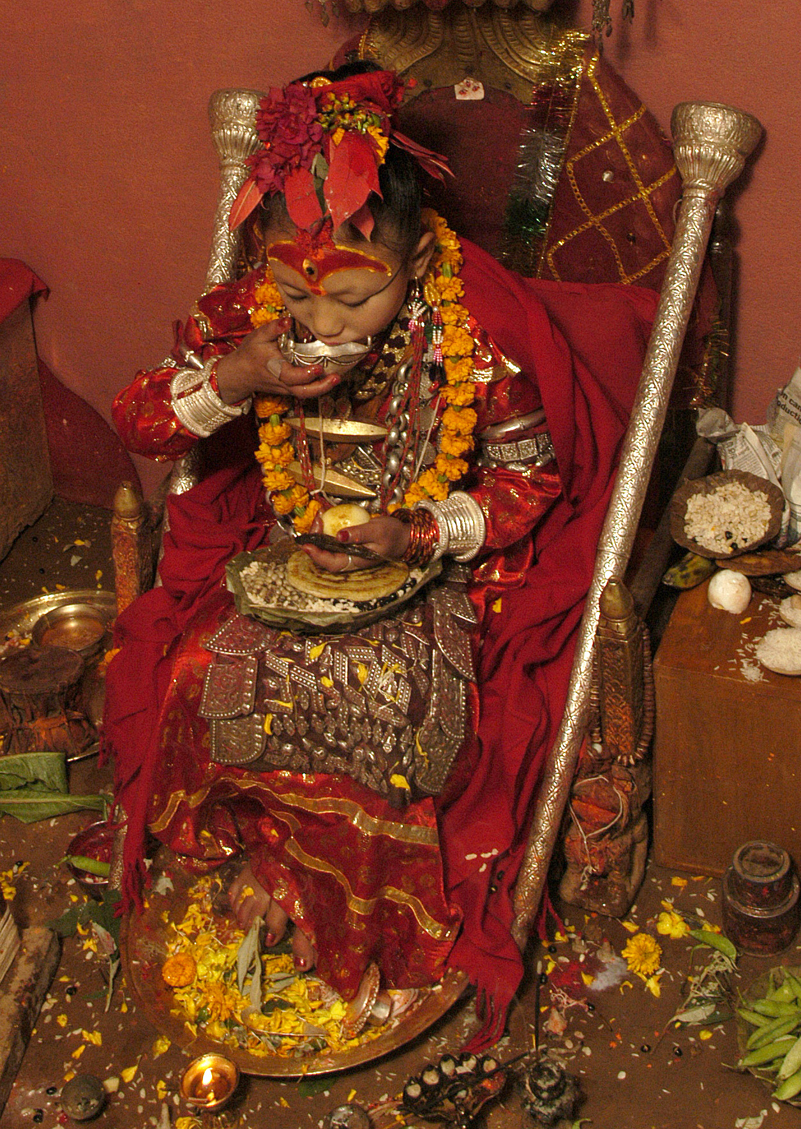
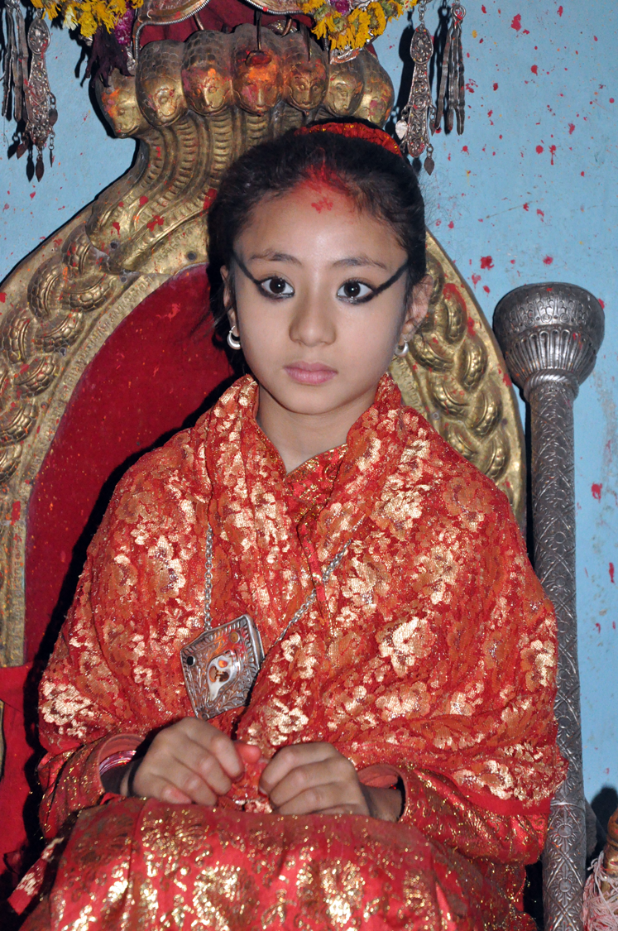

Slide 59
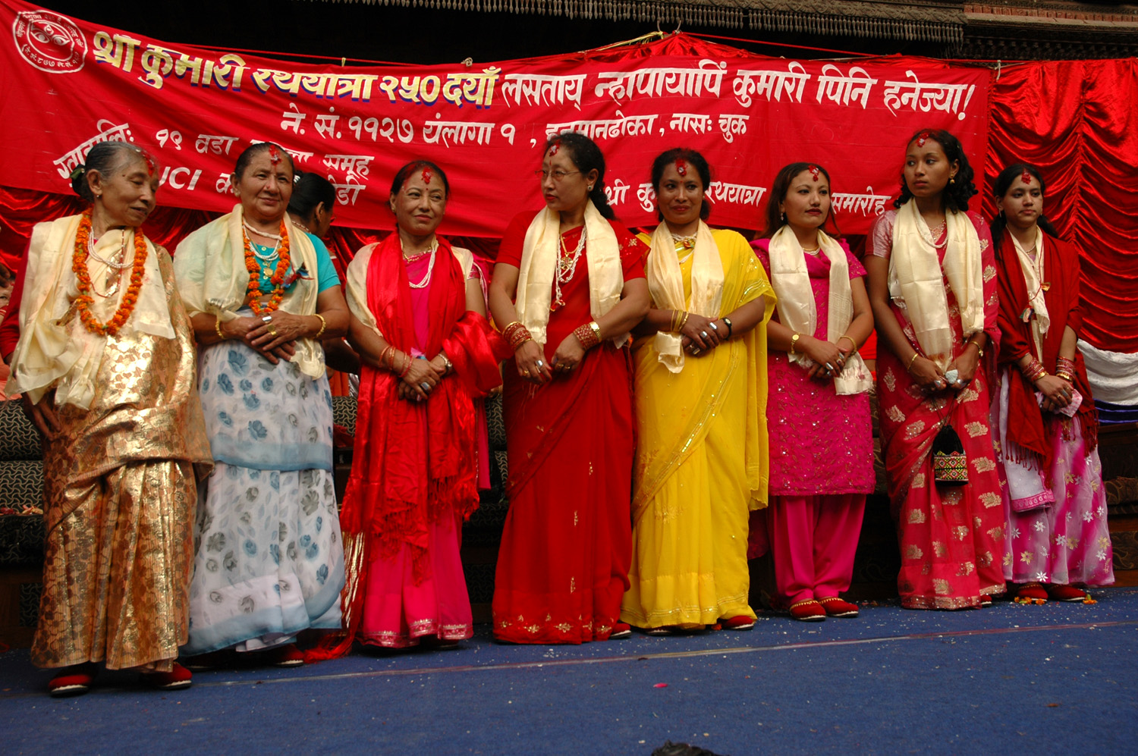
Honoring the Ex-Kumaris
Notes:
Previous living goddesses

Slide 60
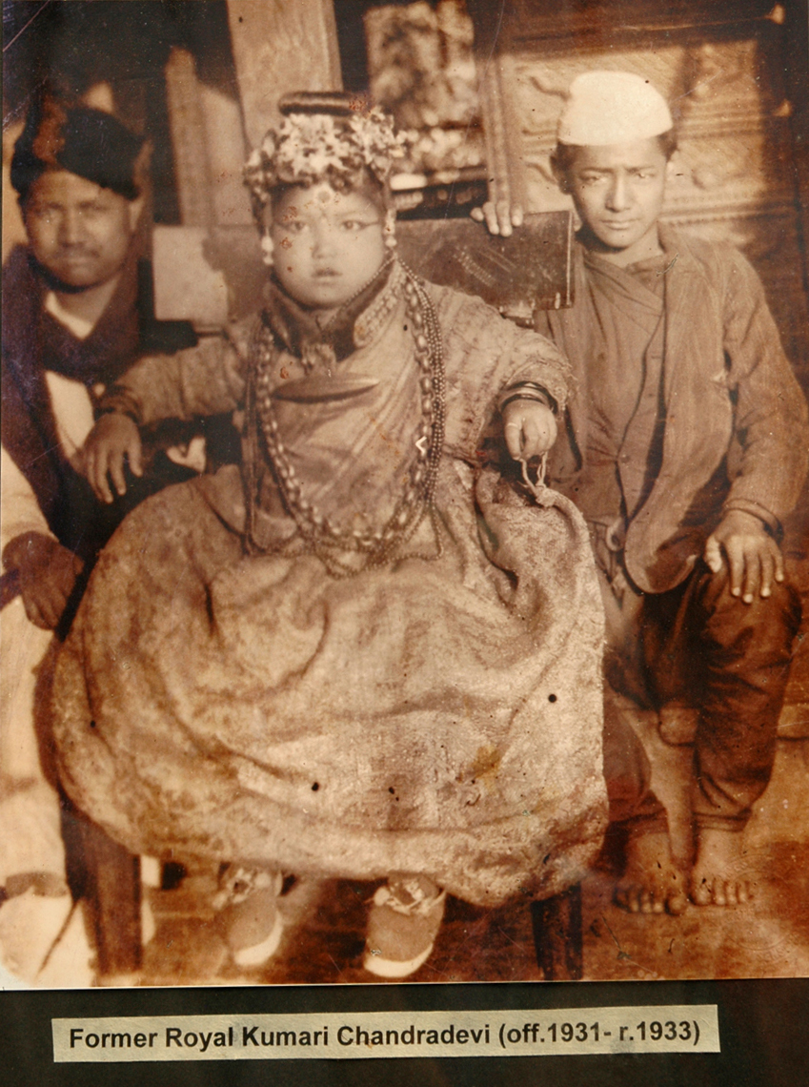
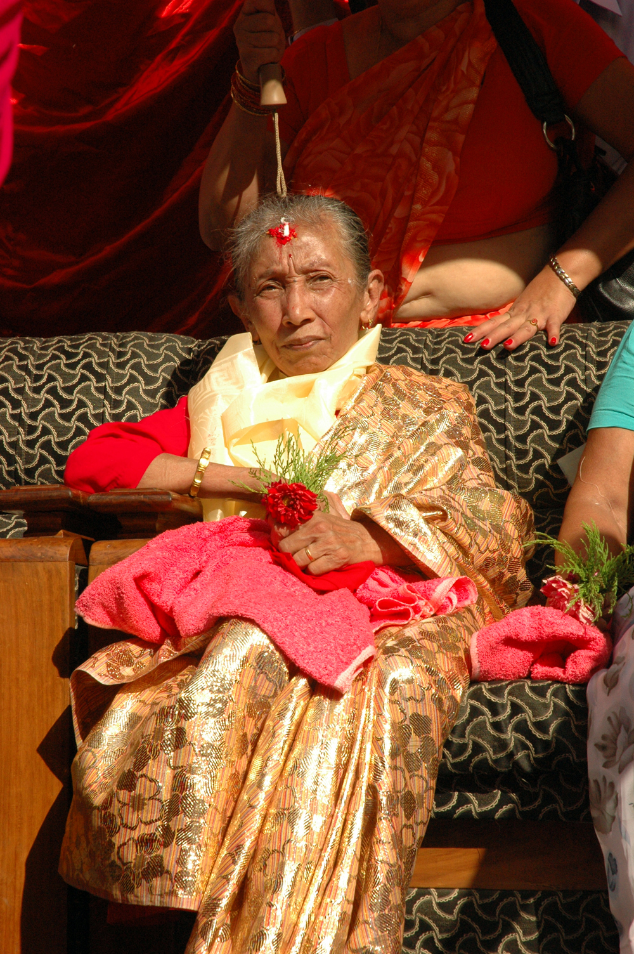

Slide 61
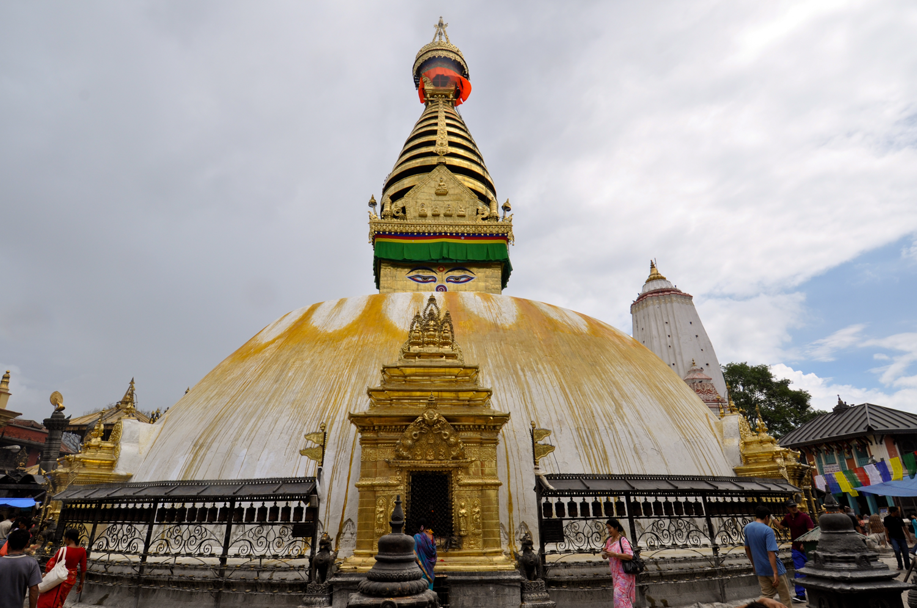
Notes:
Stupa (shrine of a characteristic shape, with relics inside)

Slide 62
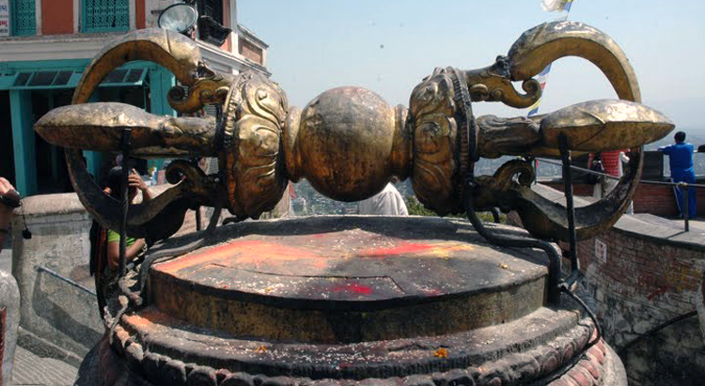
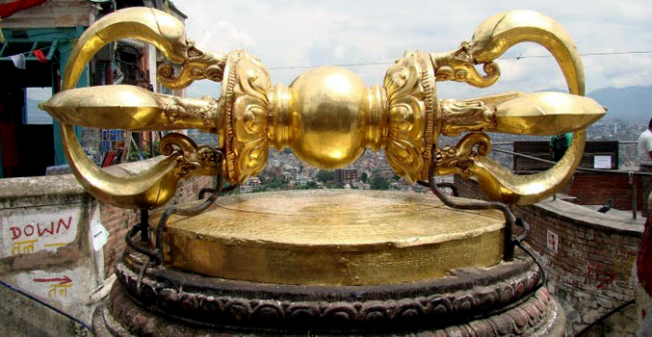
Notes:
giant vajra, before and after refinishing . . .

Slide 63
Notes:
And after being put back in service

Slide 64
Notes:
Art and practice are closely intertwined! In the west we think of Buddhism being mainly silent meditation, but in the Himalayas the practice of Buddhism is full of rituals related to art forms.

