Slide 1
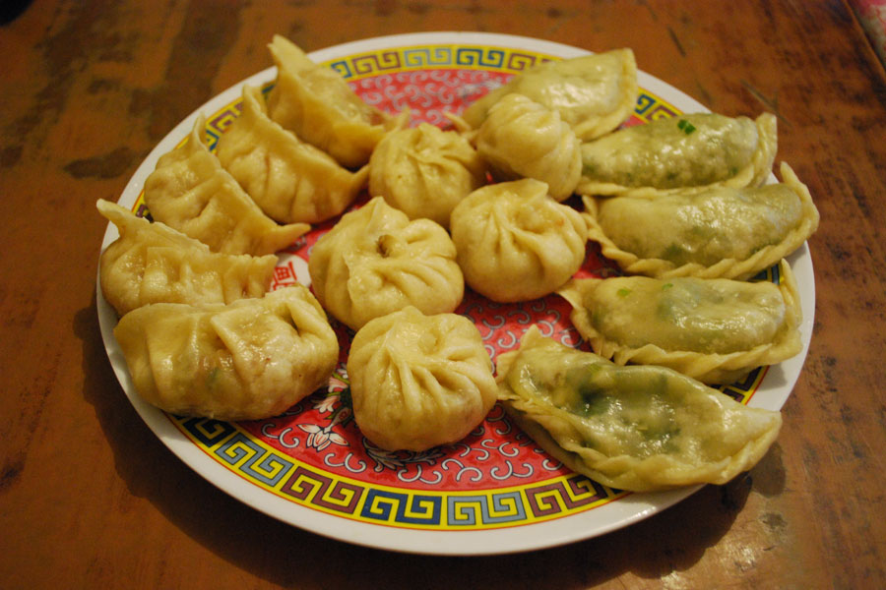
Food

Slide 2
Making Momos (dumplings)
Below is a tasty recipe for making Nepalese momo. To make Tibetan momo, just remove the green vegetables. Bring in supplies and make the momos in class. The chemistry classroom should have hotplates for boiling the water.
Wrappers 2 cups of plain flour 3/4 cup of water
Filling 500g minced meat (buffalo or yak; pork is great if those are not available!) 4-6 spring onions 1 tbsp fresh crushed ginger 1 1/2 tbsp crushed garlic 1 1/2 tsp salt
Handful of fresh coriander/cilantro leaves 2 green chilies (remove seeds for less spice) 2 tsp garam masala 2 tbsp oil
Directions:
Finely chop all the filling ingredients and mix together. Mix the wrapper ingredients to make a dough. Roll the dough and make circles 6-10 cm across.
Place a dollop of mixture in the middle of each circle and wet the edges to glue easier. Stick the sides together strongly to stop leakage. Pleat if capable!
Boil a pan of water with a steaming pot on top. Oil the steaming pot to stop sticking. Place a few momo into the steamer and steam for 5-7 minutes.
Serve with a tomato and coriander sauce!
http://www.himalayanlearning.org/the-himalaya/food-momo.php July 27, 2011

Slide 3
Make momos while listening to Tibetan music
For more detailed momo instructions, see:
http://www.yowangdu.com/tibet/tibetan-food-recipes/tibetan-dumplings.html

Slide 4
Share a Tibetan meal
Prepare a signup sheet with a list of the foods in the Tibetan meal file, and have the students sign up several days ahead of time.
Have each student prepare one food and bring it to class.
Supply the Tibetan tea, plates, cups, serving utensils, etc.

Slide 5
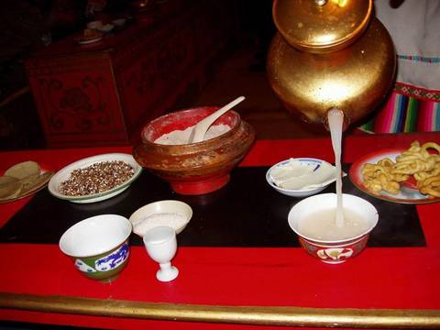
http://www.bing.com/images/search?q=Tibetan+meal&view=detail&id=1AC98D3CE41ECFEB926D706EB78D5C96B830CBB7&first=0&FORM=IDFRIR July 28, 2011

Slide 6
Students read the first section of the “Food in Tibetan Life” article. Then they all put their names in a hat and draw out someone else’s name. Each student then thinks of an appropriate nickname for the student whose name he or she drew. The name should have to do with how the person looks or acts, or something unusual that happened to them.

Slide 7
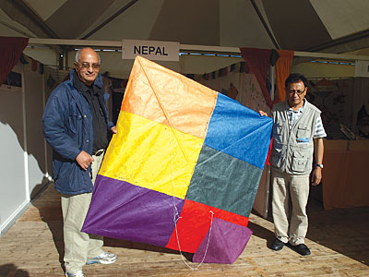
Make kites and fly them:
http://www.my-best-kite.com/how-to-make-a-kite.html
http://www.bing.com/images/search?q=Nepali+kite&view=detail&id=4151C2F74F45A51CD32FAC82DFAD138051CF1E1E&first=0&FORM=IDFRIR July 28, 2011

