Slide 1
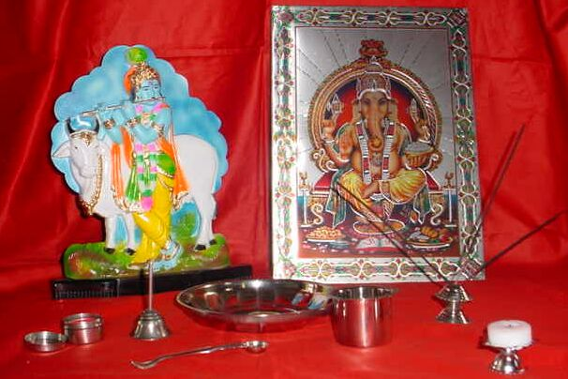
The Hindu home shrine http://www.ngfl-cymru.org.uk/vtc/ngfl/re/m_parry_carmarthenshire/arteffactau/cysegrfa.htm
Most Hindus have a small shrine in their home where they can worship daily.
This worship is called puja.
Modified by N. Power

Slide 2
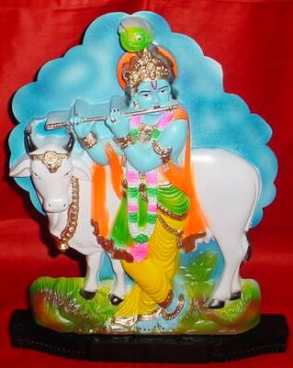
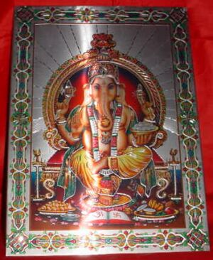
Murti (images) of gods
Lord Krishna
Lord Ganesh

Slide 3
Murtis: images of deities
The shrine will contain at least one image, called a murti, of their gods, for example, Lord Ganesh or Lord Krishna. These images help the Hindu to focus on different aspects of God.
- Murtis help Hindus to think about God when they worship.
- Showing love and respect towards the murtis is a way of showing devotion and love to God.
- Murtis have details that remind the devotees of the stories of the gods. This was especially important when most of the population was illiterate.

Slide 4
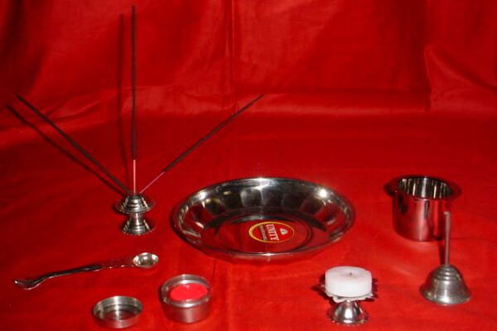
Objects Used in Puja

Slide 5
Objects used in puja
Besides images, each shrine also has a puja tray which holds seven items used in devotion. They help the Hindu to use all their senses when they worship, as a symbol that the whole person is taken up with the devotion.

Slide 6
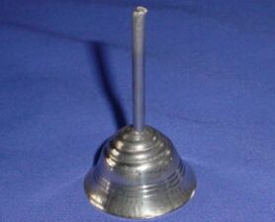
Bell
Worshippers will ring the bell to let God know that they have come to worship and to invite him into the home.

Slide 7
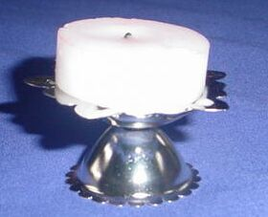
Diva Lamp
Worshippers will light the lamp and move it around in circles to bring light to the shrine. This light is a symbol of God’s presence.

Slide 8
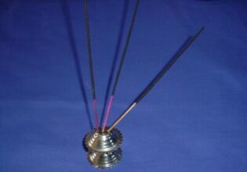
Incense holder
& incense
(joss sticks)
Worshippers will light an incense stick and move it around the shrine in circles. This purifies the air and brings a pleasing aroma to the shrine for the gods.

Slide 9
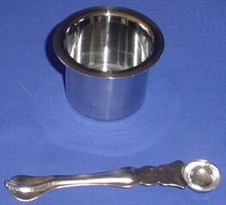
Water container and spoon
Worshippers will offer water to the gods on a spoon. This is to show respect to the gods. Traditionally in India, people welcome a guest into the house by offering them water to drink and to wash. At the start of the day, the mother of the household will wash the murtis – again to show devotion and respect to them.

Slide 10
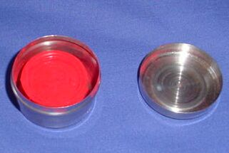
Container of kum kum powder
Worshippers will make a paste out of the red kum kum powder. They use this to make a mark on the forehead of the images. This is again a sign of respect and devotion to the gods. They will also make a mark on their own forehead as a sign that God has blessed them.

Slide 11
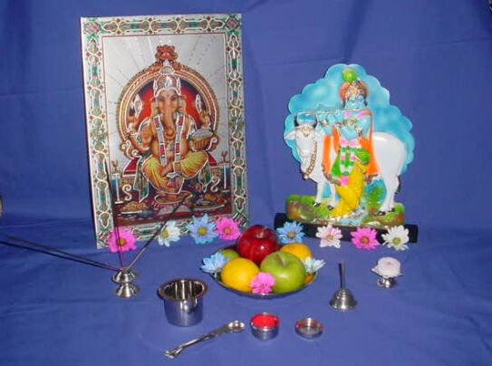
Prashad
Worshippers offer food (e.g. fruit and rice) and flowers at the shrine for the gods to bless. This blessed food is called prashad. It is later eaten by the worshippers.

