Slide 1
Hinduism
http://religions.pppst.com/hinduism.html
Modified by N. Power
What is Hinduism?

Slide 2
What is Hinduism?
One of the oldest religions of humanity
The religion of the Indian people
Gave birth to Buddhism, Jainism, Sikhism
Tolerance and diversity: "Truth is one, paths are many"
Many deities but a single, impersonal Ultimate Reality
A philosophy and a way of life – focused both on this world and beyond

Slide 3
Hinduism is an open religion:
Always being changed and added to.
No hierarchy or leaders to say what is orthodox and what is heresy.
Each person may live it out in their own way.

Slide 4
How did Hinduism begin?
No particular founder
Indus River Valley Civilization >5000 years ago
Aryans enter 4000 - 3500 years ago
Vedic Tradition 3500 – 2500 years ago:
rituals and many gods (polytheism)
sacred texts (Vedas)
social stratification (caste system)
Upanishads (metaphysical philosophy) 2800 – 2400 years ago
Vedic Tradition develops into Hinduism

Slide 5
What are the Sacred Texts?
Shruti (“heard”) – oldest, most authoritative:
Four Vedas (“truth”) – myths, rituals, chants
Upanishads - metaphysical speculation
Plus other texts
Smriti (“remembered”) – the Great Indian Epics:
Ramayana
Mahabharata (includes Bhagavad-Gita)
Plus others

Slide 6
What do Hindus believe?
One impersonal Ultimate Reality – Brahman
Manifest as many personal deities
True essence of life – Atman, the soul, is Brahman trapped in matter
Reincarnation (Samsara)– atman traverses through different bodies till it finds liberation
Karma – the law of cause and effect; “you reap what you sow”
Ultimate goal of life – to release Atman and reunite with the divine, becoming as one with Brahman (Moksha)

Slide 7
How does Hinduism direct life in this world?
Respect for all life – vegetarian
Human life as supreme:
Four “stations” of life (Caste) - priests & teachers, nobles & warriors, merchant class, servant class
Four stages of life – student, householder, retired, renunciant
Four duties of life – pleasure, success, social responsibilities, religious responsibilities (moksha)

Slide 8
What are the spiritual practices of Hinduism?
The Four Yogas - seeking union with the divine:
Karma Yoga – selfless service
Jnana Yoga –knowledge (understanding the true nature of reality and the self)
Raja Yoga – meditation
Bhakti Yoga – devotion to the gods
Guru – a spiritual teacher, especially helpful for Jnana and Raja yoga

Slide 9
How do Hindus worship?
Bhakti Yoga is seeking union with the divine through loving devotion to manifest deities
In the home (household shrines)
In the Temples (priests officiate)
Puja – making offerings to and decorating the deity images
Darsan – eye contact with the deity
Prasad – eating of food that was offered to the deity

Slide 10
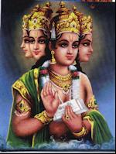
Who do Hindus worship? – the major gods of the Hindu Pantheon
Brahma, the creator god

Slide 11
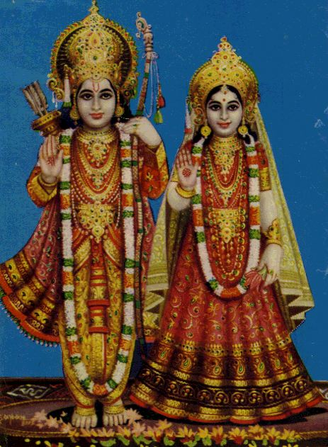
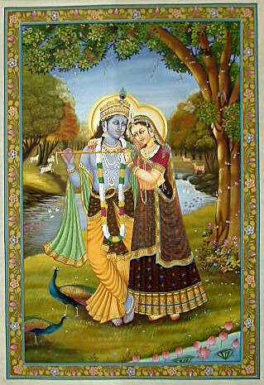
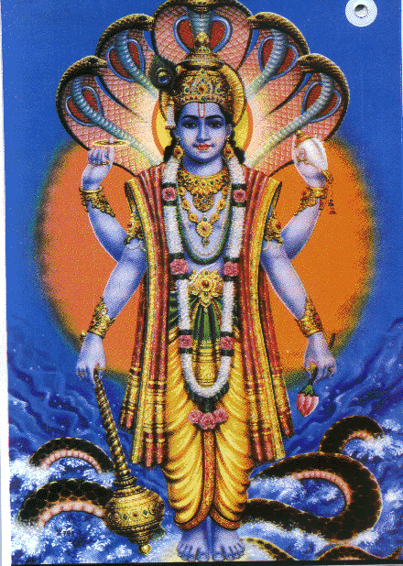
Who do Hindus worship? – the major gods of the Hindu Pantheon
Vishnu, the preserver god
Incarnates as ten avatars (descents) including:
Rama (featured in the Ramayana)
Krishna (featured in the Mahabharata)
(Each shown with his consort, Sita and Radha, respectively)

Slide 12
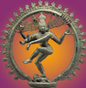
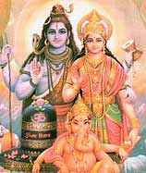
Who do Hindus worship? – the major gods of the Hindu Pantheon
Shiva, god of constructive destruction (the transformer)
Appears as Shiva Nataraj, lord of the dance of creation…
and with his wife, Parvati, and son Ganesha (the elephant headed remover of obstacles)

Slide 13
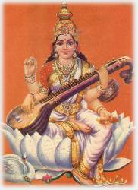
What about the goddesses? Devi – the feminine divine
Saraswati, goddess of wisdom, consort of Brahma

Slide 14
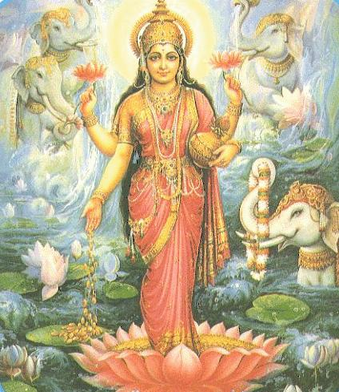
What about the goddesses? Devi – the feminine divine
Lakshmi, goddess of good fortune, consort of Vishnu

Slide 15
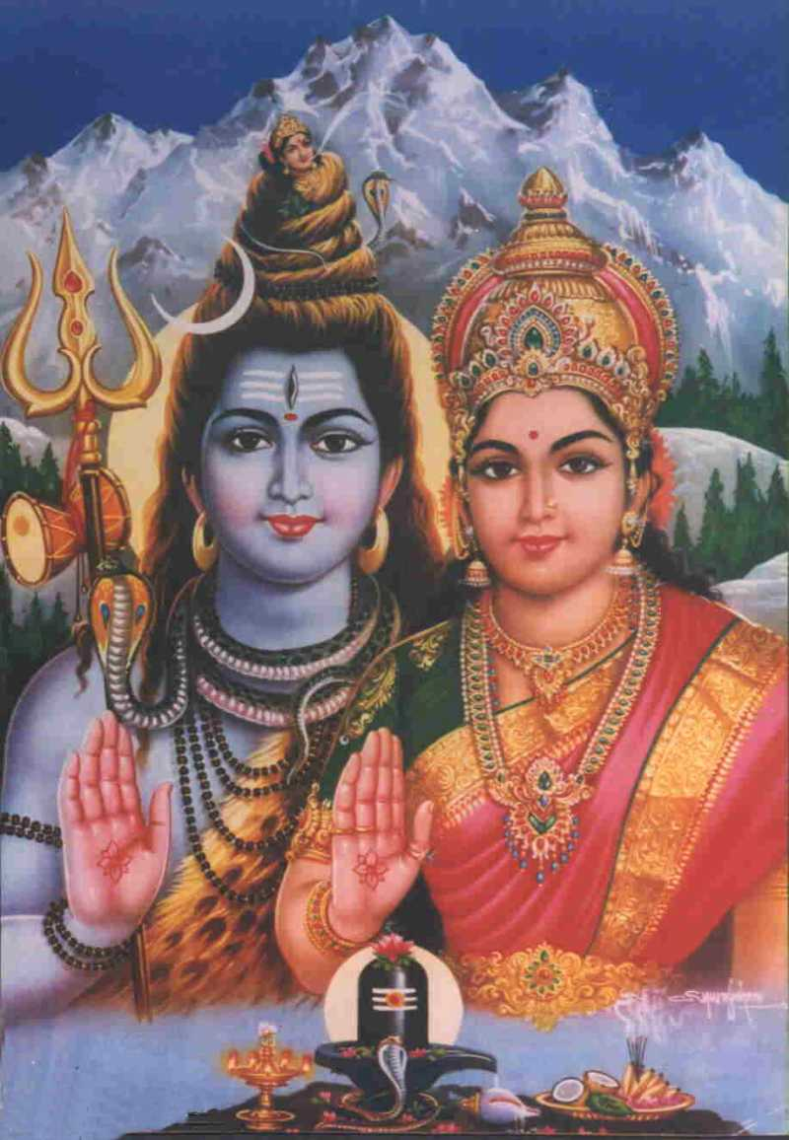
What about the goddesses? Devi – the feminine divine
Parvati, divine mother, wife of Shiva

Slide 16
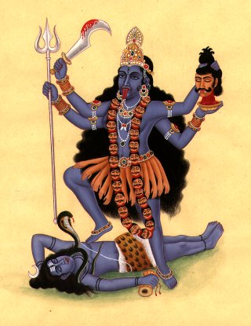
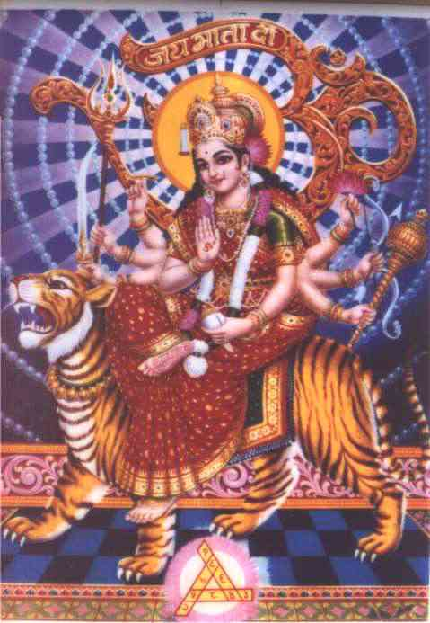
What about the goddesses? Devi – the feminine divine
Durga, protectress
Kali, destroyer of demons

Slide 17
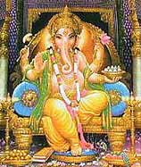
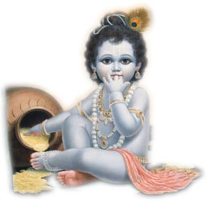
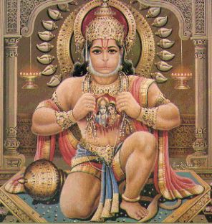
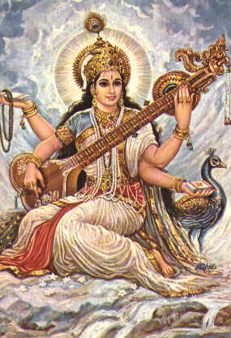
All these deities are but
Manifest forms (attributes
and functions) of the
impersonal Brahman

Slide 18
And we too are manifest forms of God!
“We are not human beings having spiritual experiences; We are spiritual beings having a human experience!”
“That art Thou”
Hinduism is about recognizing the all-pervasiveness of the divine

Slide 19
Pair share: How is Hinduism similar to your religion?
How is it different?

Slide 20
Hinduism in the Himalayas
northern India, in foothills of Himalayas
Nepal
Watch the video “The Red God” from Nepal

Slide 21
Explore Hinduism on the Web:
The Hindu Universe: Lots of information on Hinduism and the Hindu community on-line and around the world. Includes chat rooms and message board forums - www.hindunet.org
The Virtual Hindu Temple: Contains some interesting and useful pages including: Discover Hindu Gods & Goddesses and FREQUENTLY ASKED QUESTIONS ABOUT HINDUISM. Also contains a gallery of deity images and a collection of links to Hindu sacred texts online and other sites related to Hinduism - www.rajdeepa.com/vmandir/vmandirindex.htm
Hinduism for Schools provides basic, introductory info to teach primary and secondary level students about Hinduism - www.btinternet.com/~vivekananda/schools1.htm
Created by Laura Ellen Shulman

