Slide 1
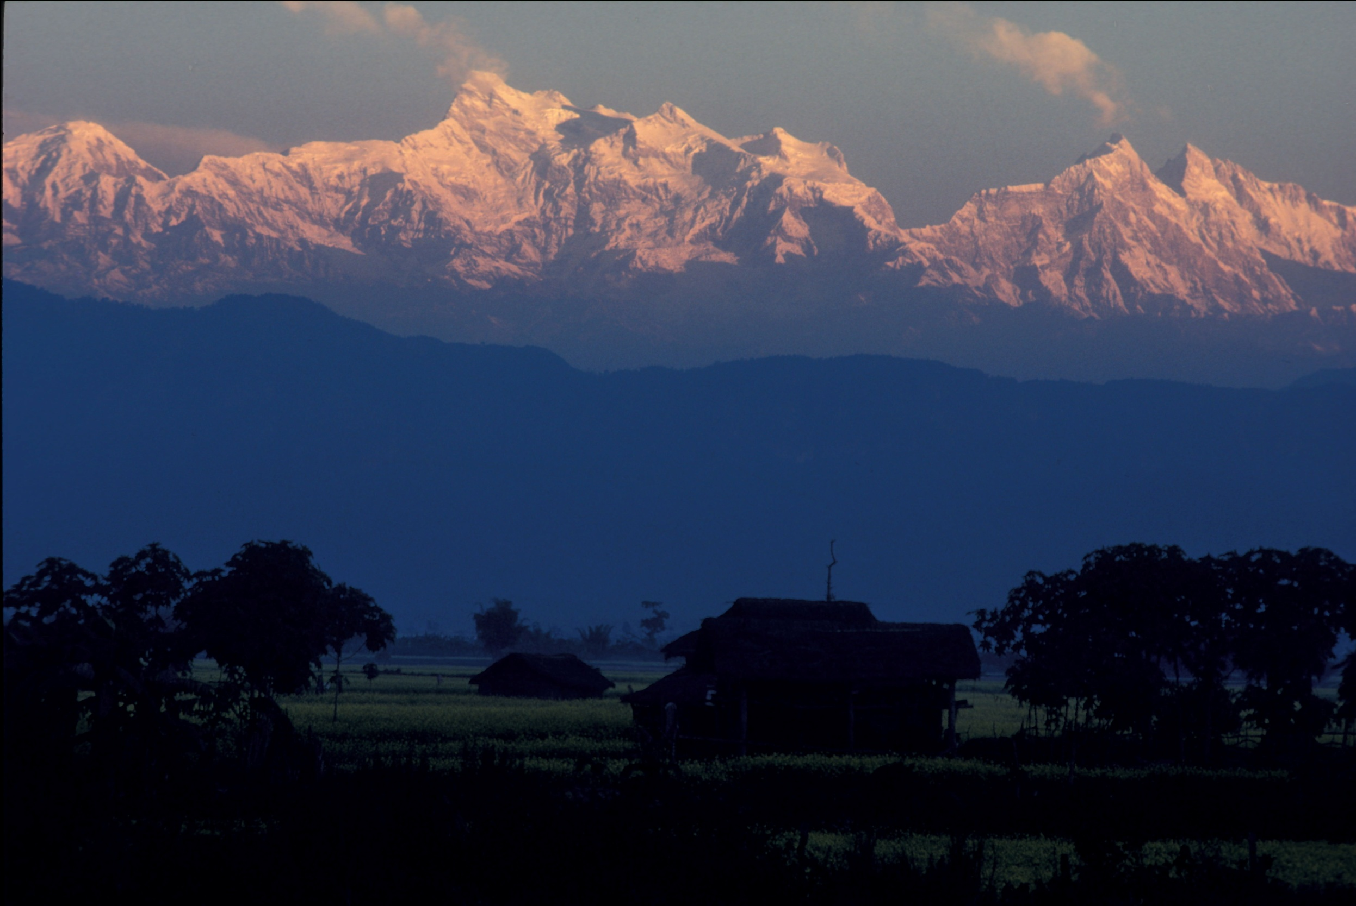
Citizen participation: a key to tiger conservation
Lessons from Nepal
July 23, 2011
Himalayan Buddhism Workshop
Holy Cross

Slide 2
Ecology and Buddhism
Why did Todd and Leonard invite a tiger ecologist to speak at a Buddhism workshop?
Do common themes exist between ecology and Buddhism?
Notes:
Buddha after many life experiences gain an insight about life the
Ecologists have a duty to the public to share thee insights about ecosystems, especially those insights that impact human lives and global well being
One of those insights is the concept of carrying capacity
Examples
Another is that altering natural ecosystems and replacing them with human constructed systems alters complex biophysical processes
Example: fossil fuel consumption increases atmospheric carbon which traps heat.
Saturday’s NY Times editorial reports that warming oceans also trapping more atmospheric carbon and becoming more acidic and due to nutrient rich becoming oxygen depleted. There are increasing dead zones, major food species are becoming depleted.
The response requires nations to work in harmony toward common goals of living sustainably within the global carrying capacity. Isn’t this similar to Buddhist philosophy?

Slide 3
Buddhism recognizes the importance of living in harmony with the natural world
The discipline of ecology endeavors to understand the complex physical and biological processes that sustain life
In both ecology and Buddhism, living within limits and in harmony, are re-occurring themes

Slide 4
Key points of my presentation
Government policies did not consider human or ecological harmony and had unforeseen consequences on the ecology and wildlife in lowland Nepal
The state of tigers over the past 150 years
Do we really need tigers?
What do we need to know to help conserve tigers
What humans need to survive
Should and can tigers and humans co-exist?

Slide 5
Status of tigers in response to Nepalese and US foreign policy

Slide 6
Foreign policy and tiger conservation
Prior to the mid-1950s, Nepal’s foreign policy inadvertently protected tigers:
Rana rulers maintained a belt of forests in the Nepalese lowlands to serve as a malaria barrier to prevent human invasions and migration from India
These malaria infested forests also support large numbers of deer and forest bison, the primary prey of tigers
Consequently, this anti-invasion policy created a high density of tigers across the Nepalese Terai

Slide 7
Tiger abundance was truly amazing
Hunts like these continued from the 1860s to the late 1930s
The last great hunt (1960) hosted Queen Elizabeth and used 300 elephants

Slide 8
The United States Agency for International Development : An agent of US Foreign policy
In the mid 1950s USAID encouraged Nepal to nationalize its forests and build a modern timber industry
Why was this a good idea? What were the US goals?
What were the implications of this policy?
Social : traditional forest management abandoned
Economic: No economic benefit to local communities
Ecological: Forests without local management and beyond the reach of the Forest Dept.became highly degraded

Slide 9
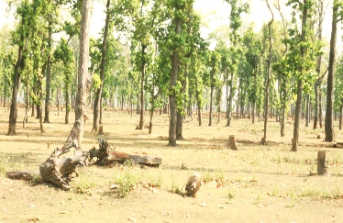
Even when USAID was extending a helping hand there were unforeseen consequences
Also in the 1950s USAID helped eradicated malaria in the Nepalese lowlands
This seemingly good deed led to a massive human transmigration from the middle hills to the lowlands
The influx of humans led to even more widespread clearing and degradation of forests and loss of tigers

Slide 10
So What! Do we really need tigers?
Tigers are deeply imbedded in many Asian cultures
Tigers evoke strong emotional responses from humans everywhere (e.g. symbol of the wild and untamed , the largest terrestrial carnivore)
For many walking in a jungle where tigers live is a humbling experience of a world not dominated by humans
Ecologically, tigers as top predators have a cascading impact on the ecosystems in which they live

Slide 11
What do we need to know to help conserve tigers?
How big an area does a tiger need?
What resources does it need?
What determines tiger carrying capacity?

Slide 12
To address these questions
We radio collared tigers to determine behavior, social dynamics and home range size
And assessed the abundance of tiger food
The project was started in 1973 and continues today

Slide 13
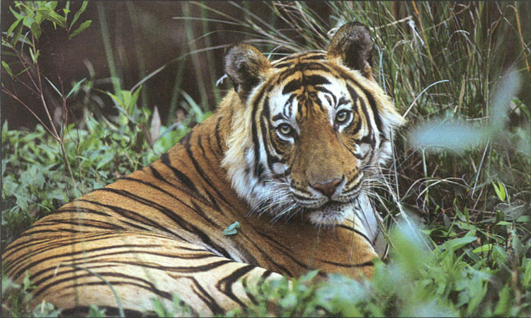
The setting was Chitwan National Park
It was an ideal study site with tigers and a diversity of prey species
Notes:
For tiger conservation in a landscape
- it is fundamental to estimate abundance and distribution of tiger’s natural prey
- determine abundance and distribution of livestock using the forest
Ten natural prey species
- Gaur: 5 times heavier than tiger
- Sambar, swamp deer, chital, hog deer, wild pig, blue bull, barking deer, four-horned antelope, langur
- livestock

Slide 14
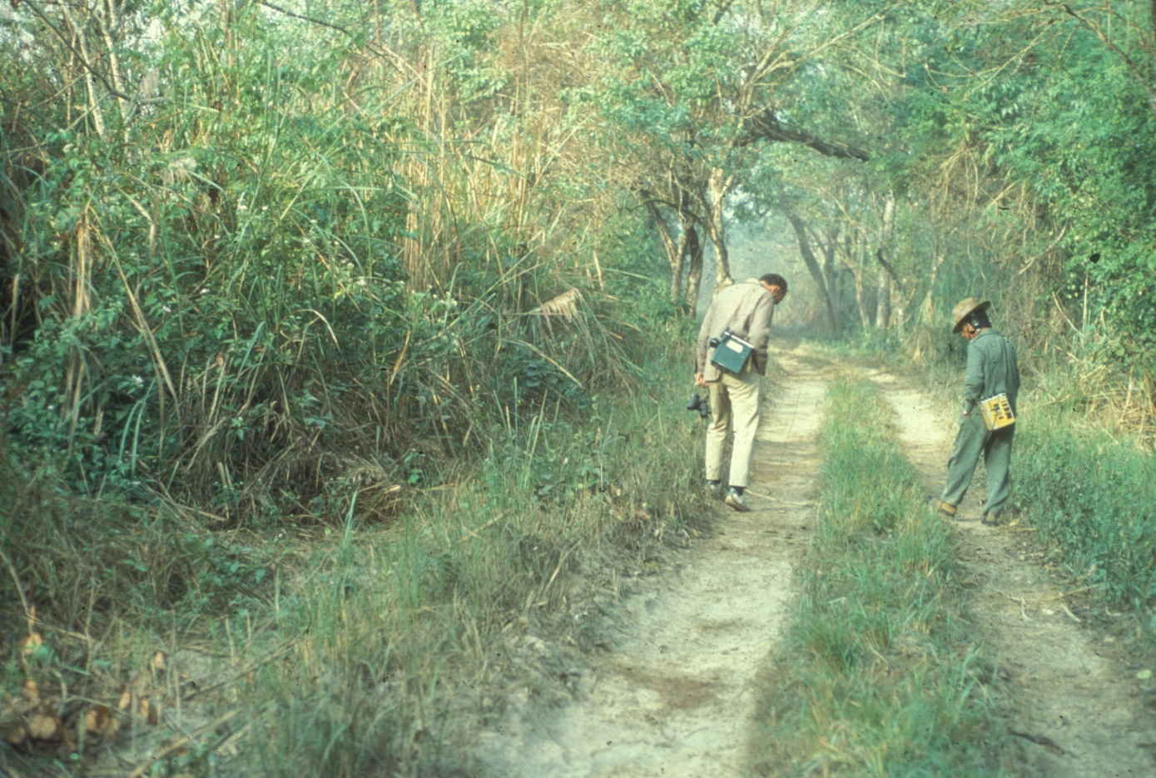
The first step in radio collaring tigers:
Finding where they are so we can capture them

Slide 15
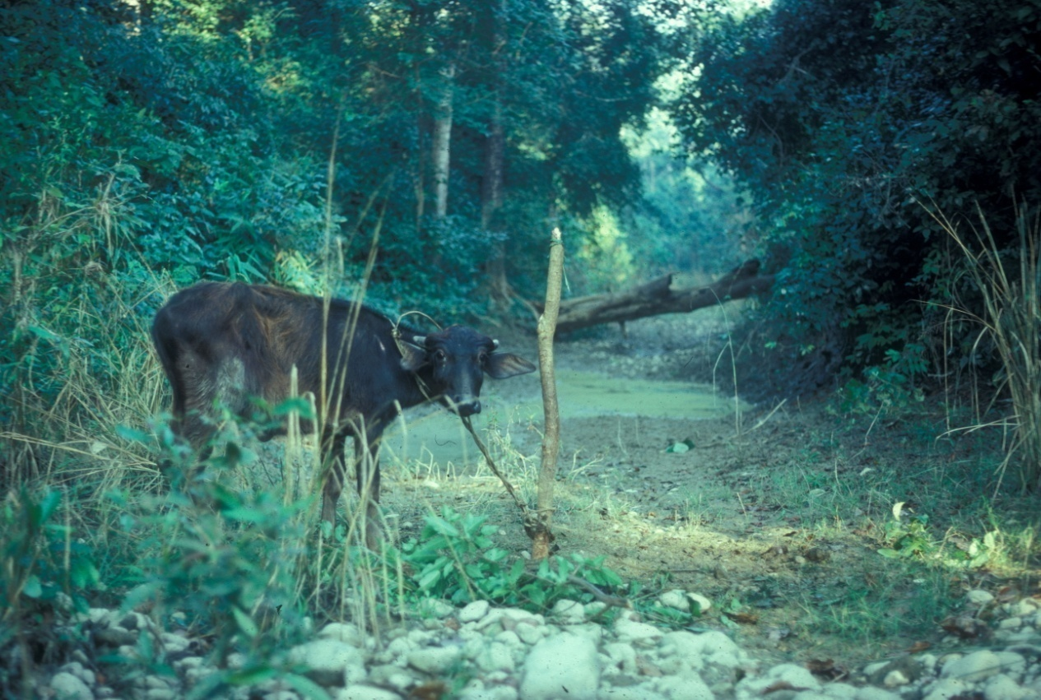
We used bait to find and localize at tigers
Baits wee placed near travel lanes
And also near dense cover where a tiger will feel secure to lay up and feed on the kill
With trees nearby to dart from

Slide 16
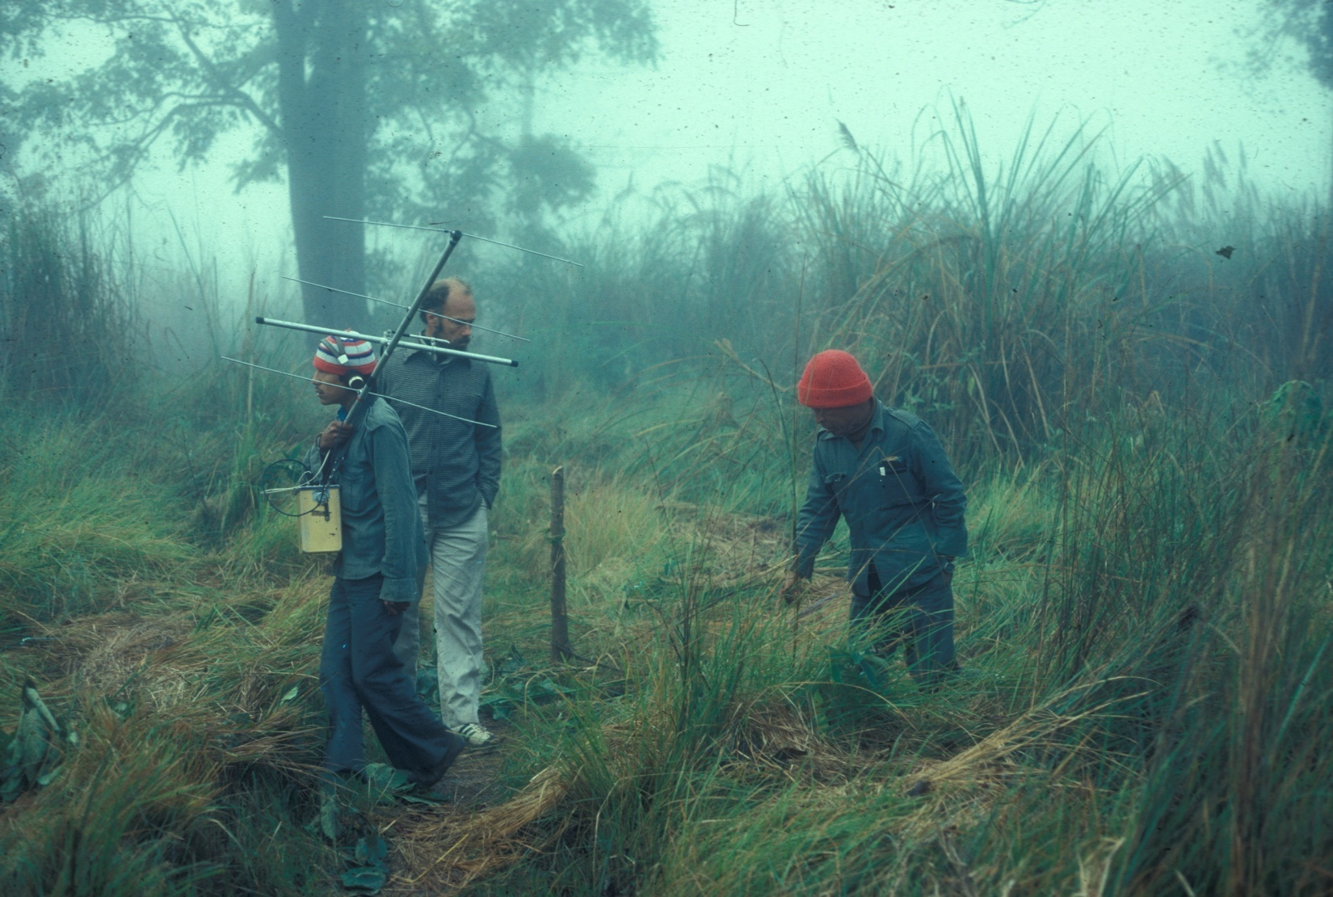
After a kill the easy question:
Which way did the tiger go?
A harder question: How far did it go?

Slide 17
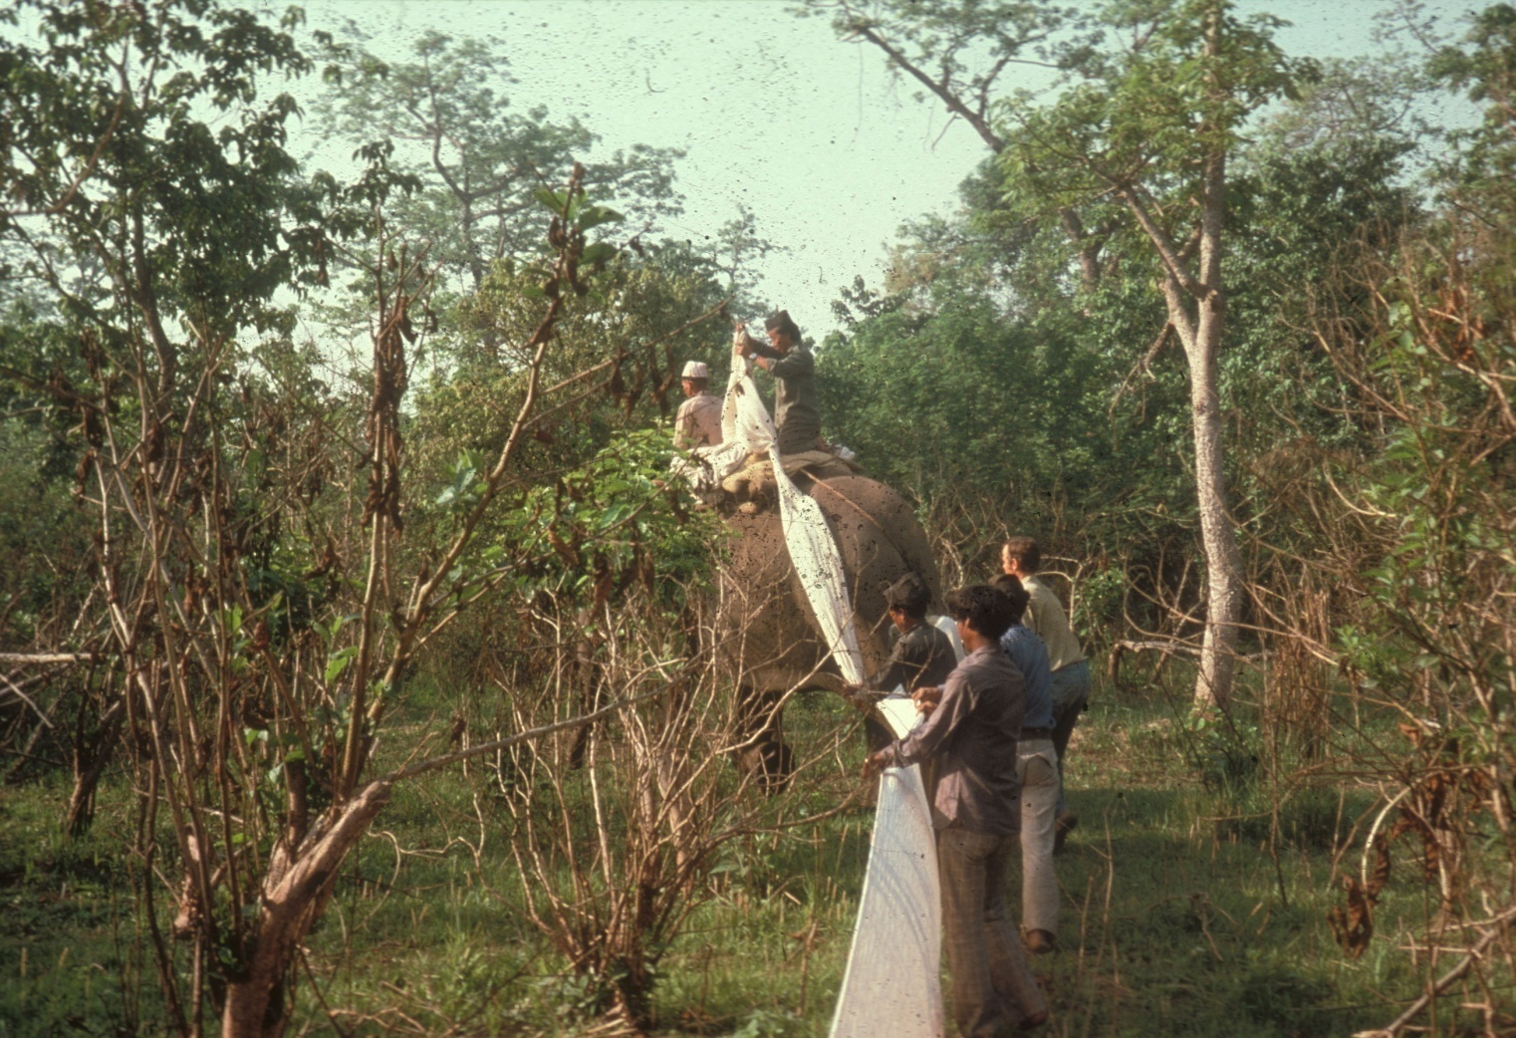
The beat cloth was developed for hunting tigers
Each elephant carries 10 bundles of 40 cloth
The cloth acts as a psychological deterrent

Slide 18
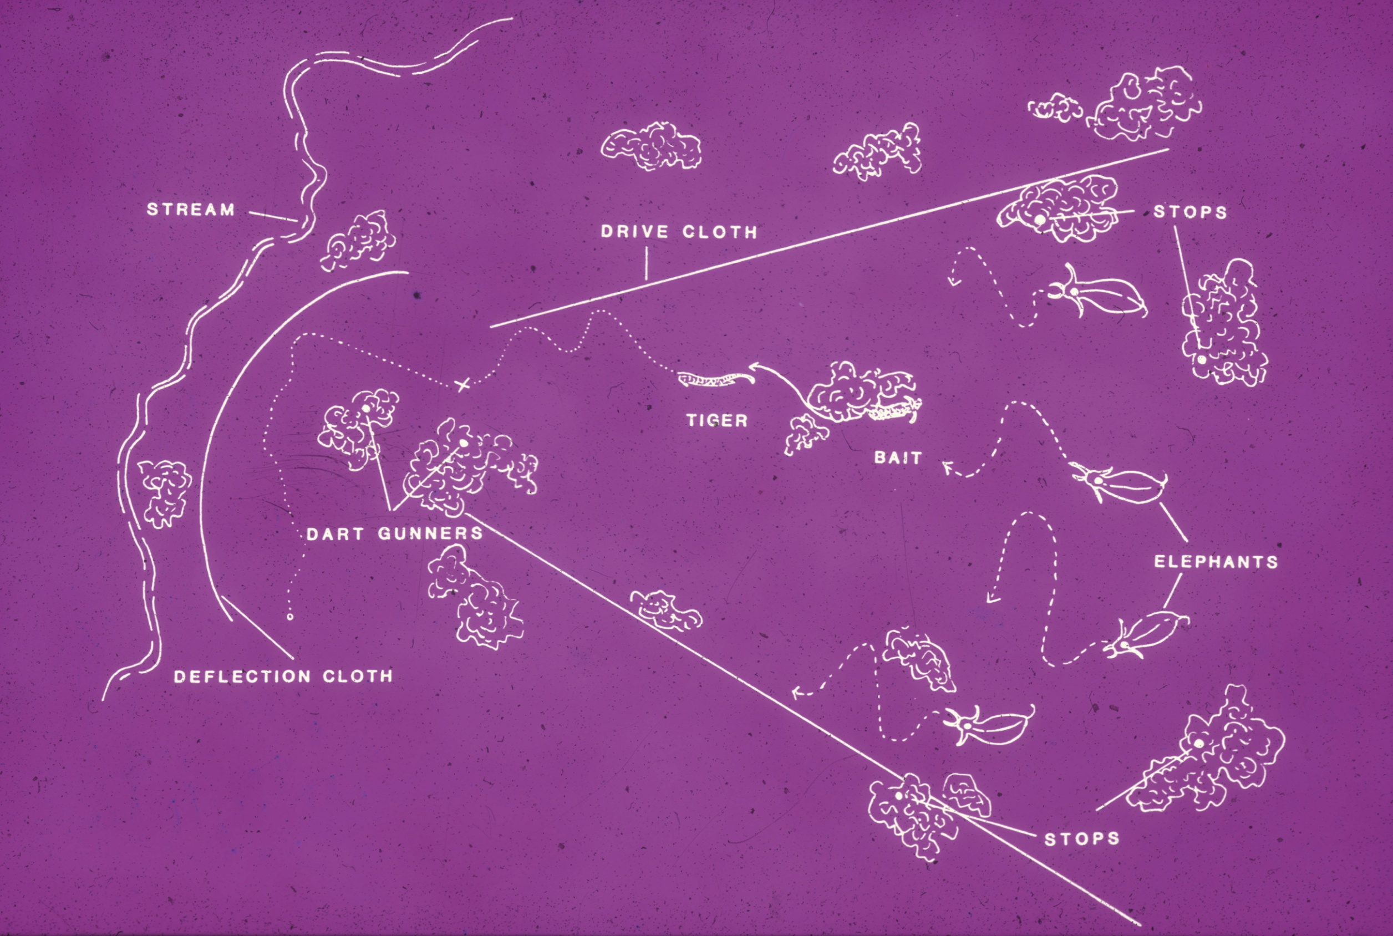

Slide 19
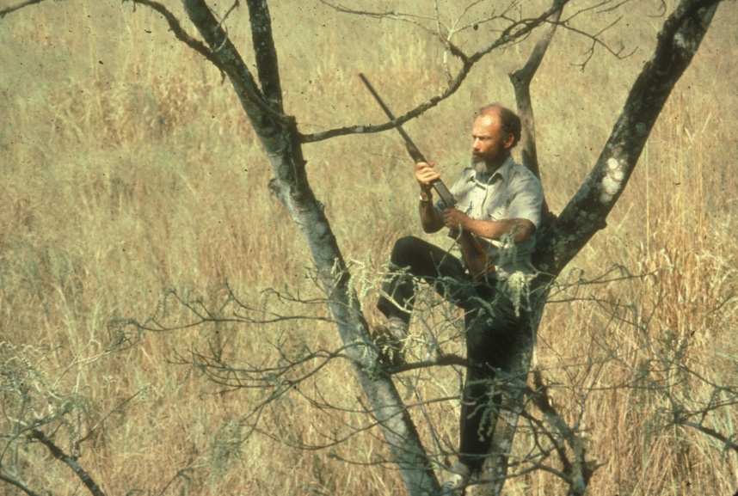
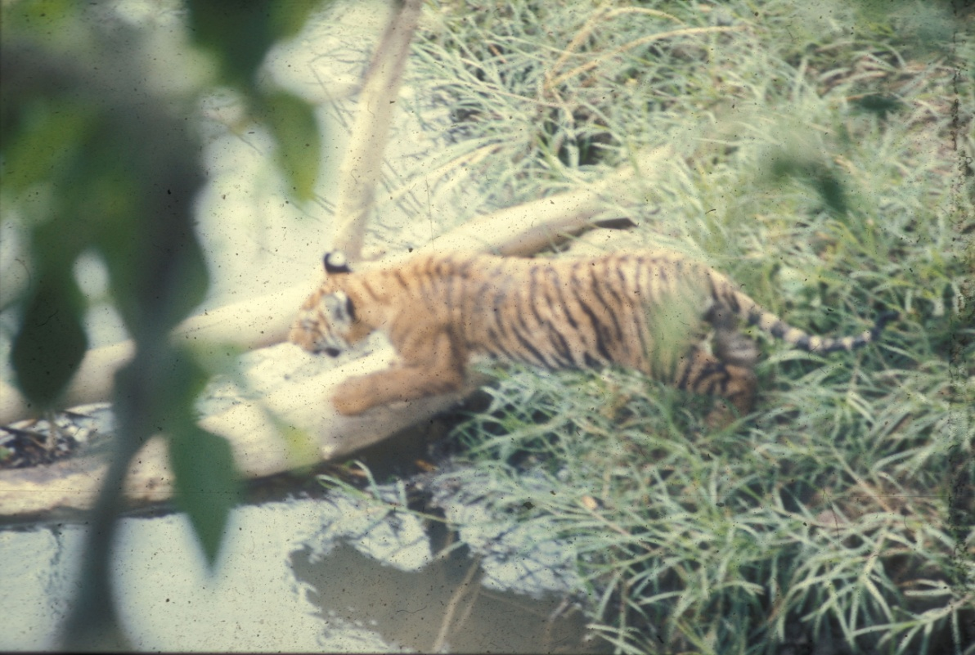
The dart gunner was at the apex of the “V”
If you think this takes skill you are wrong. The average darting distance was 11.2 m

Slide 20
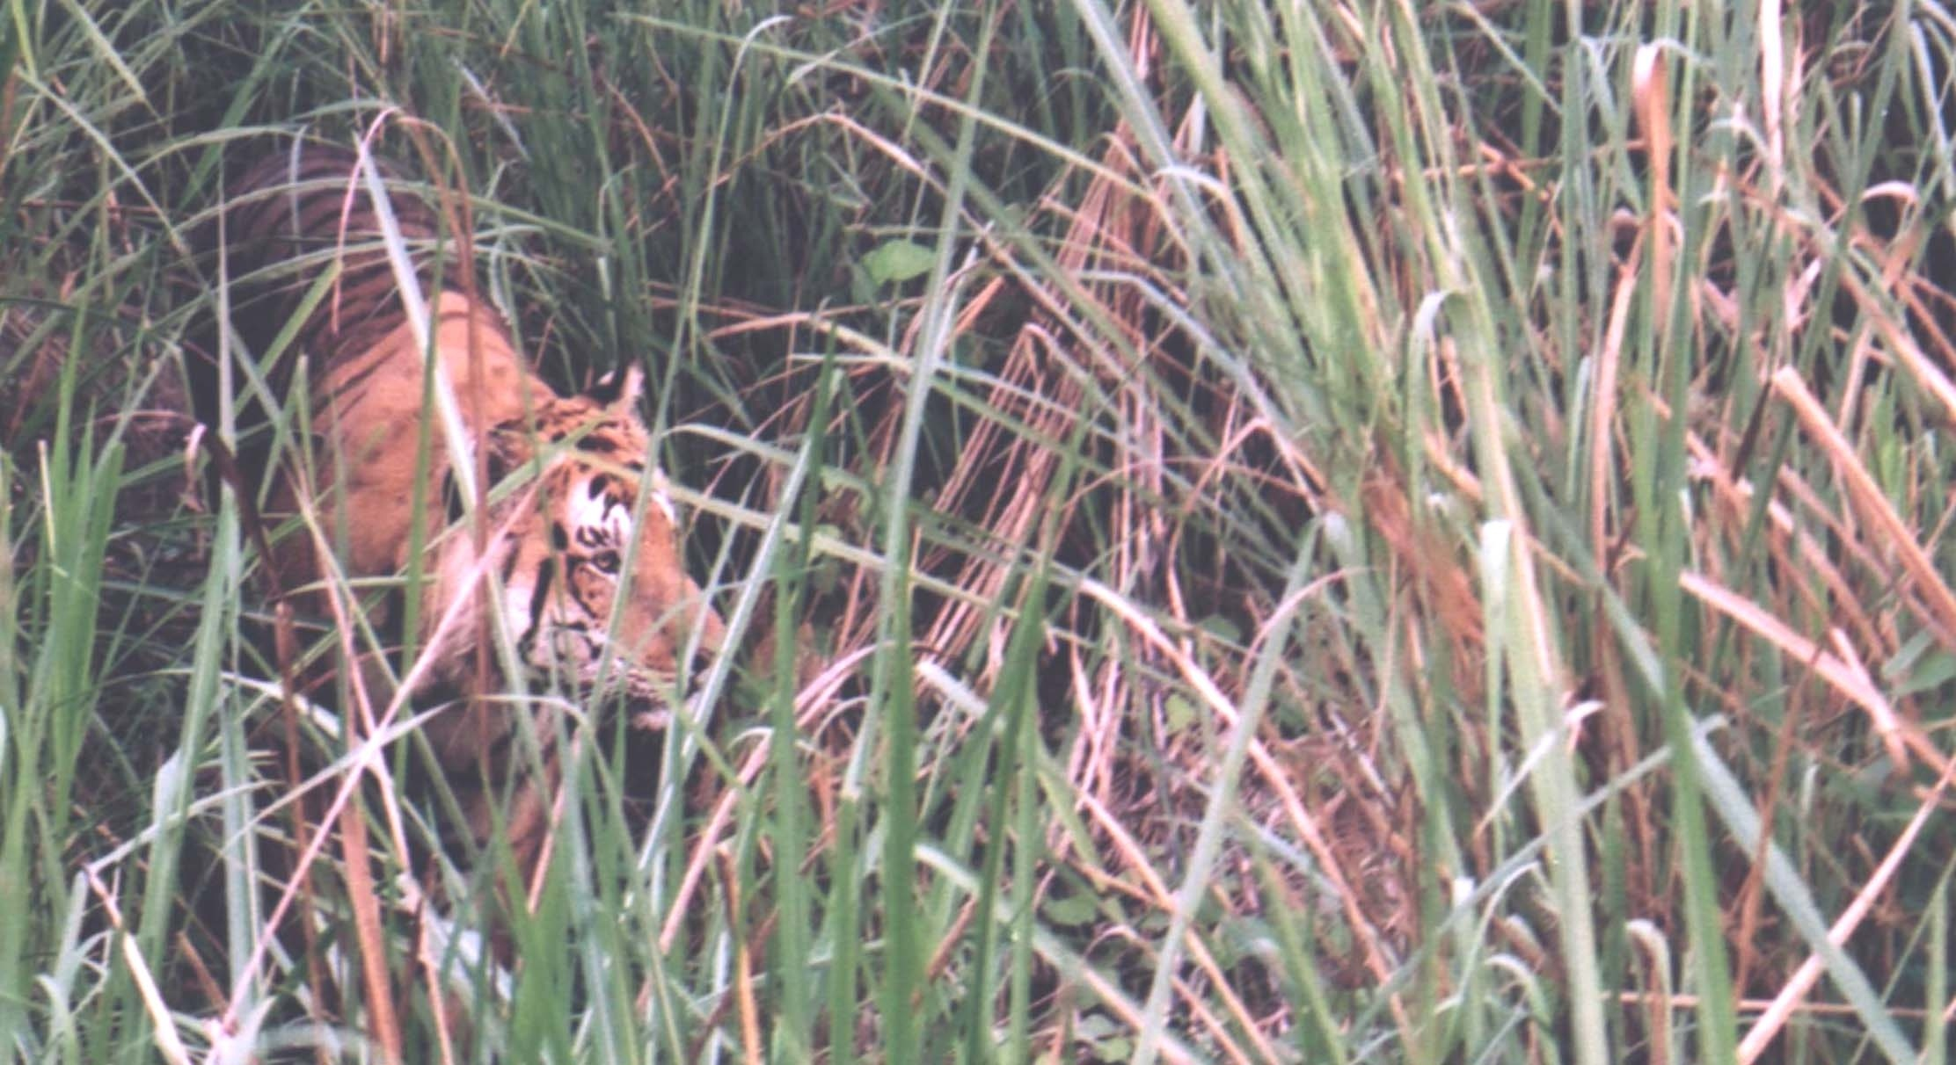
Typical view of tiger during drive

Slide 21
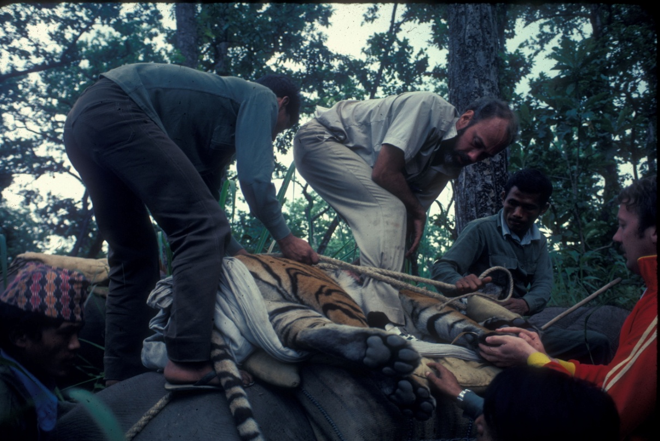
Temperatures could be in the 90s so It was important to move animals to shade

Slide 22
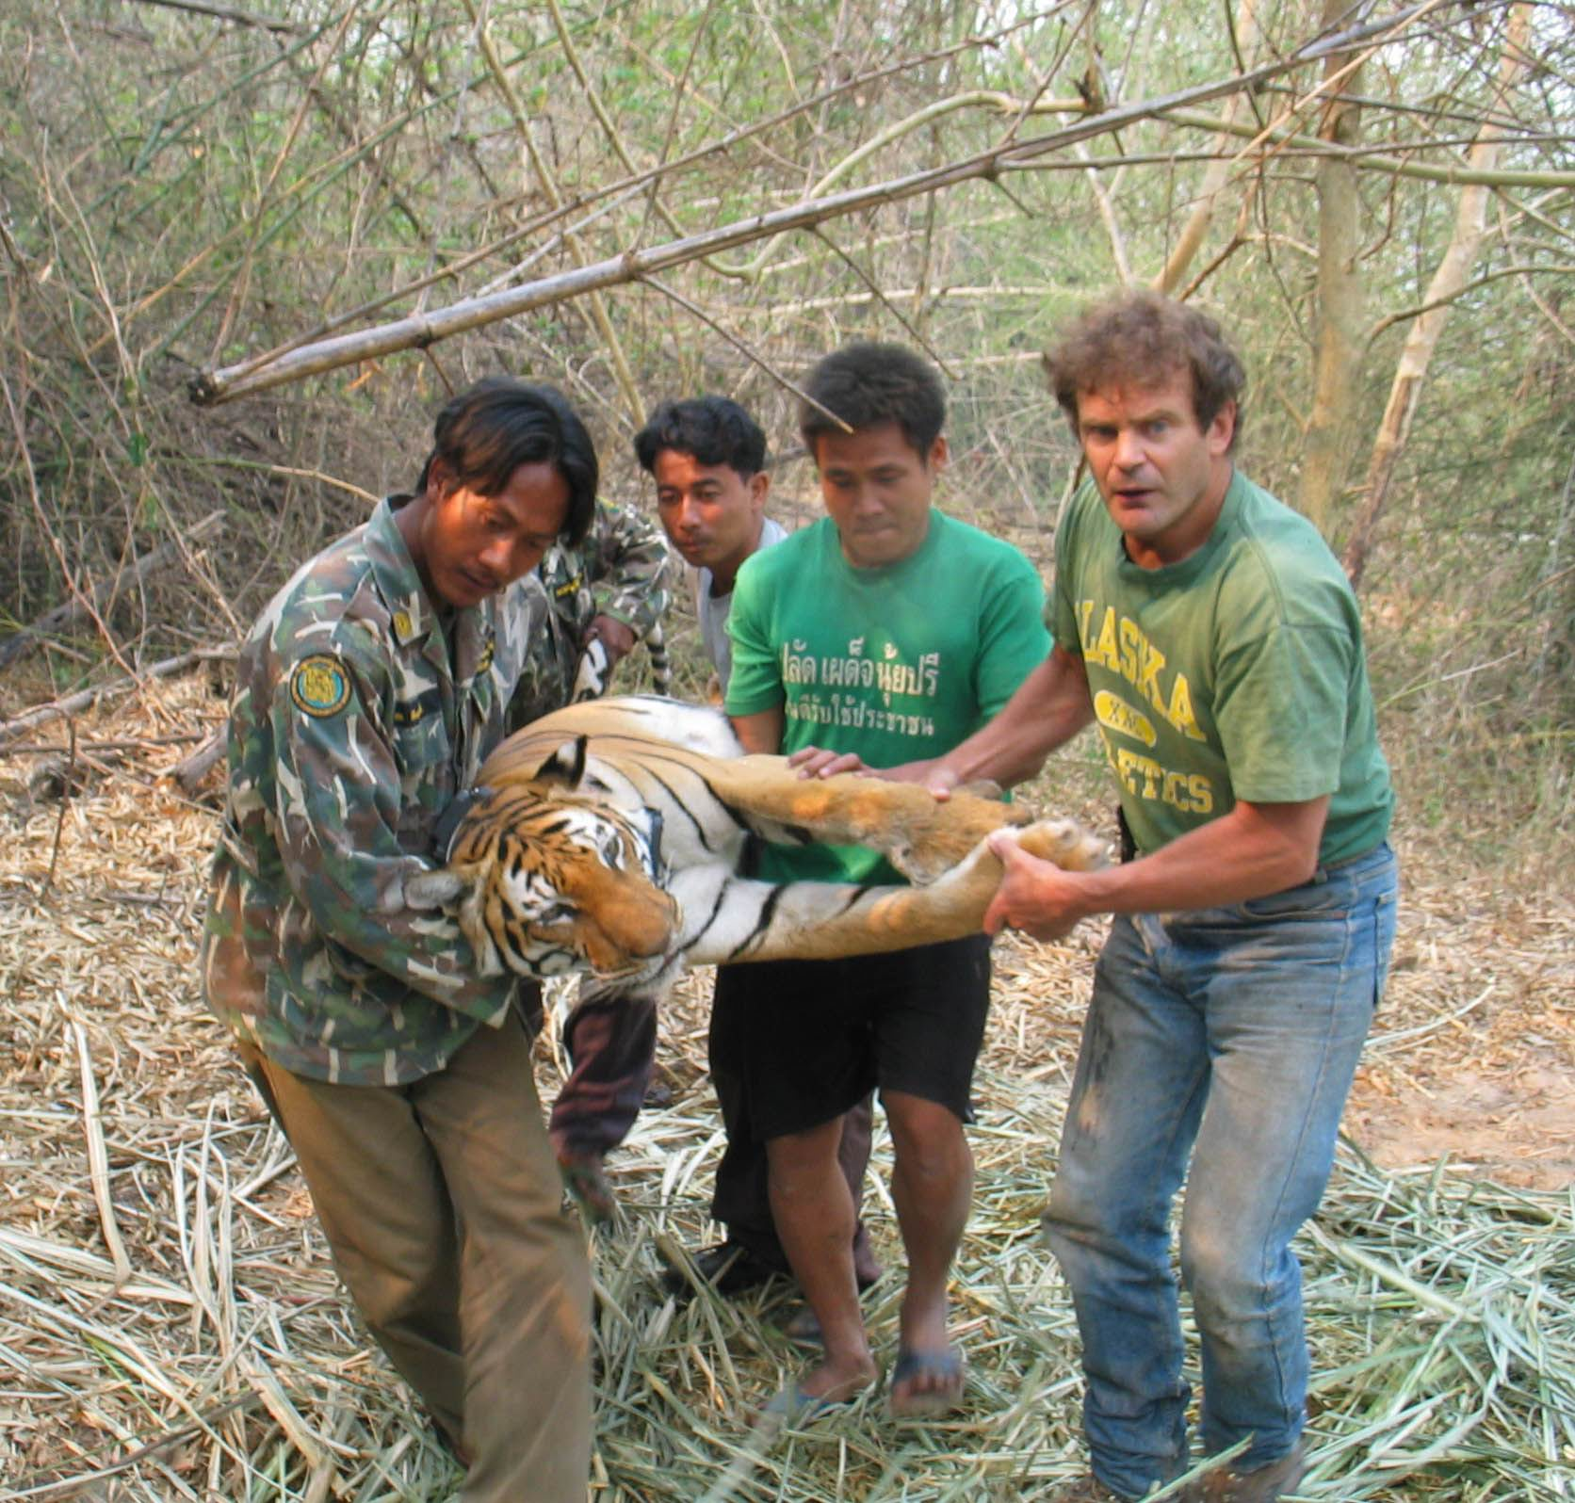

Slide 23
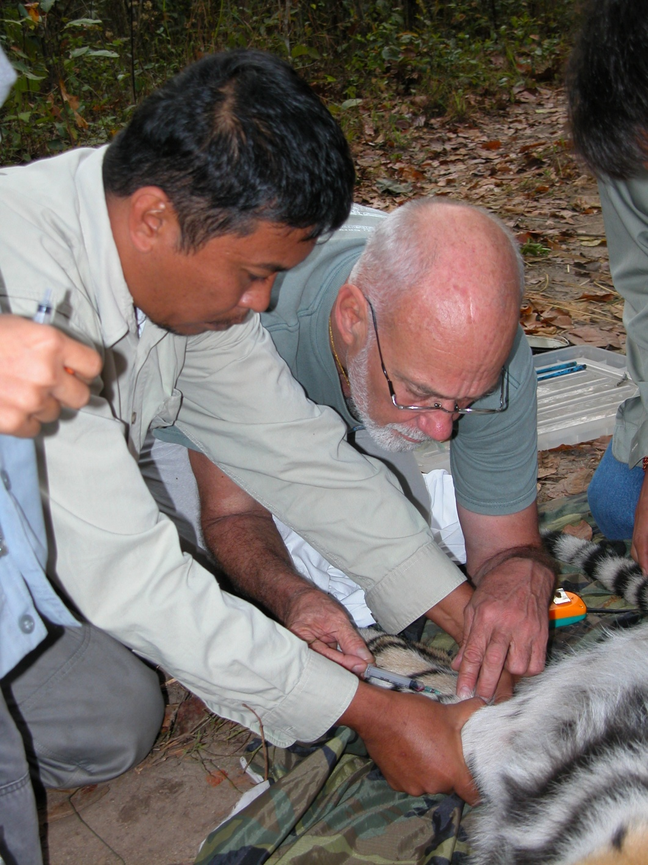
Key to drawing blood is to find the vein
– don’t guess

Slide 24
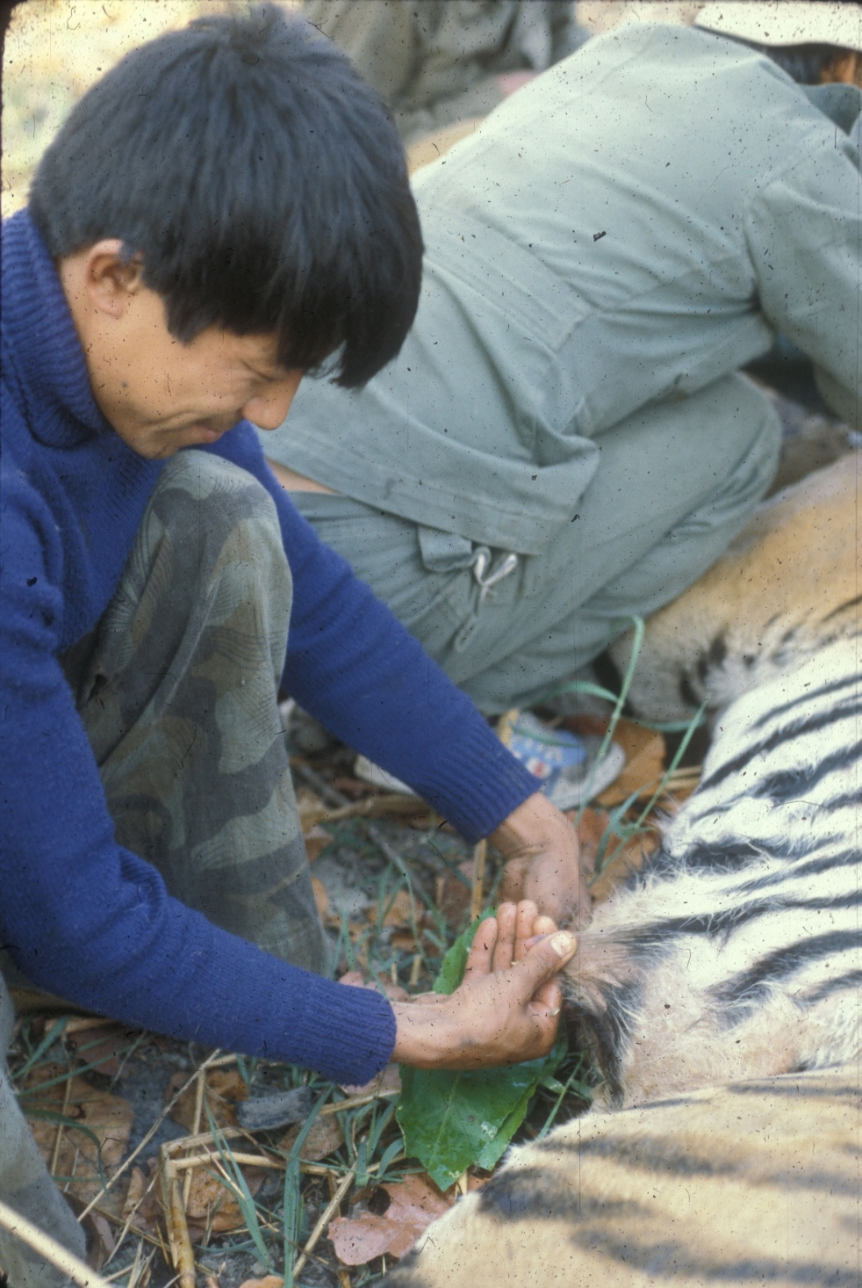
Female reproductive status?
Bishnu is checking to see if the female is lactating
Pink nipples usually indicates that the female is nulliparous
Dark nipples indicate a female has had a litter

Slide 25
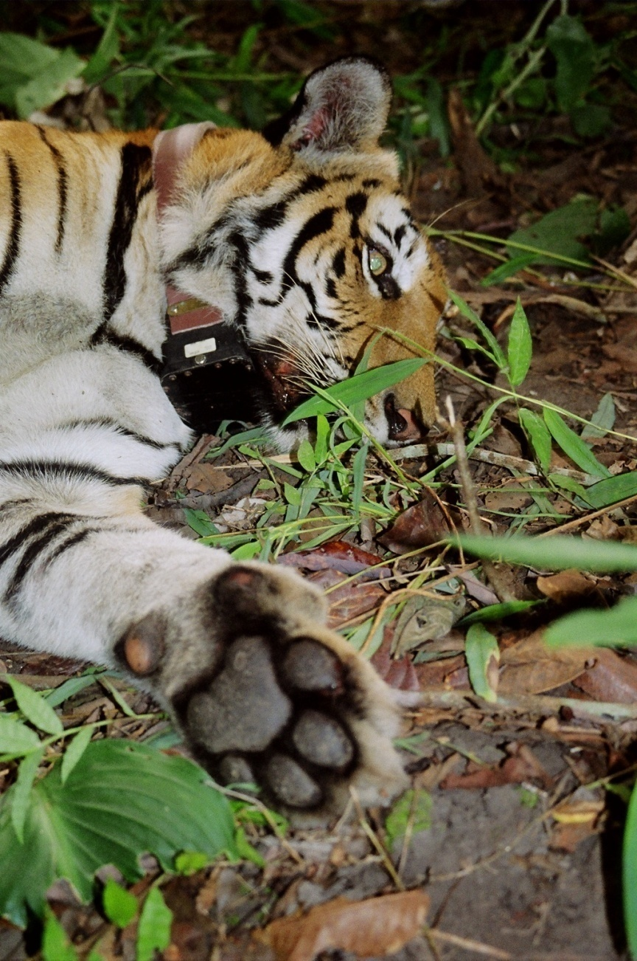
GPS collars are popular because of the large data sets we can obtain
With GPS collars do we still need to ground track tigers?

Slide 26
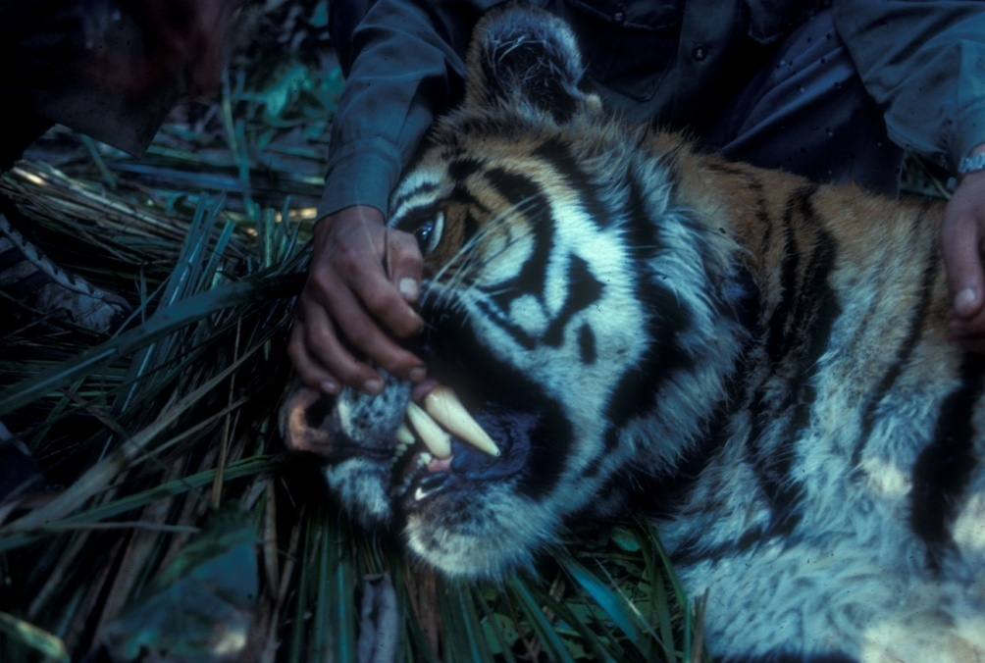
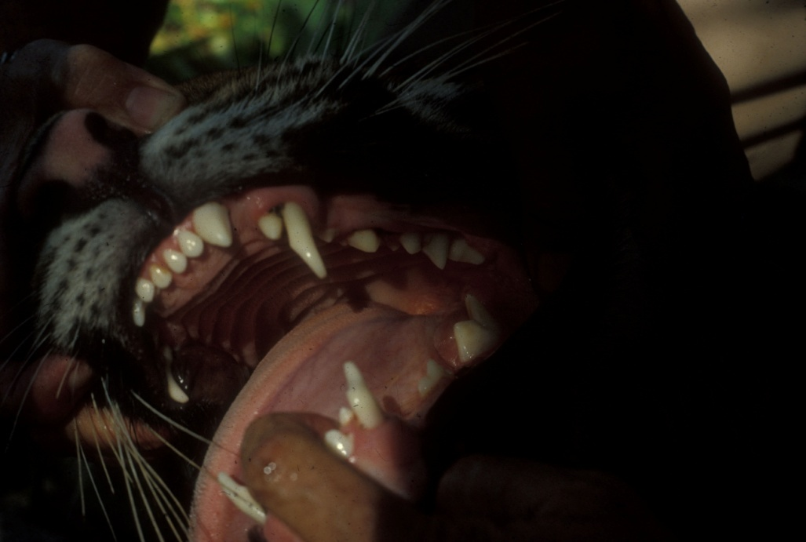
When you see these canines and examine kills you understand the specialization of cats
A 9 month old cub is replacing his “milk” canine with an adult canine

Slide 27
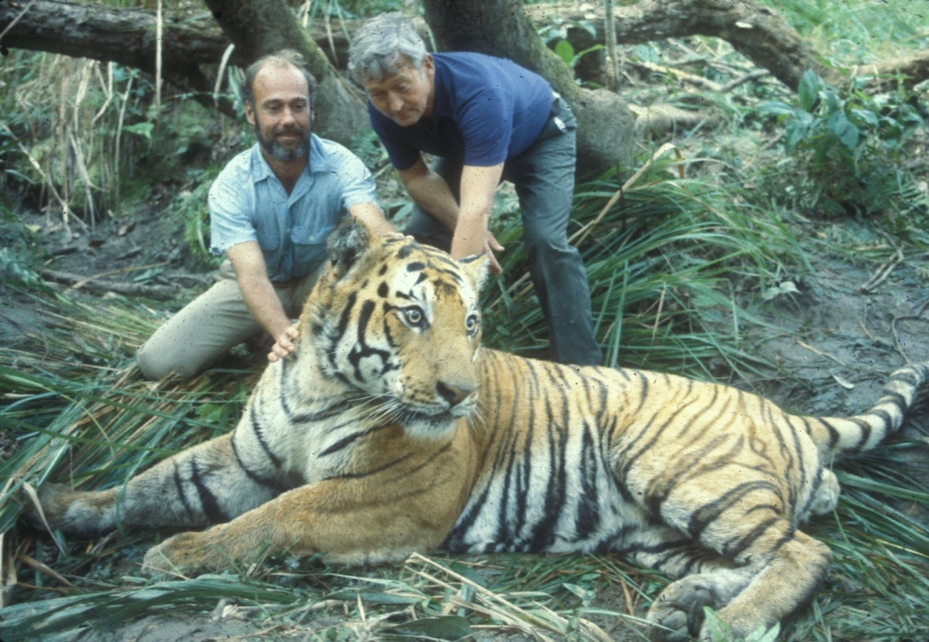
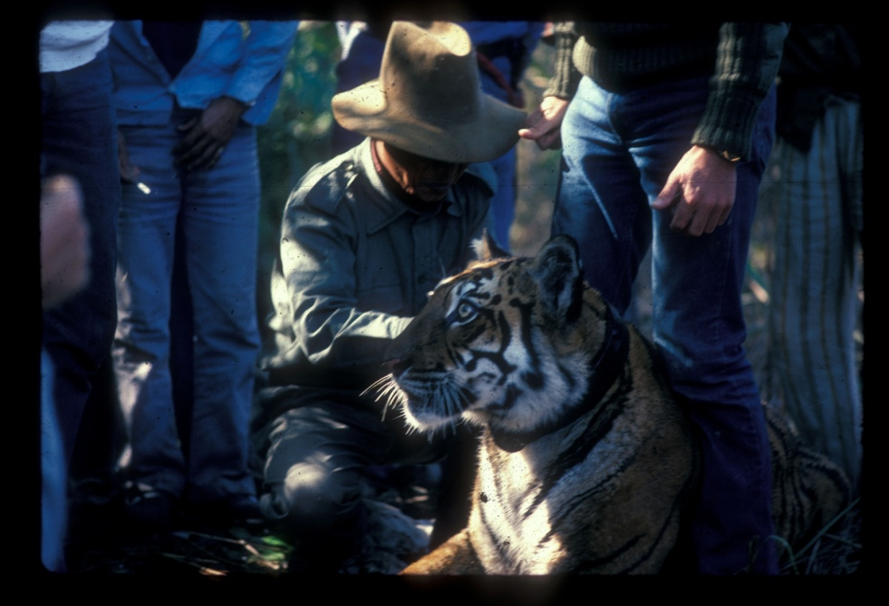
The drugs were safe for both tigers and humans

Slide 28
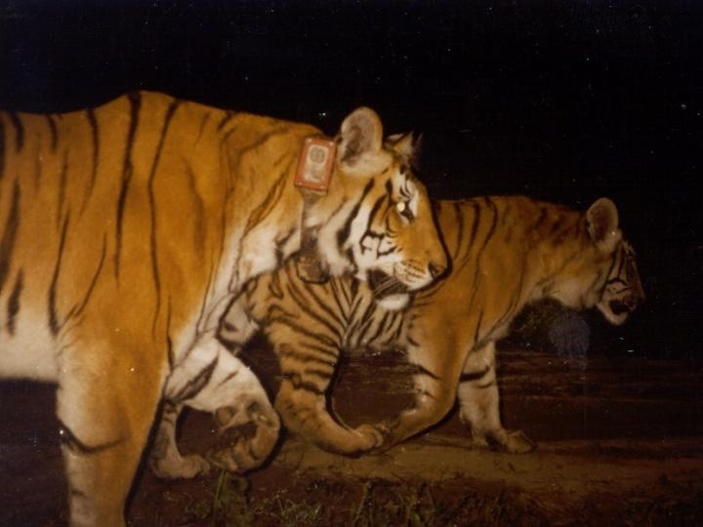
The first GPS collared tiger: a female with 4 cubs

Slide 29
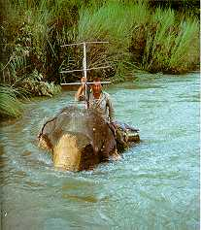
We radio tracked animals by vehicle,
foot and elephant back

Slide 30
Research during 1970 and 80s
Behavior & life histories
Social Structure
Impact on Prey
Lifetime reproduction
Dispersal
Communication
Population size

Slide 31
What did we learn about tigers?
Both sexes are territorial towards animals of the same sex
Females defend resources they need to raise young
Food and a secure place to raise young
Like most mammals, tiger mothers are the care givers
Average reproductive life: 7 years
For males, the critical resource is females
A males territory encompass es 2 to 7 female territories
Male’s parental role is not to lose their territory Why?
Males can have 3 to 55 young & 0 to 35 survive
Average reproductive life: 2 ¾ years

Slide 32
2 most critical things we learned about tigers?
Tigers don’t ride buses
And don’t cross large tracks of farm land
Female home range size determines carrying capacity
Carrying capacity is the number of tigers an area will support
Carrying capacity based on super market size

Slide 33
Using what we know about tigers we would like to build tiger Sim City models
Models can help us predict tiger response to:
forest degradation and habitat fragmentation
poisoning of tigers
reduction or increase in prey abundance
Our goal is to find the right balance of different land-use management

Slide 34
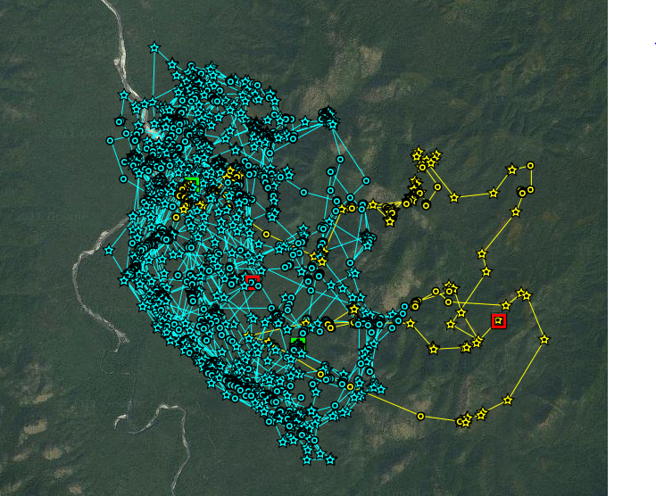
With new GPS collars we get hourly data via the internet
Does this mean we can sit in a bar and study tigers?

Slide 35
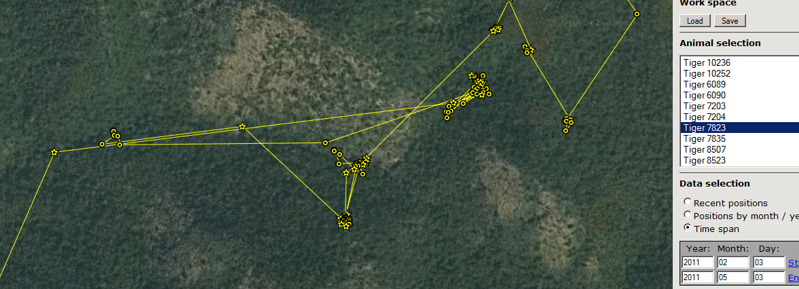
Emphatically No!
From the internet we don’t know
what the tiger was doing here

Slide 36
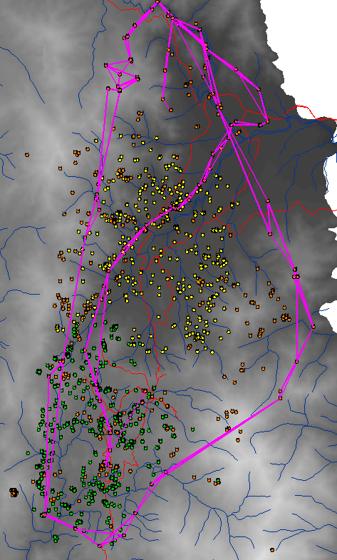
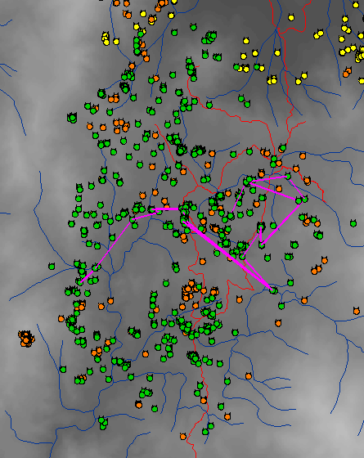
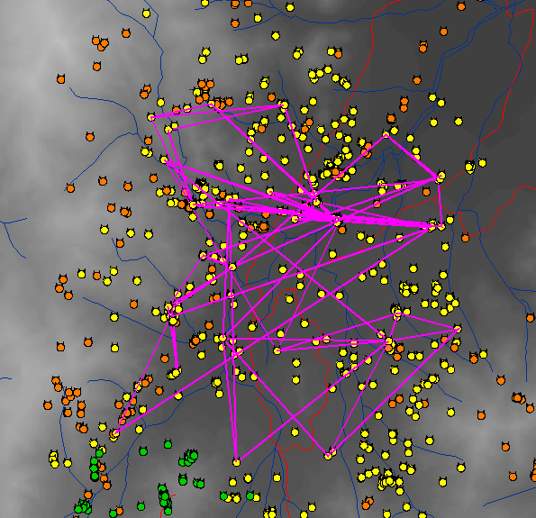
Patterns of Tiger Movement for
three tigers during a 17 day period
Male1
Fem 4
Fem 5
(with 4 mo old cubs)
16.0 KM 10.6 KM 10.1 KM
124 observations 59 observations 45 observations

Slide 37
Change object state change behavior
Mating f(event) move toward female, make female pregnant
male tiger
gets older
gets hungry
gets stressed?
time to visit next female?
Hunting f(hunger) search for prey, kill prey
Feeding f(kill) stay near prey, reduce hunger
Dead f(poison/stress) turn black
Stress f(hunger level) increase movement, die
Stress f(hunger level) increase movement, die
female tiger
gets older
gets hungry
get stressed?
gets pregnant?
time to be fertile/not?
Time to give birth?
Dead f(poison/stress) fire kill cubs trigger, turn black
TIME
Fertile f(schedule) change movement rate, turn cyan
Pregnant f(male prox.) change movement rate, turn blue
With cubs change movement rate, increase rate of hunger
Hunting f(hunger) search for prey, kill prey, turn red
Feeding f(kill) stay near prey, reduce hunger
Dead f(killed) turn black, fire poison trigger
Poison f(dead cattle turn red
within 1 KM radius)
Domestic prey
Wild prey
Dead f(killed) turn black

Slide 38
Movement pattern of Tiger
Distance & Direction are state-based
What are male states?
Hungry, Horny, Aggressive
P
r
o
b.
distance
Tiger
Hunting
Horny
Tiger
direction

Slide 39
With knowledge of tiger behavior and ecology and our Sim City tiger models Nepal is developing a participatory managed tiger human landscape
Notes:
The TAL concept originated at a December 1999 regional biodiversity workshop, which recommended a landscape level conservation approach to conserve biodiversity — the new paradigm proposed by conservationists -- in the Terai region to benefit both wildlife and people.
The vision of the TAL is to create “a globally unique landscape where biodiversity is conserved, ecological integrity is safeguarded, and sustainable livelihoods of its people are secured”
The concept is to link existing protected areas with forested corridors — using forestry practices that will provide benefits to the local people, the national economy, while allowing biodiversity conservation.

Slide 40
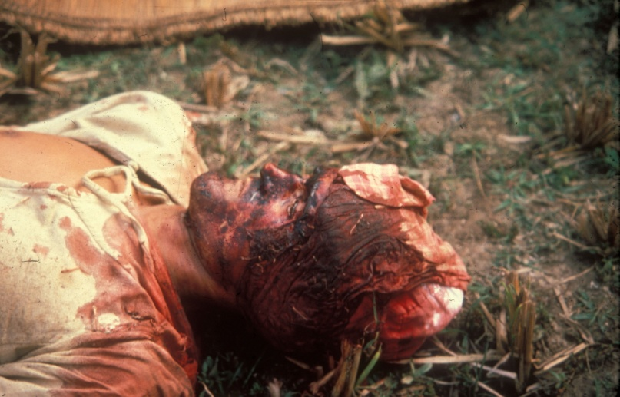
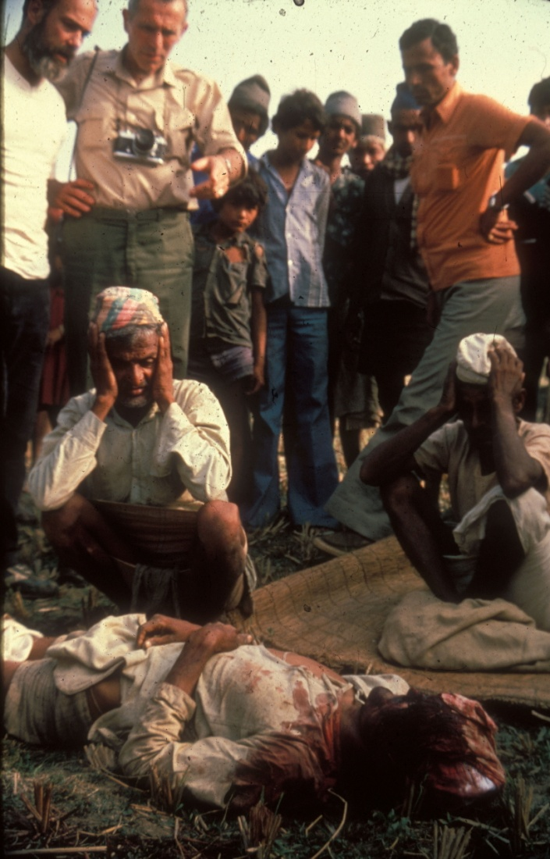
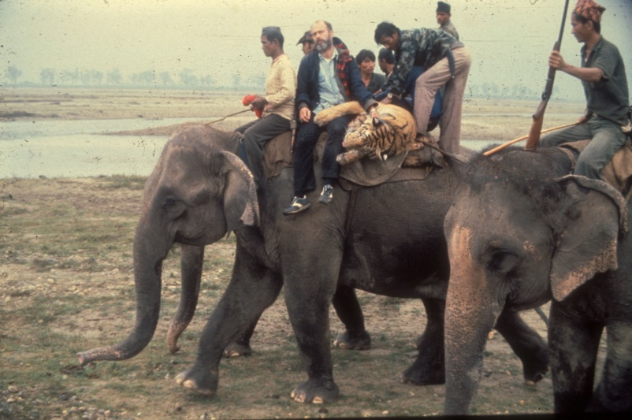
We hope models help tigers and humans
co-exist

Slide 41
Here are some ecological services the landscape needs to provide humans
Clean air
Fresh water
Biodiversity
Decomposition of wastes
Soil generation
Forest cover
Pollination
Groundwater recharge through wetlands
Greenhouse gas mitigation

Slide 42
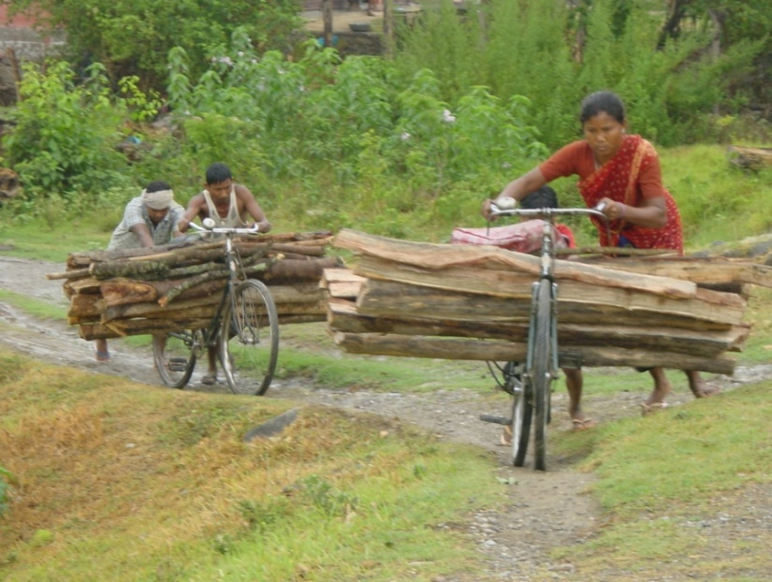
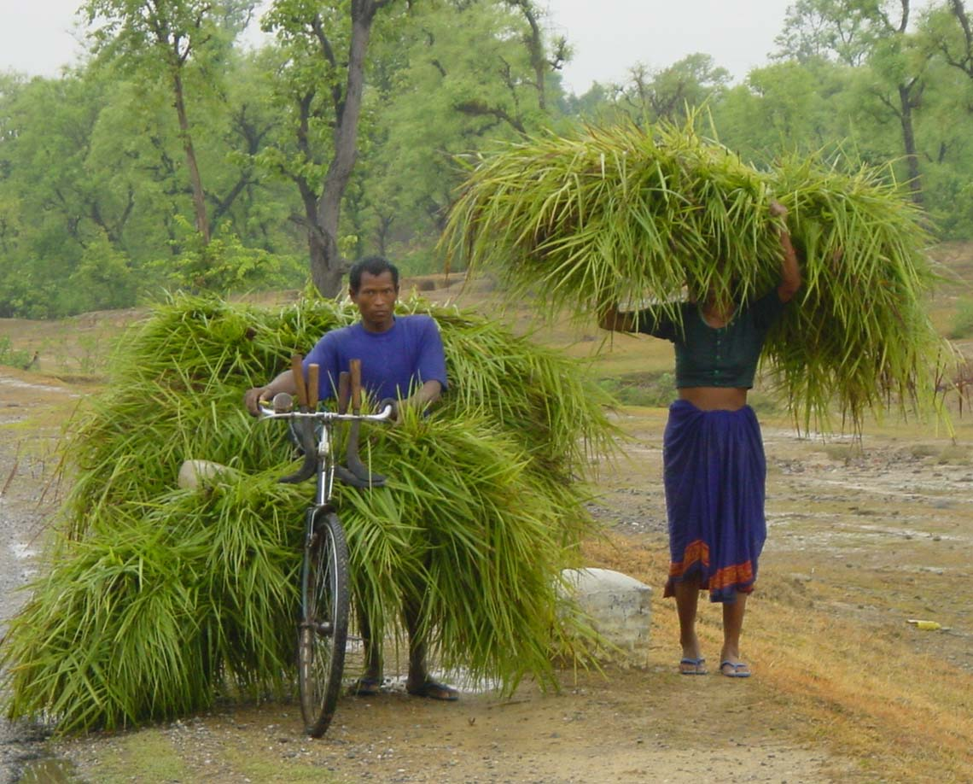
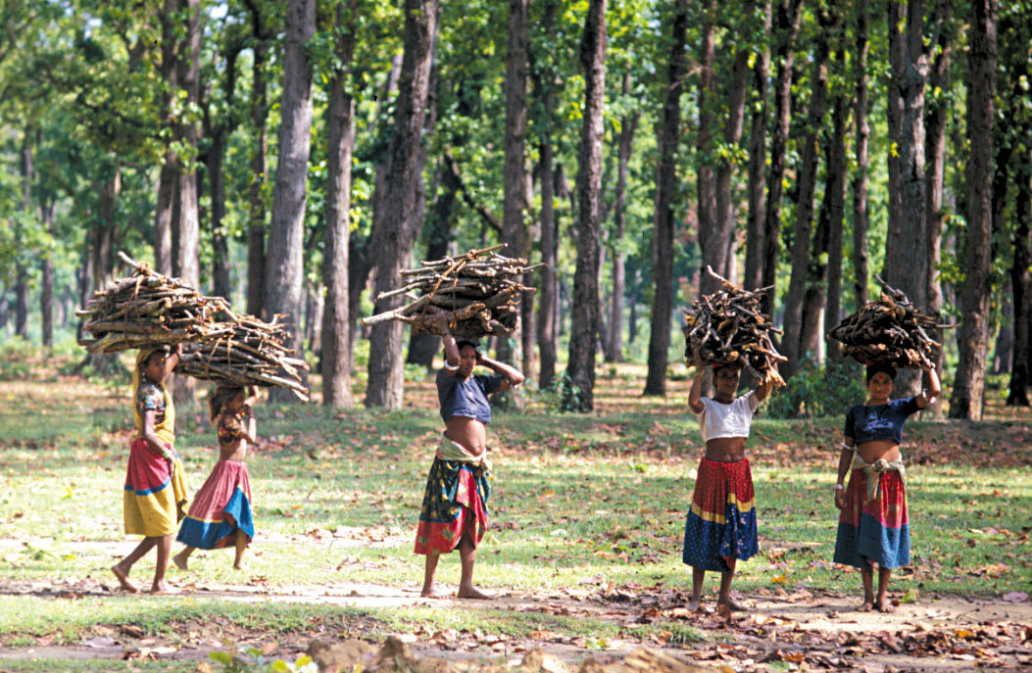
Humans also need forest resources
But uncontrolled resource harvest degrades
Both human and tiger habitat

Slide 43
Formation of community forest user groups:
Local management to achieve sustainablity
Forests
Local People
Wildlife
Partners

Slide 44
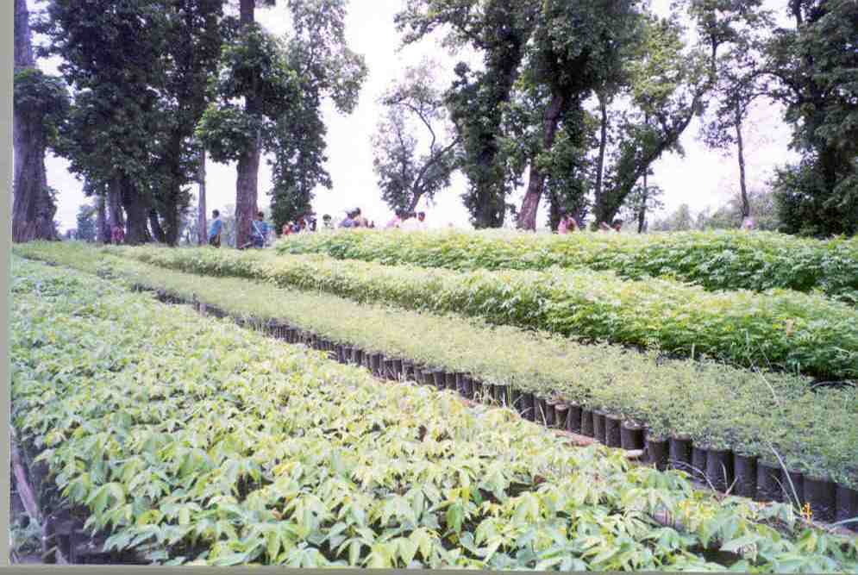
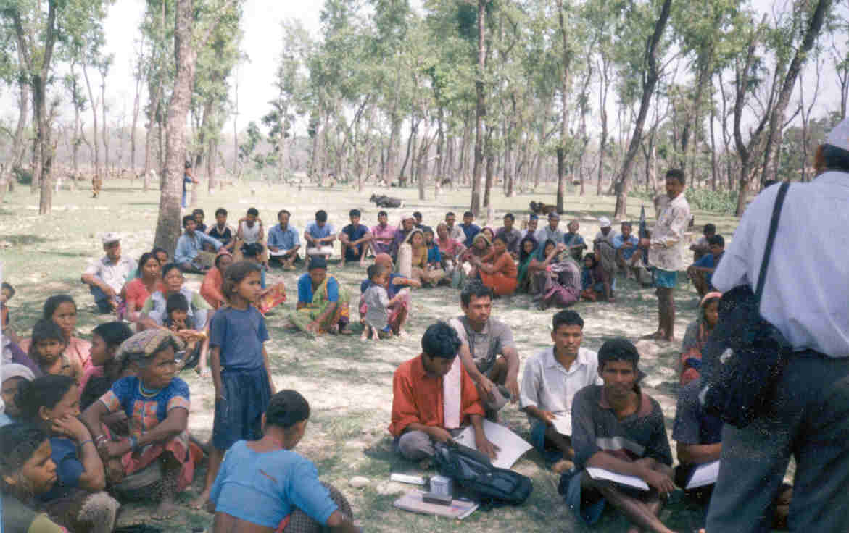
Forest Restoration
Plantation
Natural Regeneration
Community Forestry
Capacity Building

Slide 45
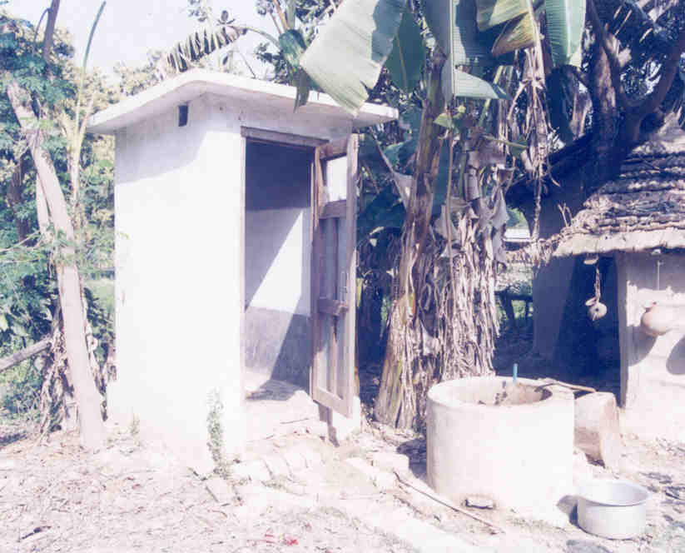
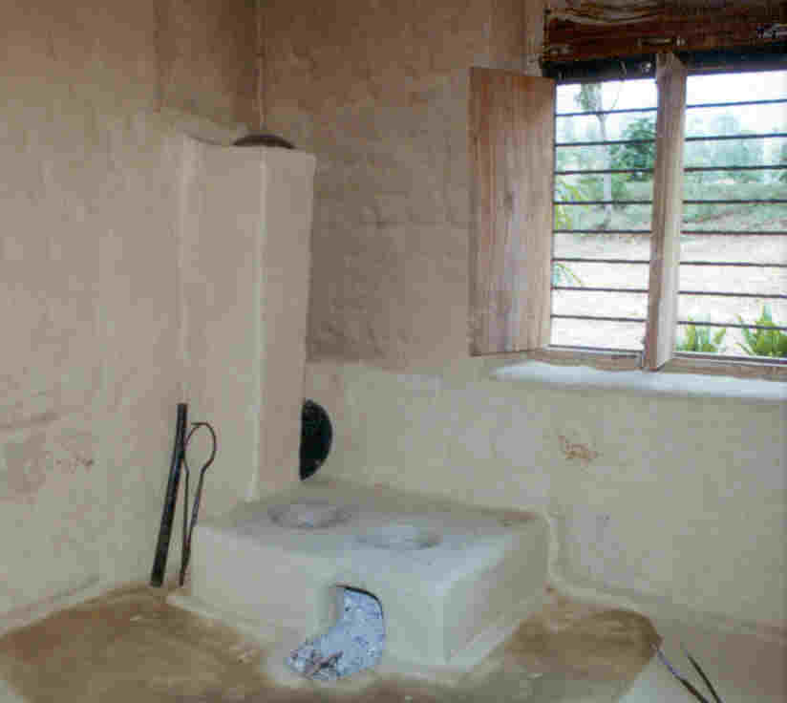
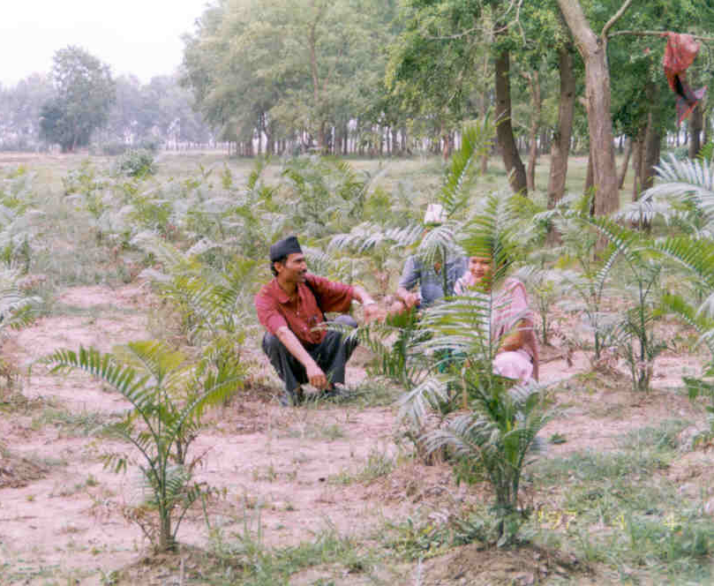
Sustainable Livelihoods
- Alternate energy
- Agro-forestry
- Income generation
- Local capacity building

Slide 46
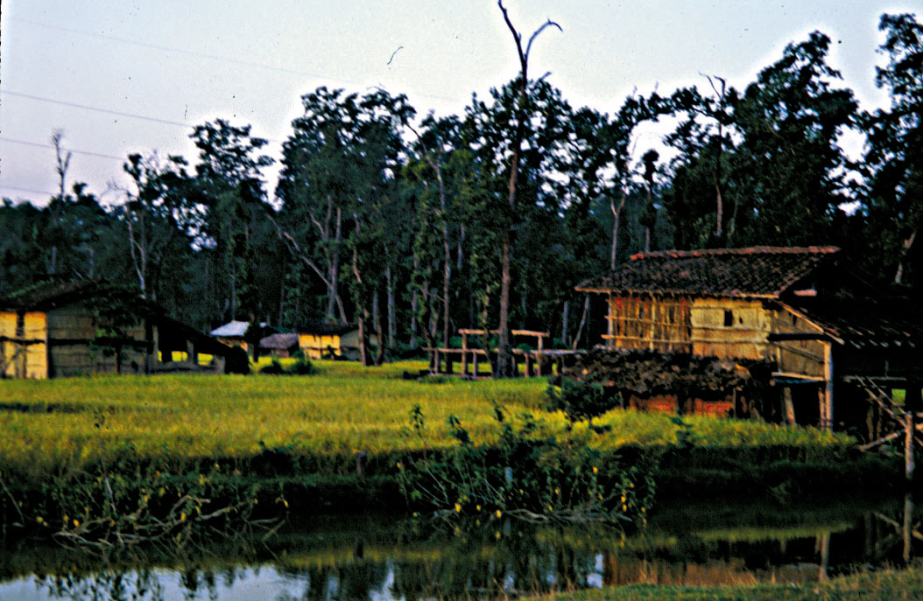
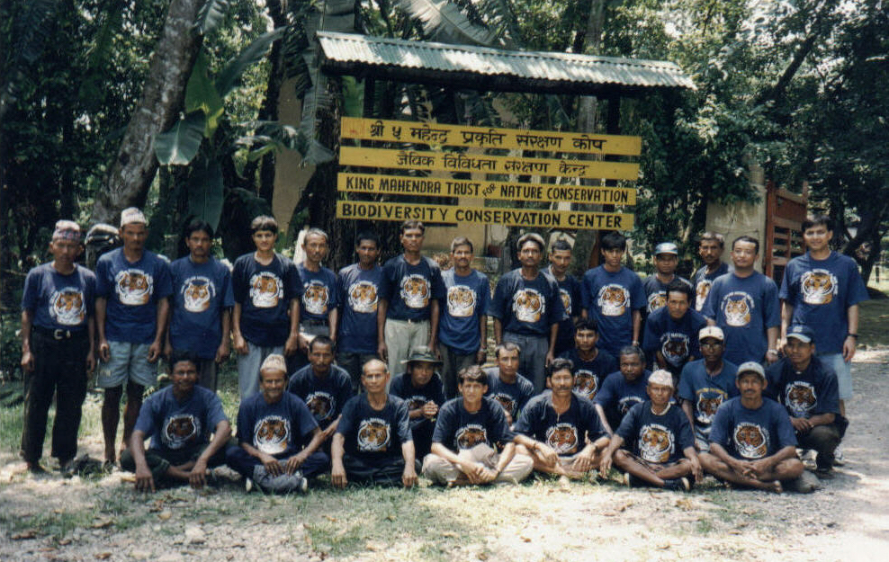
Establishing Network of “Village Rangers”
Notes:
I, first used a satellite image map of entire lowland to delineate forest cover, road and large forest blocks.
To initiate the project I hired two field coordinators who could read animal sign and can accurately distinguish between tiger and leopard and male tiger from female tigers from pugmark method based on size criteria.
Local village as village ranger was hired from the village nearest to the forest. Such as this house in Kailali belonged to one of the VR.

Slide 47
Participatory mapping tiger distribution

Slide 48
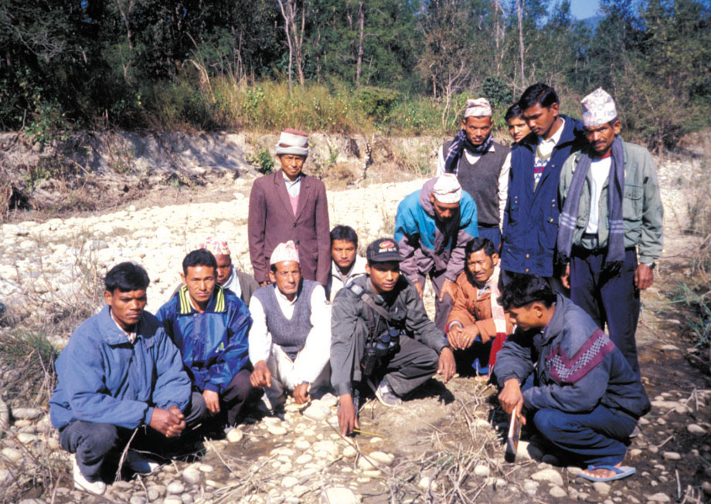
Training and Capacity Building of “Village Rangers"
Notes:
1. Immediately after hiring all 30 VRs. I conducted the 1st training workshop for 3 days in Bardia national park that focused on pugmarks measurement of tigers and leopards.
2. 2nd workshop was held after six month in March 2000 to discuss the preliminary reports and capacity building and networking.

Slide 49
Pugmark Measurement
Notes:
1. Pug marks methods relies on finding clear impressions on hard sandy substrate along river, stream where defined pug marks are encountered.

Slide 50
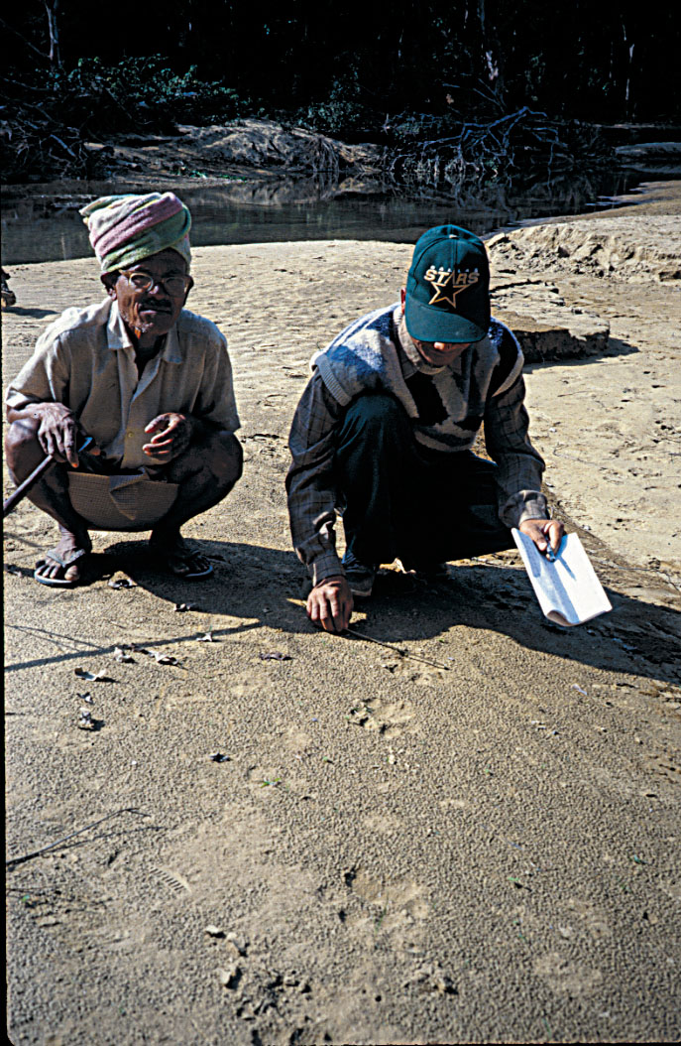
Villagers report livestock kills to the Village Rangers Together they visit the site and investigate the kill and measure pugmarks
Notes:
Field methodology for livestock kills:
Once the villagers report livestock kills to the village rangers, together they visit the site and investigate the kill and measure pugmarks and other kill sign.

Slide 51
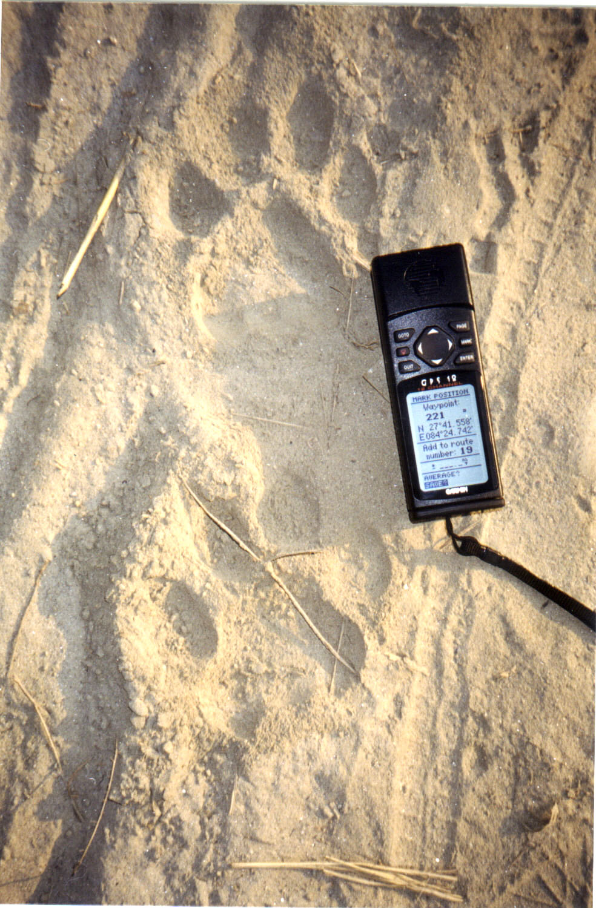
To Provide Quality Control
Coordinators visit each
“Ranger” monthly to:
Confirm data
And record location
Notes:
To provide quality control;
Field coordinators visited each VR each month to confirm the data and to record the GPS location.
VRs often covered the pugmarks with thorny branches to preserve the sign.
4. If there were no reports of kills or tracks during that particular month then technician and VR carries the surveys of the forest.

Slide 52
Social Aspects of “Village Rangers”
“Village Rangers” is a new approach
They have a strong professional pride about their work
The project increased their understanding of tiger biology and conservation issues
We hypothesize and plan to examine if local villagers also have increased understanding of tigers and conservation issues

Slide 53
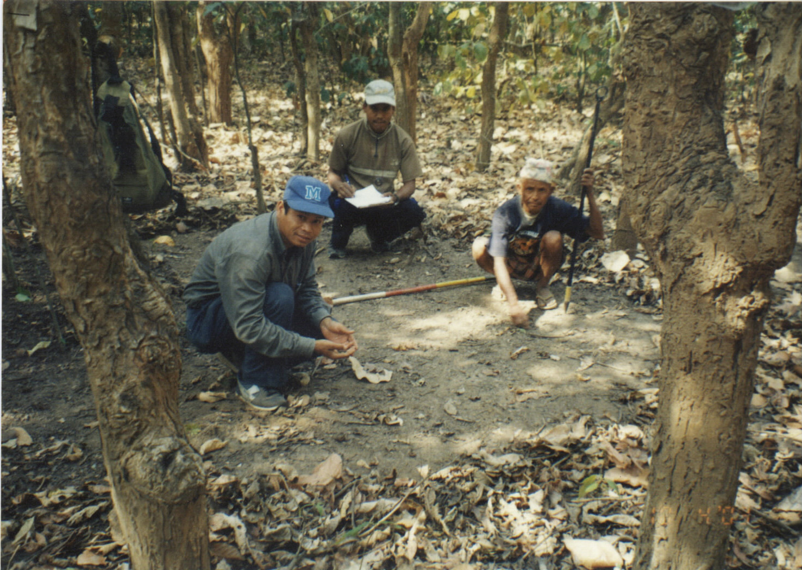
Future Directions of citizen envolvement
Expand the duties of Village Rangers to include prey assessment

Slide 54
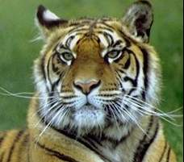
Payments for biological services
Why not make direct payments to local community forest user groups for measuring tiger prey abundance
And then provide them payments for maintaining
Notes:
Stratified random samples selected using 1:25000 topo map grids of the landscape in advance
Sample unit: 625 m long straight line georeferenced transect with 25 circular 10 m2 plots spaced 25 m apart
Measure the prey abundance, horizontal cover, and type and extent of human use.
At each point a transect line was run and coordinates of end points recorded.
Each transect were studied to count pellet groups of tiger prey species and other variables in 25 circular plots of 10 m² size at 25 m intervals.
Pellet groups count during the dry season (February to April)
Pellet size group: Small: barking and four-horned
medium: Chital, hog deer, and wild pig
large: sambar, swamp deer, blue bull
Others: primates, forest bovids, and livestock

Slide 55
Conclusions from citizen based distribution mapping
Establishing the Village Rangers biodiversity monitoring system created a strong link between citizens and governemnt
Currently joint monitoring of carnivore and prey is by forest guards and Village Rangers
Model tiger dynamics in relation to livestock grazing practices, natural prey and ecoloical variables

Slide 56
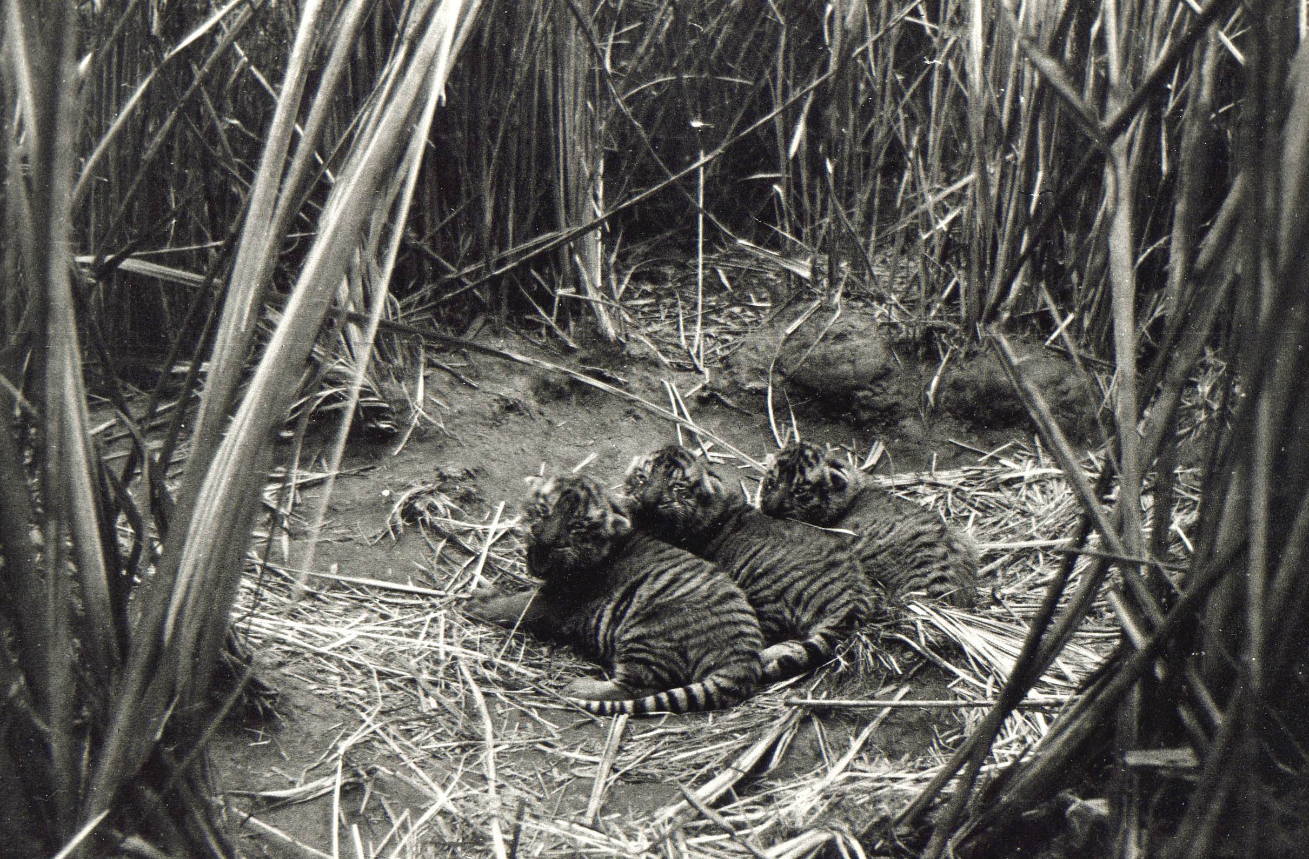
The tiger’s future depends on humans using land sustainably for their benefit as well as the tigers

