Slide 1
In the Legacy of Arniko: Newar Paubha Painting
Dina Bangdel, PhD
Department of Art History
Virginia Commonwealth University, USA
Notes:
1

Slide 2
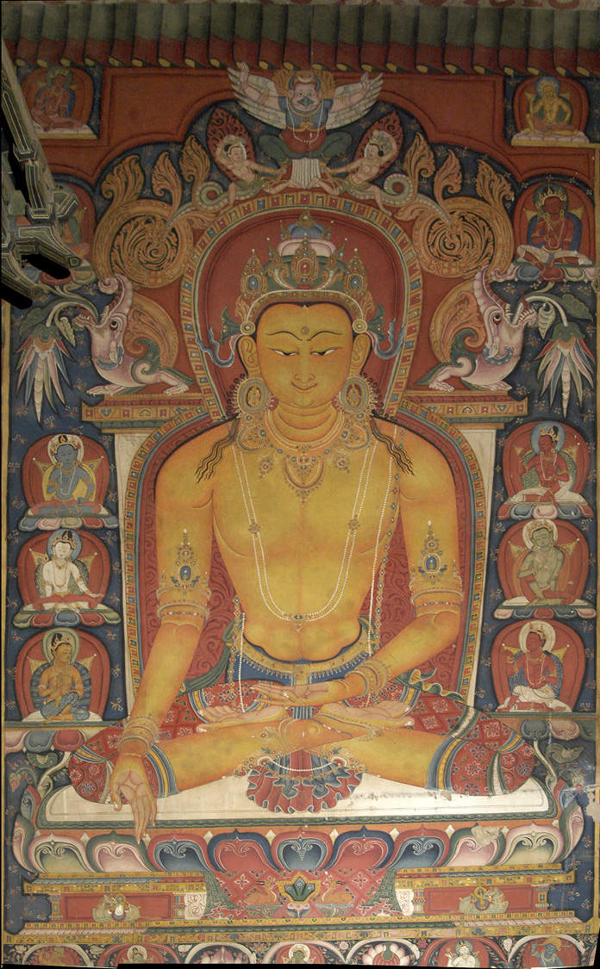
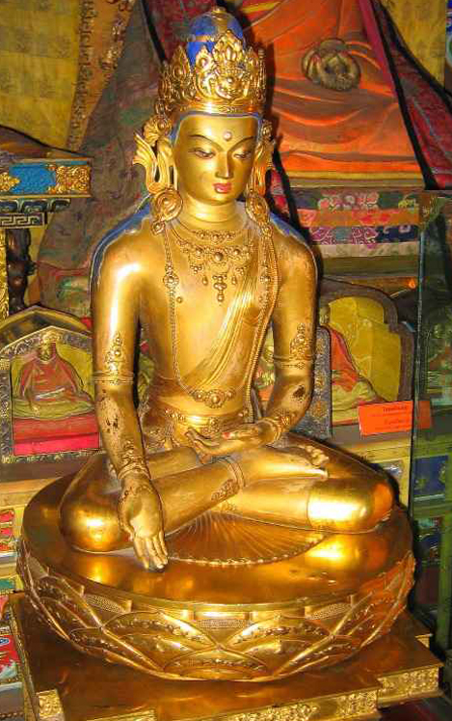
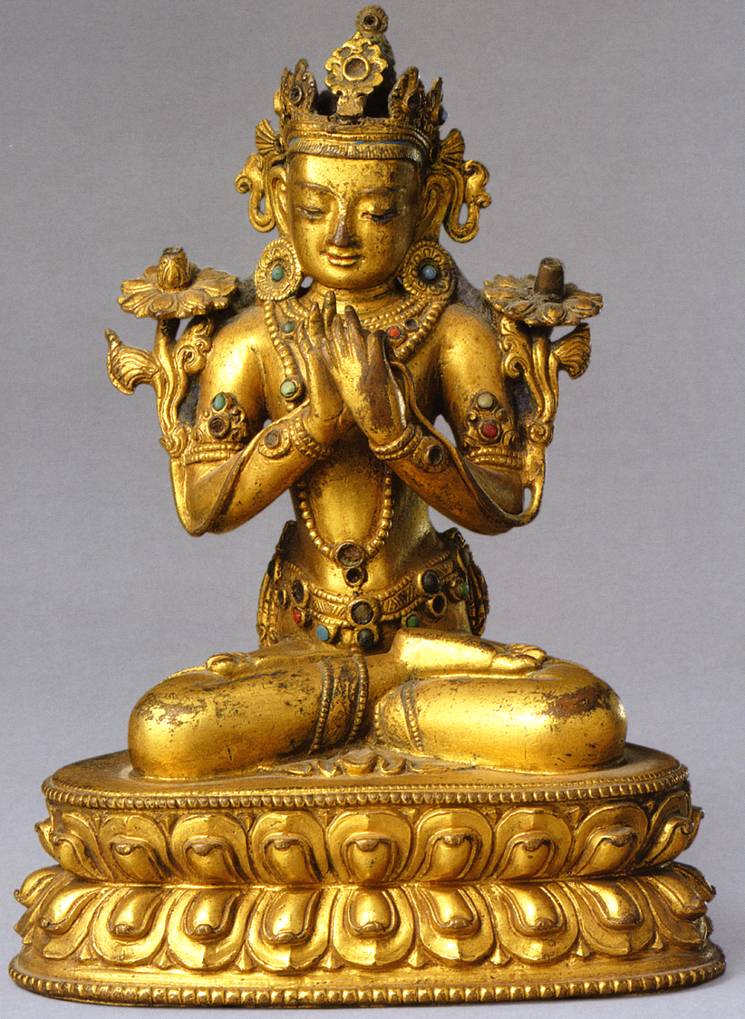
Tibet, Murals at Shalu Monastery
Ca. 13th-14thc
China, Yuan Court. 1305.
Attributed to Arniko
Mongolia, Zanabazar School.
Ca. 17thc

Slide 3
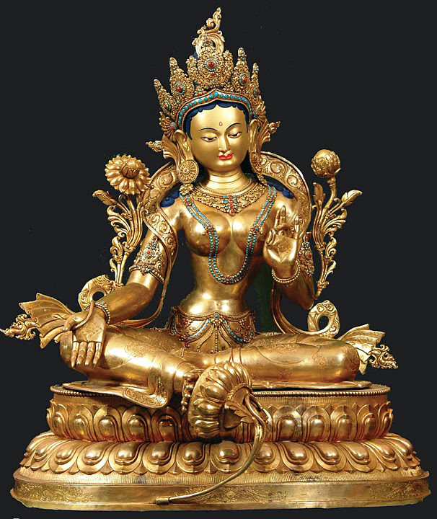
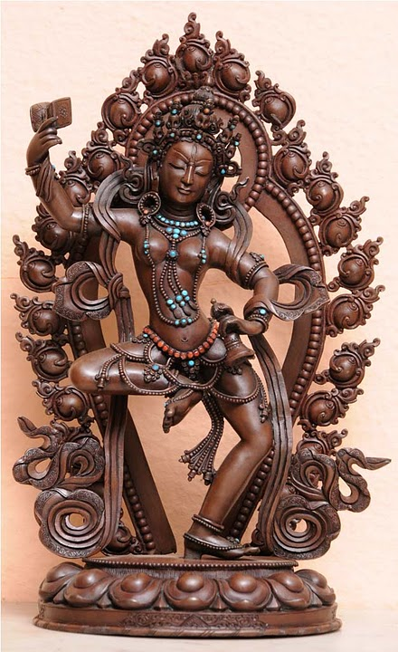
2011

Slide 4
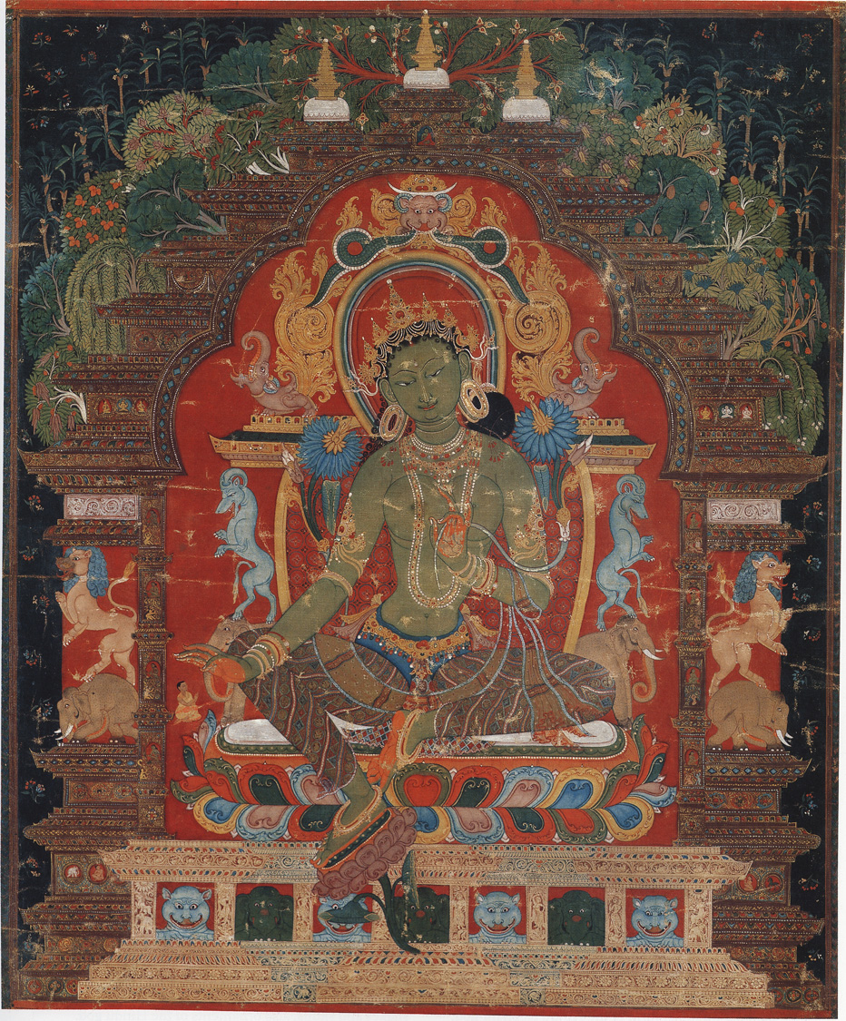
1. The Study of Himalayan Art
Style
Iconography / Iconology
Function
* Artist
* Authority (text / priest / teacher)
* Donor

Slide 5
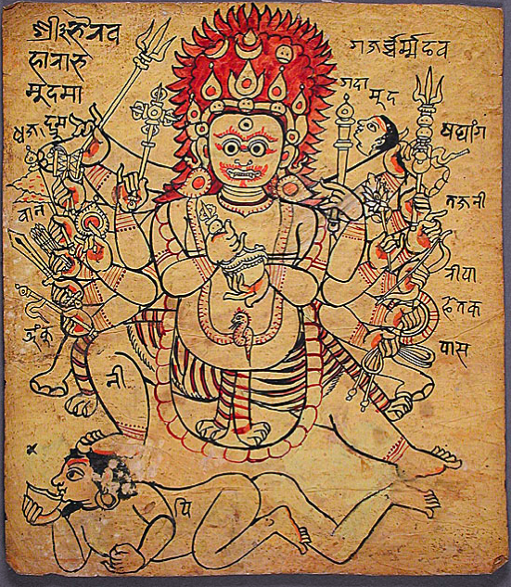
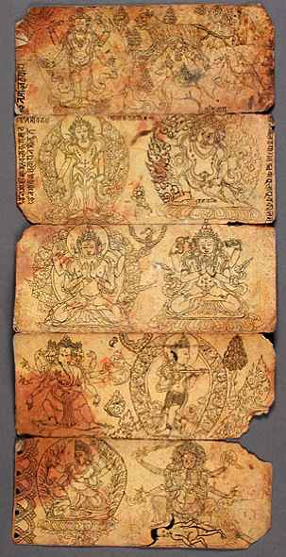
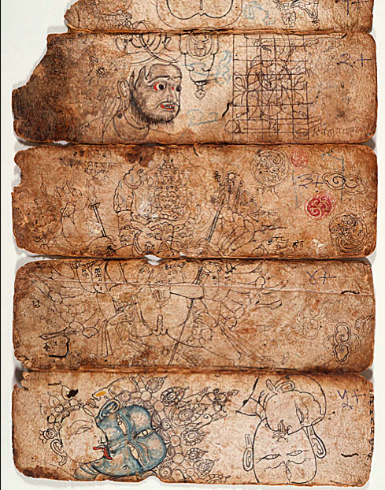

Slide 6
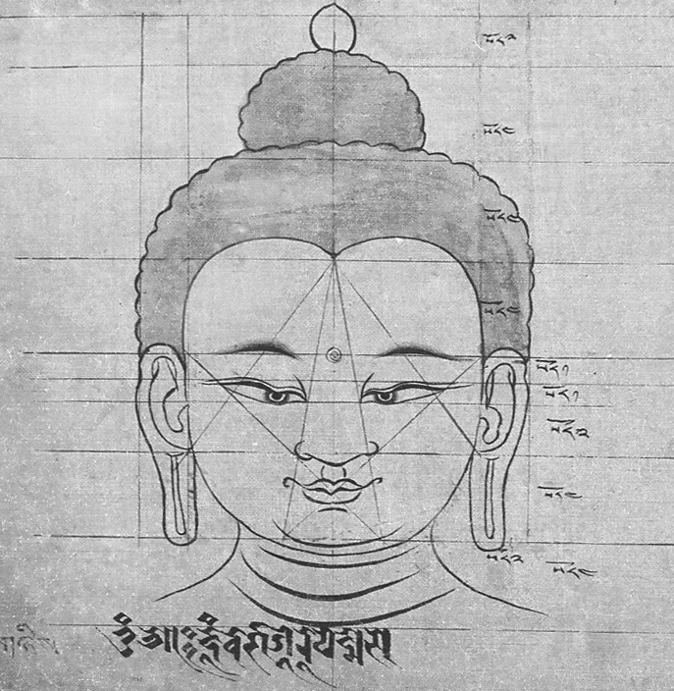
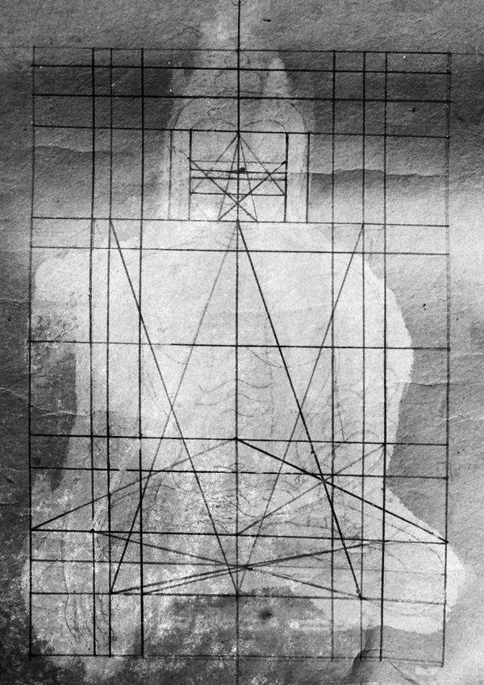
Painting Techniques: Iconometrics / Iconography

Slide 7
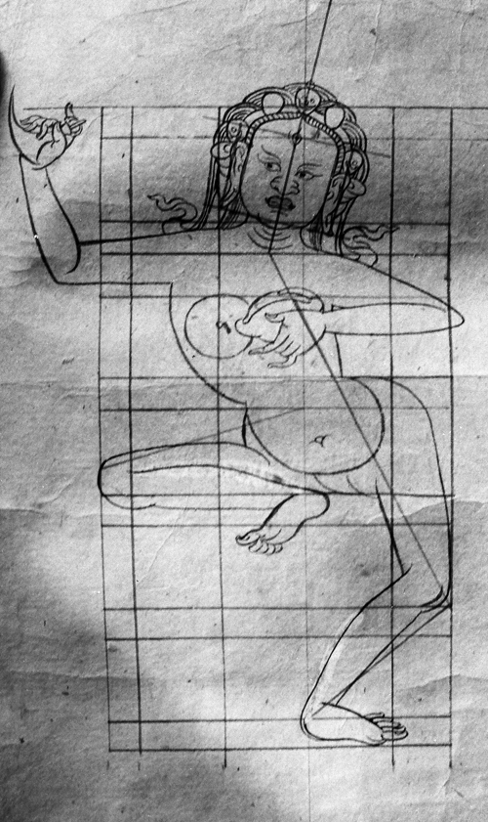
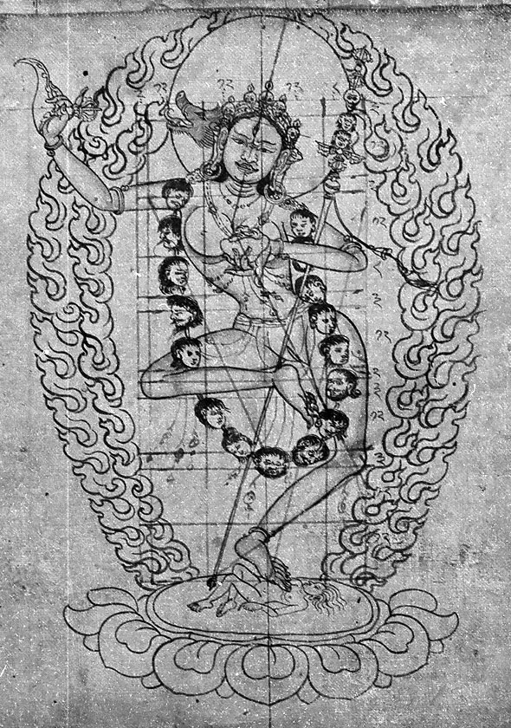

Slide 8
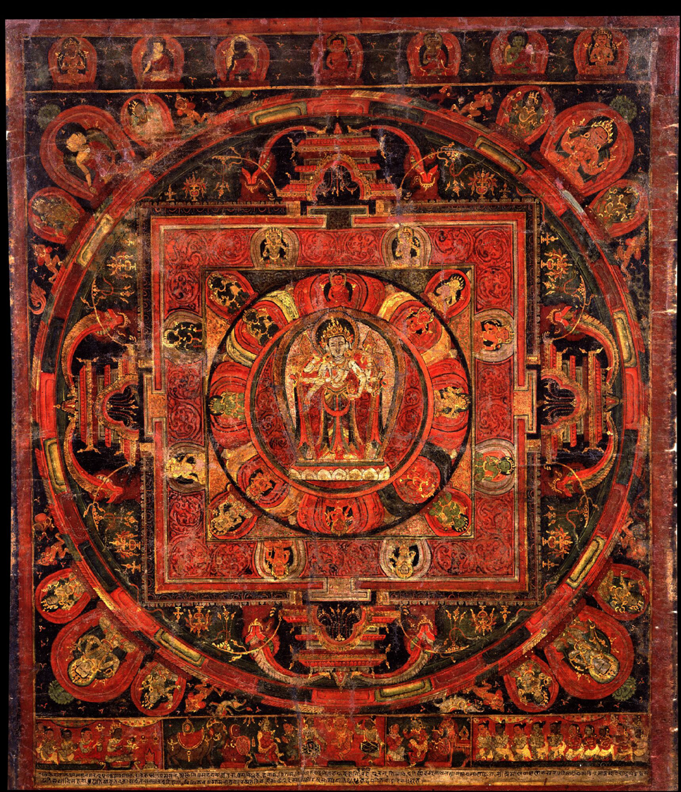
AmoghapasaLokesvara
Inscribed and dated 1508
Artist: AbhayajivaChitrakar
Donor: Kathmandu

Slide 9
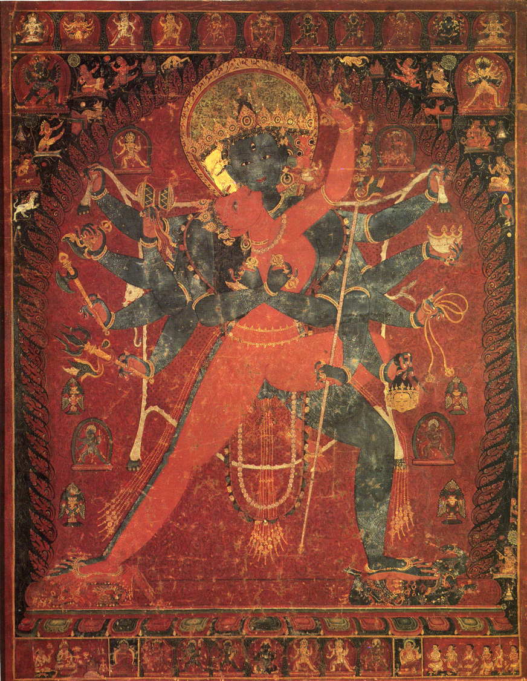
Source of Dharma:
Teachers/Buddhas
MAIN DEITY: Cakrasamvara
And Vajravarahi
READING A PAINTING
Protection Deity/
Donor’s Choice

Slide 10
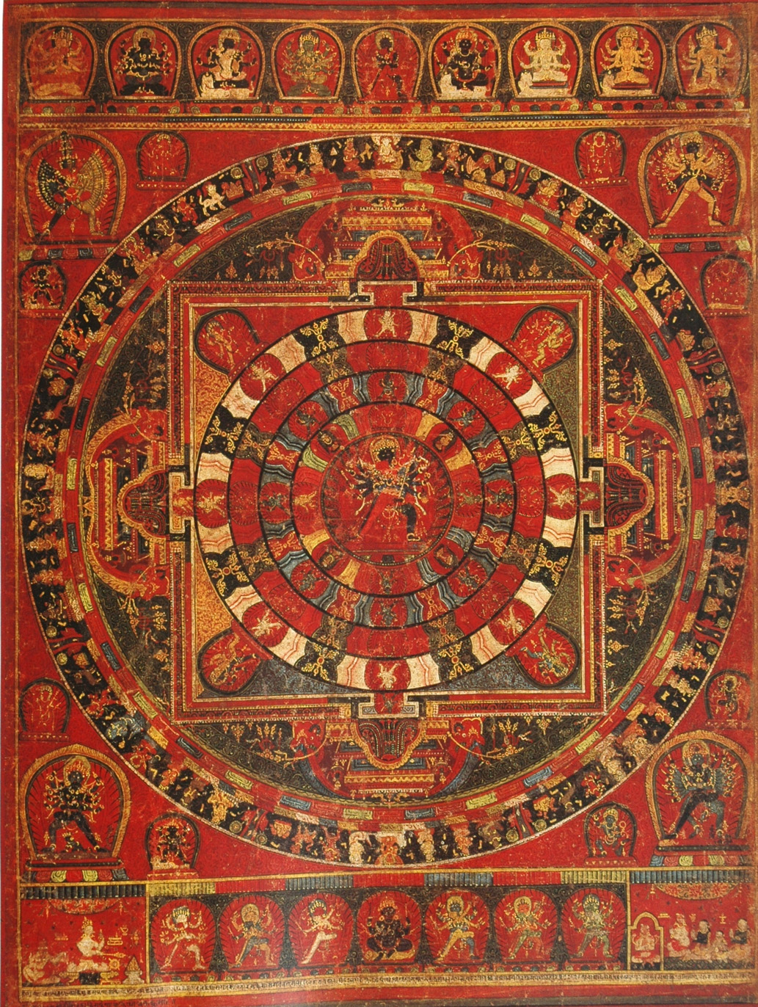
Teachers
ChakrasamvaraMandala
READING A MANDALA
Donors / Protectors

Slide 11
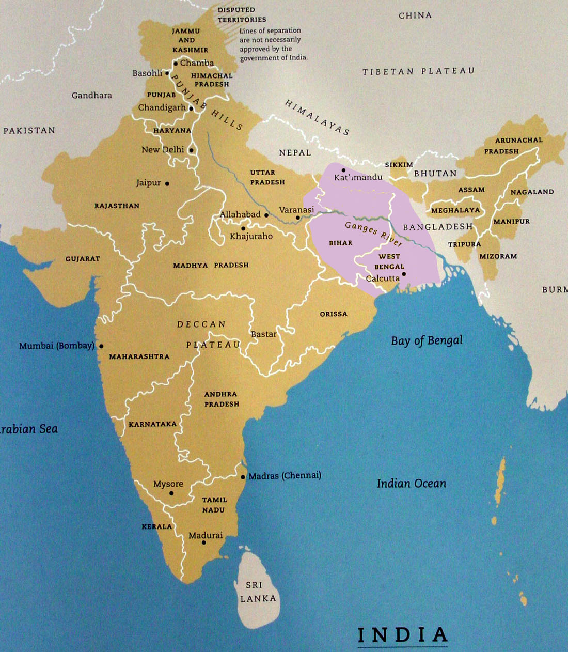
2. Newar Paubha Painting
Notes:
PATA : Manjusrimulakalpa

Slide 12
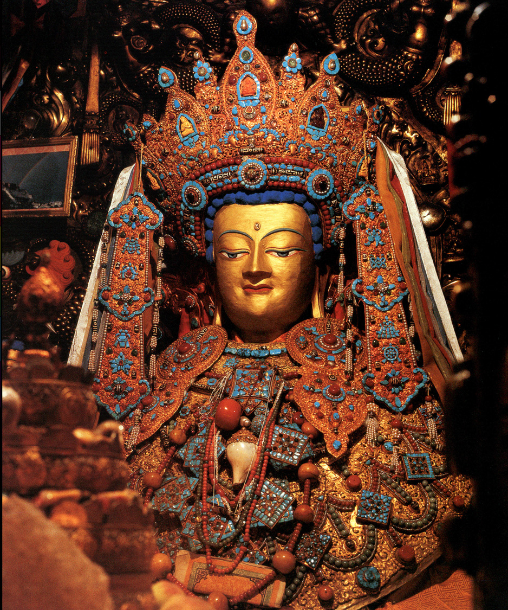
Jokhang Temple
Lhasa, Tibet
Ca. 7th century

Slide 13
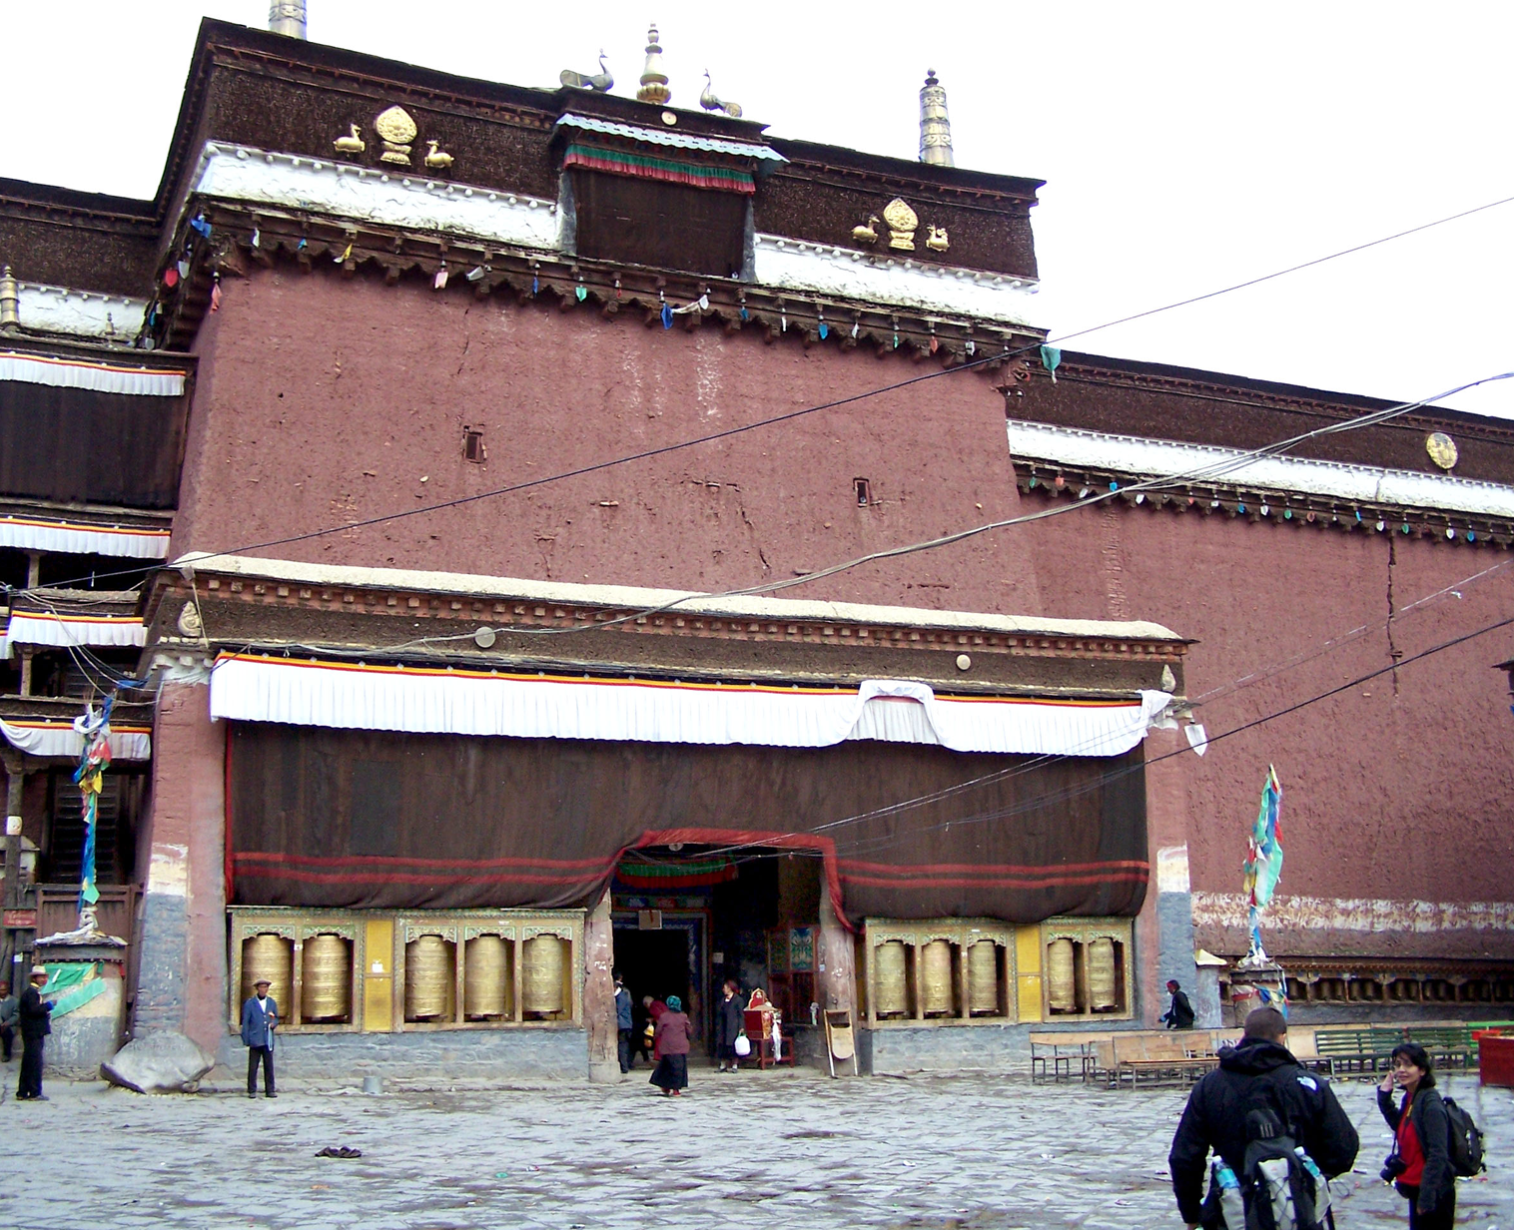

Slide 14
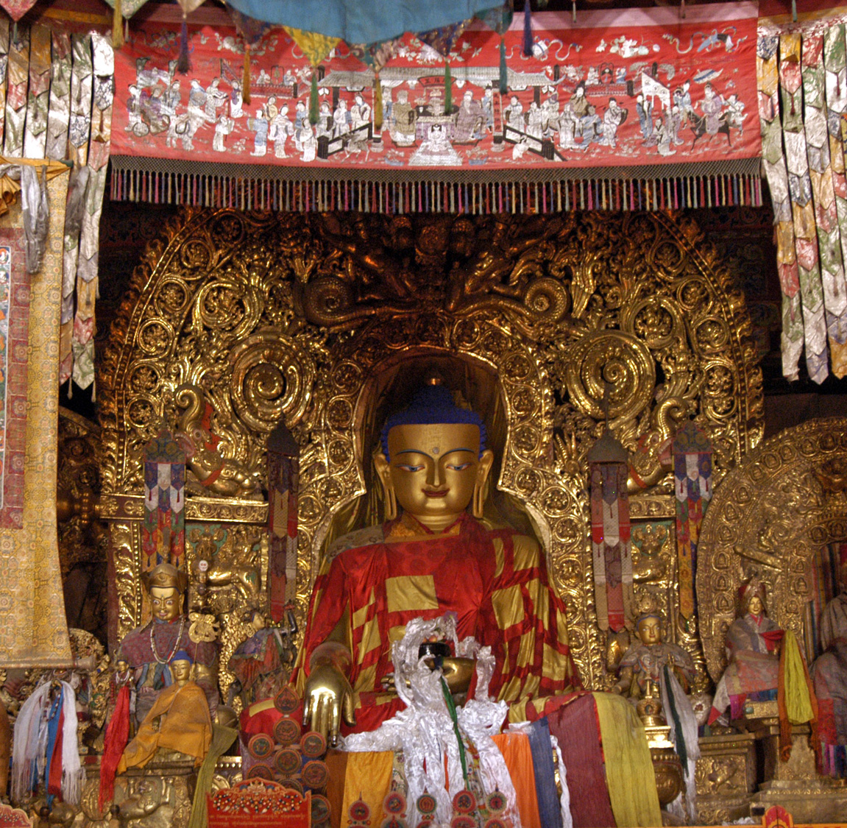
Sakya Monastery
Lhasa, Tibet
Ca. 13thc / Arniko

Slide 15
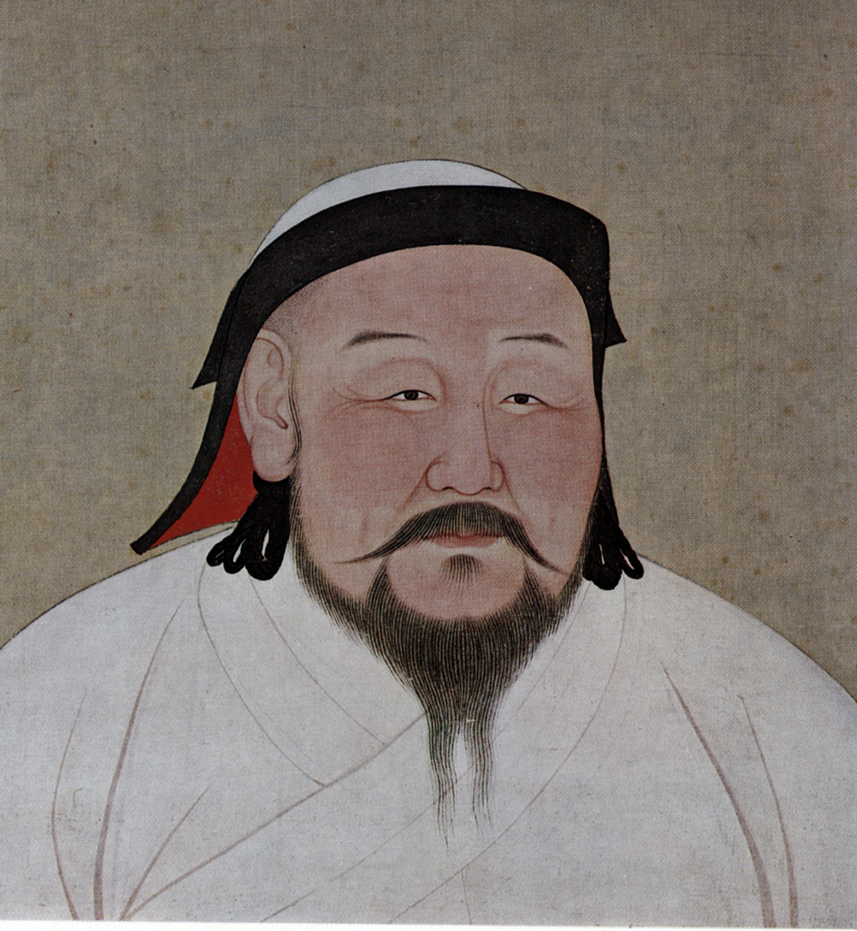
Arniko (attributed)
Kublai Khan
Yuan Dynasty, China
13thc

Slide 16
Manjusri
Attributed to workshop of Arniko
Yuan dynasty; dated 1305
Gilt bronze.
Palace Museum, Beijing

Slide 17
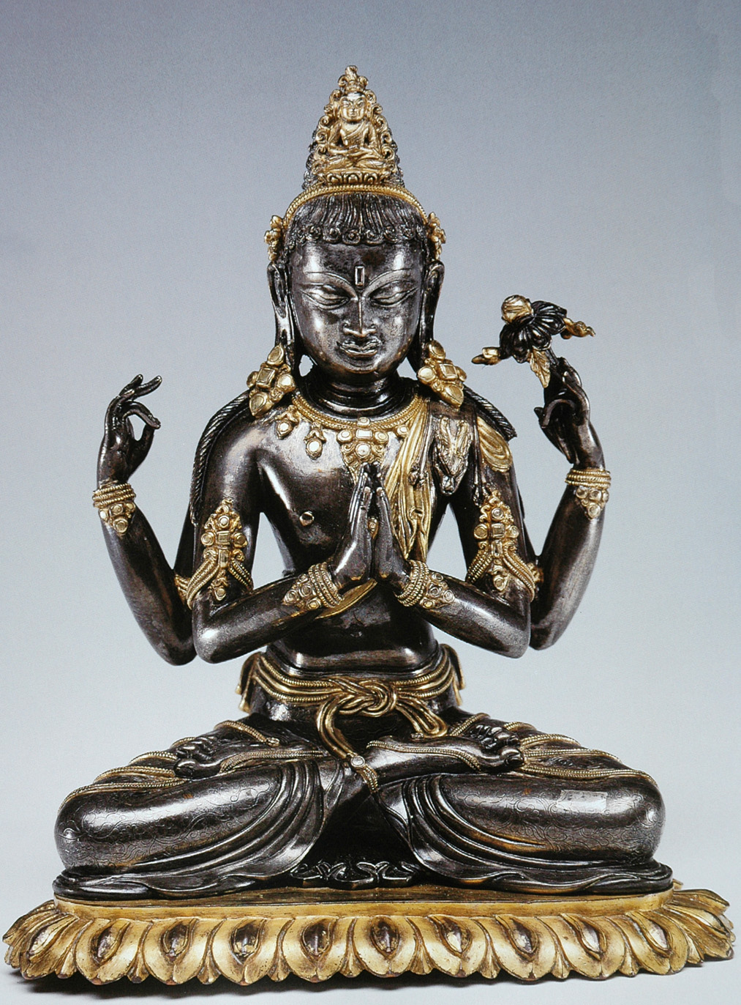
SadaksariLokesvara
China, ca. 13th century
Workshop of Arniko
Virginia Museum of Art

Slide 18
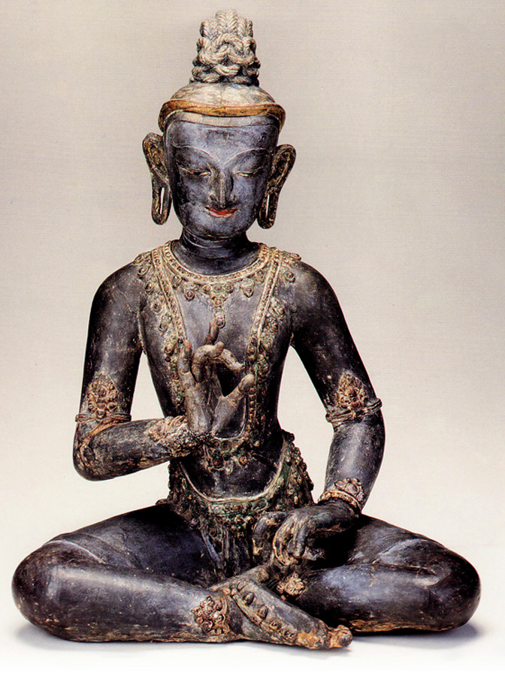
Bodhisattva
Attributed to workshop of Arniko
Yuan dynasty
Dry Lacquer
Palace Museum, Beijing

Slide 19
Green Tara
Attributed to workshop of Arniko
Ca. 13th century
Cleveland Museum of Art

Slide 20
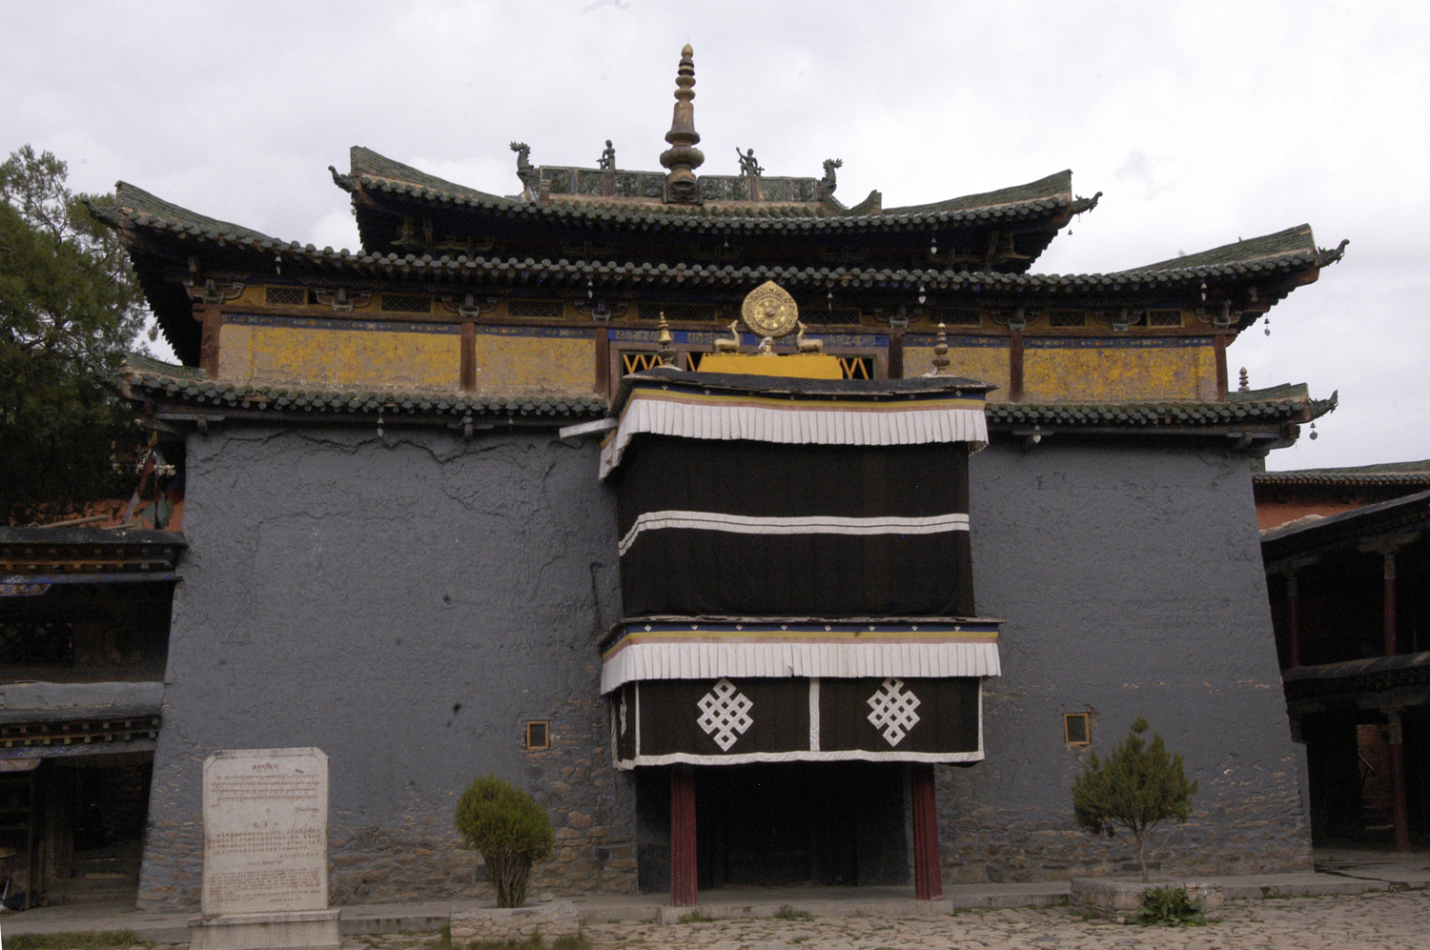
Shalu Monastery

Slide 21
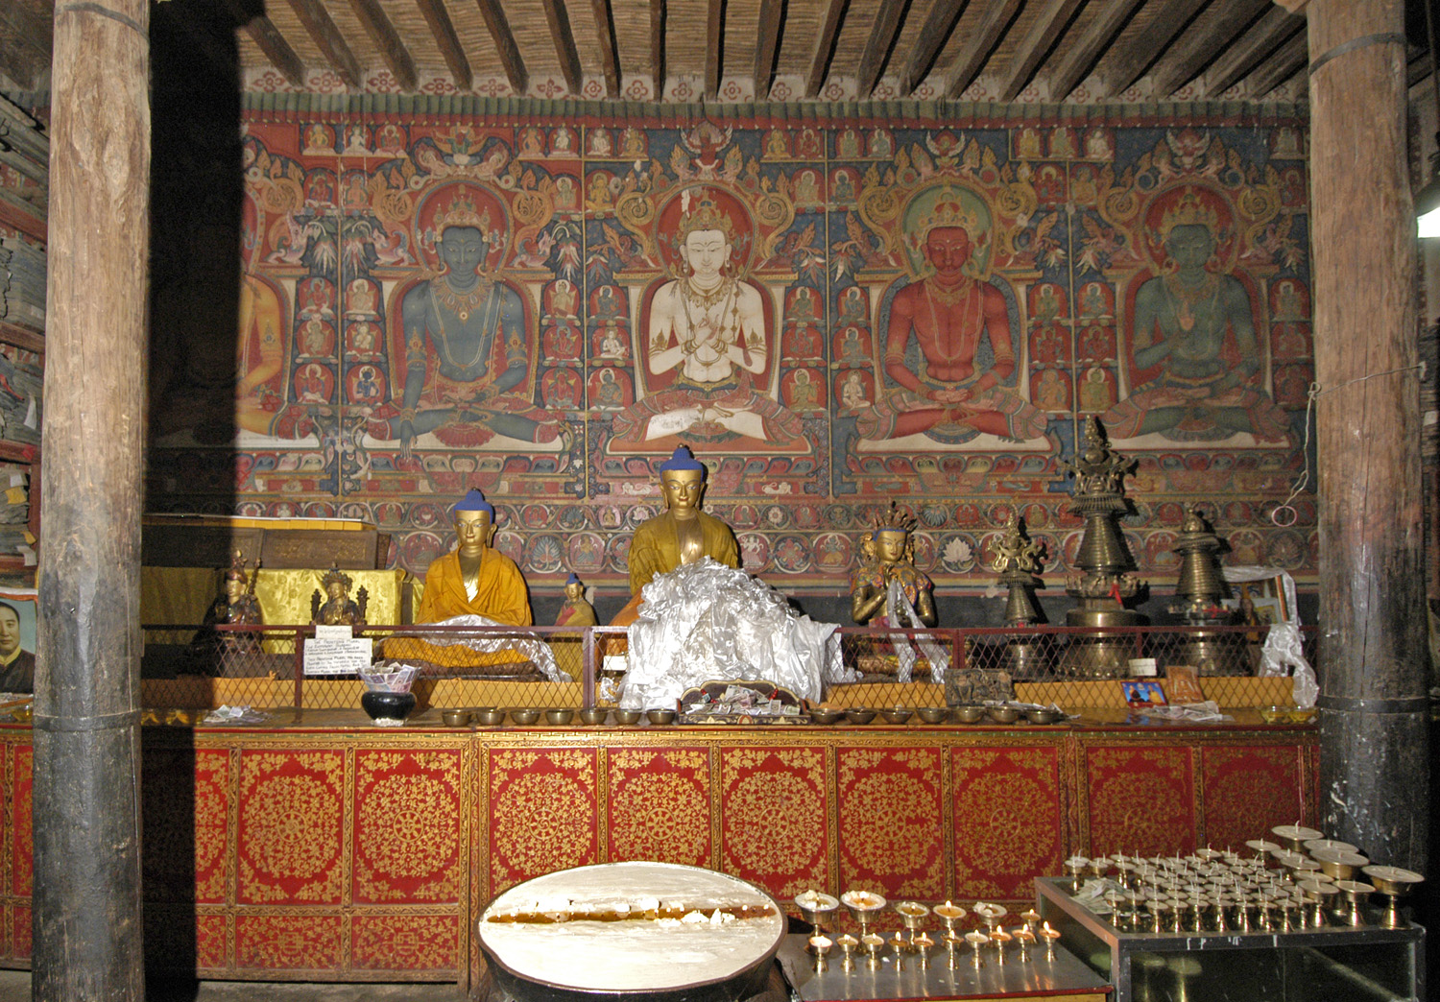

Slide 22
Shalu. Ca. 13th century
Newar influence

Slide 23
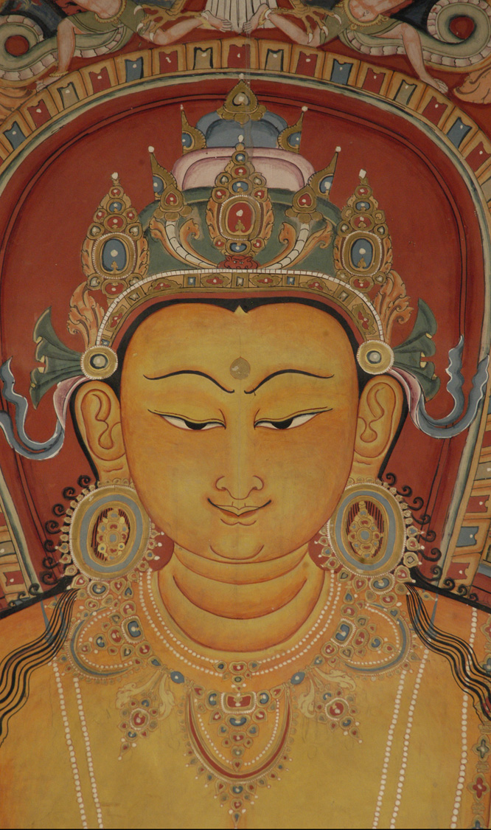
Newar painting style: 13thc
Shalu murals
Ratnasambhava

Slide 24
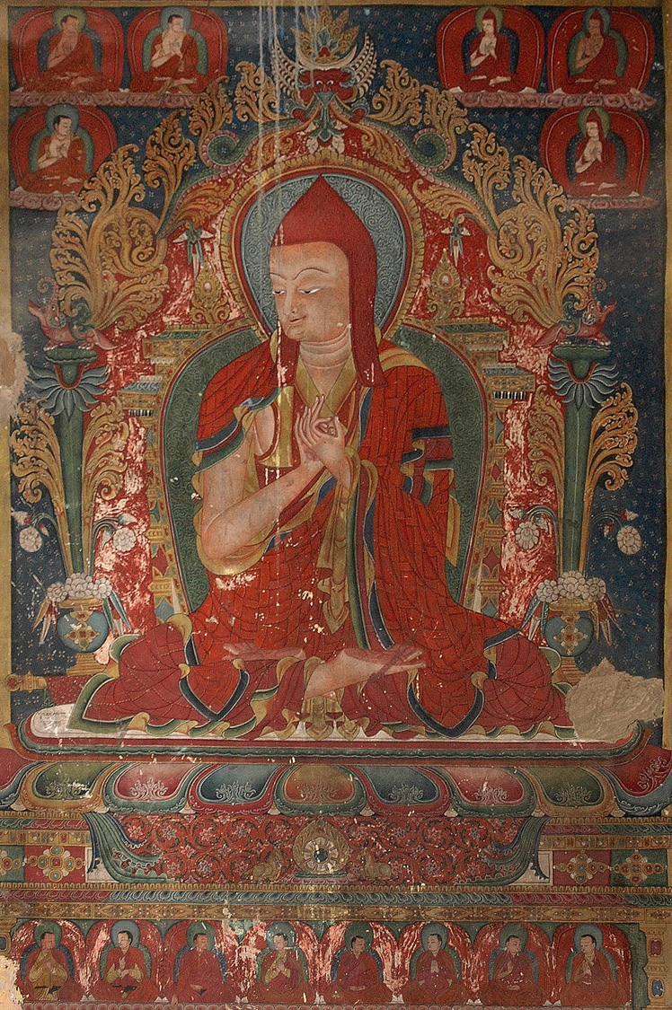
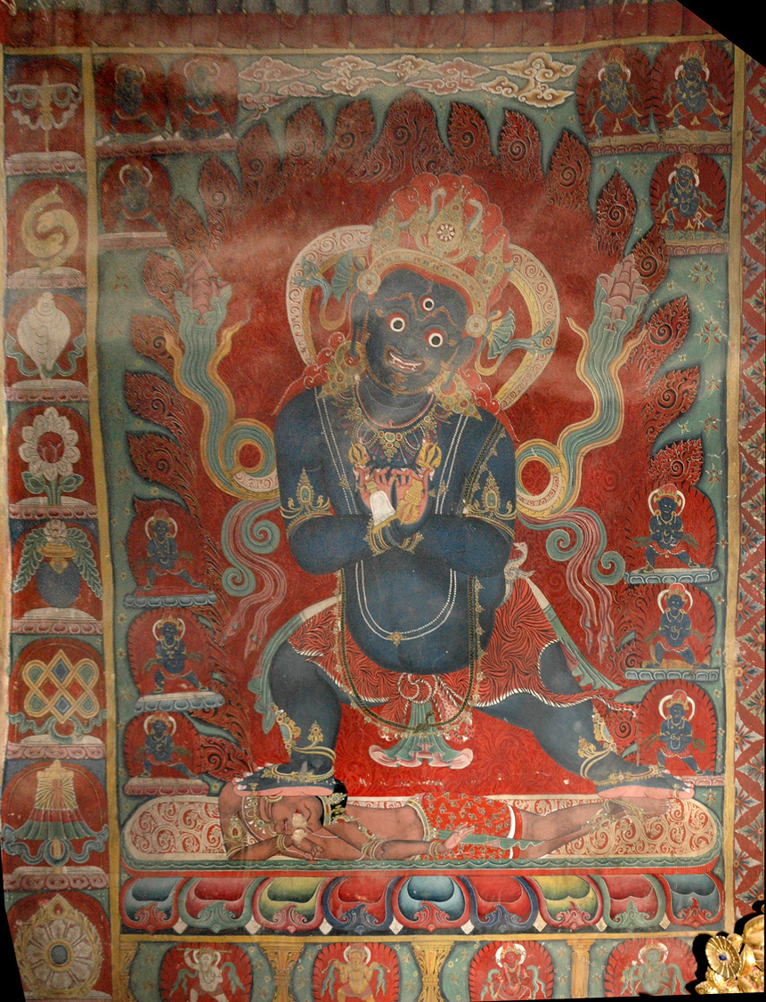

Slide 25
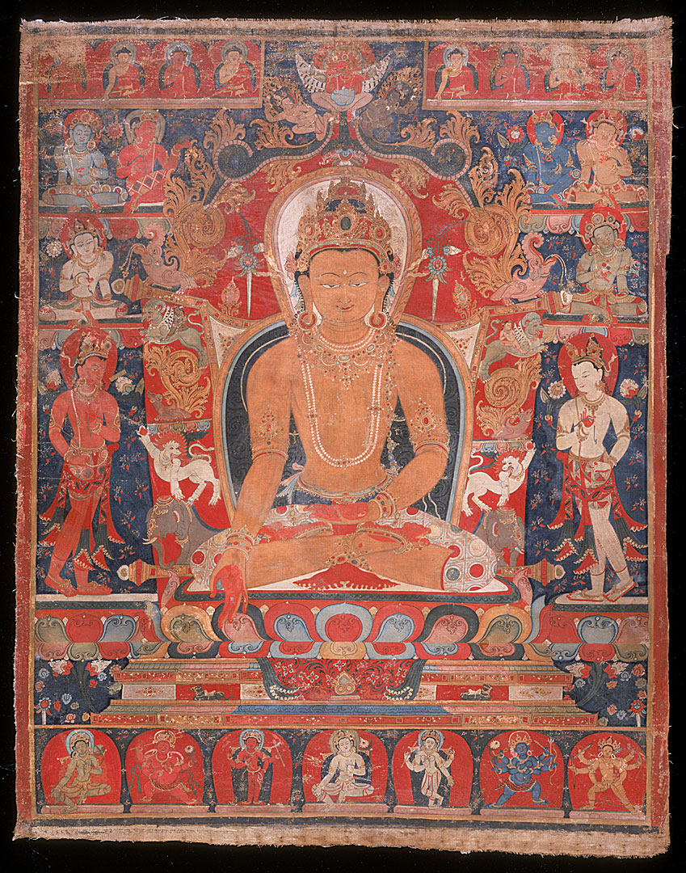
Ratnasambhava
Newar artists in Tibet
Ca. 12-13th century
Los Angeles County Museum of Art

Slide 26
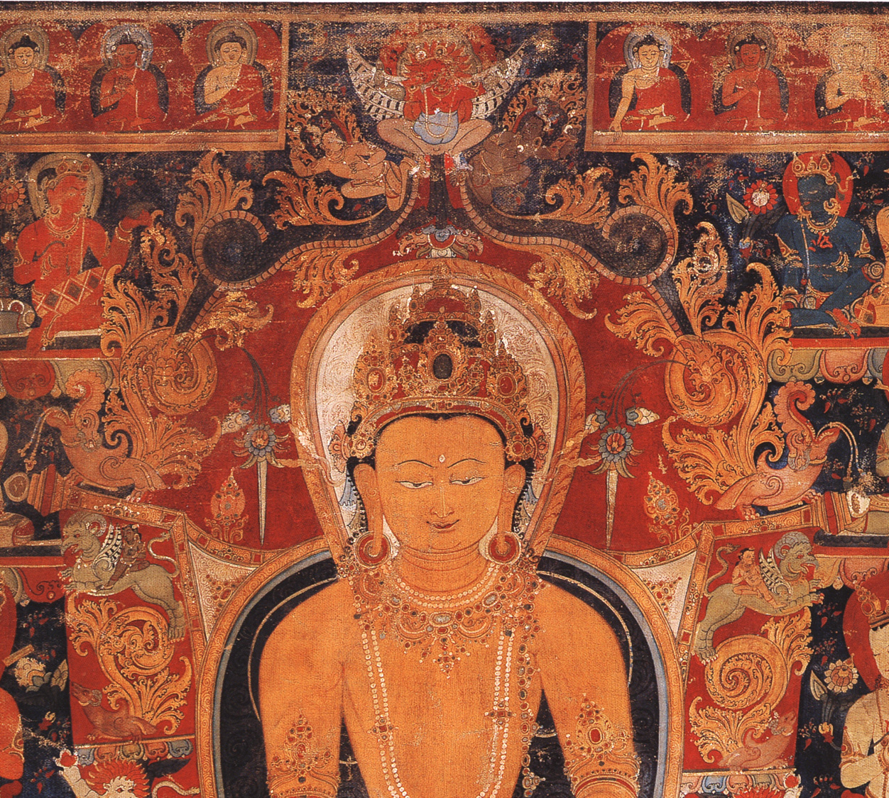

Slide 27
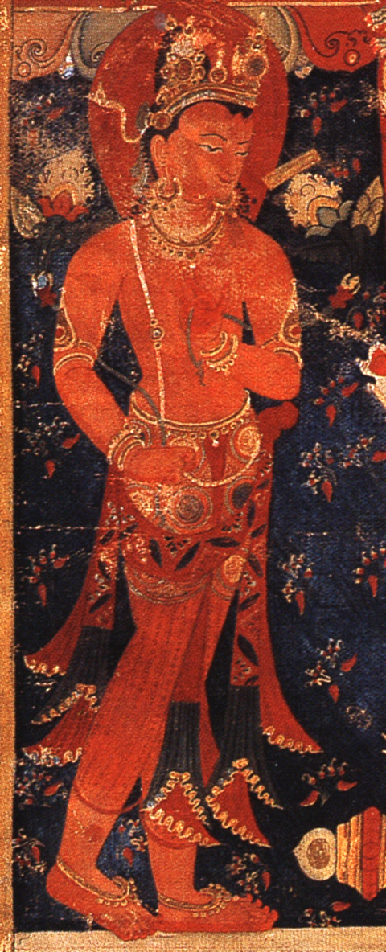
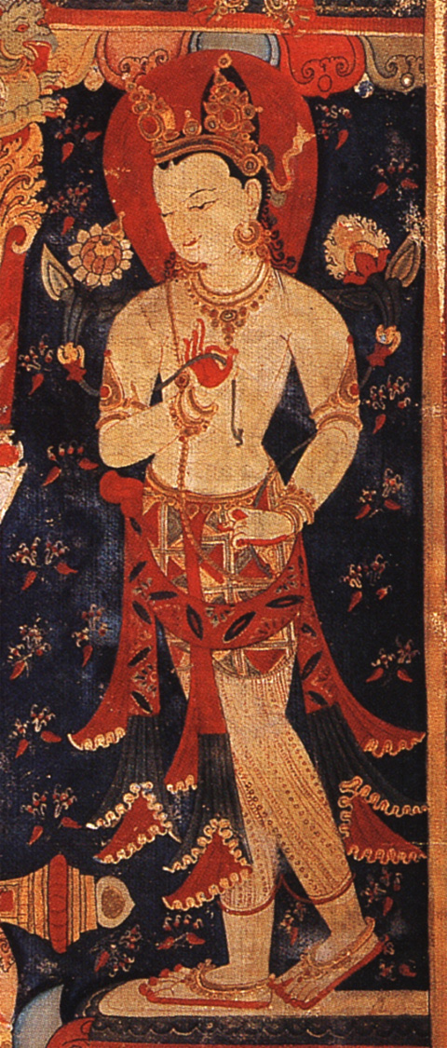

Slide 28
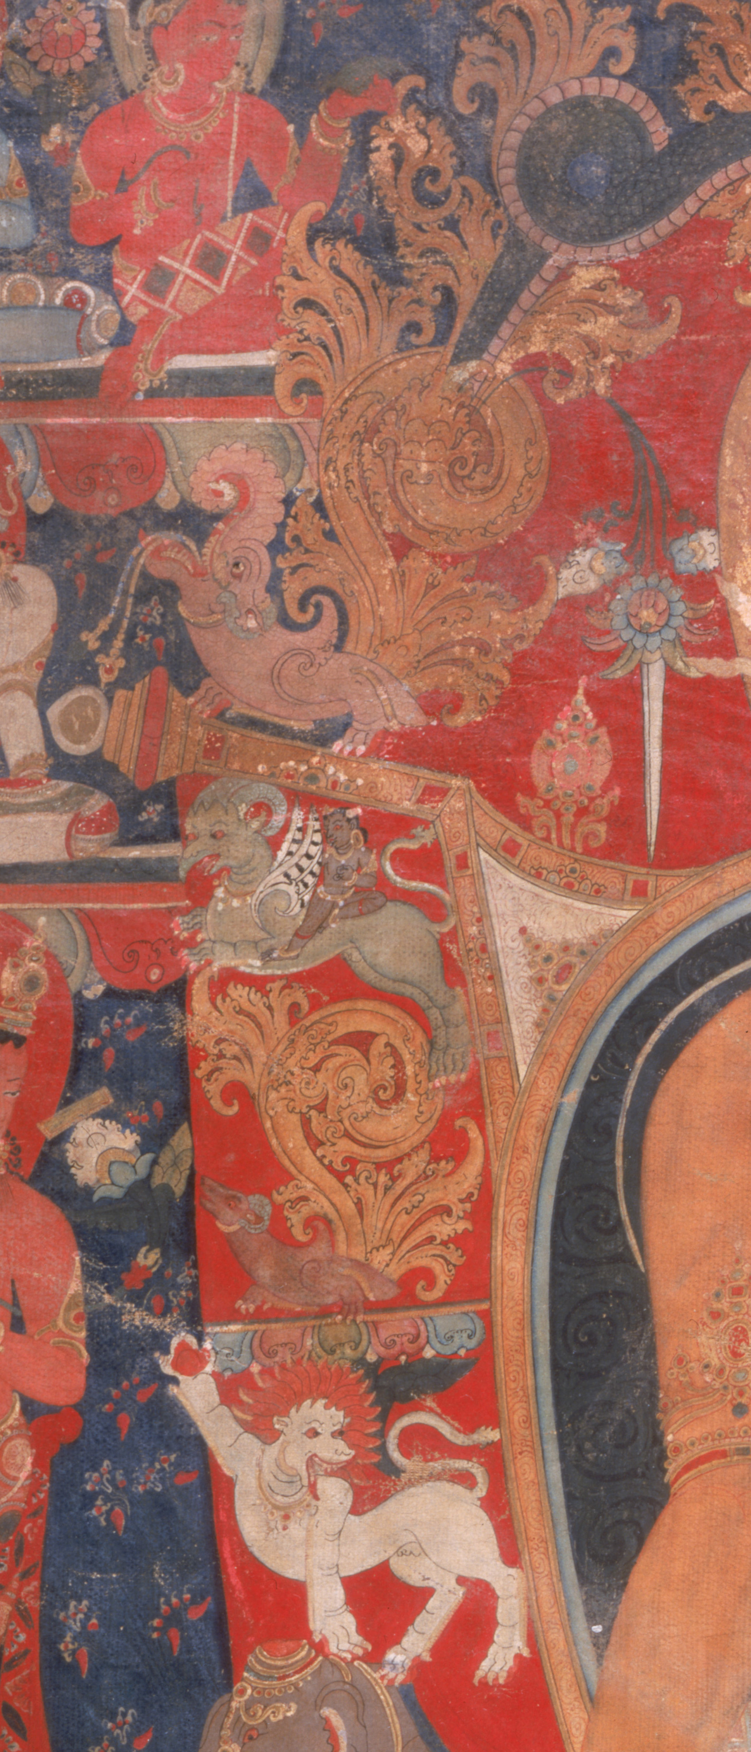
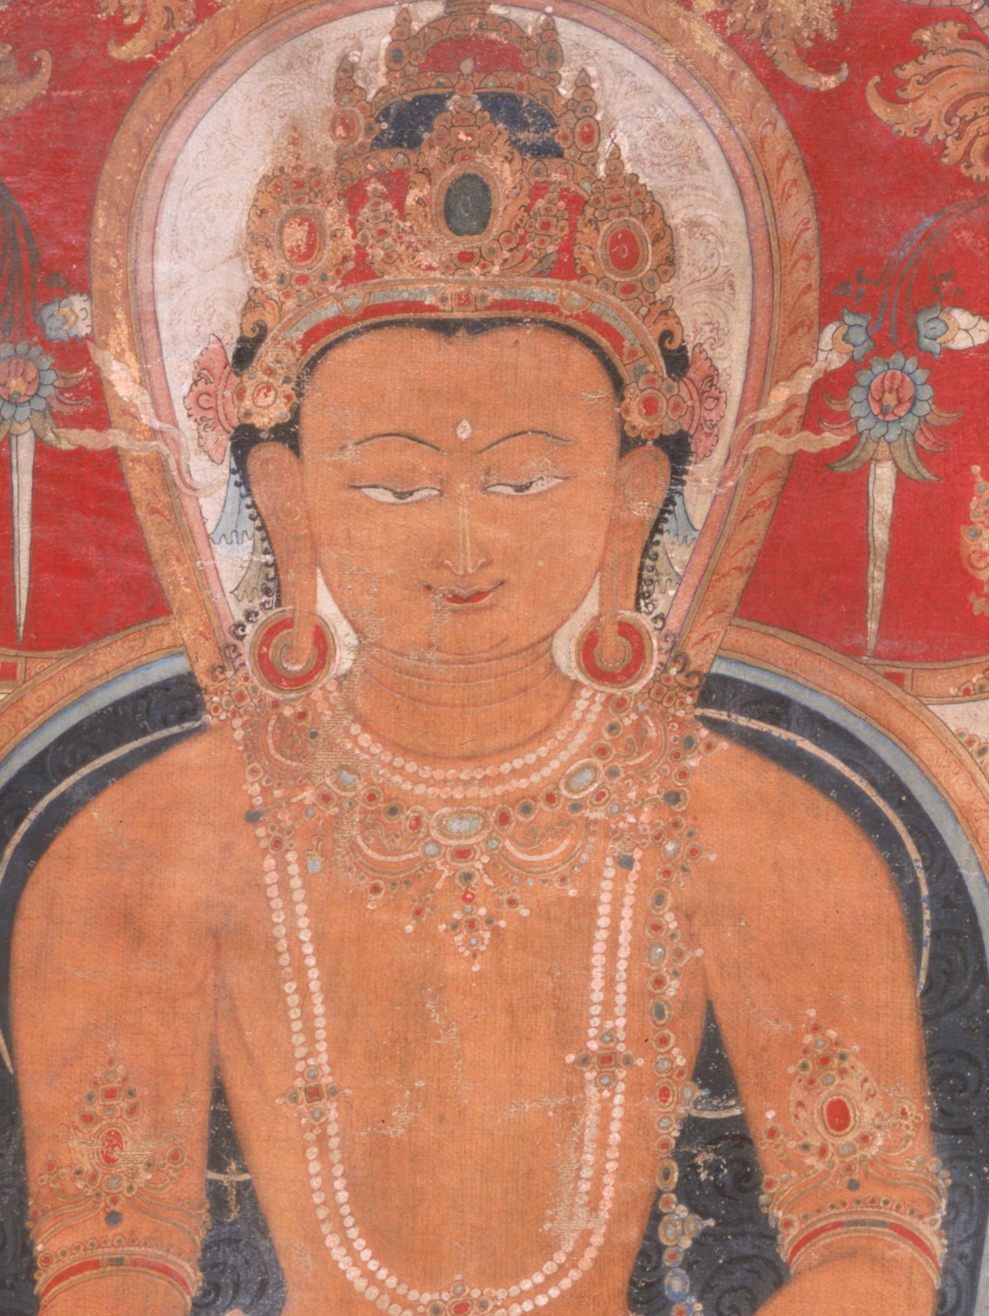
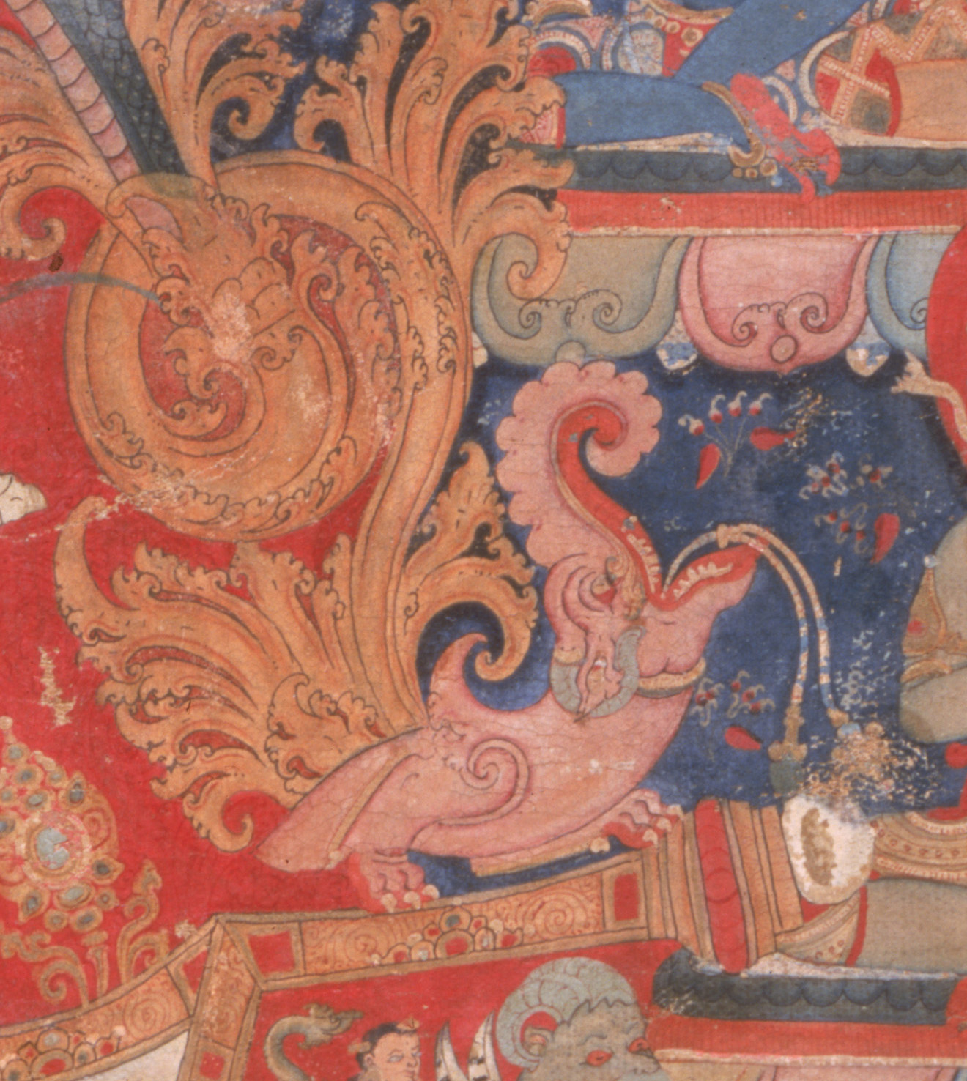
Newar style

Slide 29
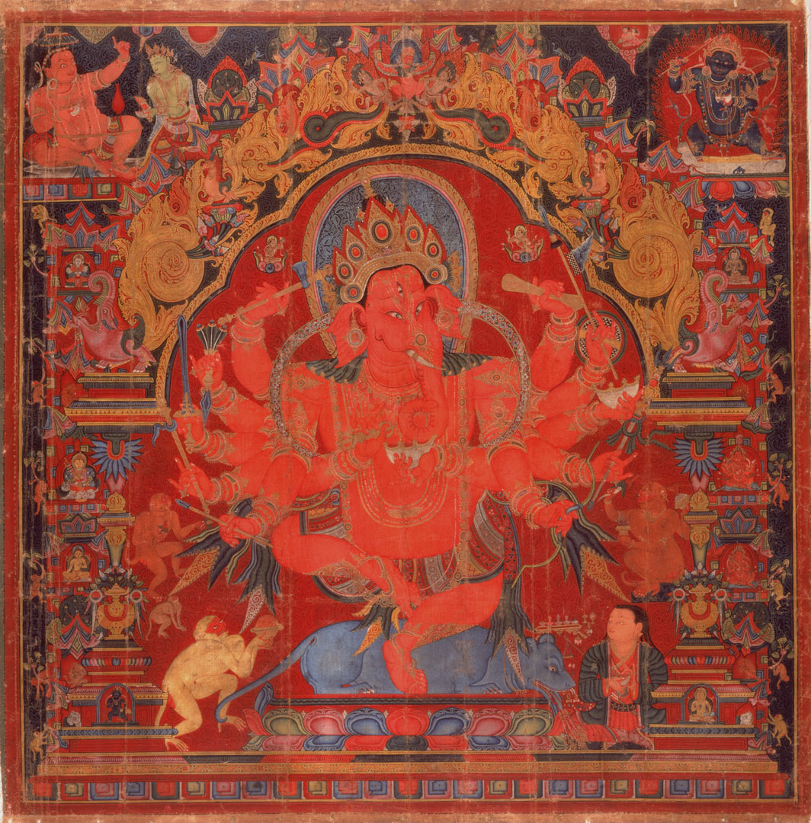
RaktaGanapati by Jivarama Tibet, Shigatse Dated 1435 Private Collection

Slide 31
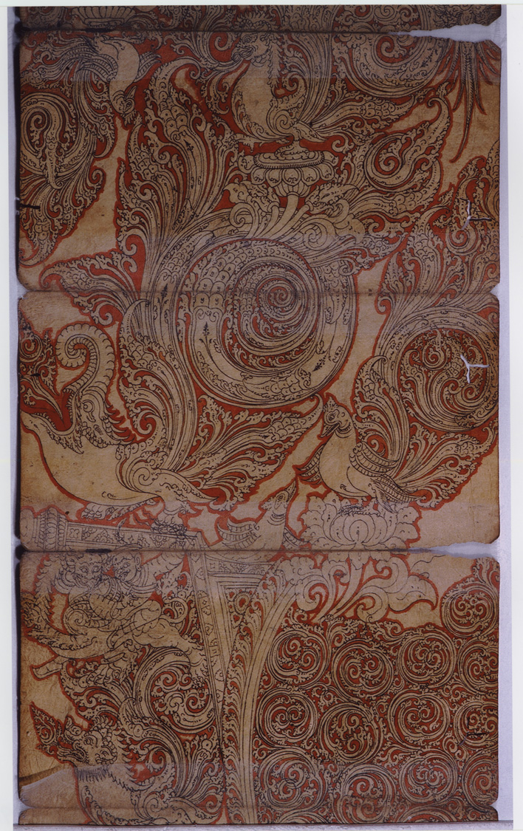
Artist Jivarama’s Sketchbook Dated 1435 Neotia Collection

Slide 32
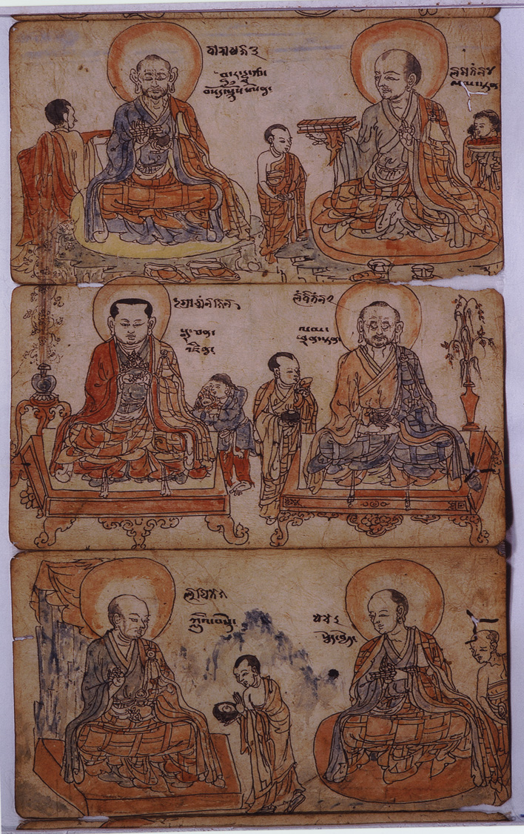
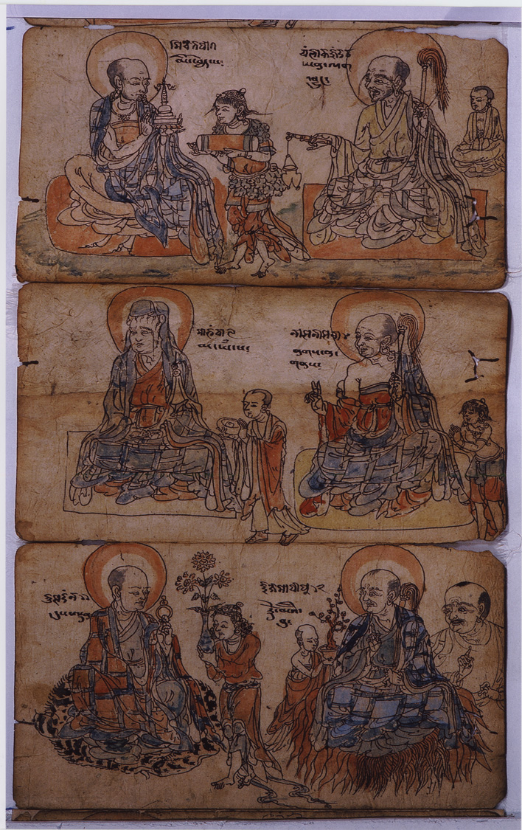

Slide 33
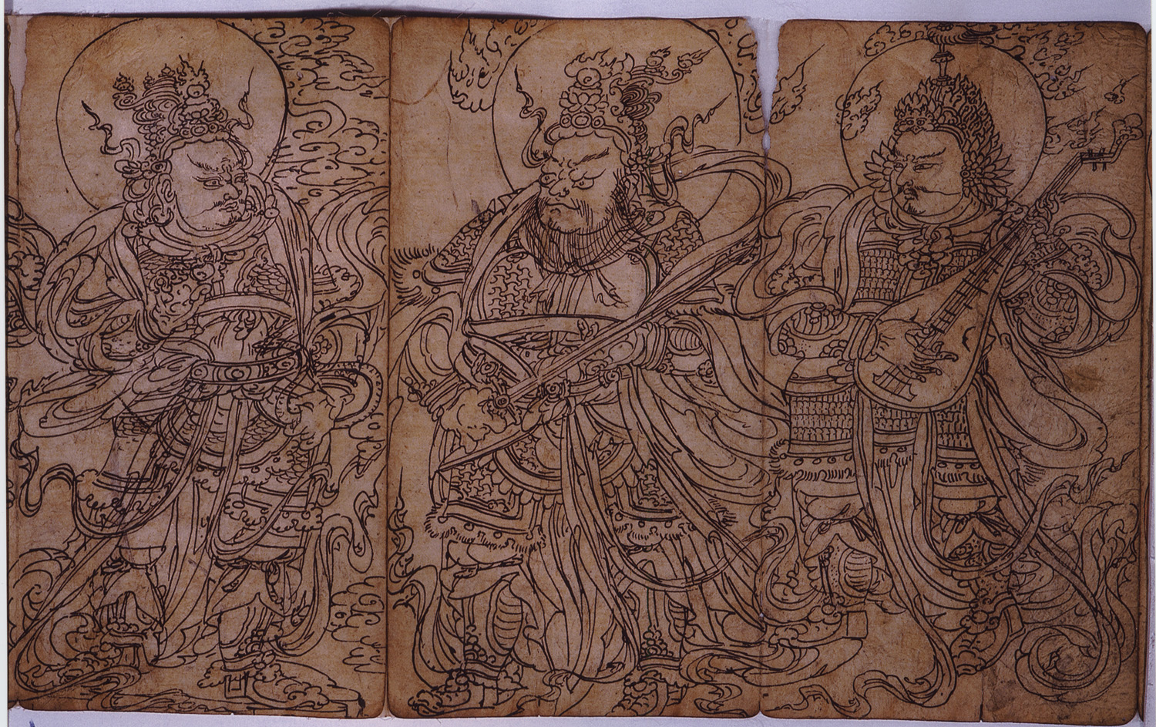

Slide 34
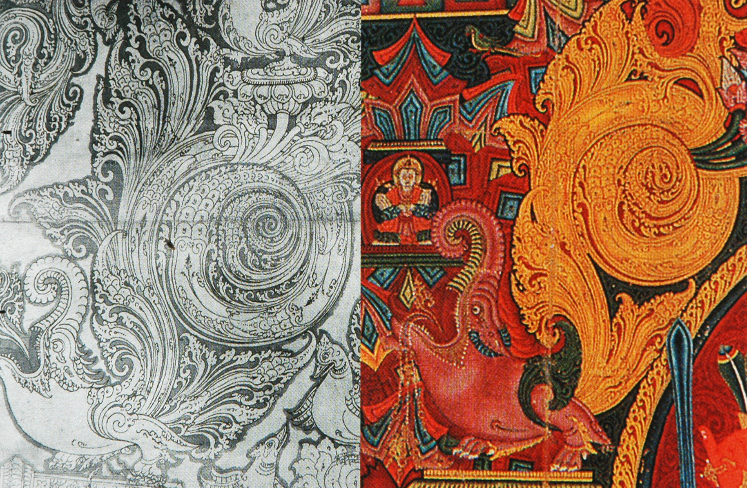

Slide 35
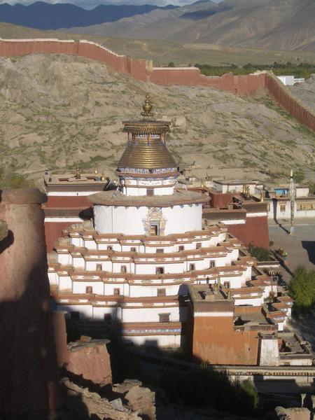
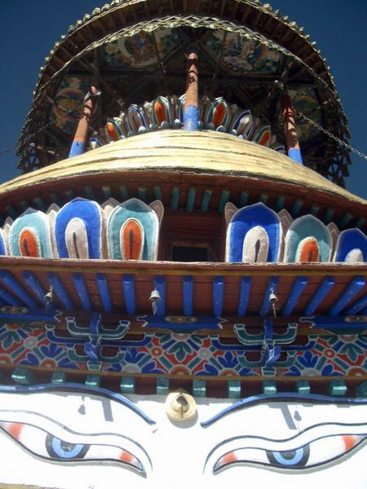
Kumbum, Gyantse

Slide 36
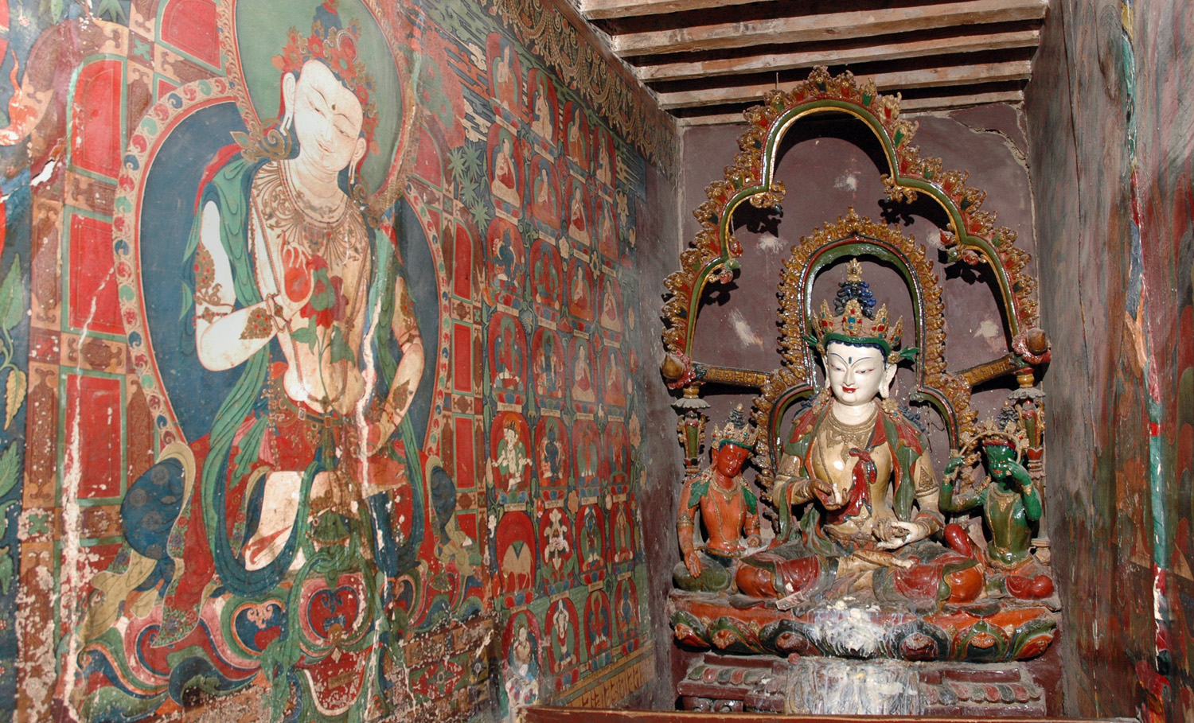
Inner Shrine Rooms: Sculpture/Painting

Slide 37
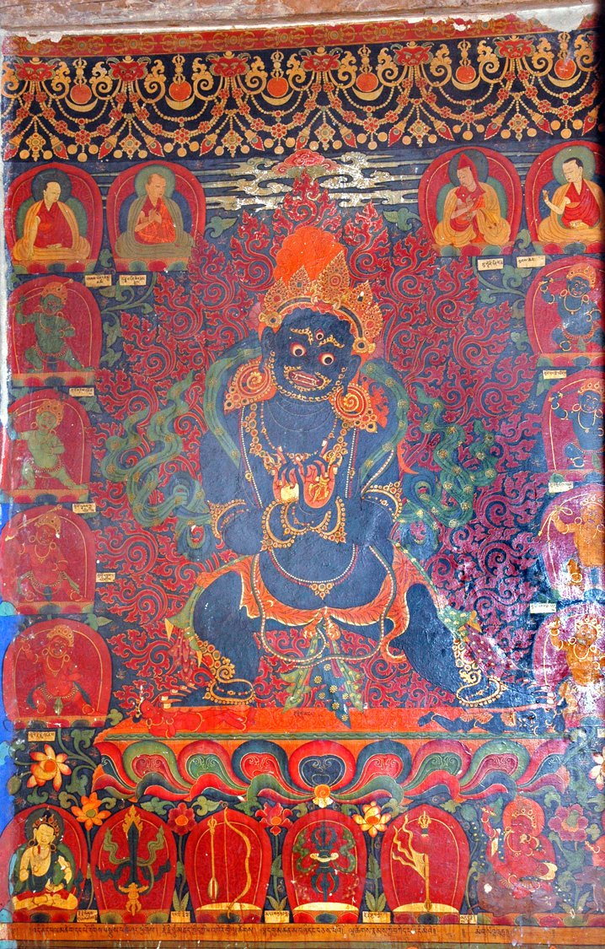
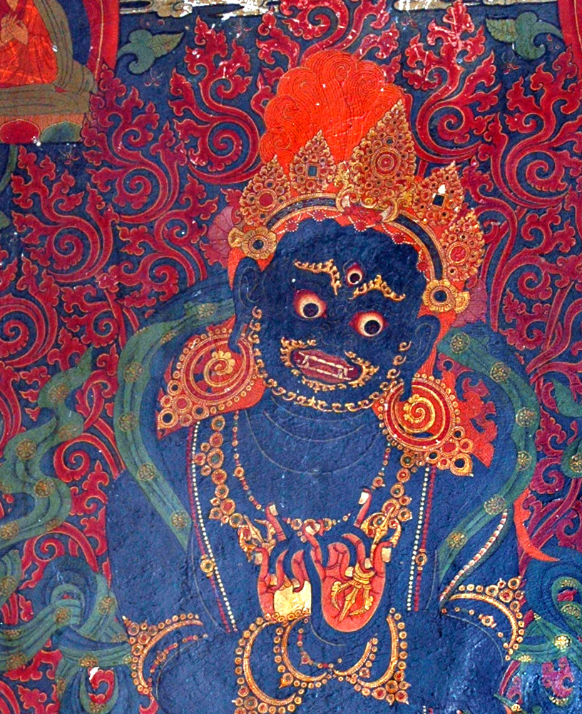
Mahakala
Kumbum Gyantse

Slide 38
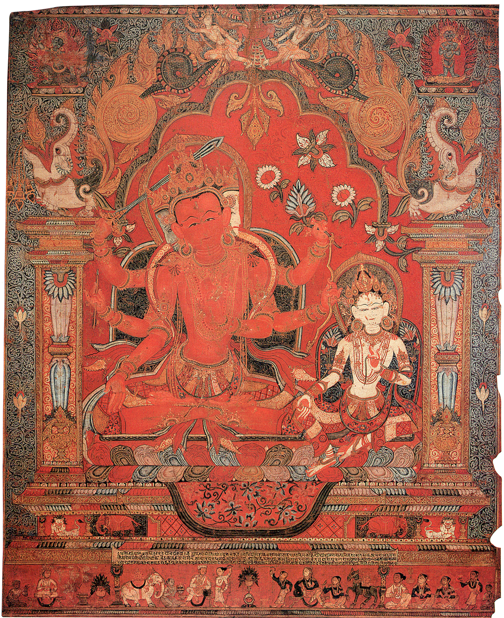
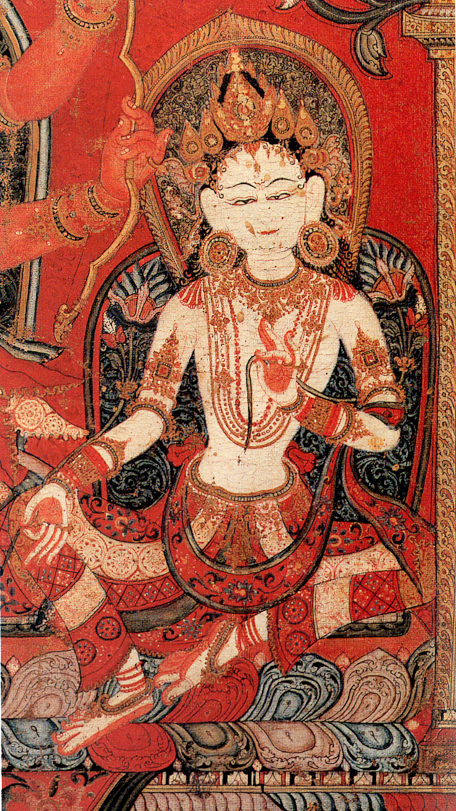

Slide 39
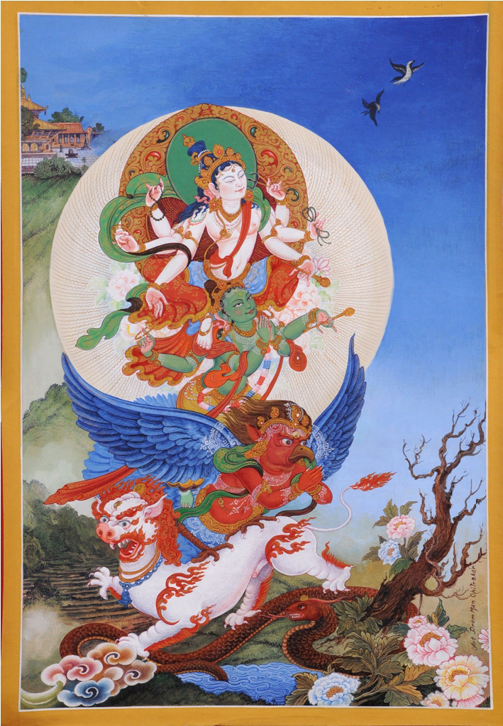
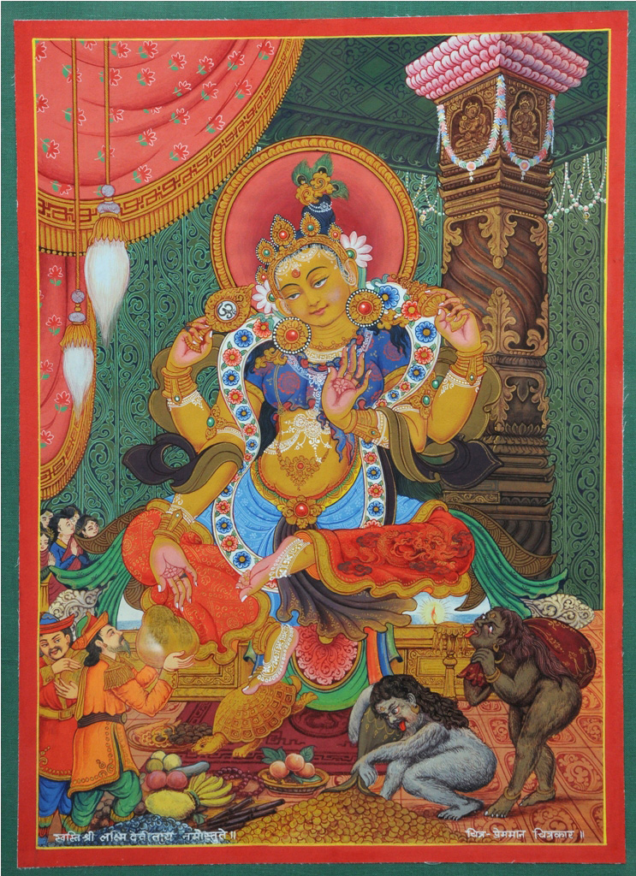

Slide 42
Wrathful Vajrapani
Samundra Man Singh Shrestha
2011

Slide 43
Painting Technique

Slide 44
Preparing the Canvas

Slide 45
2. Constructing the grid
The painter plans the initial layout of the proposed painting, deciding upon the composition, layout and size of the deities to be painted. At this point the individual grids are calculated and drawn.

Slide 46
3.Initial drawing of the deity/landscape elements
The prerequisite for a thangka is a perfect line drawing.
The chosen Buddhas are first drawn according to the iconographic prescription and measurements (iconometrics) within their grids. Landscape details are then added and landscape details are added.

Slide 49
Female Buddha Vajra-Varahi

Slide 50
Tara

Slide 55
SHADING:

Slide 56
4. Inking the Sketch
The initial sketch is outlined in ink allowing the removal of the calculated grids.

Slide 57
5. Preparing the Pigments
The pigments are prepared by the artists, who grind and heat natural minerals or organic dyes and mix the resultant powder with a binder. Pigments include indigo, lapis, turquoise, gold, silver, lac dye, red sandal wood, saffron, and mountain plants.

Slide 58
PAINTING
First Landscape then main figure

Slide 66
Application of gold The ornaments of the deities depicted and other objects in the thangka are painted with Tibetan gold according to commission.

Slide 68
- 'Opening the eyes' of the Buddha
- Consecration
The three Sanskrit letters are put at the back for consecreation. OM, AH and HUM mark the Crown, Throat and Heart Chakras respectively.

Slide 69
FRAMING:
Support of
Thankgas

