Slide 1
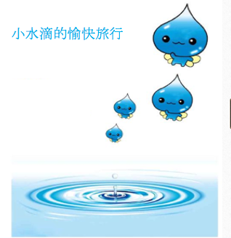
小水滴的愉快旅行
沉浸式小学三年级
Immersion Group
3rd Grade
NH/IL
Authors:
Ya-Ching Hsu-Kelkis 許雅菁
Hsiaoying Chen 陳曉瑩 Christine Chen 陈丽婷
Ling-Ling Chern 陳玲玲 Leilei Song 宋雷雷
http://sxnbook.cnki.net/cacbweb/CatalogDetail_c.aspx?bid=B121100008&s=76&e=79

Slide 2
Day 7
Objective:
Students create posters to suggest ways of conserving water at home.

Slide 3
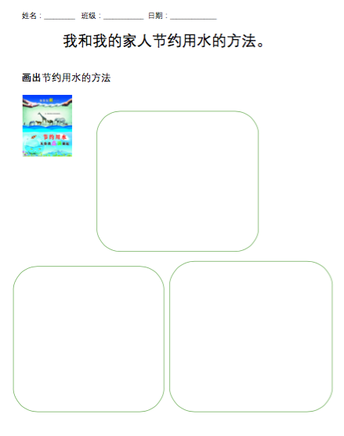
Day 7 Discuss Day 6 homework and create posters
Teaching instructions:
1.Students works in a group (2-3 students in a group)
2.Each group receive a big poster.
3.Students cut the pictures they draw on Day 6 homework.
4.With teacher’s help, students label key vocabulary on the poster next to the pictures they draw.
5. Presentation
学生报告时需要使用的语言要求。
我们节约用水的方法有…..种。
第一种方法是…......。
第二种方法是…......。
第三种方法是…......。
第四种方法是…......。
节约用水很重要, 因为…............。

