Slide 1
Gettysburg College
External Reviews
1

Slide 2
Tomorrow should be better than Today
2

Slide 3
Outline
The Reviews (what we did)
Next Steps (what we need to do)
Lessons Learned
(what we will never do again)
Is there another model?
(what we wish we could do)
3

Slide 4
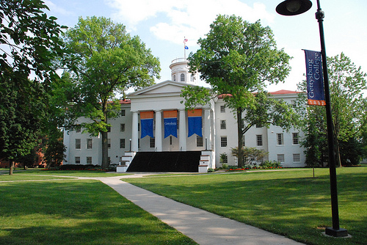
4

Slide 5
Reviews
MISO Survey (Spring 2012 and Fall 2012)
Classroom Review (Fall 2012)
Wireless Review (Fall 2012)
Divisional Review (Spring 2013)
Academic Department Visits (Spring 2013)
Department of Instructional Technology and Training Review (Spring 2013)
Risk and Security Management Review (Spring 2013 and Summer 2013)
5

Slide 6
External Review Charge
Preparing IT to Support a 21st Century Liberal Arts Institution
A Three to Five Year Outlook
Essential Questions
Instructional Technology and Training
What skill sets and instructional support will be needed by IT members, faculty, and students for blended learning?
Infrastructure and Technology Devices
What strategies and investments should IT be considering for infrastructure and devices to leverage 21st Century technologies?
6

Slide 7
Enterprise Applications
Data
What best practices are available that Gettysburg College should investigate in the fields of business intelligence and data analytics?
Mobility
What enterprise information does and will the campus need on a device?
How can IT address those needs: Home-grown apps, Vender user groups, Other methods?
7

Slide 8
Funding
What open source technologies, cloud-based technologies, strategic partnerships will provide opportunities for budget relief?
What messages should IT continue to share with the campus around IT budgeting?
Current Information Services
Are there unrealized efficiencies that are available with IT’s consolidation in the West Building?
Have there been unintended consequences from the consolidation that need to be addressed?
8

Slide 9
Resources to Send
Review from 2005
IT Organization Chart
Annual Reports
Facts and Figures
KPIs
College Strategic Plan Update
MISO Survey results
Classroom reviews from 2005 and 2012
IT Trustee Committee Charter and Yearly Lesson Plan
9

Slide 10
Next Steps
Address immediate items
Incorporate short term items into annual goals
Incorporate long term items into an
IT Master (Strategic) Plan
Time Frame: Fall 2013
Socialize
Receive feedback and buy-in
10

Slide 11
Lessons Learned
Socialize review and essential questions more before review
Avoid Sleep
Good MISO results
Great Work done since 2005
Keep it in the family
Official reviews CLAC members
Non-CLAC member perspectives are critical
11

Slide 12
Is There Another Model?
How can we receive the same information without the “process?”
How can we get the same perspectives and feedbacks as we do from “Strangers?”
12

