Slide 1
Bioenergetics -- General Principles
Biological entities obey the laws of thermodynamics.
Accordingly, they can be viewed as systems that use energy transformations to perform various types of work

Slide 2
Gibbs Free Energy
Useful for predicting whether or not a process is spontaneous.
Total Energy Change = Macroscopic + Microscopic
Total -- in constant temp/pressure, measured with E (enthalpy)
Macroscopic -- energy associated with change in the macroscopic state of matter
Microscopic -- change in entropy of system

Slide 3
Energy Transformations and Coupling Agents
How do energy transformation processes work?
Proteins as coupling agents -- devices that link spontaneous and
non-spontaneous processes.
A mechanical example (and model):

Slide 4
Coupling

Slide 5
The Concept of Efficiency
In the previous example, if we considered the energy available on the
right lever arm as the energy used to move the load on the left, then
the efficiency of this process was:
In this case, 50% of the
available energy was
conserved and the rest
was lost.

Slide 6
Free Energy Equations
Free Energy ( ) = Energy available for work, i.e., the work done in going to equilibrium
General Form:
= # units involved * a measure of useful energy (work) per unit
Simple diffusion as an example:
Notes:
6

Slide 7
Free Energy in a Diffusion Gradient
… or, restated:
Notes:
7

Slide 8
Free Energy and Electrical Charge
z = charges per particle
= Faraday’s constant -- the amount of charge in coulombs in one mol of electrons
E -- electrical potential in joules/coulomb
Notes:
8

Slide 9
Free Energy from Chemical Reactions
We can write a description of this reaction at any moment in time
as the reaction quotient (Q_{R}) or mass-action ratio (q)
Notes:
9

Slide 10
Continued
At equilibrium we say that:
Since, by definition, a system at equilibrium can do no work, then
any system displaced from equilibrium can do work in either the
forward or reverse direction (depending on the direction of
displacement from equilibrium.)
Thus:
or:
Notes:
10

Slide 11
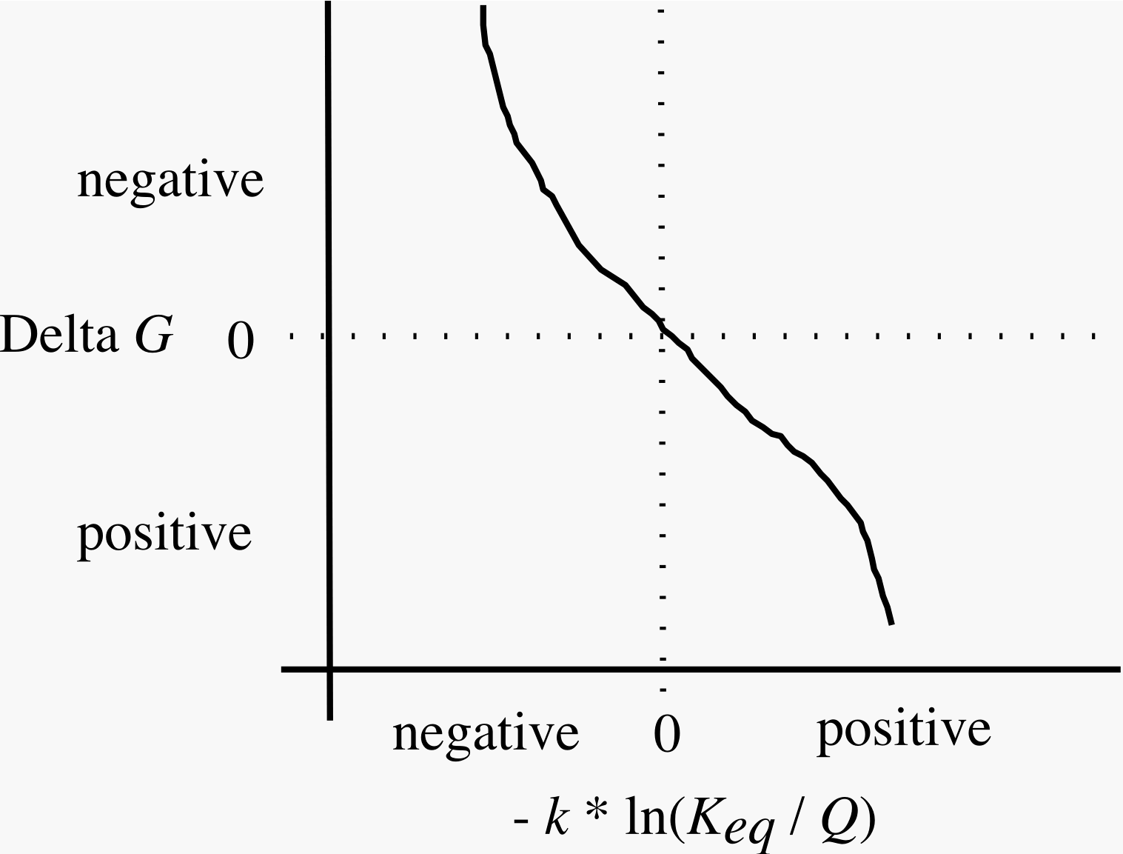
Chemical Free Energy Plot
Notes:
11

Slide 12
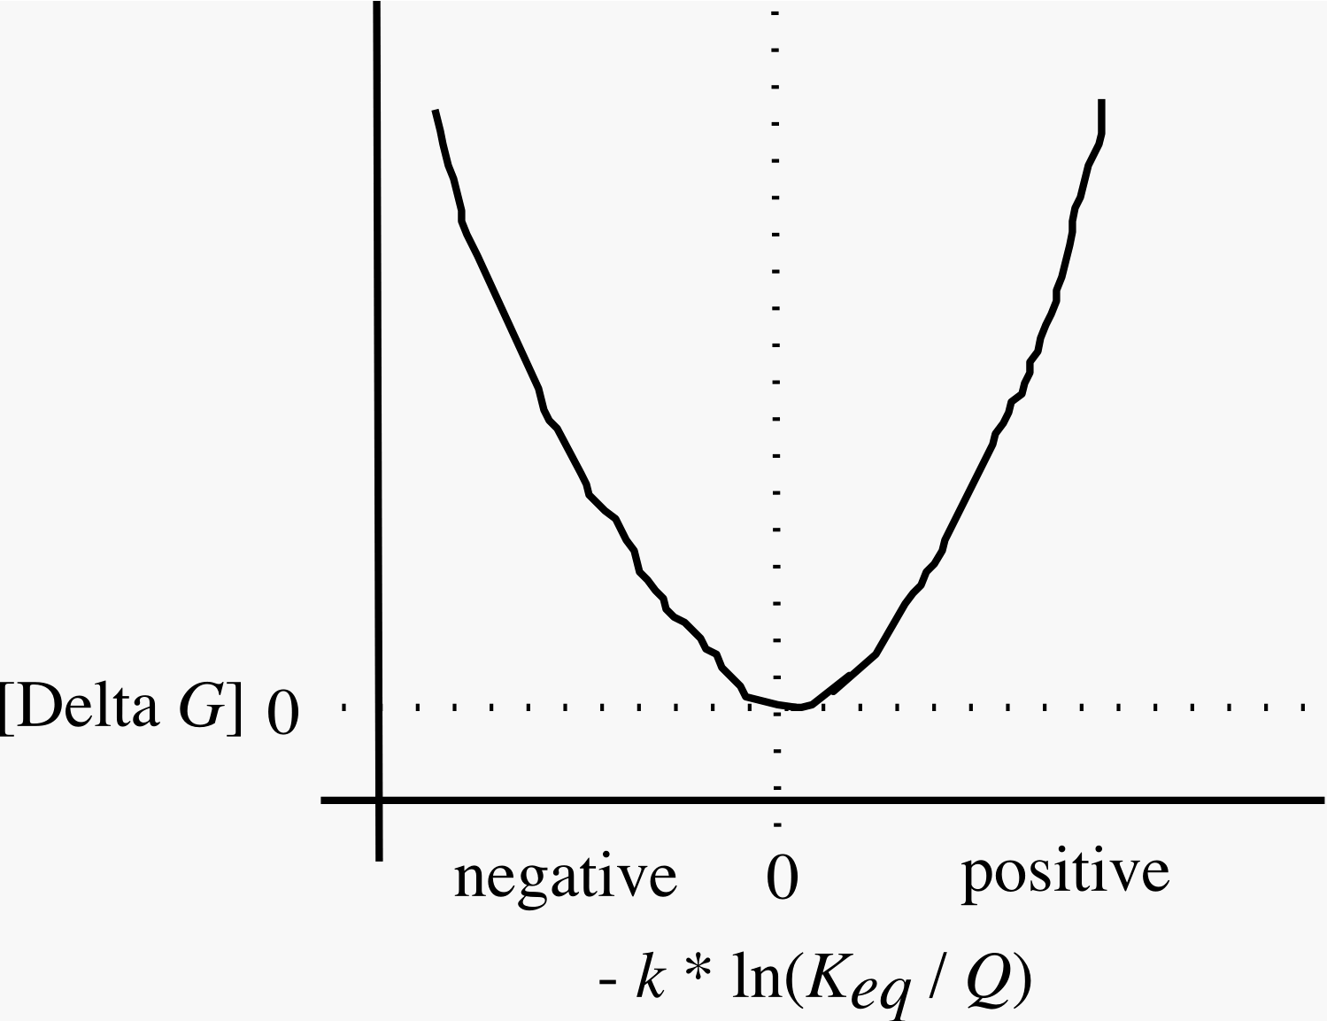
Absolute Value of ΔG
Notes:
12

Slide 13
Review Questions
What are diffusive, electrical and chemical work?
How could diffusing ions be used to drive some other process?
What would be examples of the coupler?
Notes:
13
Esp, with diffusive work, consider macro (gibbs) and micro energy states

Slide 14
ATP Free Energy Problem
Notes:
Although it does not matter here, note the importance of expressing everything in molar units. This is because R is expressed as energy per mol per K.
If you make the mathematical or conceptual error of, for example, using mM (1, 10, and 3) you will get k=3.33. In this problem, it does not matter if you do the same thing for K since in the ratio, units cancel out due to the identical mathematical formulation of K and q -- but in other problems, this will cause a huge problem.

Slide 15
Another Round of Review Questions
1. Why do cells maintain concentrations of the members of the ATP system so far from equilibrium?
2. What does being an open system have to do with your answer to question #1?
3. Can individual reactions in an otherwise open, dynamic system come to K_{eq}?

