Slide 1
Electricity -- The Basics!

Slide 2
Interactions of Charge Centers

Slide 3
Basic Electrical Relationships
Coulomb’s Law
(force in N)
Coulomb -- a unit of charge
1 coulomb = 6.2×10¹⁸ elementary charges
The electrical analog of force is electromotive force (E):
The electrical analog of velocity is current:

Slide 4
Electrical Potential
Potential to do work is always measured relative to some reference state. In electricity, zero potential (ground) can be viewed as an electrically neutral location that is an infinite sink for charge (next slide).

Slide 5
Movement of Charges
A good analogy is the expansion of gases into larger containers -- although the proximate cause of the expansion is quite different!

Slide 6
Resistance
Resistance is that which limits current flow (for a given potential) and consumes electrical energy (resistances convert electrical energy to other forms such as heat).
R (resistance) is measured in ohms (Ω);
G (conductance, its inverse) is measured in siemens (S).

Slide 7
A Purely Resistive Circuit
Which way does the current flow?

Slide 8
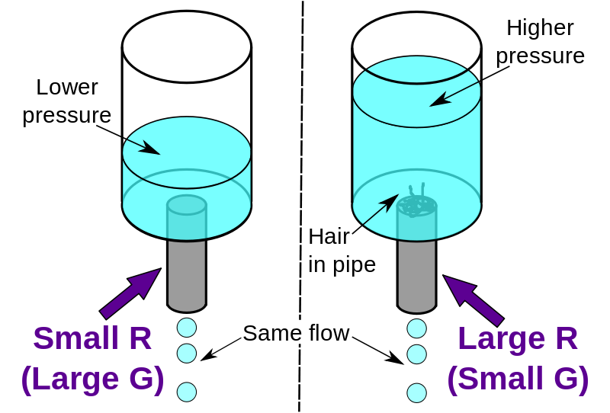
Fluid Analog to Resistance, Current and Potential
Pressure difference is potential difference
Flow is like current
"ResistanceHydraulicAnalogy" by Sbyrnes321 - Own work. Licensed under CC0 via Commons - https://commons.wikimedia.org/wiki/File:ResistanceHydraulicAnalogy.svg#/media/File:ResistanceHydraulicAnalogy.svg

Slide 9
Series and Parallel Resistive Circuits
Can you draw an analogy to these circuits using water flow?

Slide 10
Capacitance
Capacitance is the ability to store electrical charge; the larger the capacitance, the greater that ability.
Capacitors (ideal ones) do not consume energy – whatever energy they store can be retrieved.

Slide 11
Capacitance
Energy storage -- the electrical analog of elasticity

Slide 12
A Purely Capacitive Circuit

Slide 13
Equilibrium in a capacitive circuit

Slide 14
RC Circuits
RC (resistive-capacitive) circuits both store and consume energy.
These will be important in our discussions of membrane potentials, especially ones that vary and move.

Slide 15
An RC Circuit

Slide 16
The Time Constant, τ
A measure of the time needed to charge an RC circuit.
τ = RC
If t = τ then 1-(1/e) = 1-(1/2.7)
= 1 – 0.37
= 0.63

Slide 17
The Effect of the Time Constant

