Slide 1
Apparatus to Study Action Potentials

Slide 2
Stimulus and Response

Slide 3
Membrane Model
The dc generator is very low capacity.
What does this means (structurally)?

Slide 4
Membrane Components

Slide 5
Action Potentials

Slide 6
Active Responses

Slide 7
APs at Above Threshold Stimuli

Slide 8
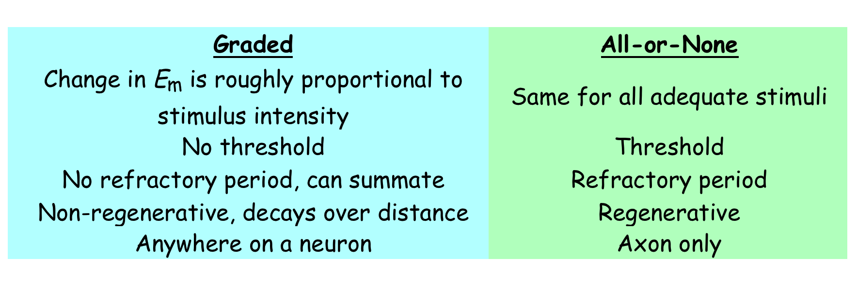
Graded vs. Action Potentials

Slide 9
The Events of an Action Potential

Slide 10
Membrane Model #2
This model is valid ONLY for a very thin section of the length of an axon (or muscle fiber).
This sort of model was hypothesized by the late 1940s

Slide 11
The Voltage Clamp, part 1
In order for E_{m} to change, the total charge (Q) across the membrane capacitance (C_{m}) must change.
For Q to change, a current must flow. (Obviously!)
However, any current associated with the membrane has two components:
  one associated with charging or discharging the C_{m} (called i_{C})
  another, i_{R}, associated with current flow through the various parallel membrane resistances, lumped together as R_{M}.
  Thus:
i_{M} = i_{C} + i_{R}

Slide 12
The Voltage Clamp, part 2
We can only measure TOTAL membrane current, i_{m} directly.
But, we are most interested in the "resistive" current components because these are associated with ionic movements through channels and gates.
-- Is there a way to separate i_{r} from the capacitive current, i_{C}?

Slide 13
The Voltage Clamp, part 3
Recall that:
If we take the time derivative of the last equation (to get current flowing in or out of the capacitance, i_{c}):

Slide 14
The Voltage Clamp, part 4
If we substitute the expression for i_{C} (last slide) into the total membrane current equation, we get:
Reminder: total membrane current, i_{m}, is:
If there is some way to keep the transmembrane potential (E_{m}) constant (dV/dt=0) then:
Thus, if E_{M} is constant, then any current we measures is moving through the membrane resistance(s)
–i.e., these currents are due to specific ions moving through specific types of channels.

Slide 15
How can we keep E_{m} constant during a time
(the AP) when E_{m} normally changes rapidly?
Answer: we use a device called the voltage clamp to deliver a current to the inside of the cell -- initially to change E_{m} to some new “clamped” voltage and then in such a way as to prevent E_{m} from changing – i.e., in a way to hold E_{m} constant.
  The clamp senses minute changes in (dE_{m}) due to ions moving through membrane channels (r_{m}) and into or out of the membrane capacitor, C_{m}.
    The clamp applies charge to the electrodes (a current) to stop this movement and keep E_{m} essentially constant.
Thus, capacitive current is zero as is the resistive current. Whatever current was applied by the clamp was equal and opposite to whatever i_{m} “tried” to flow.

Slide 16
A Drawing of the Voltage Clamp

Slide 17
More on the Voltage Clamp

Slide 18
Review of Membrane Model
Let’s review what we think we know about current flows in a resting cell.

Slide 19
Idealized Voltage Clamp, subthreshold

Slide 20
The Events of an Action Potential

Slide 21
Voltage Clamp Data for a Stimulus that Would Elicit an AP in a Non-Clamped Cell
Both of these clamp Em values are well above threshold and would normally elicit an AP.

Slide 22
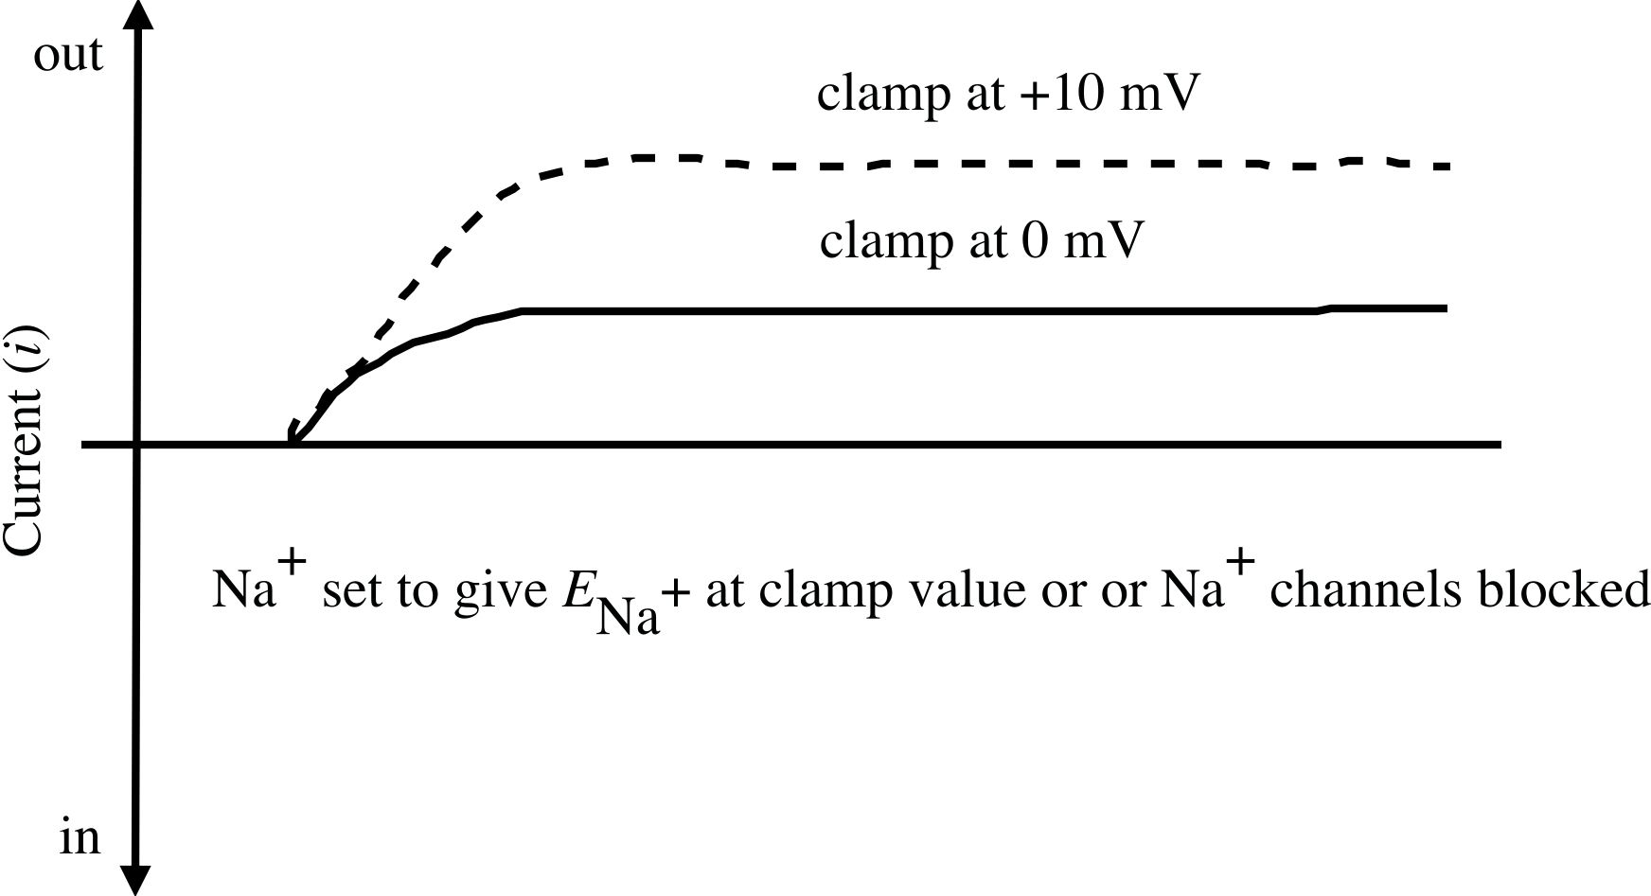
Same Stimulus as Previous But No Na⁺ Current

Slide 23
Inward and Outward Currents at Two Clamp Potentials

Slide 24
Clamp At Local Potential Values

Slide 25
Outward Current Only At Local Potential Clamp Values

Slide 26
Clamp at High Depolarizations

Slide 27
Outward Currents at High Clamp Depolarizations

Slide 28
Using Clamp Data to Find Membrane Conductances
Ohm’s Law: i_{ion} = E_{ion} * R⁻¹_{ion}
The emf for a particular ion (E_{ion}) is the difference between E_{m} and the ion's Nernst potential.
Thus: i_{ion} = G_{ion} * (E_{m} - E_{ion})

Slide 29
Calculation of the
Conductance Changes During an AP
We must calculate the conductances (G) for each ion with respect to time.
To do this, you simply use the conductance equation with the clamp voltage as E_{m}, the ion’s Donnan equilibrium voltage and the current (calculated from voltage clamp data) at any moment of time
Thus: G_{ion at time t} = (i_{ion at time t} )/ (E_{m} - E_{ion})

Slide 30
Conductances During An AP

Slide 31
Finding E_{m} with the
Goldman-Hodgkin-Katz Equation
(a.k.a. Goldman or Goldman Field eq.)

Slide 32
Our Latest Membrane Model
Could this be further modified?

Slide 33
Populations of Channels and Voltage-Gated Channels
How do we modify our model to take into account several types of K⁺ channels?

