Slide 1
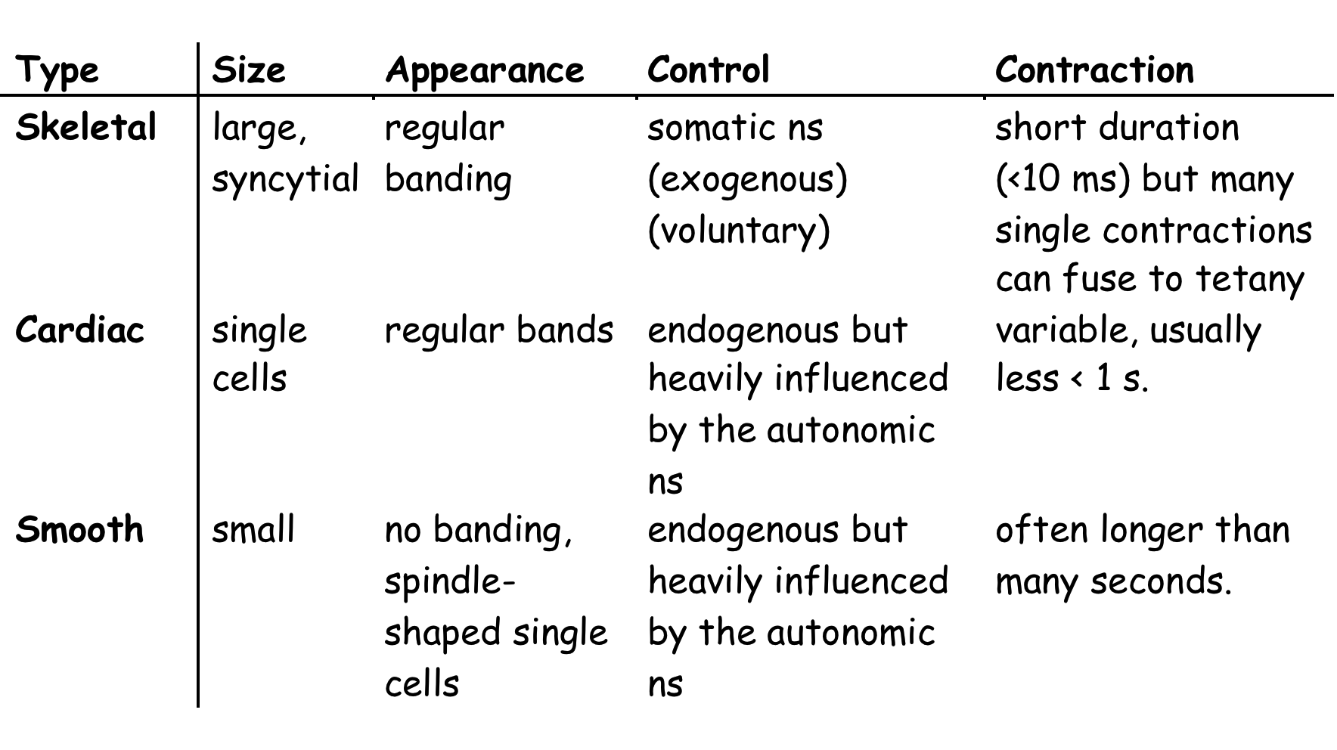
Muscle Types and Their Characteristics

Slide 2
Skeletal Muscle Anatomy

Slide 3
Muscle Fiber Anatomy

Slide 4
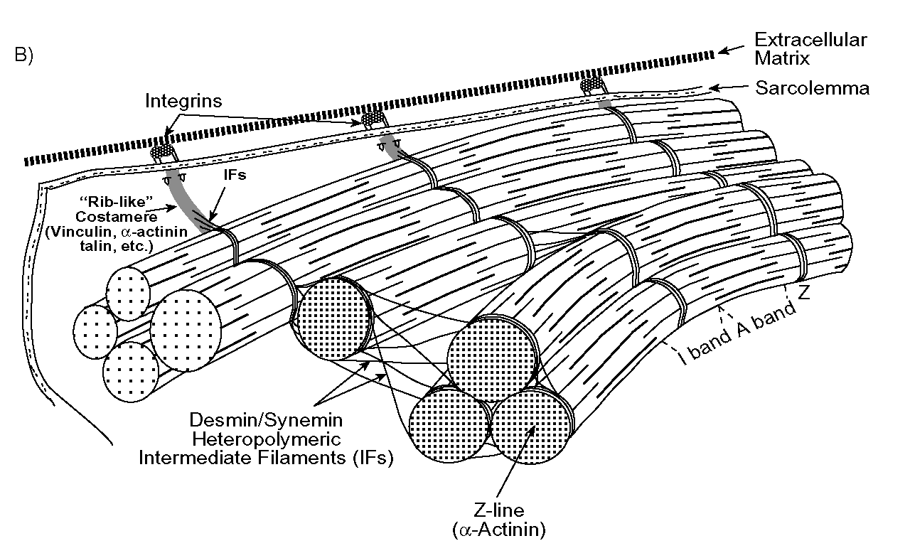
Anchoring the Myofilaments

Slide 5
Sarcomere Banding

Slide 6
Contraction in a
Sarcomere

Slide 7
Thin and Thick Filaments of the Sarcomere

Slide 8
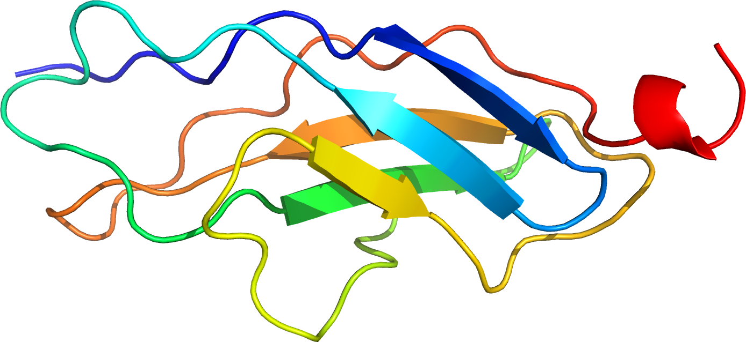
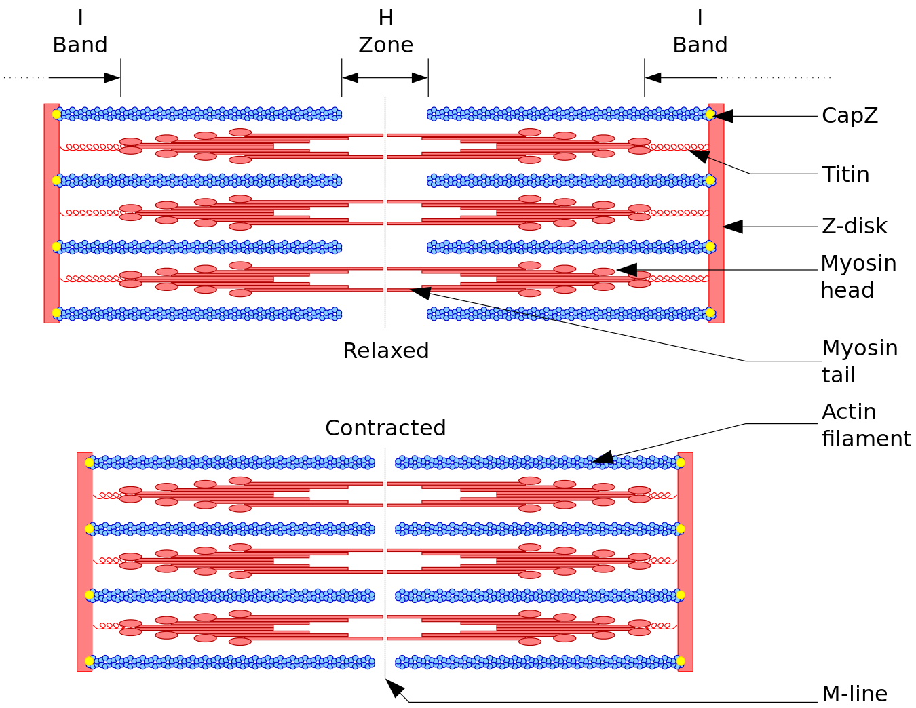
Titin
https://en.wikipedia.org
Runs between Z lines and M line.
Helps organize sarcomere and limits length change or at least contributes to stiffness of resting sarcomeres.
Important elastic component of muscles.
https://en.wikipedia.org

Slide 9
Actin

Slide 10
Thin Filament Side View

Slide 11
Thin and Thick Filament Interaction

Slide 12
Energetics of Troponin

Slide 13
More on the Organization of the Thin Filament

Slide 14
Attachment of Thin Filaments to Z-Lines

Slide 15
A Schematic of Myosin

Slide 16
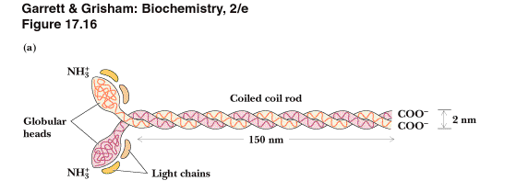
Myosin Dimer

Slide 17
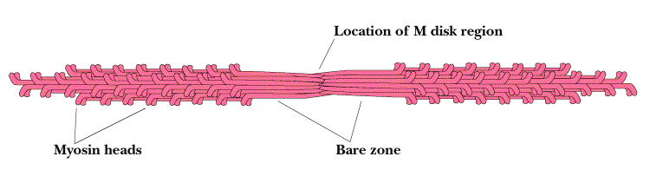
"Polarity of the Thick Filaments"

Slide 18
Polarity of the Myosin Power Stroke

Slide 19
Arrangement of Myosin Heads Around a Thick Filament

Slide 20
Linked Allosteric Forms of a Protein

Slide 21
The Crossbridge Cycle
Let's start here (relaxed muscle)

Slide 22
Energy and Entropy
Entropic systems change state randomly such that the macrostate remains the same.
Organized systems change state in a decided direction (essentially the useful work of the system); "energy" input is what provide directionality.

Slide 23
Ca⁺⁺ Regulation at the SR

Slide 24
Calsequestrin as a Ca⁺⁺ Buffer

Slide 25
Relative Binding Affinities of the SR-bound Ca⁺⁺ Pump vs. Thin Filament Bound Troponin

Slide 26
Ca⁺⁺ and Binding to Troponin

Slide 27
Questions: How is Thin Filament Regulation Organized?
What has a greater potential activity -- Ca⁺⁺ gates or Ca⁺⁺ ATPase?
What has a greater affinity -- the Ca⁺⁺ ATPase or the calmodulin (troponin C)?

Slide 28
Excitation-Contraction Coupling
EC coupling is defined as the events that link a nervous system command (both contract and relax) to the mechanical events of muscle contraction.

