Slide 1
Integrated Muscle Function

Slide 2
Twitches and Tetany

Slide 3
Ca⁺⁺, Active State, and Force in a Twitch and Tetany

Slide 4
The Effect of Load on Skeletal
Muscle Contraction

Slide 5
Velocity vs. Load Plot

Slide 6
External Power vs. Load

Slide 7
Myosin Types

Slide 8
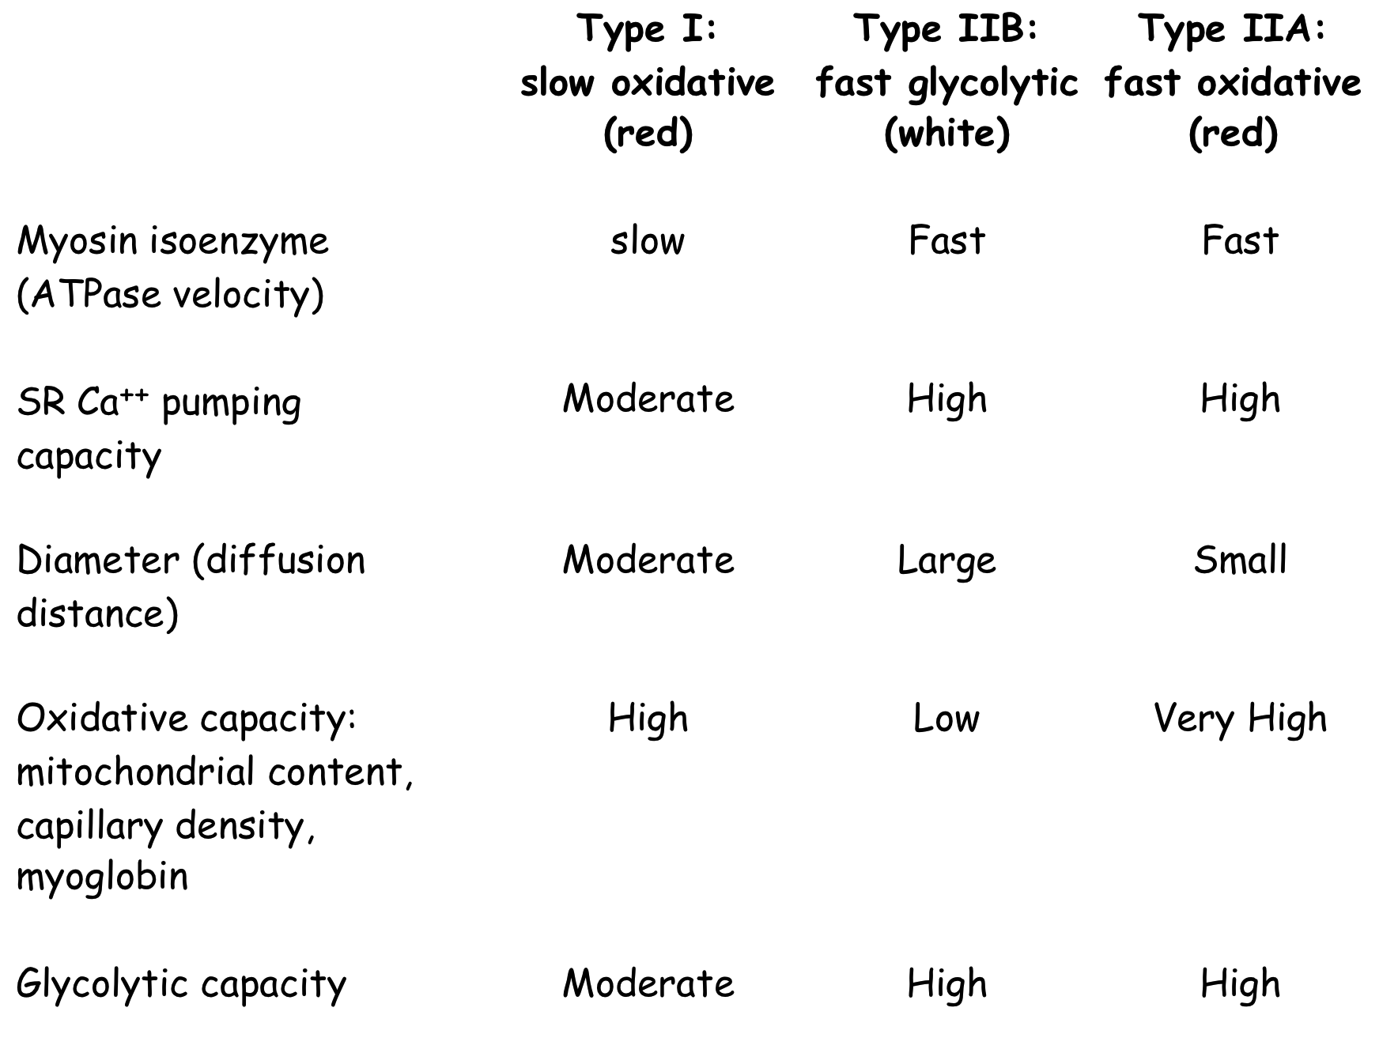
Characteristics of Fiber Types

Slide 9
Anatomy of Spinal Nerves and Motor Units

Slide 10
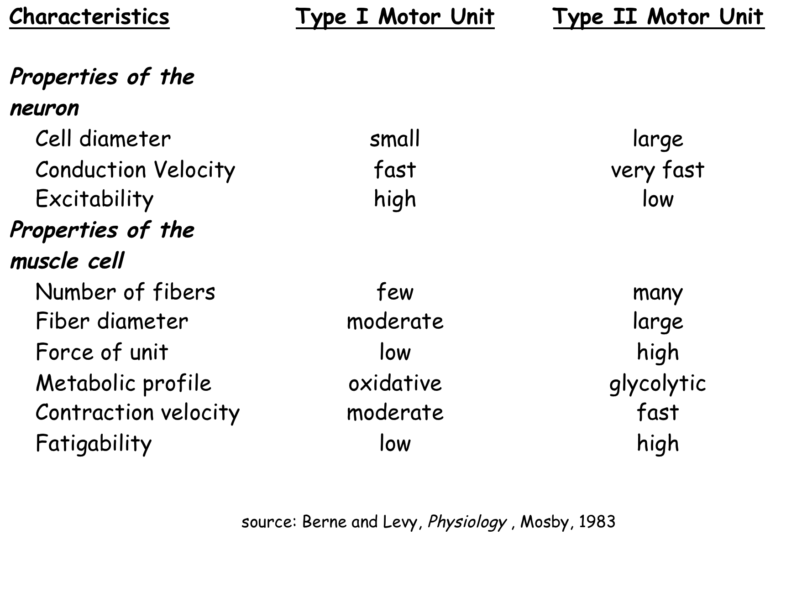
Motor Unit Types

Slide 11
Recruitment

Slide 12
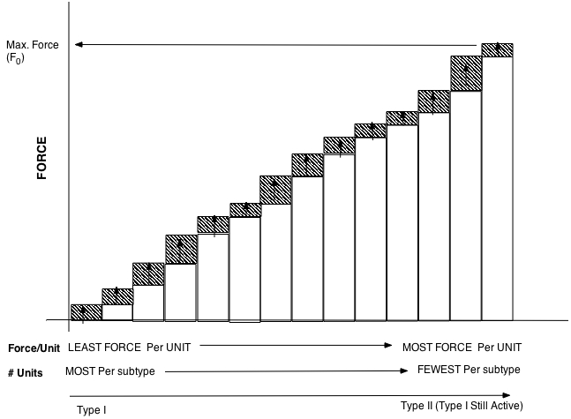
Another Version of the Previous Diagram

