Slide 1
Mechanics of the Heart and Control of Cardiac Output

Slide 2
Characterize the Total Work a Pump Does in Physical Terms (Power, time etc.)

Slide 3
Cardiac Output

Slide 4
Fick’s Principle for Determination of Cardiac Output
Is there a non-invasive way to determine cardiac output?

Slide 5
Characterize the Work Done a Pump Over One Cycle

Slide 6
Cardiac Work Loop

Slide 7
Summary: the Timing of Mechanical and Electrical Events (Wiggers Diagram)

Slide 8
Autonomic Effects on Chronotropicity: 1. Parasympathetic Effects
Parasympathetic (mediated via X cranial (vagus) nerve)
Receptor: muscarinic m-2 (inhibitory)
Agonists -- ACH, muscarine, carbachol -- all have negative chronotropic effects and slow rate from what it would have been
Antagonists: atropine -- block negative chronotropic effect.

Slide 9
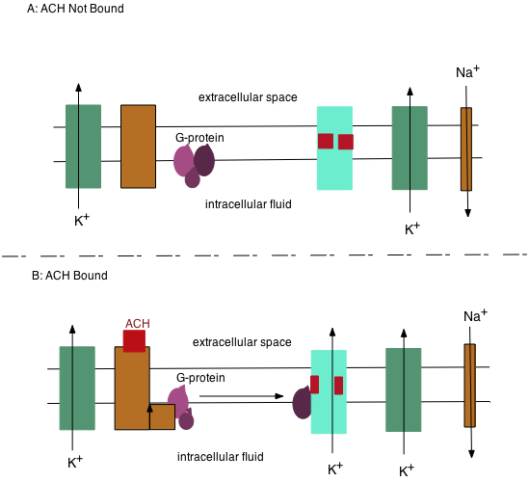
Muscarinic Receptor
The sizes of the channels indicate their relative conductances in the synaptic area – why does E_{M} move towards E_{K+} when the chemically gated K⁺ channel is operated? What closes it?

Slide 10
Autonomic Effects on Chronotropicity: 2. Sympathetic Effects
Sympathetic (mediated via “accelerator” nerve and epinephrine).
Receptors: α₁ (NE from accelerator) and β₁epinephrine.
α₁
Agonists: NE and phenylepherine -- both have weak positive chronotropic effects.
Antagonist: phenoxybenzomine has a very slight negative or no chronotropic effect.
β₁
Agonists: E, isoproterenol (isupryl) and ephedrine all have strong positive chronotropic effects.
Antagonists: propranolol (inderal) -- blocks positive chronotropic effect.

Slide 11
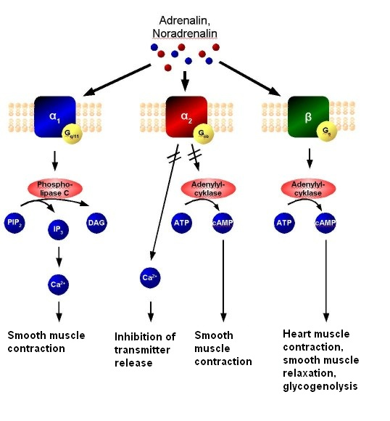
Review: Actions of Catecholamine Receptors
http://en.wikipedia.org

Slide 12
Nodal Cells and Chronotropicity

Slide 13
The Frank-Starling Law of the Heart

Slide 14
The Autonomic NS and Ionotropic Effects
Parasympathetic -- no direct effect, indirect effect only (covered later).
Sympathetic -- strong ionotropic effect (think about what happens when you are scared).
Therefore, alpha- & beta-agonists (e.g. epinephrine and isoproterenol) will have a strong positive ionotropic effect (and increase electrical excitability).
β -blockers (propranolol (inderal)) will generally cause a decrease in contractile force and stroke volume (and electrical excitability) as they block the E that is normally present.

Slide 15
The Effect of Epinephrine on Contractility

