Slide 1
Important Measures of Flow
pressure, P, – force/area, usually given as mmHg or kPa
volume, V or q, given as liters or some fraction
particle velocity, v, given is m * s⁻¹
Volume velocity, , given as liters/sec or minute

Slide 2
Poiseuille’s Equation
Valid for established laminar flow.

Slide 3
Work and Energy
Pressure is a measure of energy per volume

Slide 4
Laminar and Turbulent Flow
In turbulent flow:

Slide 5
Reynold’s Numbers and Turbulent Flow

Slide 6
Factors that favor Turbulent flow
(a) high velocity,
(b) large diameter and
(c) low viscosity.

Slide 7
Viscosity (η)

Slide 8
Anomalous Viscosity

Slide 9
Particle Velocity in Newtonian Solutions
If we consider tubes in series such that volume velocity is the same in each (steady-state) then:

Slide 10
Pressures and Flow

Slide 11
Blood Vessel Dimensions:
Exchange vs. Transport Vessels
Notes:
Anomalous viscosity only occurs in vessels between 0.3 and 0.01 mm – so, in the arterioles, venules and largest capillaries (in the small ones, cells fold and have friction with the walls

Slide 12
Blood Vessel Wall Tension and Stress
Law of Laplace
Notes:
Transmural pressure is the pressure across the wall – note that a large vessel needs to resist greater tensions for a given pressure – and given that pressures on the arterial side tend to be higher in larger vessels, the effect is magnified for them (but not for veins)
Thus, to reduce stress, wall diameters need to be greater!

Slide 13
Tissue Composition of Blood Vessels

Slide 14
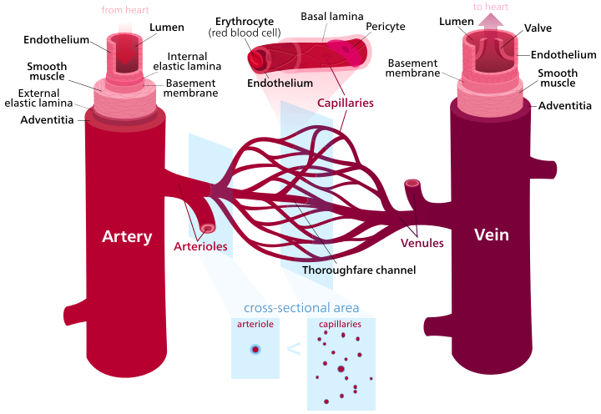
Blood Vessel Structure
"Blood vessels-en" by Kelvinsong - Own work. Licensed under CC BY-SA 3.0 via Commons - https://commons.wikimedia.org/wiki/File:Blood_vessels-en.svg#/media/File:Blood_vessels-en.svg

Slide 15
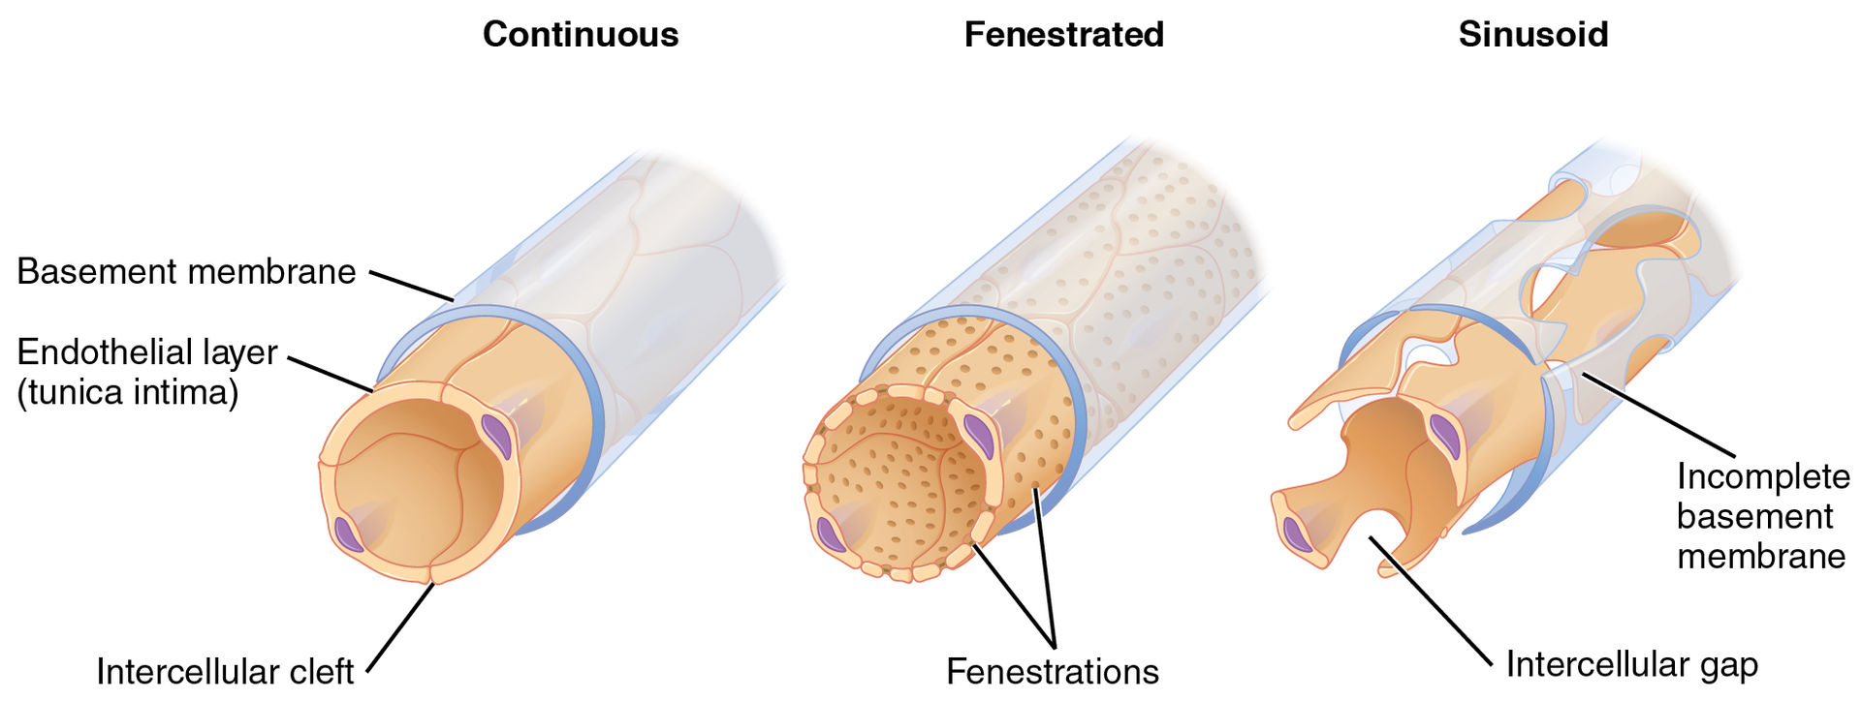
Capillaries
"2104 Three Major Capillary Types" by OpenStax College - Anatomy & Physiology, Connexions Web site. http://cnx.org/content/col11496/1.6/, Jun 19, 2013.. Licensed under CC BY 3.0 via Commons - https://commons.wikimedia.org/wiki/File:2104_Three_Major_Capillary_Types.jpg#/media/File:2104_Three_Major_Capillary_Types.jpg

Slide 16
Capacitance and dP/dT
This model is a bit unrealistic because it only considers compliance….

Slide 17
Flow Relationships in Different Vessels

Slide 18
Control of Microcirculation

Slide 19
Control of the Peripheral Circulation
Central Control
Control at the arteriole and venule level -- vasomotion of smooth muscle components of vessels
Adrenergic
α₁: vasoconstriction in skin, GI, coronary, kidney and brain
β₂: vasodilation of small coronary & sk mus arteries
Cholinergic -- M3 muscarinic receptor on vascular endothelial cells causes synthesis of NO that leads to vasodilation of smooth muscle

Slide 20
Local Control
Metabolites: H⁺, lactate, CO₂ -- vasodilators
Adenosine, some prostaglandins are potent vasodilators
UTP and others are potent vasoconstrictors
Autoregulation -- changes in vasomotor tone in response to stretch induced by upstream/downstream changes in blood pressure

Slide 21
Local Control in the Brain’s
Pericytes
Peppiatt et al., Nature 2006 v443 p 700

Slide 22
Hydrostatic Filtration in Capillaries and the Formation of Interstitial Fluid/Lymph

Slide 23
Filtration: The Starling Hypothesis

Slide 24
Filtration in Capillaries

Slide 25
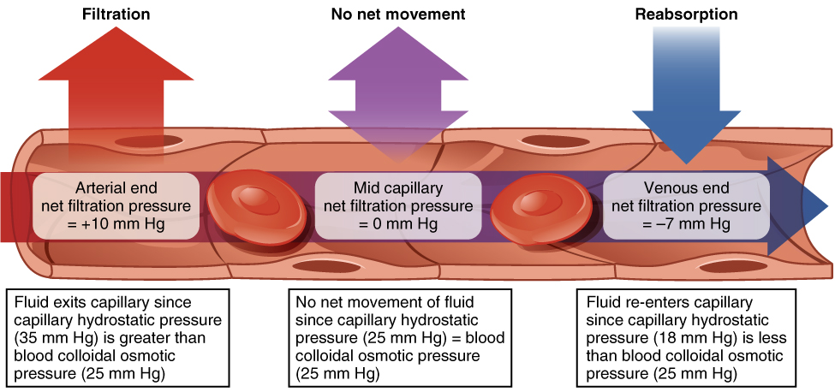
Another View
"2108 Capillary Exchange" by OpenStax College - Anatomy & Physiology, Connexions Web site. http://cnx.org/content/col11496/1.6/, Jun 19, 2013.. Licensed under CC BY 3.0 via Commons - https://commons.wikimedia.org/wiki/File:2108_Capillary_Exchange.jpg#/media/File:2108_Capillary_Exchange.jpg

Slide 26
Large-scale Influences on Blood Flow

Slide 27
Mean Arterial Pressure

Slide 28
Mean Arterial Pressure and SV

Slide 29
Total Peripheral Resistance

Slide 30
End-Resistance and Pressure
Note greater filling with higher R.

Slide 31
Changes in Capacitance
Remember -- low capacitance is high elastance

Slide 32
Capacitance and ΔP/ΔT
The rate at which pressure changes is directly proportional to the volume flow and inversely proportional to the vessel capacitance.
1.
2.
So:

Slide 33
Vessel Compliance and Age in Humans

Slide 34
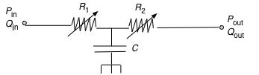
Resistance/Capacitance Considered Together
When we consider compliance (capacitance) and resistance, the way we need to look at in arteries is different than how we looked at it in electrical circuits.
The crucial consideration is that arterial compliances have both and inflow and outflow.
Inflow is largely determined by stroke volume – resistance at this end is usually constant.
Outflow is determined by resistance of the arterioles, which can change rapidly.
With a constant stroke volume, what is the effect of an increased peripheral resistance on dP/dt in the arteries?
Of decreased capacitance?
(Note that increased peripheral resistance and decreased capacitance often go together in vascular disease.)

Slide 35
Hydraulic Filtration in the Arteries
What is the effect of reduced peripheral resistance on filtering?
Non-patent valve? Reduced capacitance?

Slide 36
The Effect of Arterial Compliance on the Work of the Heart
(From pump to vessel)

