Slide 1
Integrated Regulation of the Circulation
Guyton’s Models as an Example

Slide 2
Mean Arterial and Venous Pressure and Cardiac Output
If the compliance ratio is 19:1, for which cardiac output is the ratio of venous to arterial volume 19:1?
What is peripheral resistance at CO=0?

Slide 3
Cardiac Output and Venous Pressure
In all of the following graphs we assume that the heart rate is constant, thus changes in stroke volume account for all changes in cardiac output.

Slide 4
Re-plotted -- Cardiac Output and Venous Pressure

Slide 5
Blood Volume, , and Mean Venous Pressure
Why does increased blood volume raise mean venous pressure?

Slide 6
Peripheral Resistance, , and Mean Venous Pressure
Why does increased vasoconstriction lower mean venous pressure?

Slide 7
Cardiac Function by Pre-load

Slide 8
Circulatory "Equilibrium" Point

Slide 9
Return to Steady State After an Increase in Mean Venous Pressure

Slide 10
New Steady-State After Sympathetic Stimulation
– relate this to work diagram

Slide 11
Response to Increased Blood Volume
In the absence of a change in HR

Slide 12
Blood Volume and Cardiac Function
Cardiac
Output
(L/min)
increased blood volume
(hypervolumia)
12
normal
10
normal
volume
moderate heart failure
12
#3
N
#4
6
severe heart failure
#1
4
#2
2
0
knp
-2
0
2
4
6
8
Venous Pressure
(mmHg)

Slide 13
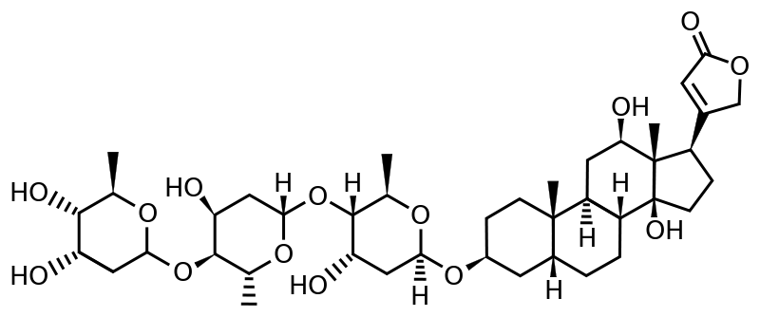
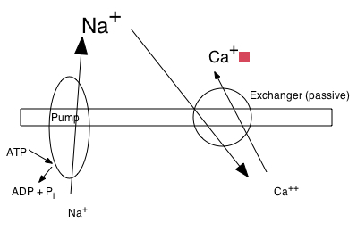
Digoxin and Cardiac Function in Congestive Heart Failure
http://en.wikipedia.org/wiki/File:Digoxin_structure.svg
Cardiac glycoside
http://aggie-horticulture.tamu.edu/wildseed/

