Slide 1
Gross Structure of the Mammalian Kidney

Slide 2
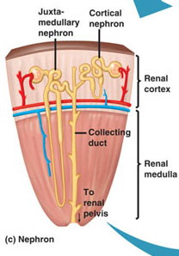
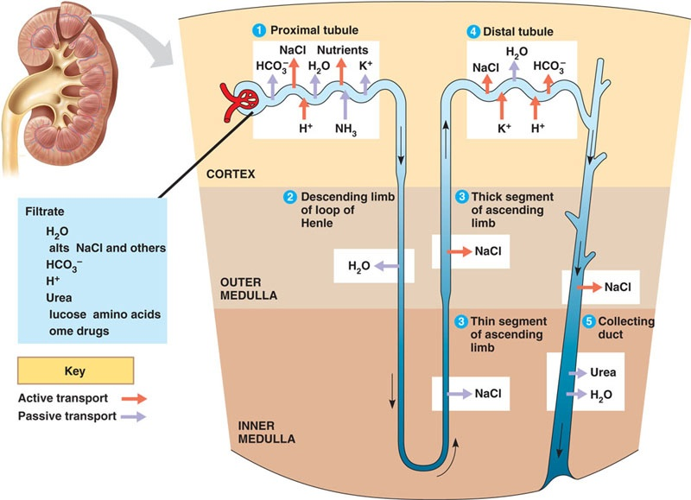
Nephron Anatomy

Slide 3
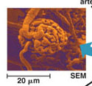
The Filtration Unit: the Glomerulus and Bowman's capsule

Slide 4
Filtration and Molecular Characteristics

Slide 5
Glomerular Filtration

Slide 6
Autoregulation of Filtration

Slide 7
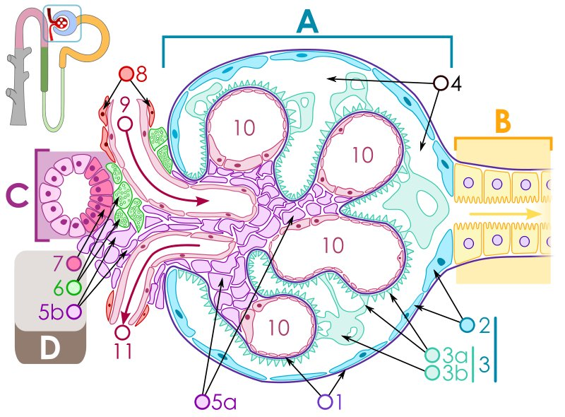
Mechanisms of Autoregulation
Myogenic regulation -- response to stretch
Tubular glomerular feedback -- flow sensed by juxtaglomerular apparatus; chemical signaling to regulate flow (tubuloglomerular feedback, a form of autoregulation)
juxtaglomerular apparatus (D)

Slide 8
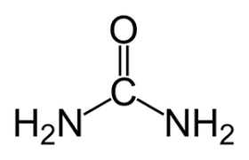
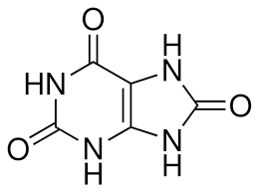
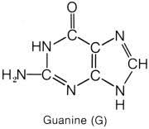
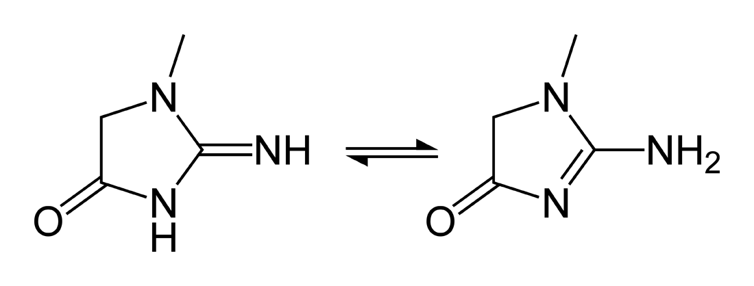
Handling of Solutes by the Kidney
Metabolites that need to be eliminated:
Nitrogenous wastes from amino acid and nucleic acid metabolism
Ammonia (very toxic but easily removed in watery environments)
-> Urea (requires considerable water; mammals & others)
-> Uric acid &/or guanine (many groups –arthropods, reptiles, birds)
Creatinine from creatine metabolism:
Unrecognized substances (potential toxins – foreign to normal body function)
Recognized toxins or things like them

Slide 9
Handling of Solutes by the Kidney:
Examples of “it depends”
H⁺ and bicarbonate (HCO₃⁻)
Other cations and anions (e.g., Na⁺, K⁺, Ca⁺⁺, Mg⁺⁺, P_{i} (=H₂PO₄⁻)
Examples of things to be reclaimed (not eliminated):
nutrients (amino acids, glucose, etc.)

Slide 10
Filtration
Freely-filterable
Filterable but large size

Slide 11
Blood Flow After the Glomerulus
Most blood leaves the glomerulus and enters the peritubular circulation
It first travels to the PCT.
Next, the thick descending and ascending regions of the loop of Henle (in juxtamedullary nephrons).
A portion of blood travels through vessels called the vasa recta that serve the thin descending and ascending loops; these flow through a counter current exchanger (more about this later).
Blood from the loop (thick portions and vasa recta flow) then goes to the DCT.
Finally the blood passes around the collecting tubules before entering the renal vein and exiting the kidney.

Slide 12
Nephron Anatomy

Slide 13
Filtration and Reabsorption

Slide 14
Excretion of a Substance that is Filtered and Reabsorbed

Slide 15
Glucose Excretion
What causes the non-linear then linear portions of this curve?

Slide 16
Filtration and Secretion

