Slide 1
Renal Function: Clearance

Slide 2
Reminder: Filtration and Reabsorption

Slide 3
Reminder: Excretion of a Substance that is Filtered and Reabsorbed

Slide 4
Reminder: Filtration and Secretion

Slide 5
The Clearance Concept, part 1
1. Clearance is defined as the plasma vol./time (plasma flow rate) necessary to account for all of a substance that is found in the urine.
2. The clearance is often (but not always) a virtual volume because it assumes that all of the substance that enters the kidney via the renal artery is removed to the urine and therefore the renal vein has none of this substance!
3. The only time the clearance actually equals the renal plasma flow is for a substance that is both filtered and secreted and that enters the kidney at a low plasma concentration

Slide 6
The Clearance Concept -- Mathematical Derivation
Amount of x Excreted = (A-V [substance x])
Excretion rate of x = (A-V [substance x])/time
We now assume that be blood leaving the kidney is completely cleared of substance x; thus P_{x}^{v} = 0
Notes:
Why is the RPF substituted for the flow rate of renal artery plasma and flow rate of renal vein plasma? Hint – how much urine is typically made per minute (and what do you think is the RPF)?

Slide 7
Clearance, continued
Now, for the case we have examined where all of substance x is removed ([x]_{renal vein} = 0), then the amount of plasma supposedly "swept clean" of x is the RPF. Thus:

Slide 8
Do Most Substances Clear 100%?
i.e., are most substances totally removed from the plasma in one pass through the kidney?
The answer is NO but we still calculate their clearance the same way because we can use their “clearance” to determine how they are handled by the kidney.
For example, what about a substance that is only filtered?

Slide 9
Types of Clearance

Slide 10
Inulin and the GFR
Inulin is only filtered -- is it actually 100% cleared?
If we calculate it’s clearance, we get a number that represents the amount of plasma required to account for the inulin we see in the urine. This is a virtual volume that would need to be swept clean to account for the inulin in urine.
We call this virtual volume the GFR or glomerular filtration rate.

Slide 11
Rules of Thumb
Clearance of X = GFR_{inulin}
Filtered Only
Clearance of X > GFR_{inulin}
Filtered and Secreted
Clearance of X < GFR_{inulin}
Filtered and Reabsorbed

Slide 12
Filtered Load
i.e., what goes in, must come out!

Slide 13
Water Conservation

Slide 14
The Medullary Gradient

Slide 15
Creating the Medullary Gradient, 1

Slide 16
Creating the Medullary Graident, 2

Slide 17
Permeabilities and Transport Capacities

Slide 18
The Medullary Gradient

Slide 19
Concentration of Urine in the Collecting Tubules

Slide 20
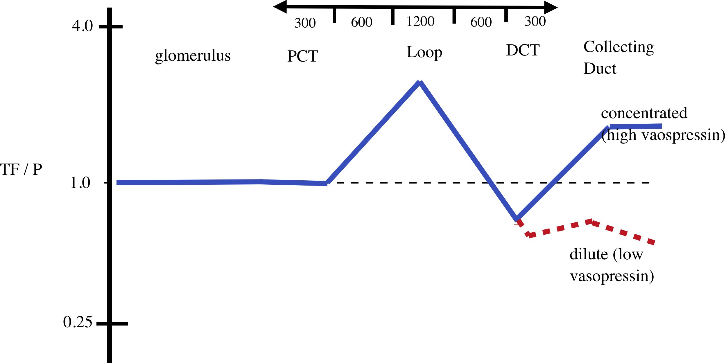
Osmolarities in Tubular Fluid
Important role of Na⁺/K⁺ ATPase in water reabsorption
up to 10% of water

Slide 21
More on Hormones
We will concentrate on:
the mineralocortocoid aldosterone
the renin-angiotensin system
atrial natriuretic hormone

Slide 22
Endocrine Effects

Slide 23
The Renin-Angiotensin System
(Juxtaglomerular apparatus)

Slide 24
Atrial Natriuretic Hormone
Peptide
Secreted by the atria in response to stretch (high blood volume)
Increases renal loss of Na⁺ (and anions); leads to an increase in water loss

