Slide 1
Henderson-Hasselbalch Equation
HA <--> H⁺ + A⁻

Slide 2
Titration Curve for a Weak Acid or Base

Slide 3
Isohydric Principle
All buffer systems are in equilibrium with the same pool of H⁺

Slide 4
Henderson-Hasselbalch, Restated for Blood
or

Slide 5
Davenport Space

Slide 6
The Blood Buffer Line

Slide 7
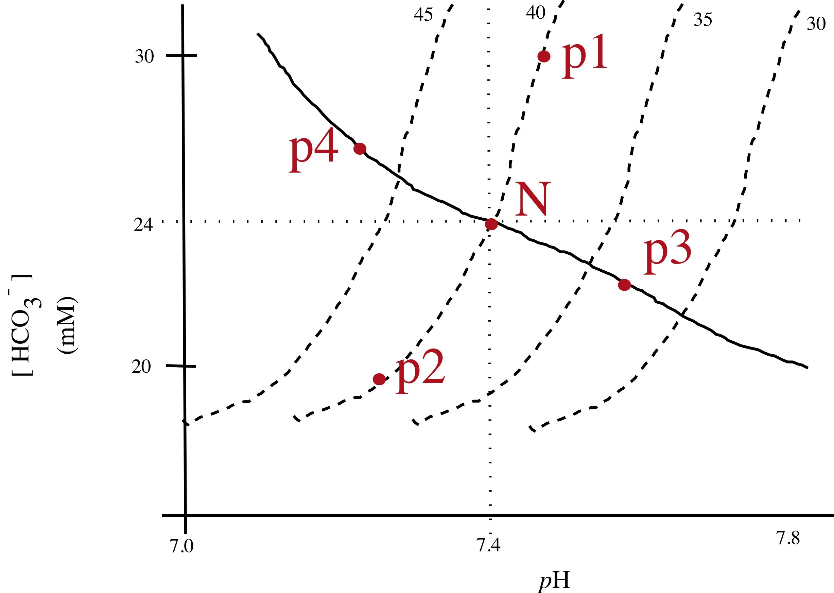
Idealized Acid-Base Disturbances in Humans

Slide 8
Sites of Acid/Base Regulation
We assume that acid or base is added due to metabolic processes or digestion.
(… but an approximation!)

Slide 9
Regulation Based on Oxygen
Carotid Bodies
Regulated by O₂ content more than P_{O2}

Slide 10
Regulation Based on pH
pH as an important variable independent of oxygen
In terrestrial animals, it is easiest to regulate pH via changes in ventilation that lead to changes in P_{CO2}
In most cases, regulation of pH will indirectly take care of oxygen

Slide 11
Titration Curve for the Blood Buffer-- The Actual pH is far from the pK_{a}

Slide 12
Alveolar Gas and

Slide 13
Co-Regulation of Circulation and Ventilation
Ventilation-perfusion matching

Slide 14
Over and Under Ventilation
Hyperventilation -- where elimination of CO2 is greater than production at the tissue level.
Normally considered as a difference between input (from tissues) and elimination (at exchanger) of blood CO₂.
But, we can also consider a sort of hyperventilation that might occur if we over perfuse the tissues where we consider the effects on tissues (? What controls perfusion??)
Hypoventilation -- the opposite
What are the acid base disturbances associated with hyper- and hypo-ventilation.

Slide 15
Steady and Non-Steady State Ventilation
Recall our multiple stage gas exchange model.
In steady-state ventilation:
In non-steady state, one or more of these will not be equal.

Slide 16
Special Problems in Respiration

Slide 17
High Altitude Adaptation in Humans

