Slide 1
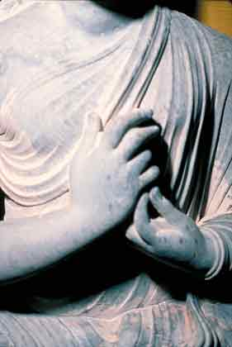
Mudrā
Seated Buddha in Dharma cakra, kushan, Gandhara, India, C.3rd C., The Asian Arts Museum of San Francisco, California, ACSAA
The majority of the images and
Information in this presentation have been
taken from the book entitled, The Circle
Of Bliss: Buddhist Meditational Art by
John C. Huntington and Dina Bangdel

Slide 2
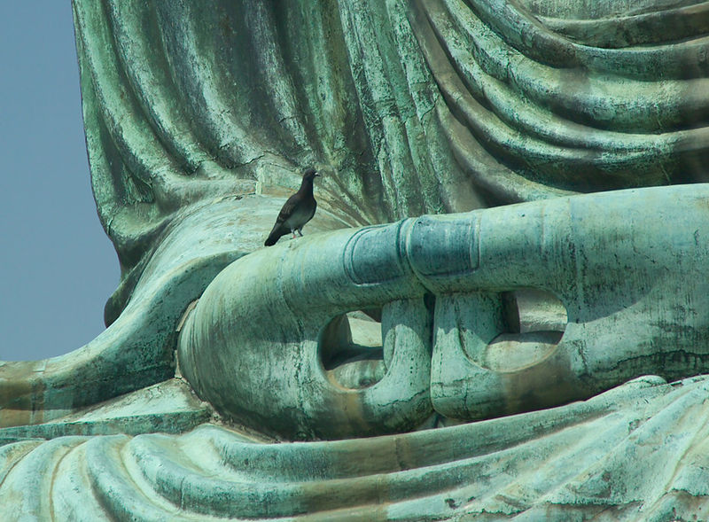
What is a mudrā?
A mudrā is a hand position or gesture which has a symbolic meaning in Hinduism or Buddhism. The word mudrā means “spiritual gesture” or “seal of authenticity.”

Slide 3
Dhyāna Mudrā
GAUTAMA BUDDHA SHRINE
15th century Terracotta with gold lacquer and paint H: 24.5 W: 15.4 D: 10.2 cm Tibet, Freer and Sackler Galleries

Slide 4
What is a Dhyāna Mudrā?
The Dhyāna mudrā consists of two hands which are in a person’s lap with palms facing upward. This mudrā symbolically represents concentration, meditation, and the Sangha.
This position forms a triangle with represents spiritual fire or the three jewels or Triratna. The Triratna are Buddha, Dharma, which is the teaching of the Buddha, and the Sangha which are the people who have attained Enlightenment. Sangha.
This mudrā most likely originated in Northern India in the Gandhara.

Slide 6
Varada Mudrā
Amoghapasha Lokeshvara, India, 9th or 10th Century
The varada mudrā depicts sincerity, compassion, giving, charity, welcome, and offering. The left arm is usually bent with the palm facing upward in which the fingers are often bent.

Slide 7
Varada Mudrā
Amoghapasha Lokeshvara is a bodhisattva who embodies compassion and is a form of Avolokiteshvara.
Amoghapasha has six heads and an image of Amitabha Buddha in his head.
Amoghapasha’s right hand is in the varada mudra and his left hand holds the stalk of the lotus. The upper hands hold recitation beads and an adamantine noose which is a symbol of attraction.
In the middle right hand is a chintamani which is a wish granting gem
In the lower left hand is a flask which is used for rituals in an ascetic lifestyle

Slide 9
Karanda mudrā
Bodhisatttva Vajrapani with Vajra Anuchara, India, c. 7th or early 8th century.
This mudra symbolizes the expulsion of demons and removes obstables such as sickness and negative thoughts. It is made by raising the index and the little finger, and folding the other fingers.

Slide 10
Karanda mudrā
This bodhisattva wears five elements of jewelry which include earrings, bracelets, a necklace, a girdle, and rings.
Vajrapani wears a crown which is hiding his hair. On top of his hair is a lotus flower which is hidden in this view.
In this case Vajrapani is a vision of Buddha’s heart-mind power.
He holds a vajra-an ornament symbolic of a thunderbolt in his right hand which is in the position of a karanda mudra.
The small figure next to him is Vajra Anuchara who is a symbol of compacted power. He wears a snake necklace and has wide powerful eyes. His arms are in the vinaya hasta mudra which is symbolic of aggression and determination. He carries a noose in his left hand.

Slide 11
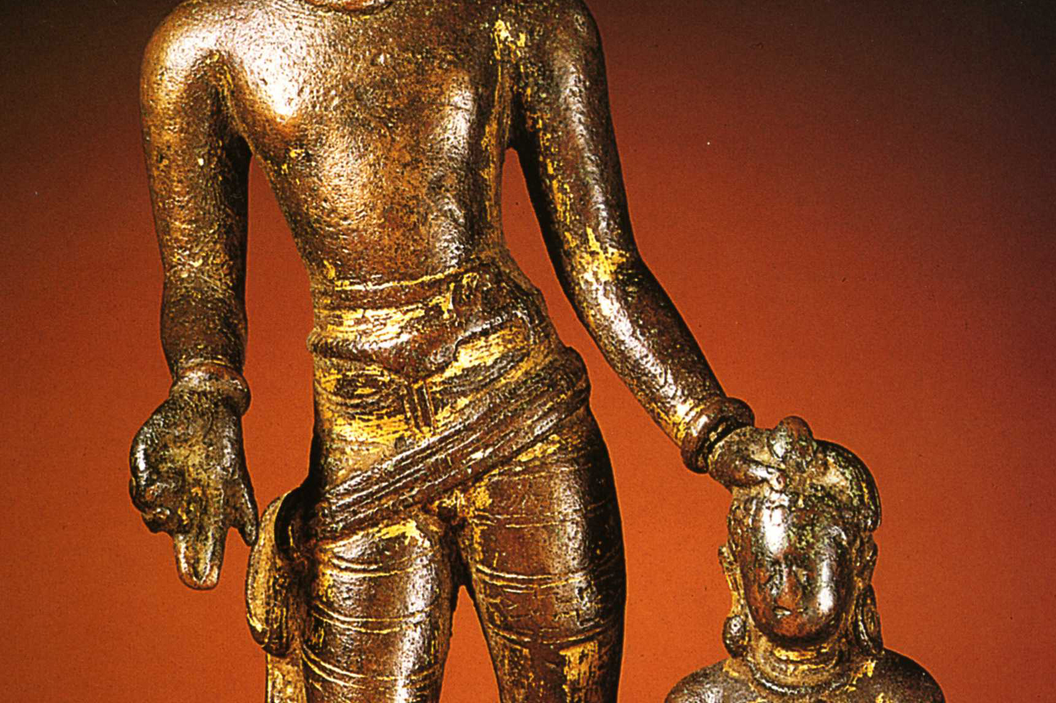

Slide 12
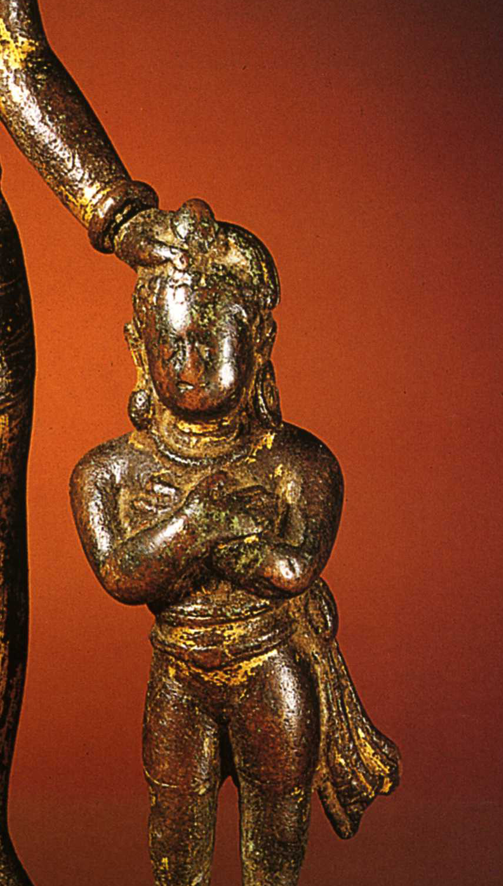

Slide 13
Vitarka Mudrā
Dampa Sangye, Tibet, 14th C, Bronze with copper and silver inlay
This mudra is the gesture of discussion and transmission of Buddhist teachings. In this gesture the index finger and thumb are touching one another. While the tips of the thumb and the index are joined together and the other fingers are straight.

Slide 14
Vitarka Mudrā
Dampa Sangye was an important Buddhist teacher in Tibet in the 11th century.
His hands are in the vitarka mudra which indicates that he is a teacher.
He wears a flowered crown which symbolizes the fact that he has been initiated by dakinis.
His skirt is simple and the positioning of his legs indicates that he may have practiced changali which is a form of heat meditation.

Slide 15
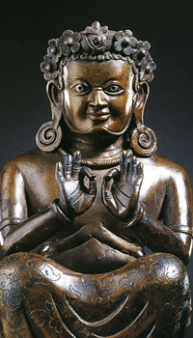

Slide 16
Abhaya Mudrā
Green (Shyama) Tara Attended by white (Sita) Tara and Bhrikuti, attributed to Kumaradeva, India, Ca. 8th Century
The Abhaya Mudrā represents fearlessness and protection and lets viewers know that they should "have no fear." In this gesture the figure has a raised right hand and lowered left hand which is facing palm forward. This gesture also represents peace and benevolence.

Slide 17
Abhaya Mudrā
This is a shrine altar whose main figure is Green Tara who is the Buddha of enlightened activity.
Above Tara’s head are Vajrapani, Amitabha Buddha in a dhyana mudra gesture, and Avolokiteshvara
Tara’s right hand is in the position of a varada mudra and is holding a custard apple. The exact symbolism of this custard apple is unknown. The left hand is in the gesture of an abhaya mudra.
In this sculpture, Tara is depicted in a paradise. This paradise is Khadiravani Vati.
On Tara’s right is Sita Tara who is shown making the varada mudra and holding a white lotus flower and on her left is Bhrikuti. These goddesses are usually depicted with Avolokiteshvara.
In this case both Sita Tara and Green Tara are probably both reified tears Avolikiteshvara who symbolizes compassion.
In this case Tara is a Buddha and is flanked by goddesses who represent wisdom and compassion. Sita Tara represents compassion and and Bhrikuti who represents wisdom.

Slide 18
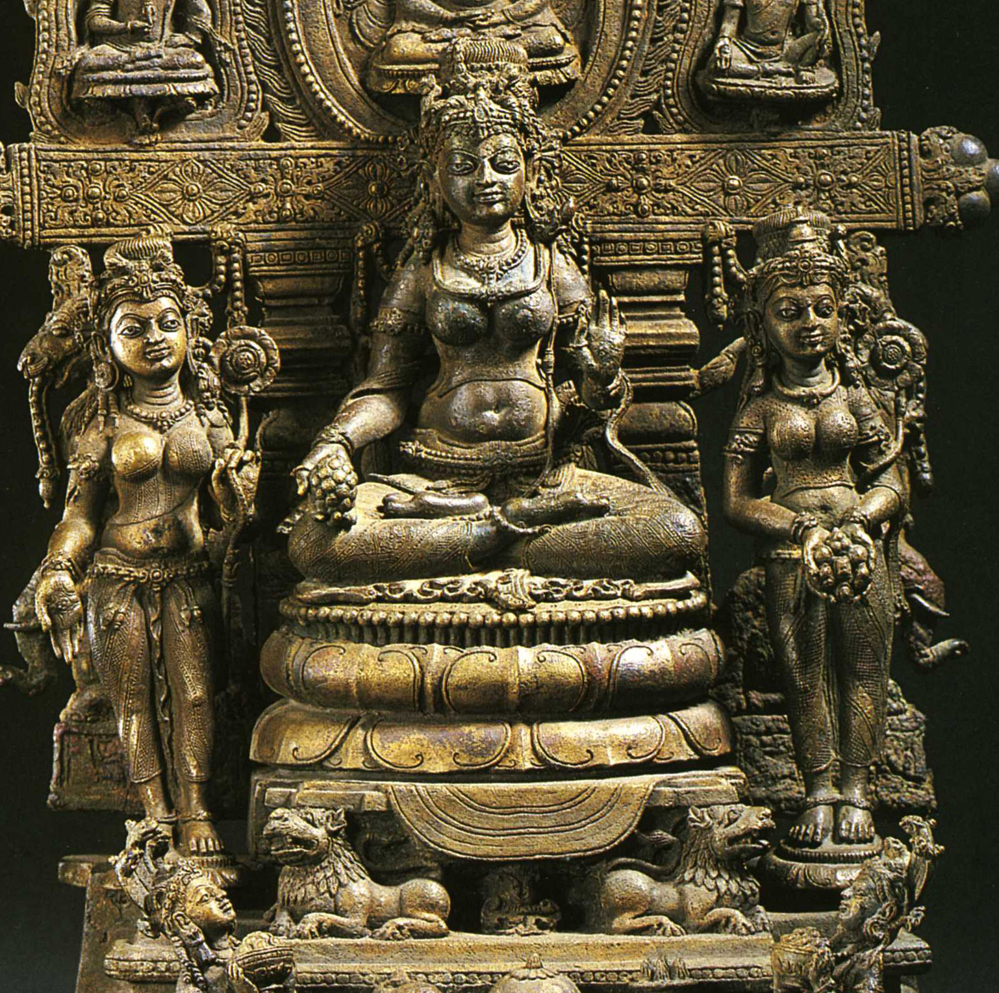

Slide 19
Bhumisparsha Mudrā
Victory over Mara, 11th C
This is the calling the earth to witness mudra. The right hand is draped over the right leg and the palm is facing the leg and the left hand is facing palm up and is positioned at waist level. This gesture refers to Siddhartha's enlightenment. When he gained gained enlightenment, Siddhartha called the Earth Goddess to witness his right to enlightenment by placing the right hand to ground. Shakyamuni Buddha made this gesture when he reached the moment of enlightenment. This mudra sometimes represents the subjugation of the demon horde of Mara.

Slide 20
Bhumisparsha Mudrā
This sculpture is Shakyamuni Buddha and depicts the moment when Buddha realizes that he can become enlightened. While sitting under the Bodhi tree, Buddha had to contend with Mara, a king associated with death. Mara questioned whether or not the Buddha should become enlightened. Buddha summons the goddess Bhu by touching his hand to the earth She drives away Mara so that Buddha can become enlightened.
The gesture in this sculpture is called the bhumisparsha mudra.
In this particular depiction, the body is thin and elongated and the rings around the neck add a sense of beauty and simplicity. This sculpture also includes an ushnisha or crown as well as elongated earlobes and wheel designs (chakras) on his feet. These chakras symbolize Buddha’s transcendent being. There is also an urna or curl in the middle of the forehead. The earlobes and curly hair symbolize when Buddha gave up his connection to worldy desires. The ornament at the top of the head represents light coming from Buddha’s heat.

Slide 21
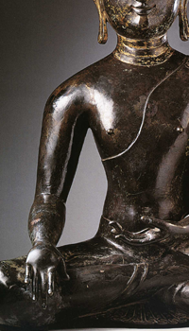

Slide 22
Dharmachakra Mudrā
Shakyamuni/Vairochana in Akanishta, Kashmir, 90 C.E.
Dharmachakra Mudra: This mudrā relates to the first sermon that Buddha preached after his moment of Enlightenment in the Deer Park in Sarnath. This mudrā depicts the turning of the wheel of Dharma. In turning the wheel of Dharma, Buddha teaches people about the process of gaining enlightenment. In this mudrā, the two hands are close together in front of the figure's chest in Vitarka with the right palm forward and the left palm facing upward. The left hand sometimes faces the chest.

Slide 23
Dharmachakra Mudrā
This sculpture depicts Shakyamuni Buddha He is visiting the paradise in order to teach Bodhissatvas residing there.
Shakyamuni is seated on a jeweled throne which is on a lotus. There are two nagas at the foot of the lotus. These nagas are snake heads with male bodies and are emerging from a lake. There is a Dharma wheel at the bottom of the sculpture.
There are two chaityas or stupas on Buddha’s sides which represent Buddha’s enlightened mind and symbolize progress towards realization.
The figures on the right and the left are the donor family.
The mudra depicted here is the dharmachakra mudra. This mudra represents the teaching gesture and refers to the turning of the wheel of Dharma. The wheel is depicted on
Right hand. The pinky finger of the left hand is pointing to the wheel. The left hand is holding a robe and which refers to enlightenment. The third finger on the right hand refers to turning the wheel of Dharma three times.

Slide 24
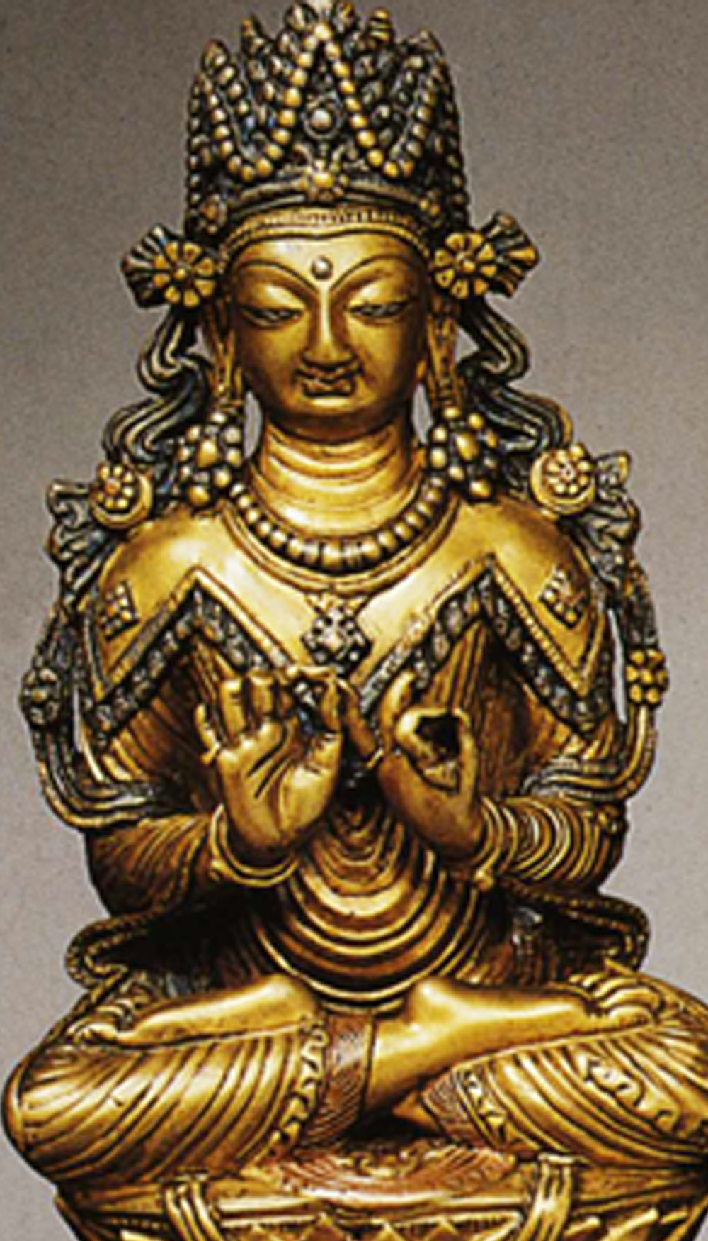

Slide 25
Vajra Mudrā
This is the gesture of knowledge. It is made making a fist with the right hand, index finger extending upward, and the left hand also making a fist and enclosing the index.
This is a sculpture of Gandhara

Slide 26
What mudra is depicted
here?

Slide 29
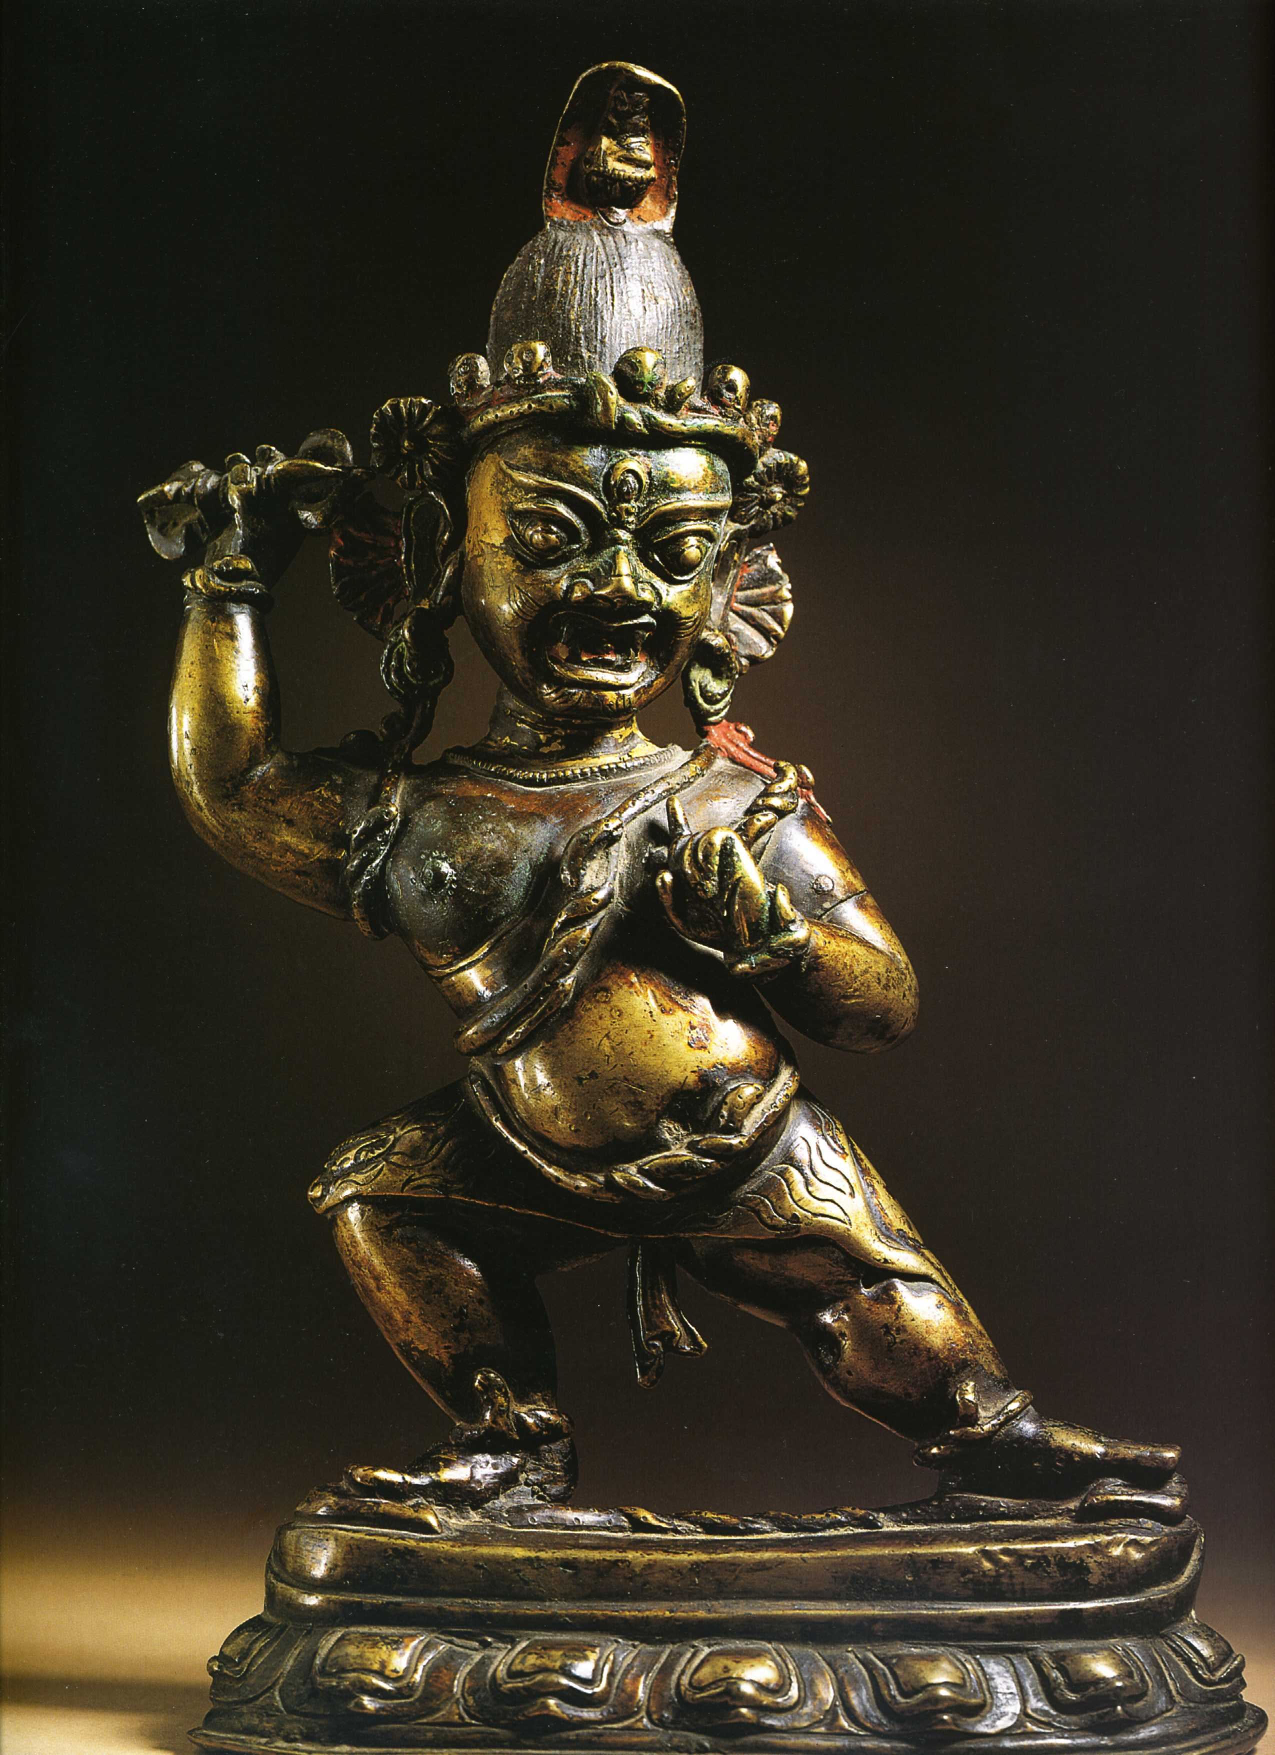

Slide 30
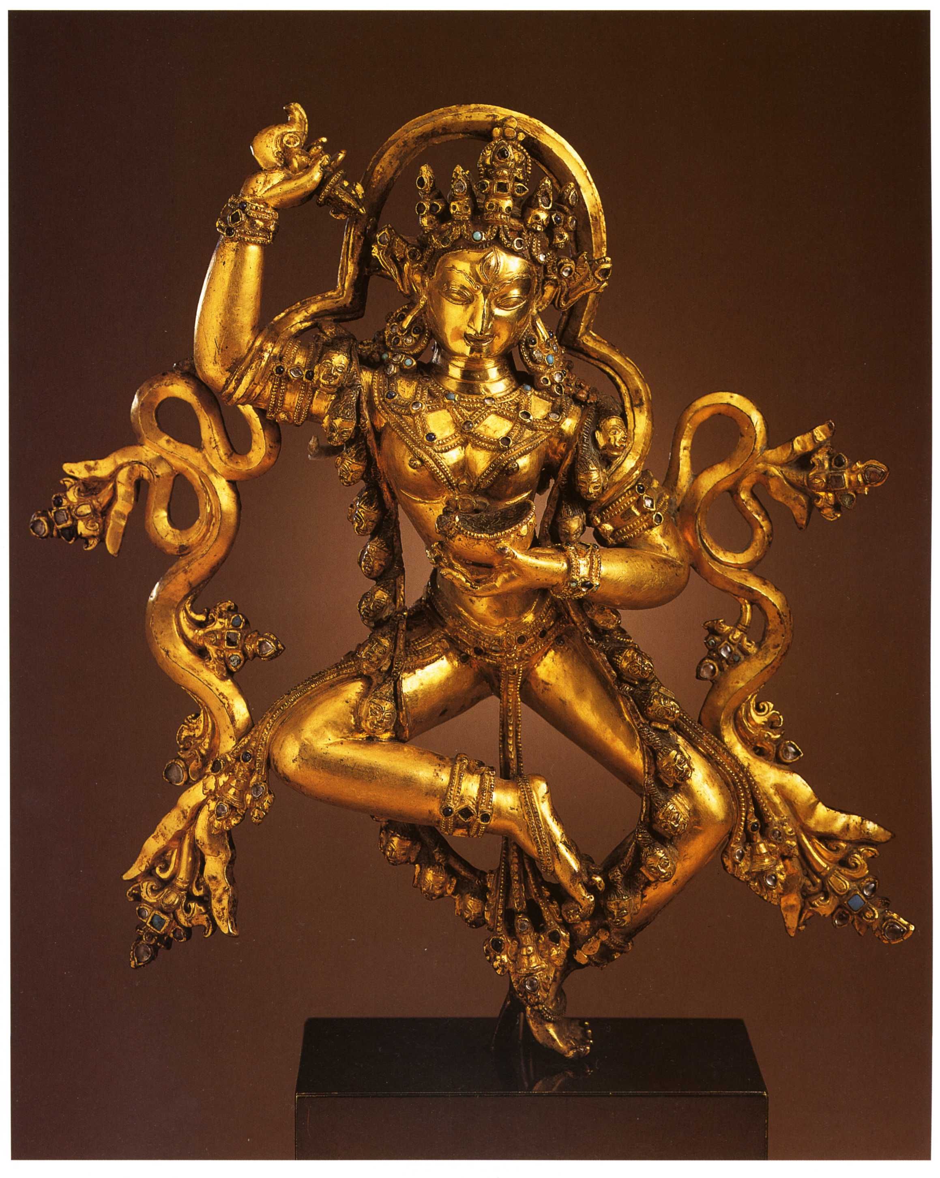

Slide 31
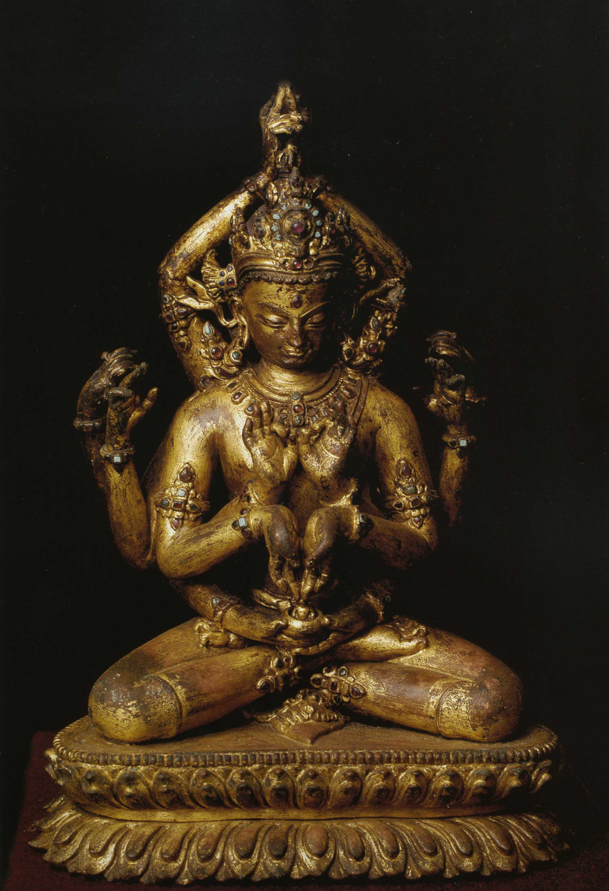

Slide 32
