Slide 1
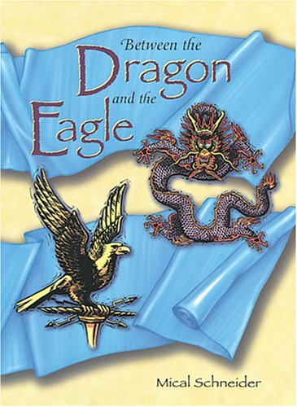
A Visual Journey Along the Silk Road
Part 1:
Chapters 1-9
Designed by
Tamara Anderson
Rundlett Middle School
Concord, NH

Slide 2
Part 1
“The Blue Silk Travels from Changan to Merv”

Slide 3
Chapter 1
These coins would be similar to the coins given to Han Tzu by Yin Li.
The scroll that Yin Li held may have been similar to this one.

Slide 4
Han Tsu may have looked something like this man.
This may be what
Yin Li looked like.

Slide 5
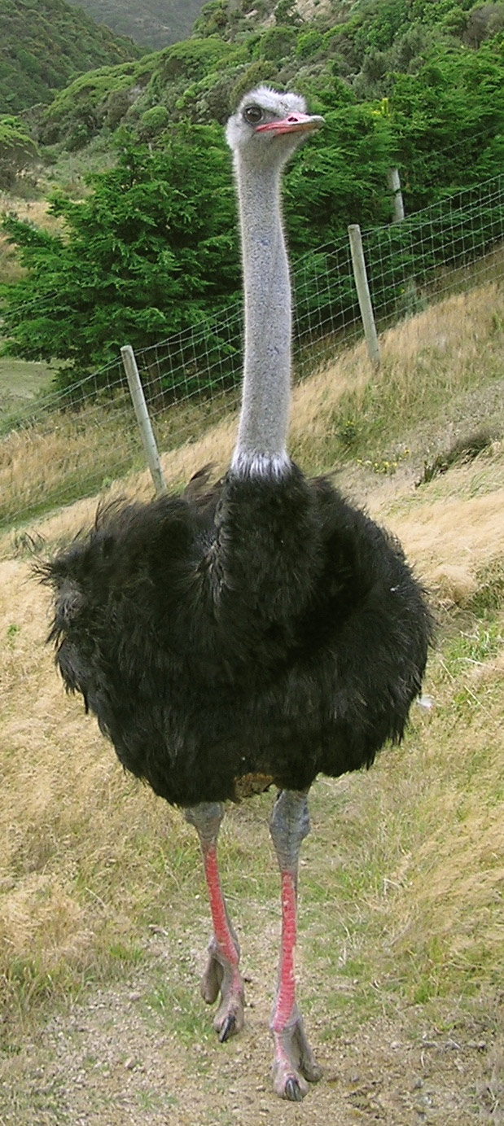
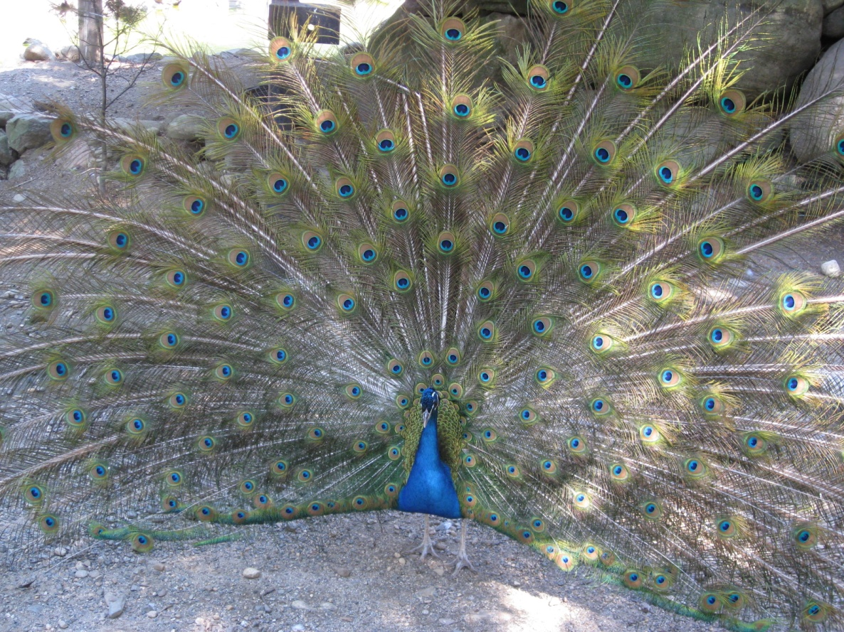
When Han Tzu describes the birds he has seen in the marketplace in Merv, he is referring to peacocks and probably ostriches.

Slide 6
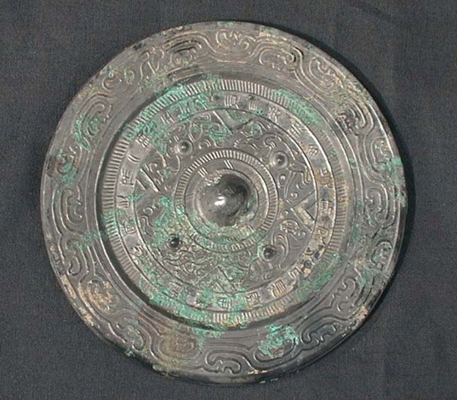
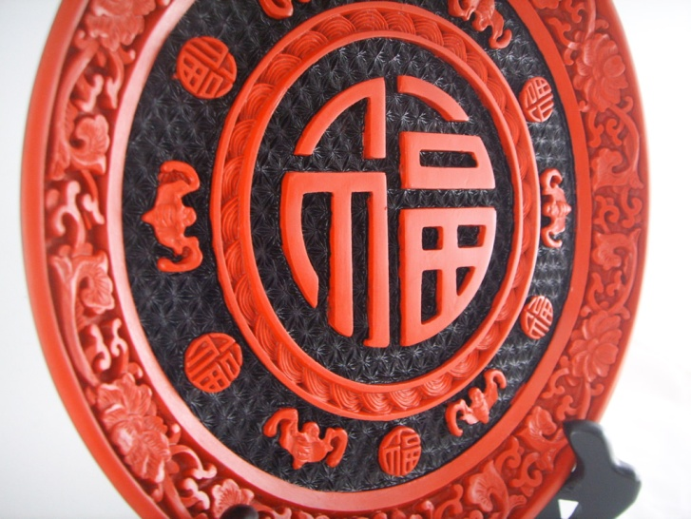
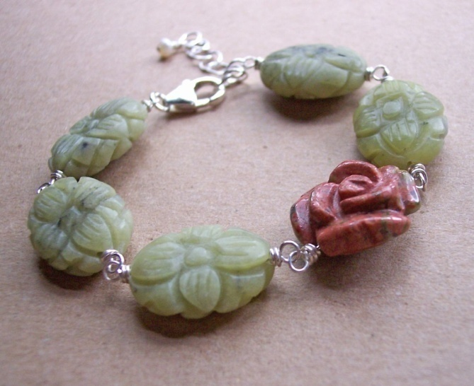
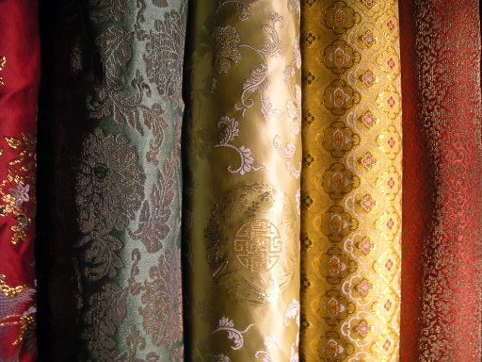
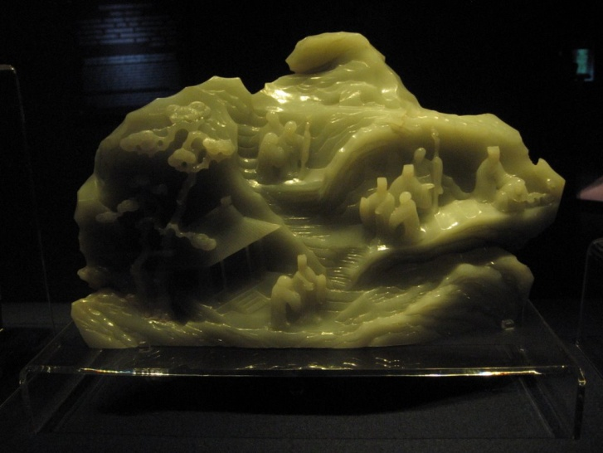
The items that would travel with Han Tzu
from Changan to Merv
Bronze Mirror
Lacquerware
Jade Bracelet
Jade Carving
Bolts of Silk

Slide 7
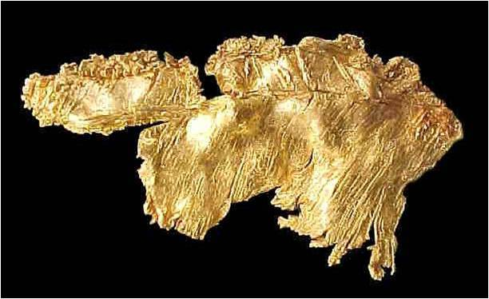
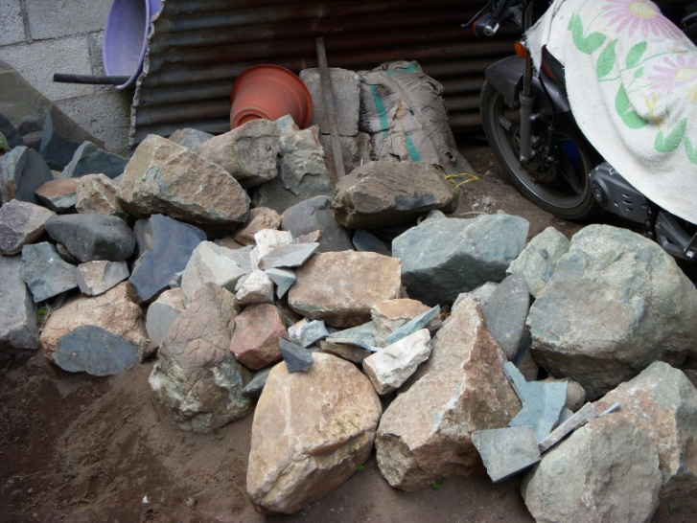
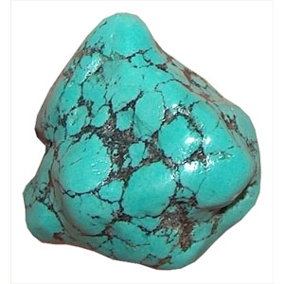
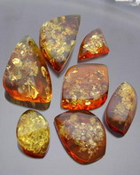
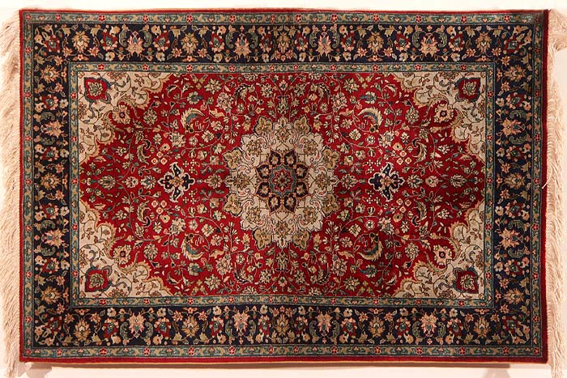
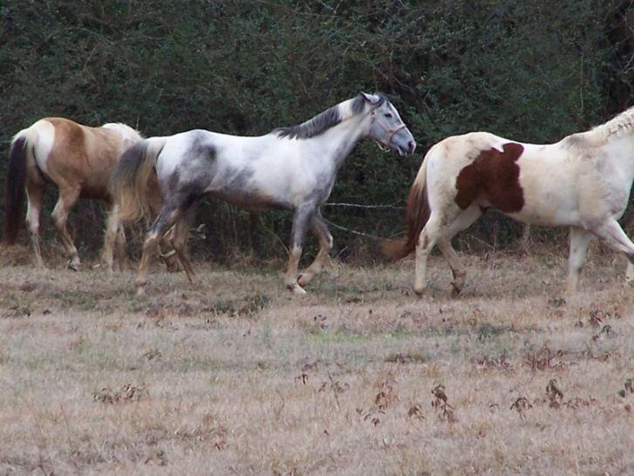
Han Tzu was commissioned to bring back valuable items from Merv. These items would have come from places as far away as Rome through various traders along the Silk Road.
Gold
Raw Jade
Gems such as turquoise
Amber
Rugs
Horses

Slide 8
Insert Map Here

Slide 9
A copper pot similar to what Wei Chien would have cooked in.

Slide 10
Peasant farmers

Slide 11
This army of Terracotta Warriors are probably dressed similarly to the soldiers in the story.

Slide 12
Chinese homes would have altars similar to this one for worshipping, or paying respect to, their dead ancestors.

Slide 13
Silk Weaving Loom

Slide 14
Silk with embroidered dragons for good fortune.

Slide 15
Two-humped camels, called Bactrian Camels were used in caravans along the Silk Road.

Slide 16
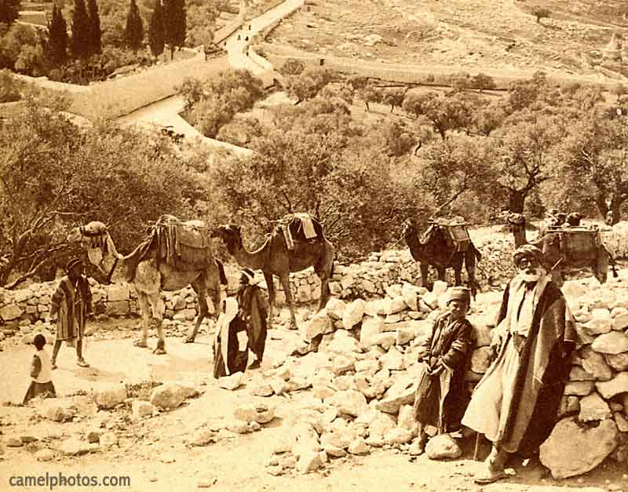
A typical caravan would have consisted of many people and animals, usually camels. Among the travelers would be merchants, guides, caravan leaders, camel drivers, and cooks and their assistants.

Slide 17
Chinese Farming Tools

Slide 18
The Great Wall of China

Slide 19
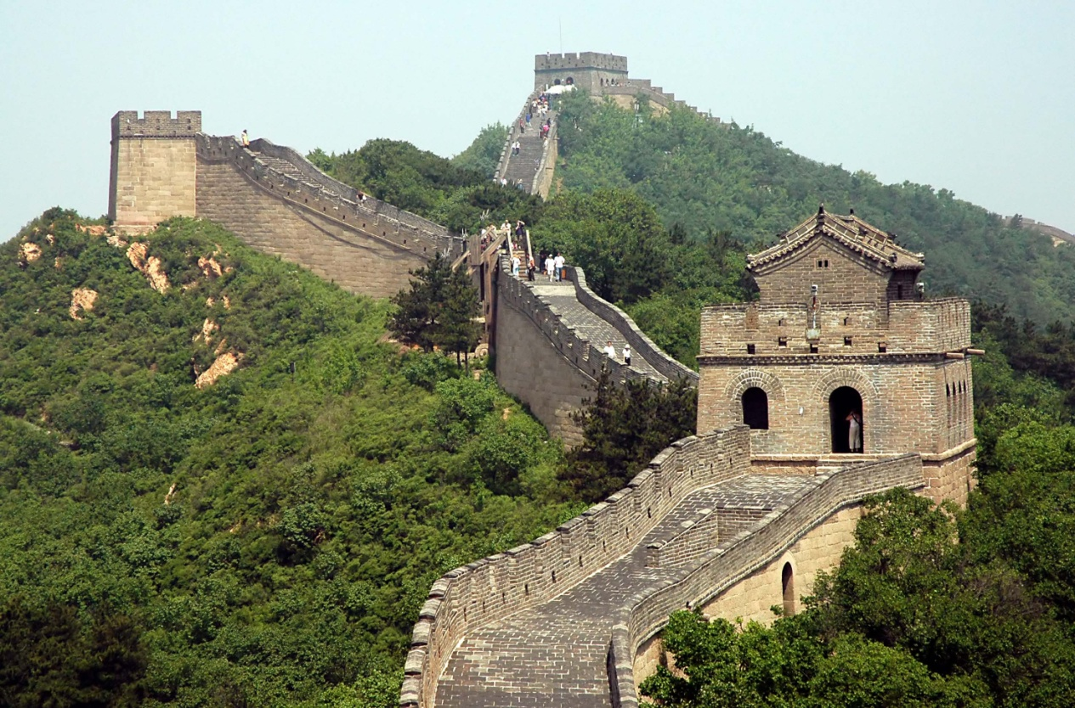
The Garrisons, or watch towers, where soldiers stood watch for invaders.

Slide 20
The meat of sheep is called “mutton”.

Slide 21
This Buddhist monk is dressed similarly to the monk Han Tzu encountered on his journey.

Slide 22
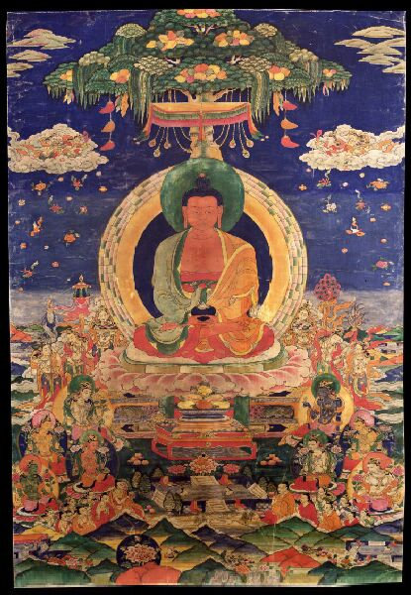
Buddha’s Life The Three Forms of Suffering: Poverty, Sickness, and Death

Slide 23
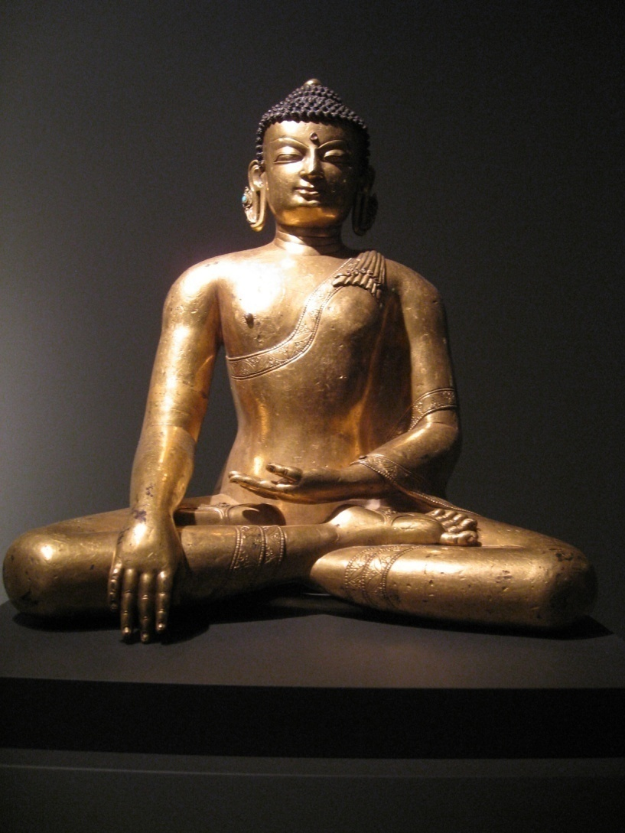
Buddha and a monk in meditation posture.

Slide 24
Aerial View of Lop Nor area

Slide 25
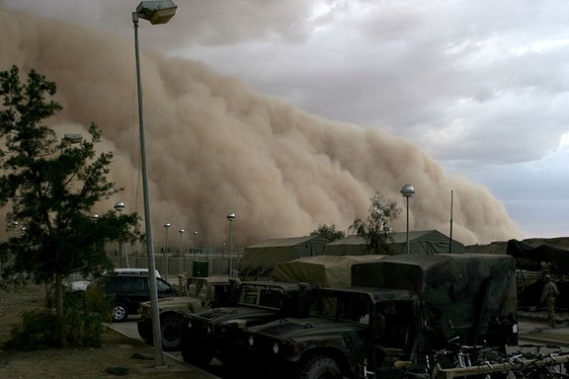
A Sandstorm in Iraq

Slide 26
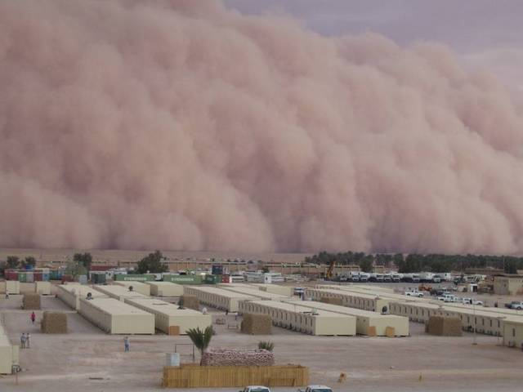
Doomsday in the city!

Slide 27
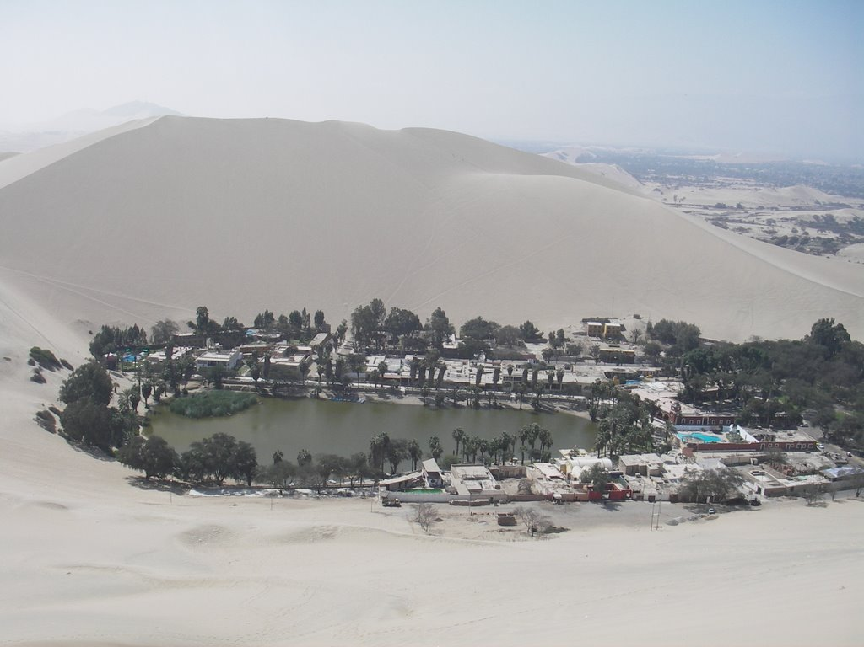
Desert Oasis Town

Slide 28
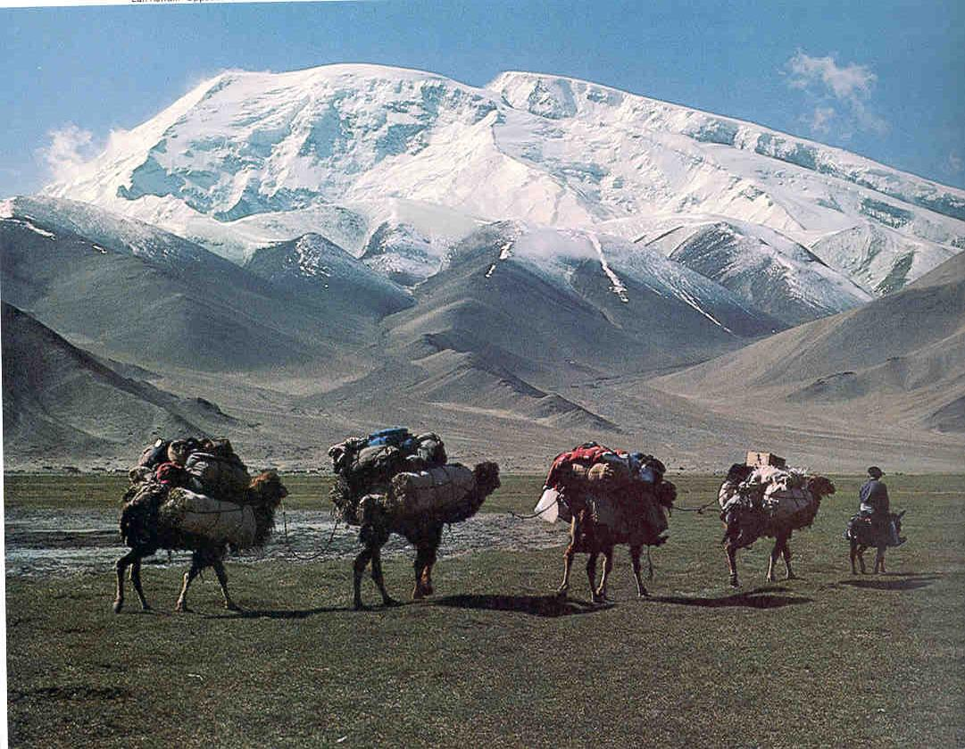
Small caravan entering the Pamir Mountains,
one of the highest and least-accessible
mountain ranges in the world.

Slide 29
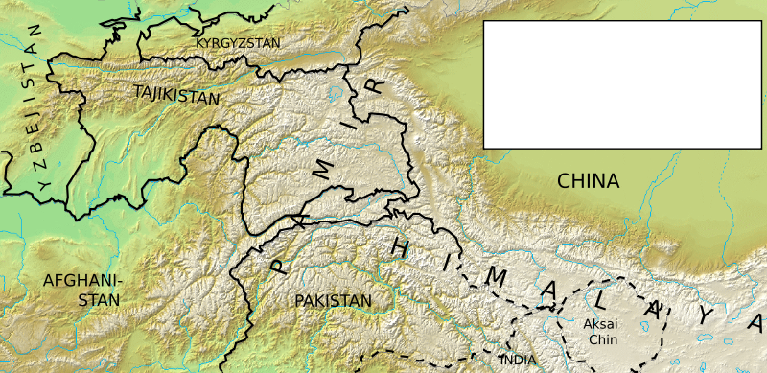
The Pamir Mountains are located in Central Asia and are formed by the junction or knot of the Tian Shan, Karakoram, Kunlun, and Hindu Kush ranges.
The Pamir region is centered in the Tajikistani region of Gorno-Badakhshan. Parts of the Pamir also lie in the countries of Kyrgyzstan, Afghanistan, and Pakistan.
Source: Wikipedia

Slide 30
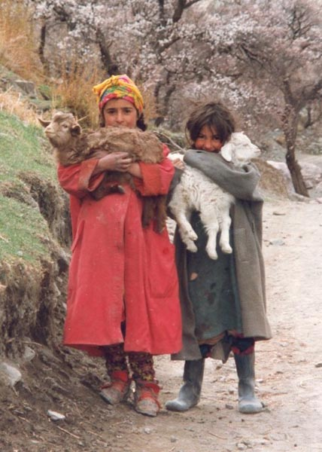
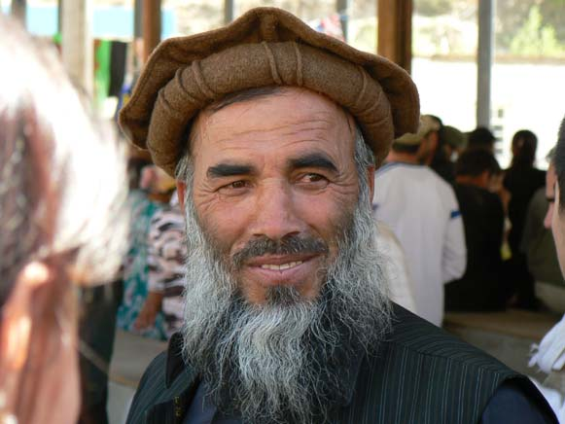
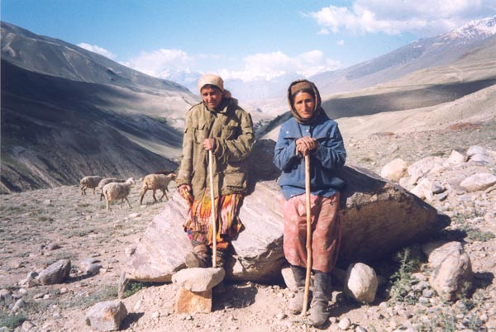
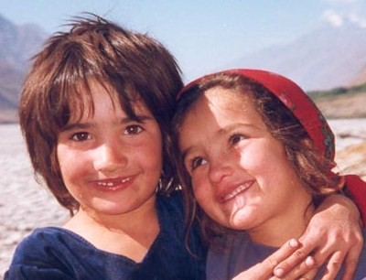
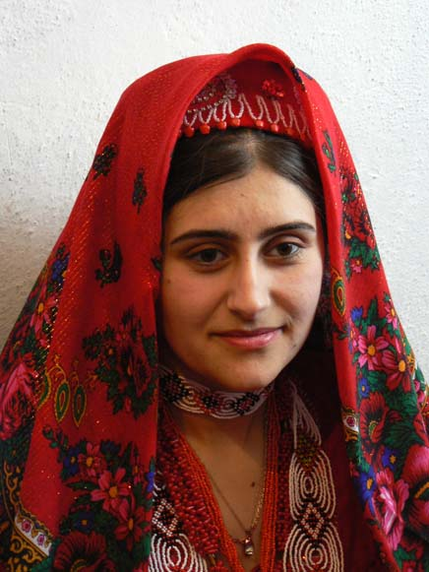
People of the Pamir Region

Slide 31
Panoramic view of a Mountain Pass in the Pamirs
Panoramic view of the Pamirs from a plains region

Slide 32
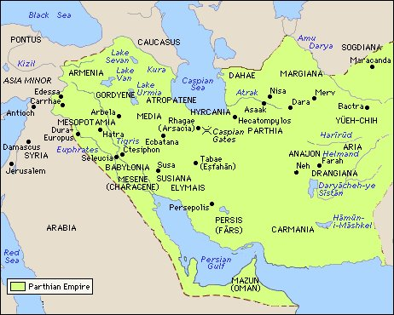
Merv, Han Tzu’s final destination, was located in the Parthian Empire west of the Pamir Mountains, in the region of modern-day Turkmenistan near Iran.
“There are the ruins of a Buddhist temple, a mosque, and what may have been
an early Christian church within walking distance of one another…”
Source: Suite101.com

Slide 33
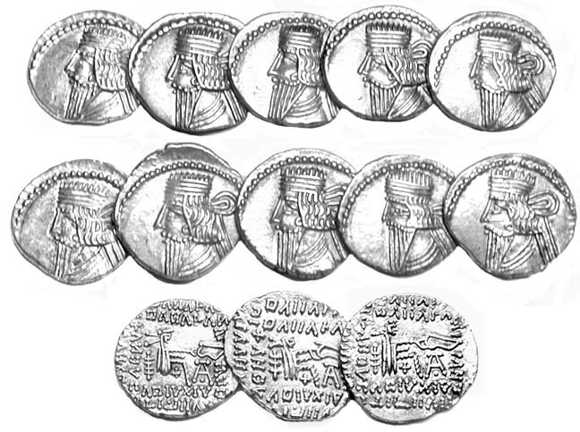
Parthian Coins

Slide 34
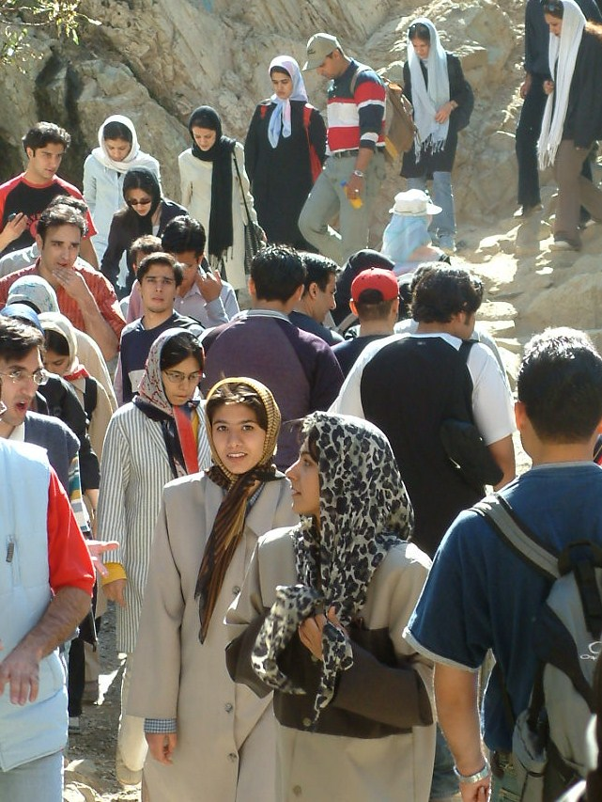
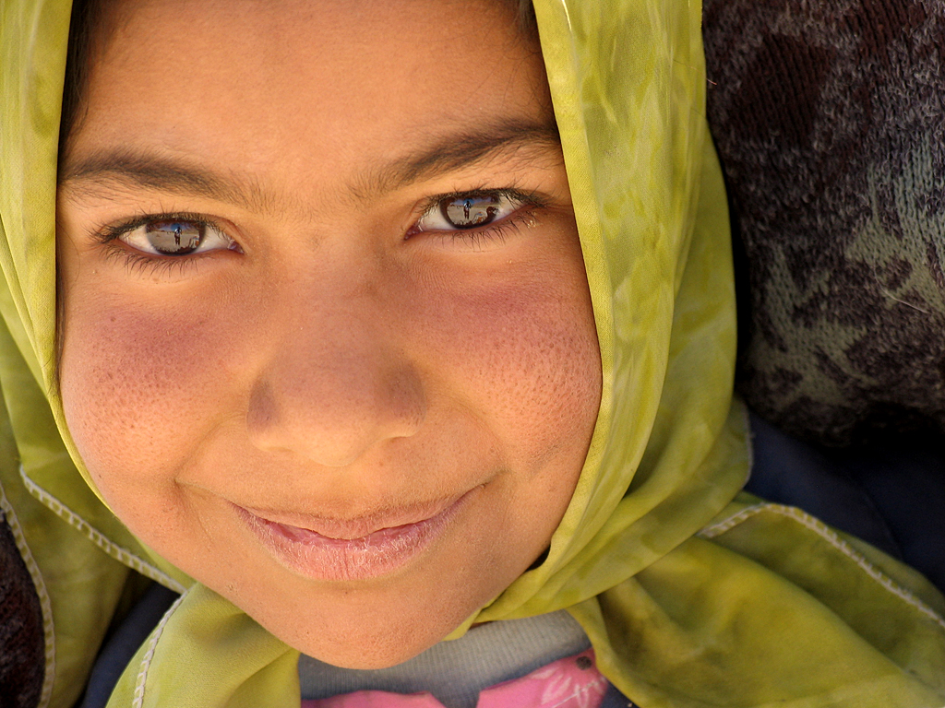
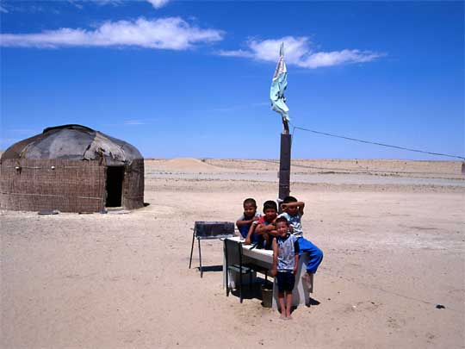
The people
of the region.

Slide 35
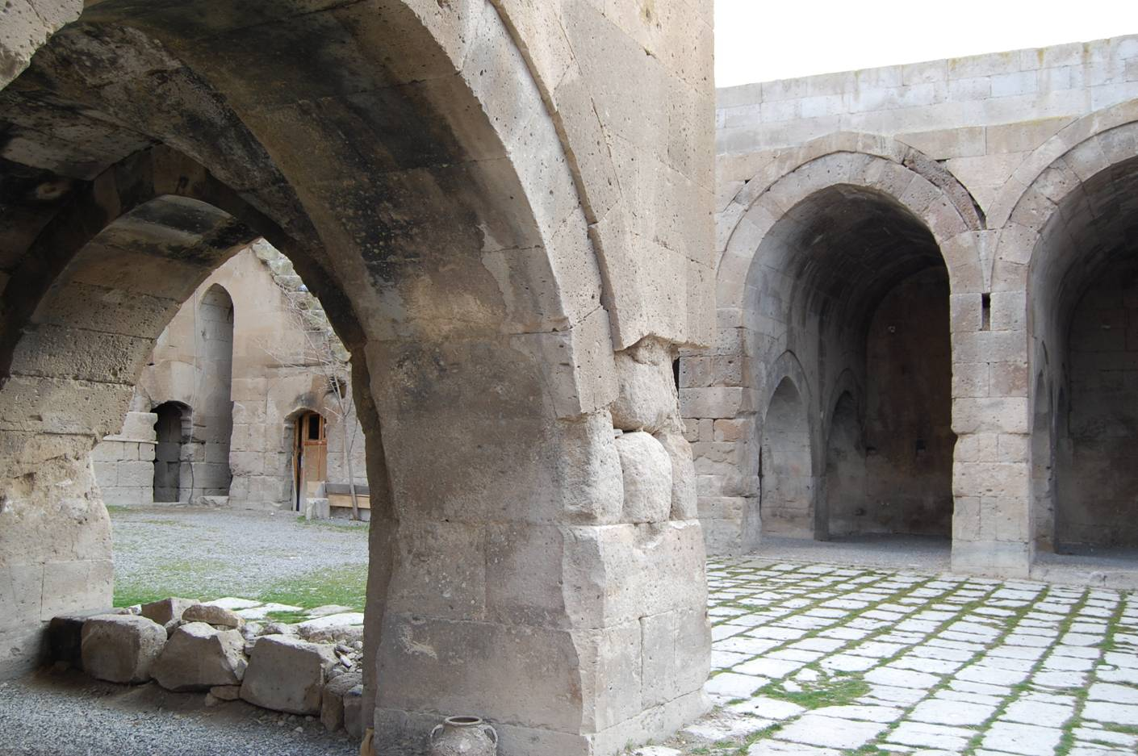
Caravanserai were a bit like hotels where weary travelers could stay for the night to rest and seek medical attention if necessary.

