Slide 1
A Visual Journey Along the Silk Road
Part 2:
Chapters 10-14
Designed by
Tamara Anderson
Rundlett Middle School
Concord, NH

Slide 2
Part 2
“The Blue Silk Goes from Merv to Palmyra”

Slide 3
Insert Map Here

Slide 4
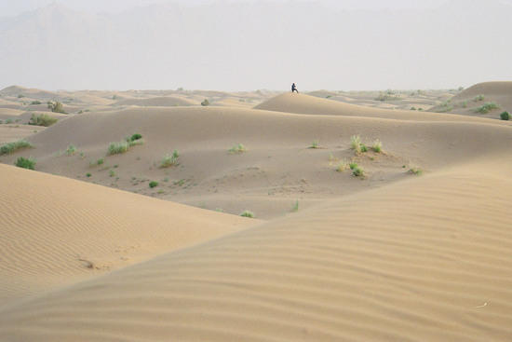
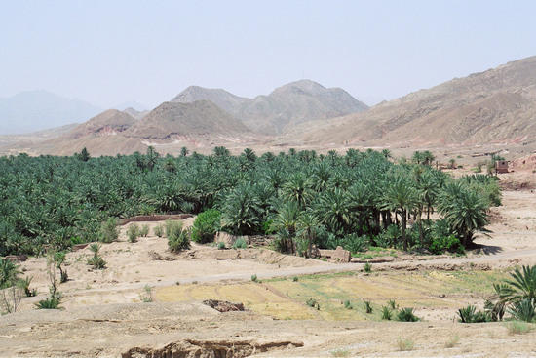
Dasht-E-Kavir Desert in modern-day Iran.
This is the desert that Pacorus has to travel across
to get to Palmyra.
The Dunes
The vegetation near the oasis

Slide 5
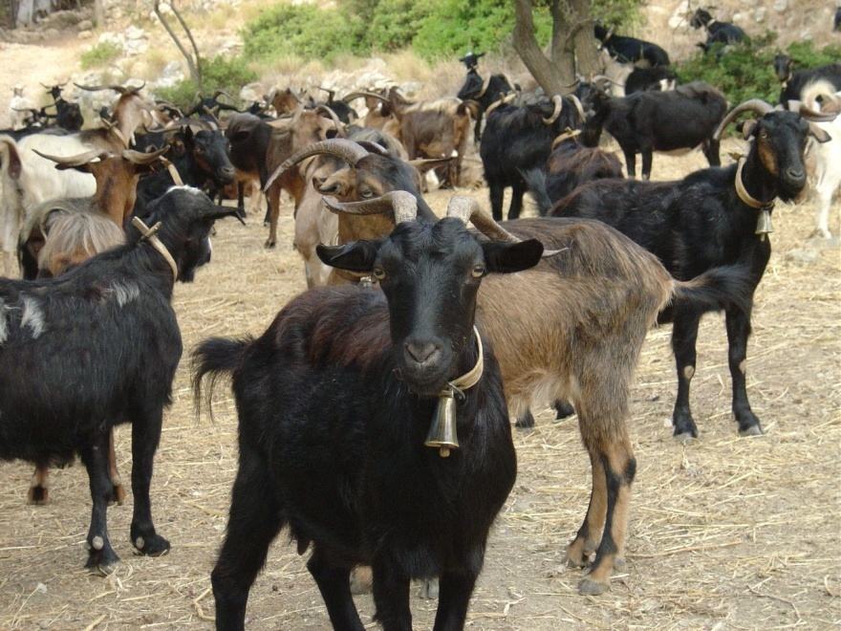
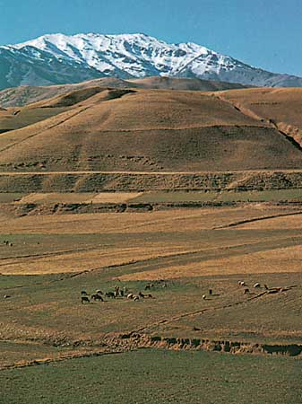
The Zagros Mountains, the largest mountain range in modern-day Iran and Iraq, where Pacorus and his caravan were robbed.
Goats are a common animal in the Zagros Mountains.

Slide 6
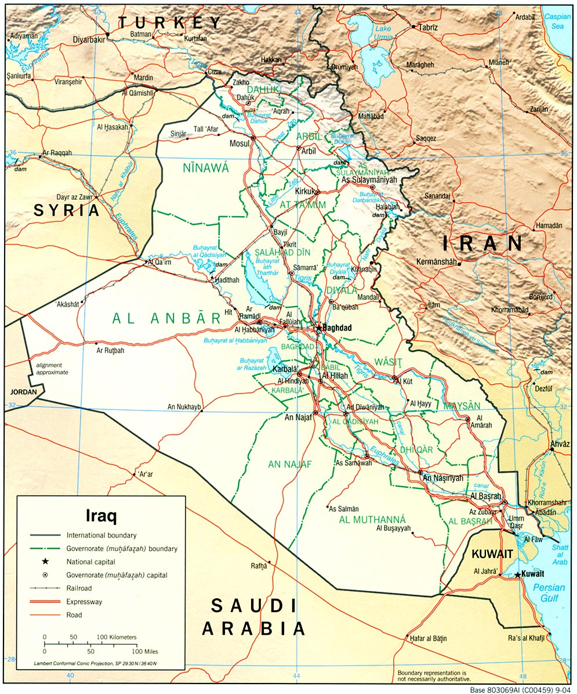
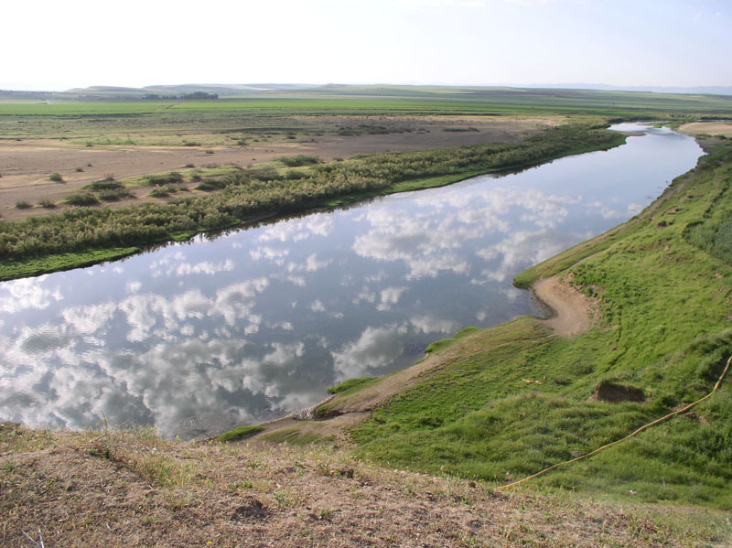
Pacorus’ caravan is in this region of the world near the Tigris River.
The bank of the Tigris River

Slide 7
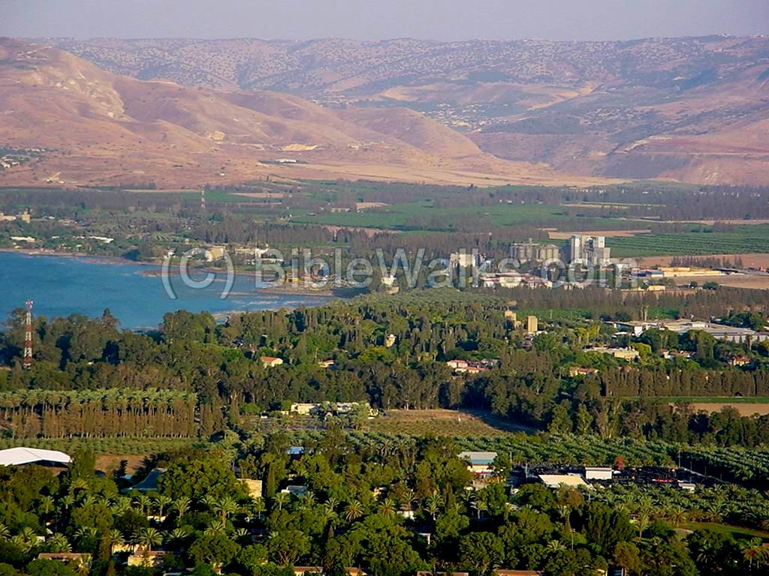
The Euphrates River Valley near modern-day Jordan

Slide 8
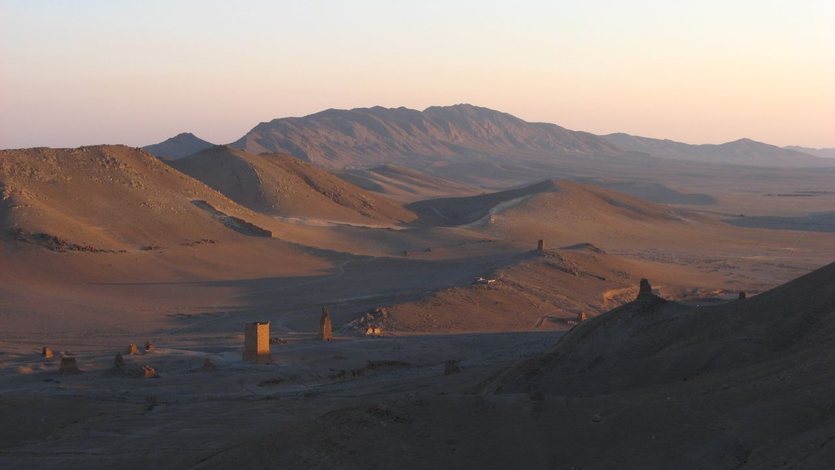
A view of the Syrian Desert, part of Pacorus’s journey.

Slide 9
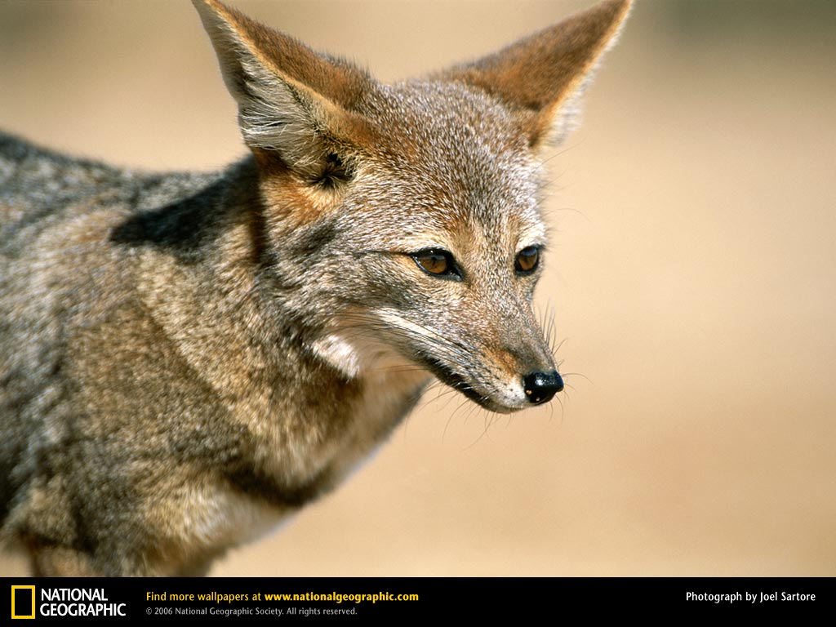
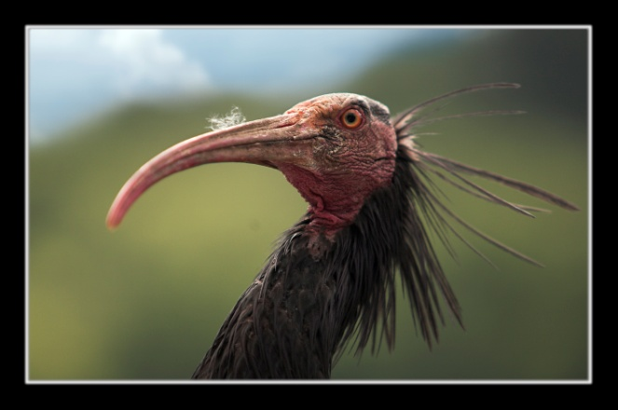
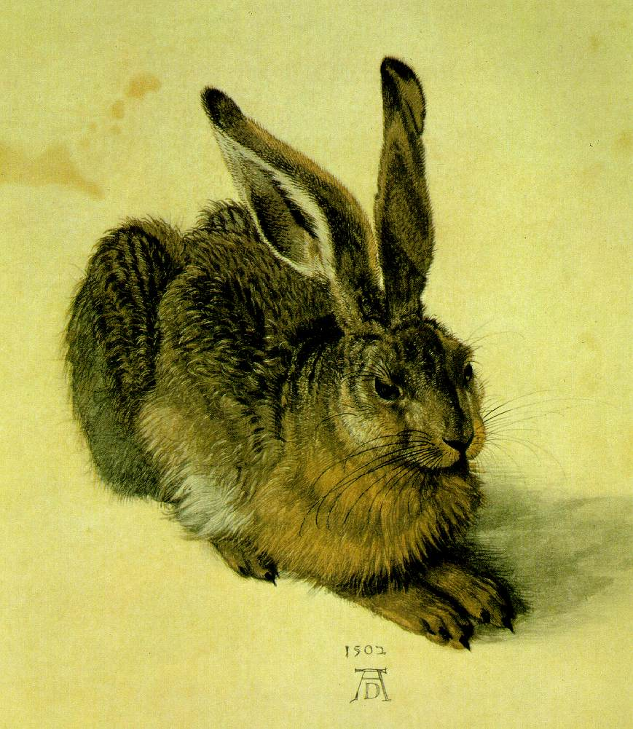
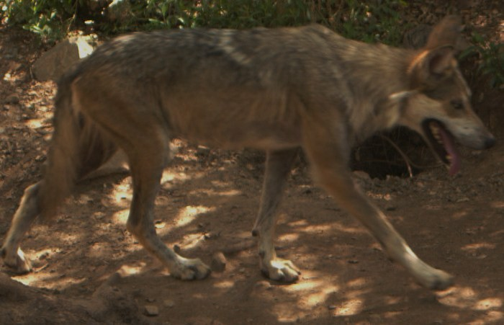
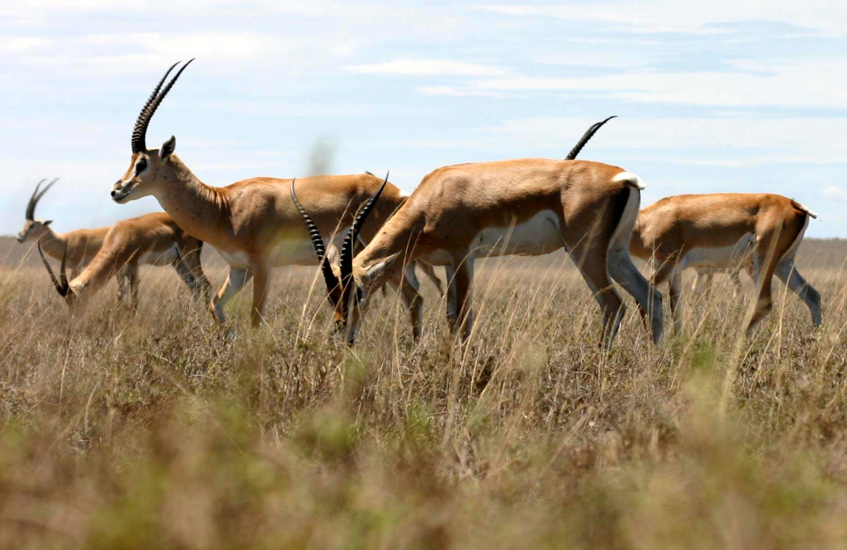
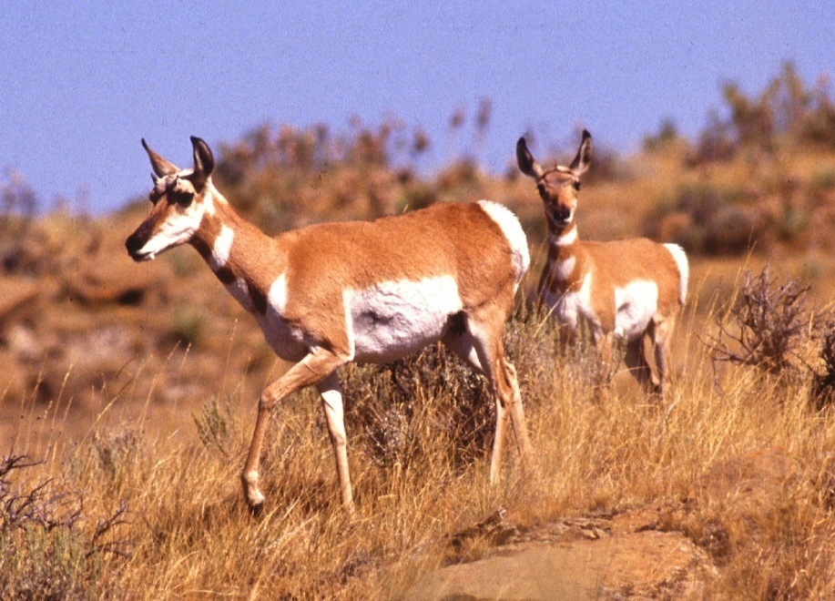
the
Desert
of
Animals

Slide 10
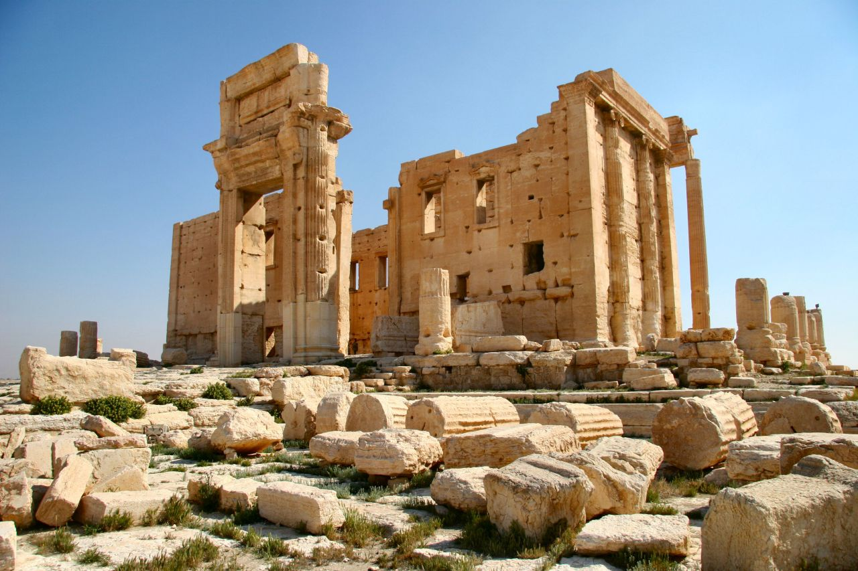
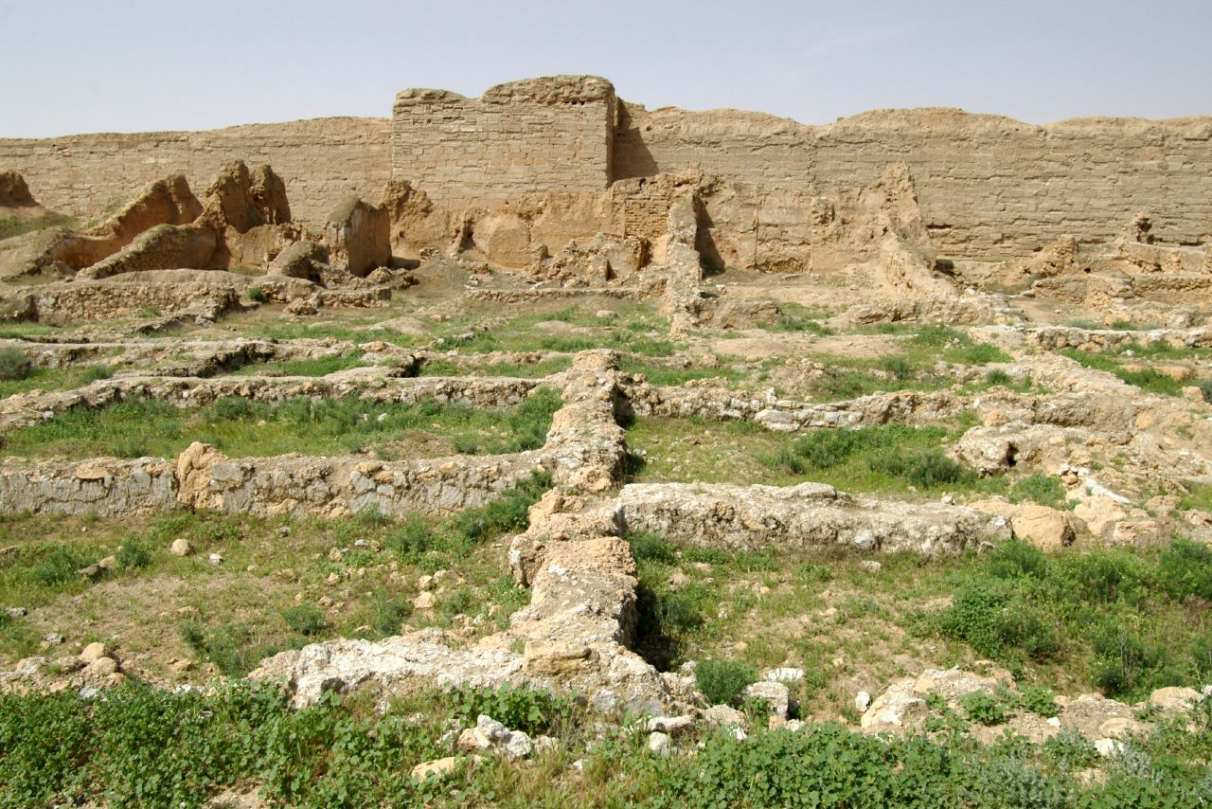
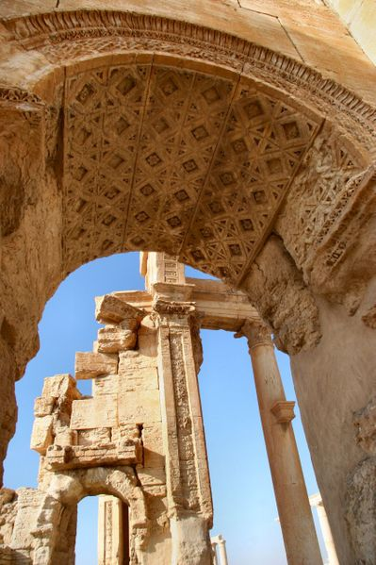
Ancient ruins of Palmyra, what was once a thriving trade stop on the Silk Road.

Slide 11
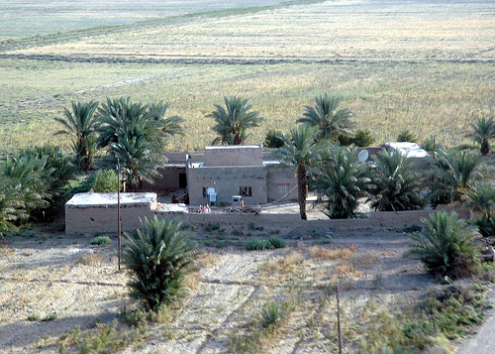
Flat-topped stone house similar to what
Pacoras stayed at in Palmyra.

