Slide 1
A Visual Journey Along the Silk Road
Part 4:
Chapters 19-27
Designed by
Tamara Anderson
Rundlett Middle School
Concord, NH

Slide 2
Part 4
“The Blue Silk Makes Its Way From Petra to Alexandria”

Slide 3
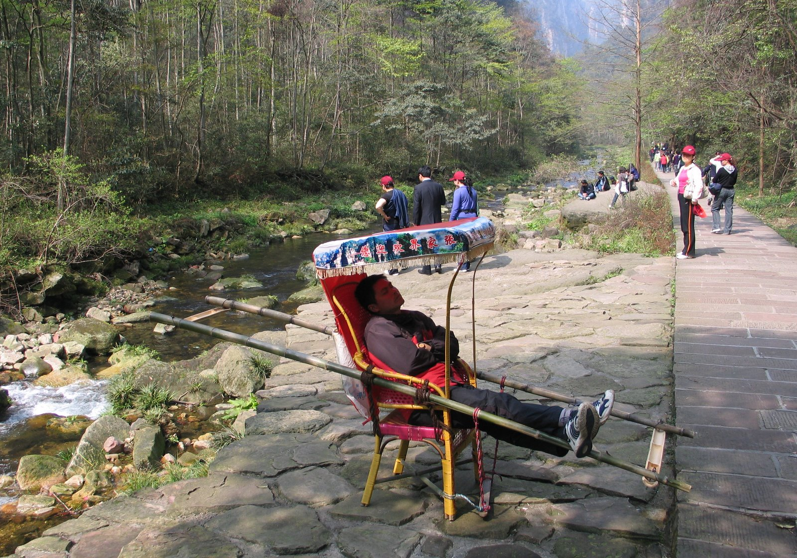
This is a sedan chair, like what Claudius Rufus Gallus arrived to the marketplace in. It is probably different in design than the one in the story.

Slide 4
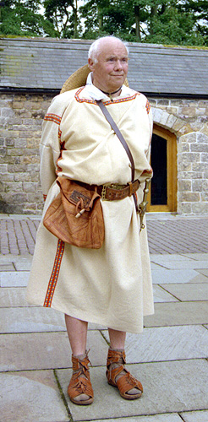
This tunic may be similar to the one worn by Claudius Rufus Gallus and other Romans.

Slide 5
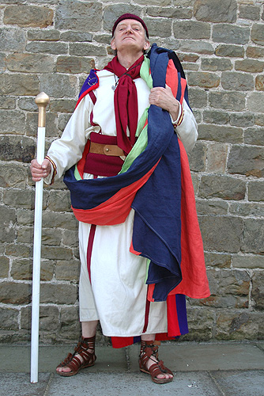
Togas were worn by male citizens of Rome who held good social status.

Slide 6
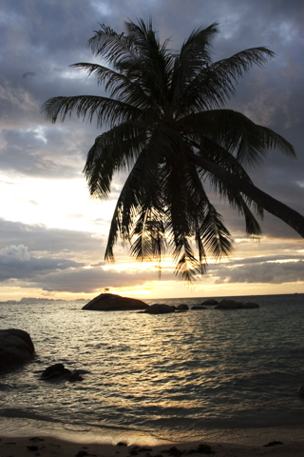
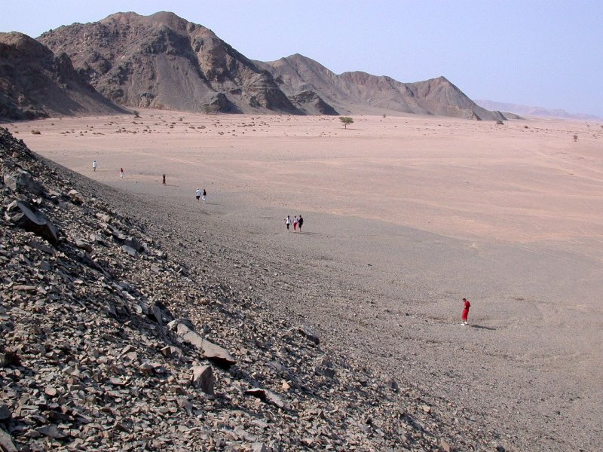
Firmus Octavius Parro crossed the Red Sea to the Egyptian Desert

Slide 7
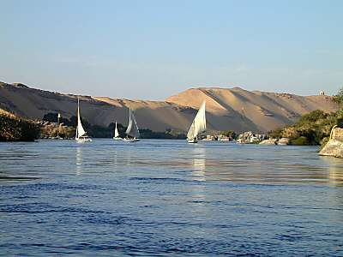
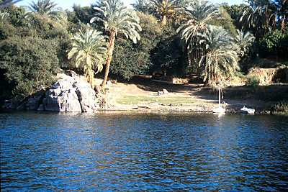
They traveled down the Nile River toward Alexandria, the seaport to the Mediterranean Sea where they would sail across into Rome.

Slide 8
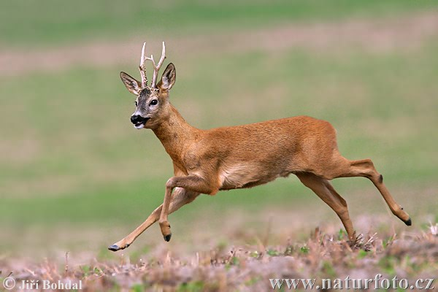
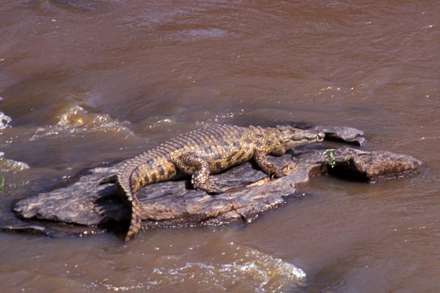
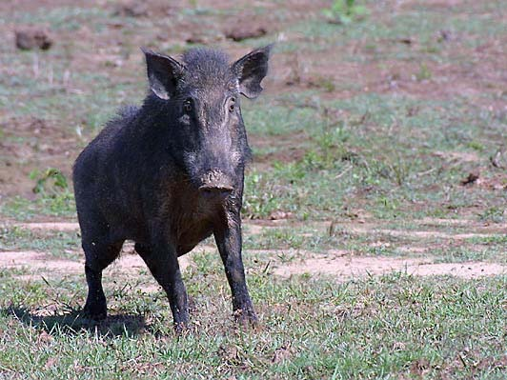
Some of the animals Firmus and his men saw as they sailed down the Nile.

Slide 9
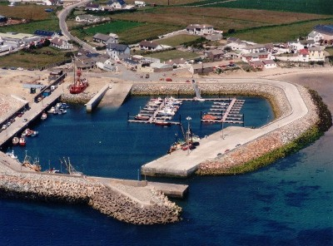
This might be like the quays that Firmus walked along looking for a ship into Rome.

Slide 10
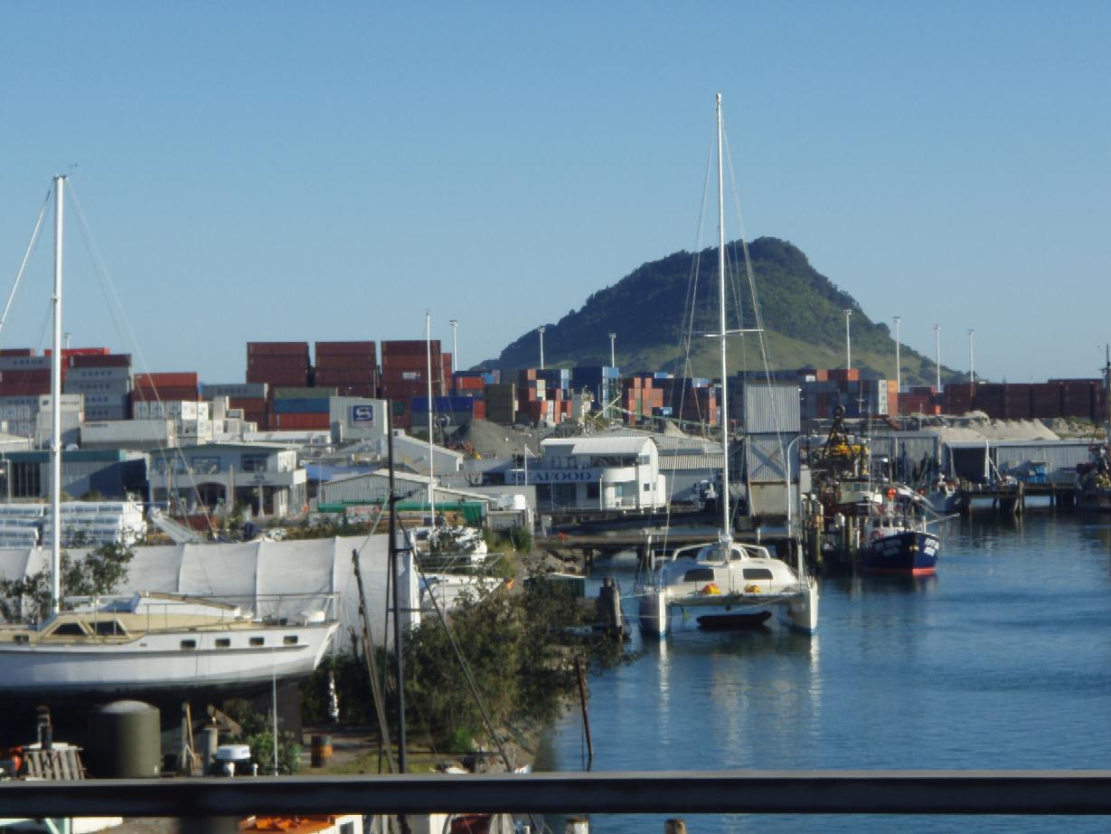
A wharf is a place where
boats are docked.

Slide 11
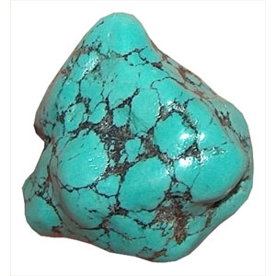
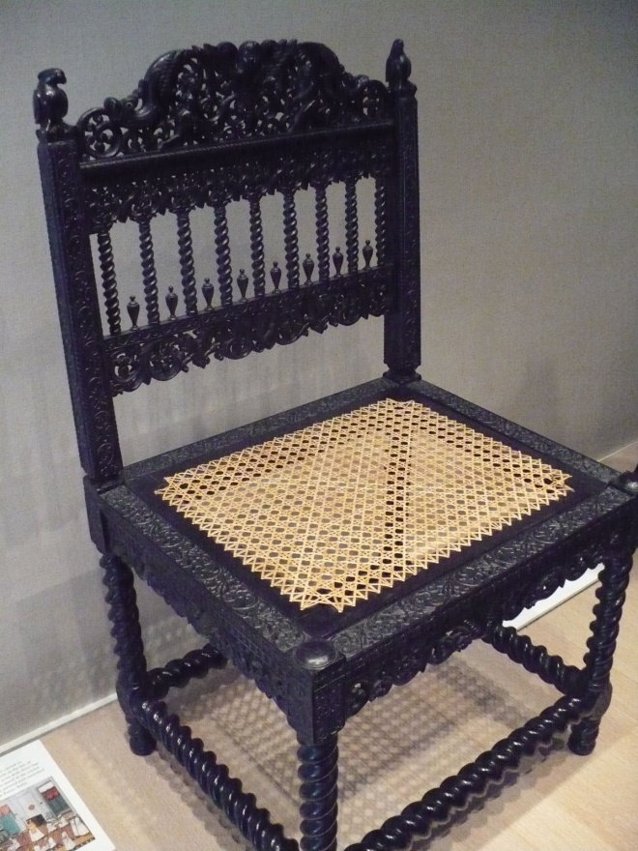
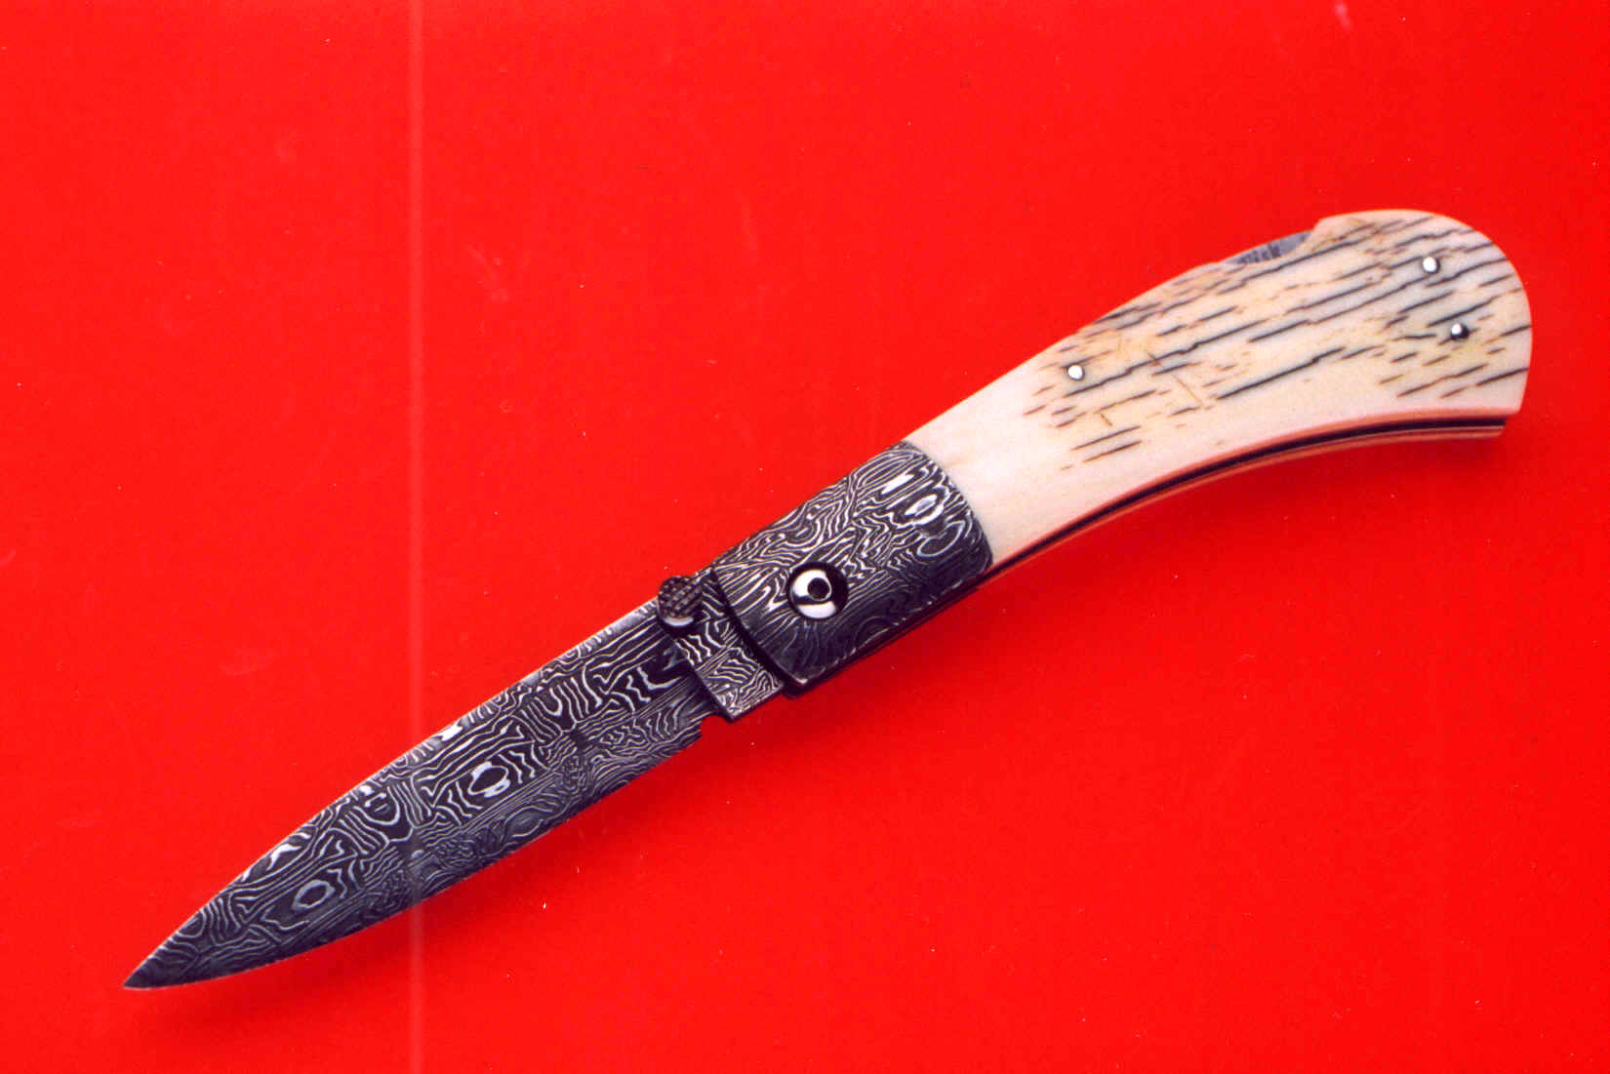
Some of the items that Claudius bragged he’d be taking back to Rome to sell.

Slide 12
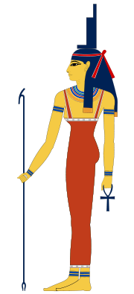
Isis
The goddess of healing, widows, young girls, and the sea.

Slide 13
The Blue Silk Arrives in Rome

Slide 14
Insert Map Here

Slide 15
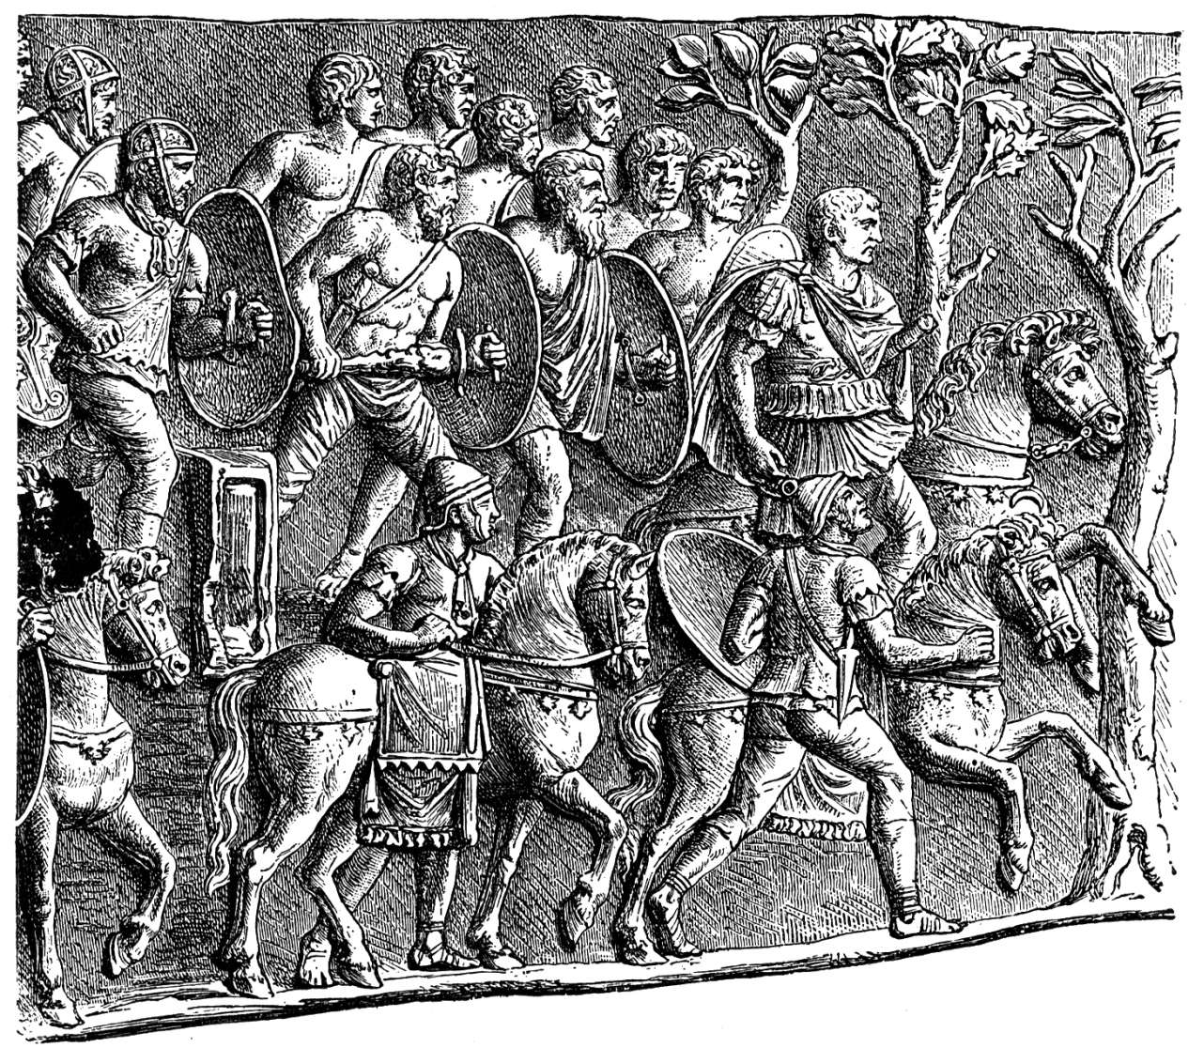
The Roman Imperial Soldiers that Julia Sabina and her slave, Melissa saw as they entered the Roman square.

Slide 16
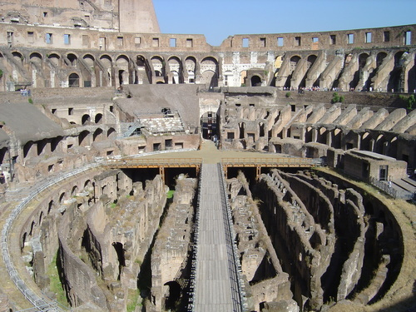
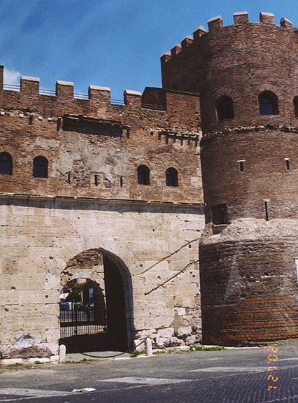
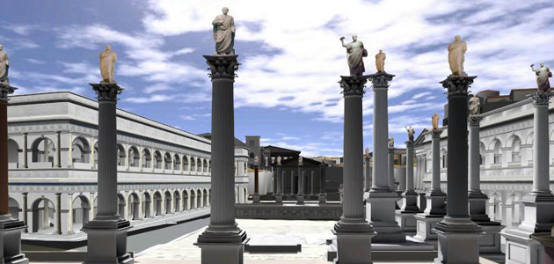
Roman Coliseum
Images of
Rome
The City Gate
Computer Reproduction of the Roman square

Slide 17
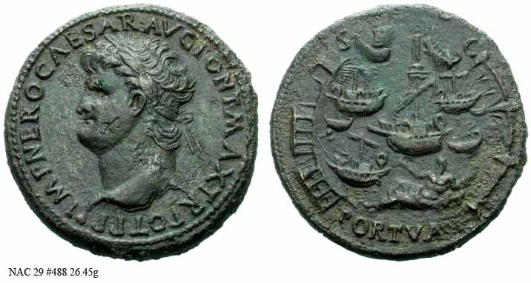
Coins from ancient Rome

Slide 18
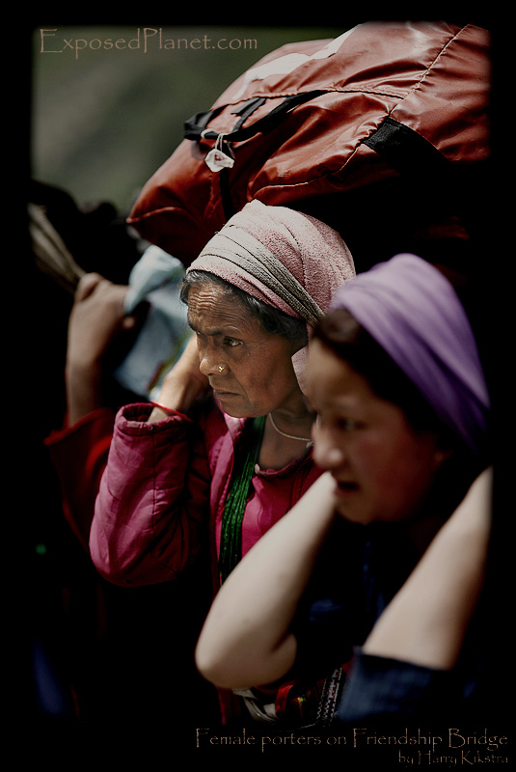
A porter’s job is to carry items to be transported. Like the porters who carried the blue silk to its final destination…to be made into Julia’s wedding dress!

