Slide 1
Atisha
Atiśa Dipankara Shrijnana
Carol Lynne Tombers
Visual Art Department
The Blake School
www.blakeschool.org

Slide 2
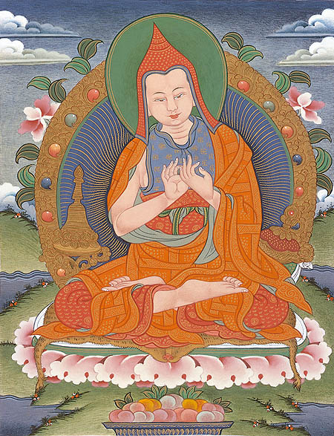
a Buddhist teacher from the pala empire
c. 980–1054 CE
The Pāla Empire was one of the major middle kingdoms of India existed from 750–1174 CE.
Ruled by a Buddhist dynasty from Bengal in the eastern region of India.
1

Slide 3
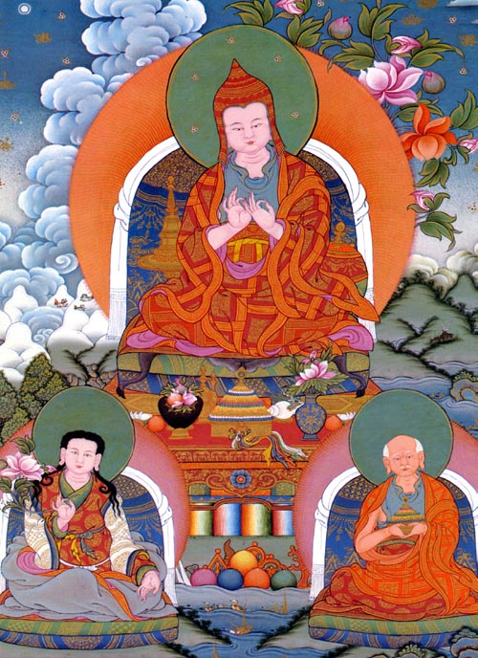
Helped to establish the sarma lineages in Tibet
Sarma-“new translation”
In Tibetan Buddhism, the Sarma schools include the three newest of the four main schools:
Kagyu
Sakya
Kadam/Geluk
and their sub-branches.
The Nyingma school is the sole Ngagyur or "old translation," school.
2
Notes:
The 14th Dalai Lama is from the Geluk school

Slide 4
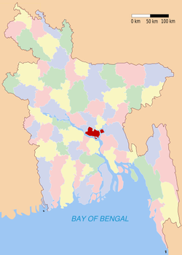
The birth of Aisha
Atisha is most commonly said to have been born in the year 980 in Vajrayogini village in Bikrampur, the northeastern region of Bengal (located in modern day Bangladesh). He lived to the age of seventy-two.
3

Slide 5
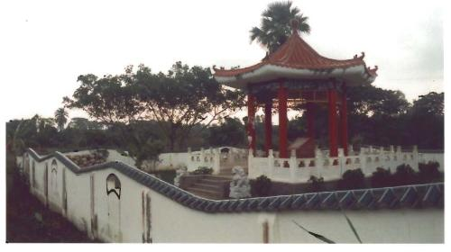
The birth of Aisha
Atisha was allegedly born into royalty; the palace in which he was raised, aptly named the Golden Banner Palace.
It is said that as Atisha was born flowers rained down upon the city of Vikramapura, a rainbow canopy appeared, and the gods sang hymns which brought gladness and joy to all the people.
4
Notes:
His father was the king of Bengal known as Kalyana Shri, and his mother was Shri Prabhavati. One of three royal brothers, Atisha went by the name of Chandragarbha during the first part of his life. In fact, it was not until he traveled to Tibet and encountered the king Jangchub Ö (Byang Chub Od) that he was given the name of Atisha, a Tibetan reference to peace.

Slide 6
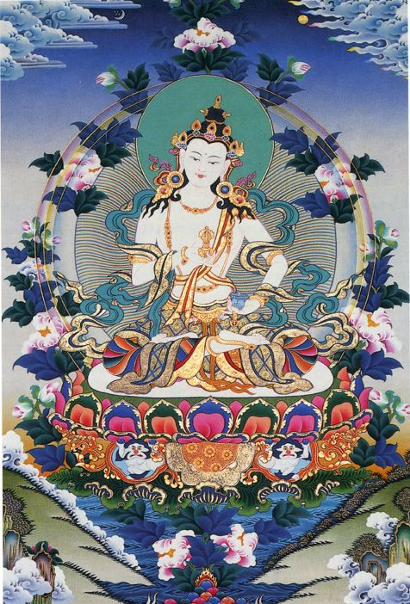
The birth of atisha
The emergence of a rainbow canopy symbolizes the reincarnation of a Bodhisattva.
The image of flowers falling from the sky appears in the episode of Shakyamuni Buddha's attainment of perfect enlightenment,
5

Slide 7
The birth of atisha
Most importantly, however, is that the arrival of Atisha brought certain happiness to sentient beings. This effect of Atisha's birth corresponds directly with the Buddhist concept of dedicating one's life to the uplifting and enlightenment of all conscious beings.
5

Slide 8
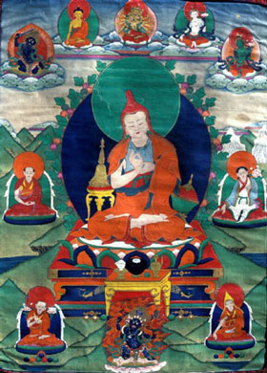
A spiritually advanced child
From a young age Chandragarbha independently worshiped the holy objects both inside and surrounding the temple, renouncing his ties to the world and his family and committing himself to religious pursuit.
6
Notes:
He didn’t receive the name Arish until his ordination

Slide 9
A spiritually advanced child
The story clearly gives an impression of Atisha as a spiritually advanced and relatively enlightened individual at only eighteen months old.
He had become "well-versed in astrology, writing and Sanskrit" by the age of three, "able to distinguish between the Buddhist and non-Buddhist doctrines" by the age of ten.
5
Notes:
When Atisha learned from his parents of the crowd's status as his own subjects, he prayed that they may "be possessed of merit like that of [his] parents, rule kingdoms that reach the summit of prosperity, be reborn as sons of kings [and] be sustained by holy and virtuous deeds."

Slide 10
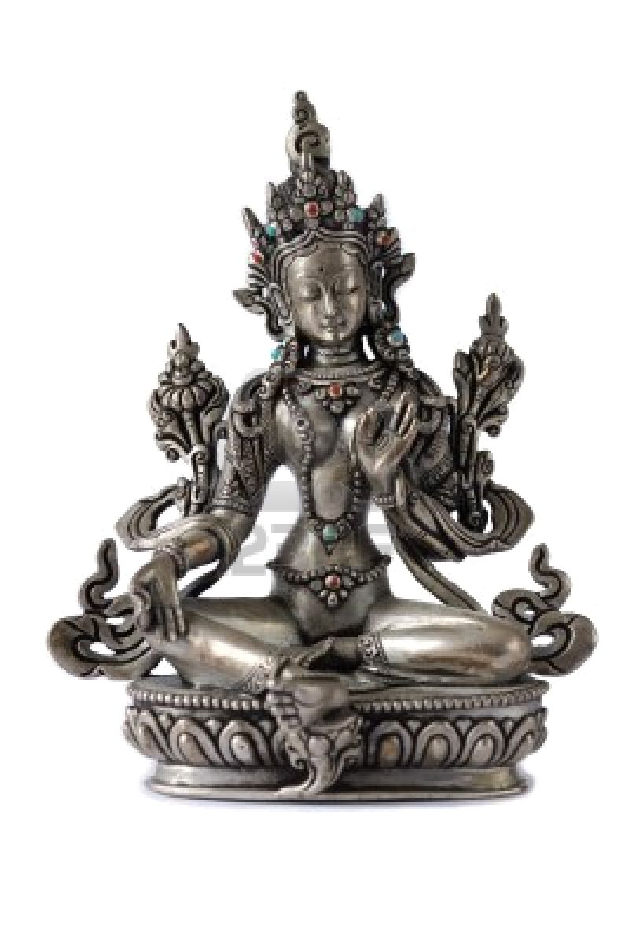
First vision of Tara
His parents identified him as the brightest of their sons and natural successor to power and Atisha's parents commenced matrimonial preparations on his behalf.
On the eve of his wedding, Atisha experienced a momentous encounter with the Vajrayana goddess Tara, who would continue with him as a guiding spirit until the end of his life.
7

Slide 11
Taking refuge
While feigning a hunting trip, in order to avoid marriage, Atisha made the acquaintance of the brahmin Jetari, a Buddhist recluse and renowned teacher.
Jetari taught the young man taking refuge in the Three Jewels
The Buddha
The dharma
The sangha
8
Notes:
He did one other thing, Jatari encouraged him to go to Narlanda

Slide 12
Atisha’s teacher Jatari
Educated young Atisha in the basic principles of Mahayana Buddhism.
Taught him bodhichitta; the mind-oriented aspiration towards enlightenment with the intent of benefiting all sentient beings.
9
Notes:
Jatari encouraged him to go to Narlanda

Slide 13
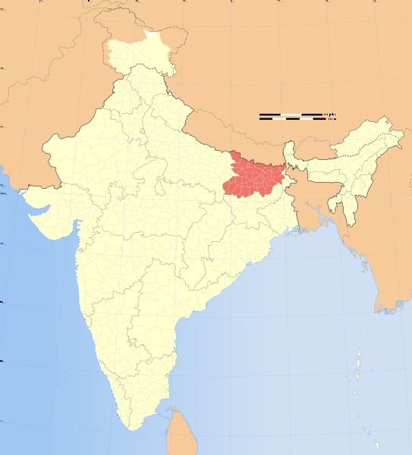
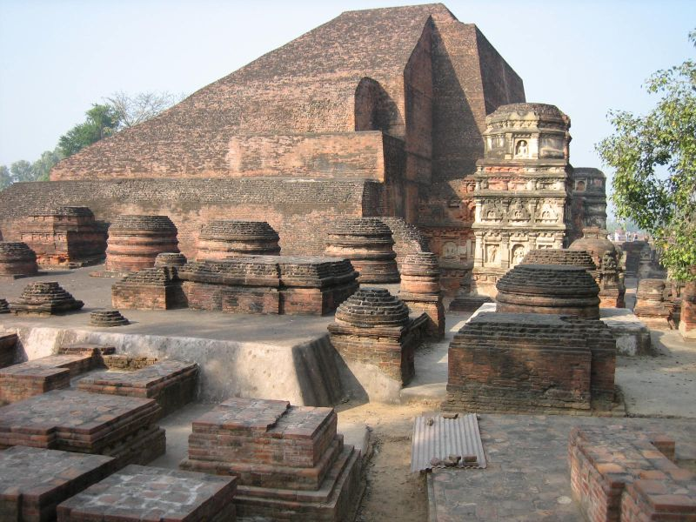
Narlanda University c. 600-1197 ce.
10
Notes:
Nalanda means "insatiable in giving.”c.
The Chinese pilgrim-monk Xuanzang gives several explanations of the name Nālandā. One is that it was named after the Nāga who lived in a tank in the middle of the mango grove. Another – the one he accepted – is that Shakyamuni Buddha once had his capital here and gave "alms without intermission", hence the name.

Slide 14
Narlanda University c. 600-1197 ce.
At its peak, this Buddhist center for learning attracted scholars and students from as far away as China, Greece, and Persia.
10
Notes:
Nalanda means "insatiable in giving.”c.
The Chinese pilgrim-monk Xuanzang gives several explanations of the name Nālandā. One is that it was named after the Nāga who lived in a tank in the middle of the mango grove. Another – the one he accepted – is that Shakyamuni Buddha once had his capital here and gave "alms without intermission", hence the name.

Slide 15
Narlanda University c. 600-1197 ce.
Atisha received instruction regarding the Bodhisattva vows and the meditation of perceiving emptiness .
10
Notes:
Atisha's acquisition of the wisdom to perceive emptiness is particularly significant. It is during this stage of study that Atisha became aware of pure human nature and the fundamental freedom inherent to every sentient being's existence; a freedom exclusive of physical attachments and mental bondage.

Slide 16
Atisha meets a woman alternately crying and laughing.
Confused with her behaviour, he inquires about her condition, and she responds:
"[O]ne's own mind has been a Buddha from beginning less time. By not knowing this, great complications follow from such a small base of error for hundreds of thousands of sentient beings…. Not being able to bear the suffering for so many beings, I cry. And then, I laugh because when this small basis of error is known—when one knows one's own mind—one is freed."

Slide 17
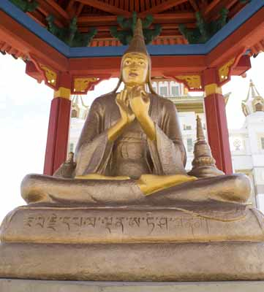
The further training of atisa
Atisa studied with several gurus including the Black Mountain Yogi who cast a lightening bolt at Atisa as he first approached and tested Atisha in numerous ways.
The Black Mountian Yogi insists that Atisa gain permission from his parents before continuing to study the dharma.
11
Notes:
First, he cast a lightening bolt in Atisha's direction as he first approached. He then granted the prince thirteen days of instruction, teaching him the Hevajra lineage and bestowing him with the code name Indestructible Wisdom. Finally, the Black Mountain Yogi insisted that before Atisha continue in his studies that he gain permission from his parents to be formally acquitted of royal responsibility, summoning eight naked yogis and yoginis to escort the prince back to Vikramapura.

Slide 18
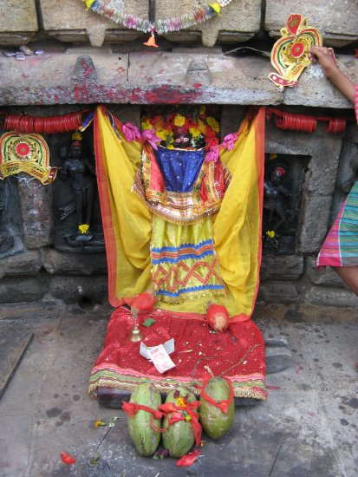
Atisa returns home
Eight naked yogis and yoginis escorted the prince back to Vikramapura.
Atisha's parents and subjects believed he had gone mad during his jungle refuge.
12
Other Yogini Temples of India
http://www.indiasite.com/archaeology/hirapur.html
Notes:
Returning to the royal palace, Atisha's parents and subjects believed he had gone mad during his jungle refuge. He explained to his parents, however, that his pursuit of Dharma was for the greater benefit of all sentient beings and that "if [he] had become a king [he] would be with [them] only for this life. In future lives [they] would never meet, and this life, for all its luxury and wealth would have been for nothing" . Essentially, Atisha's motivation in renouncing the wealth and luxury in his life was to repay his parents and fellow beings. In understanding his reasons and remembering the religious signs that accompanied the prince's birth, Atisha's mother willingly gave her consent and approved her son's decision to pursue the Dharma. Atisha's father, on the other hand, was much harder to convince and, like the Shakyamuni Buddha's own father, only conceded after multiple requests.
Driven forth by his parent's approval, Atisha went back to Avadhutipa to continue his studies

Slide 19
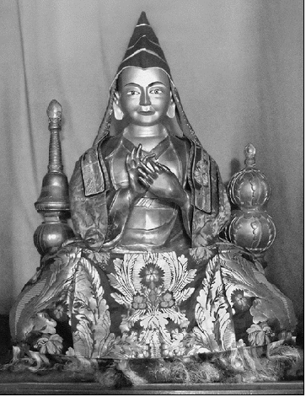
Monastic life
In his twenty-ninth year, Atisha was formally declared a monk under an ordination of the great Shilarakshita, and given the new name of Dipamkara Srijnana, meaning "He Whose Deep Awareness Acts as a Lamp."
13

Slide 20
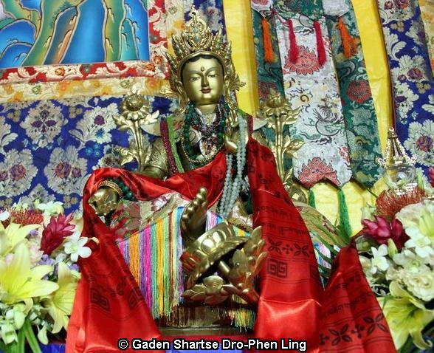
Visions of Tara
He made a pilgrimage to Bodhgaya and, as he was circumambulating the great stupa there, had a vision consisting of two materializations of Tara.
One asked the other what the most important practice for attaining enlightenment was, and the other duly replied that "the practice of bodhichitta, supported by loving kindness and great compassion is most important."
Atisha thenceforth dedicated himself to refining his understanding and practice of bodhichitta.
16

Slide 21
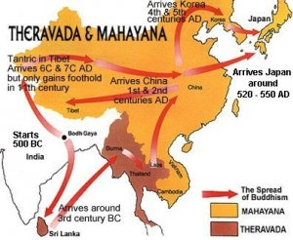
Twelve years in Sumatra
At the age of thirty-one, the monk undertook a perilous journey, traveling for thirteen months to Sumatra in order to study under the reputable Suvarnadvipi Dharmakirti, known in Tibetan as Serlingpa a master of bodhichitta.
Atisha remained on the island of Sumatra for twelve years studying bodhichitta. After a decade of intensive training, Dharmarakshita advised Atisha to "go to the north, the Land of Snows."
18
Notes:
at the age of thirty-one, the monk arranged for a perilous journey, traveling for thirteen months to Sumatra in order to study under the reputable Suvarnadvipi Dharmakirti, sometimes called Dharmarakshita and known in Tibetan as Serlingpa (Wylie:Gser-gling-pa), a supposed master of bodhichitta. Under the guidance of Dharmarakshita, Atisha remained on the island of Sumatra for twelve years studying bodhichitta and exclusive mind training techniques of oral origination. Finally, after over a decade of intensive training, Dharmarakshita advised Atisha to "go to the north. In the north is the Land of Snows."

Slide 22
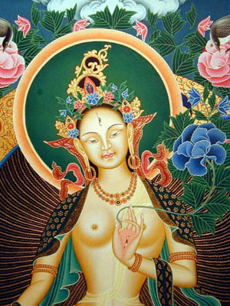
A vision of Tara
He received a vision in which Tara informed him that his trip to Tibet would be very successful: not only would he greatly honour and assist the Tibetans, but he would also find a dedicated disciple and further contribute to the spread of Dharma.
In exchange for these benefits, however, he would only live to seventy-two years.
19
Notes:
he received a vision in which his tutelary guide Tara informed him that his trip to Tibet would be very successful: not only would he greatly honour and assist the Tibetans, but he would also find a dedicated disciple and further contribute to the spread of Dharma. In exchange for these benefits, however, he would only live to seventy-two years.

Slide 23
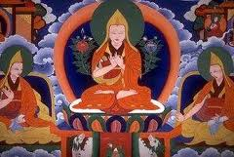
First he goes back to India
Before journeying to Tibet, Atisha first returned to India. The knowledgeable monk received much attention for his teachings and skills in debate and philosophy.
On three separate occasions, the monk Atisha was acclaimed for defeating non-Buddhist extremists in debate.
20

Slide 24
On To Tibet
According to the Blue Annals, new king of the Western Tibetan kingdom of Guge by the name of Lha Lama Yeshe Yod, however, was a strict believer in Dharma and so sent his academic followers to learn and translate some of the Sanskrit Buddhist texts.
Among these academics was Nagtso, who was eventually sent to Vikramasila college to study Sanskrit and plead with Atisha to come teach the Dharma in his homeland.
21

Slide 25
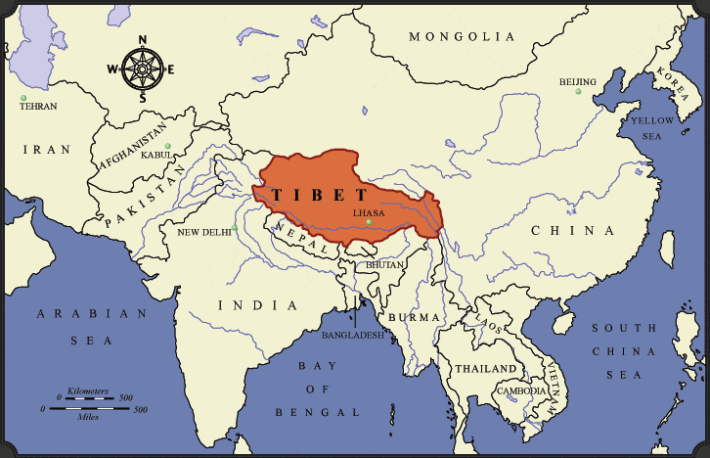
Atisa brings tonglen to Tibet.
Tongleng meditation recycles negative energy into loving and healing energy.

Slide 26
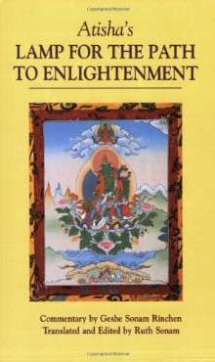
Scholar and teacher
At Ngari, he was very impressed with the king's request for "a teaching of the people […] had [Atisha] been asked for advanced empowerments into tantric deity systems […] he would have been far less pleased" .
It was during the three years Atisha spent in this town that he compiled his teachings into his most influential scholarly work, A Lamp for the Path to Enlightenment.
He encountered the disciple forecast by Tara, Dromtonpa.
22

Slide 27
Samye monastery
26

Slide 28
Samye monastery
27

Slide 29
Samye monastery
28

Slide 30
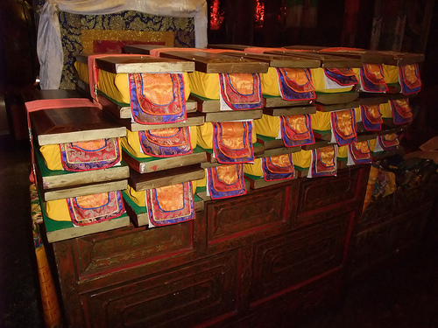
The library At samye
According to Jamgon Kongtrul, when Atisha discovered the store of Sanskrit texts at Pekar Kordzoling, the library of Samye, "he said that the degree to which the Vajrayana had spread in Tibet was unparalleled, even in India.
After saying this, he reverently folded his hands and praised the great dharma kings, translators, and panditas of the previous centuries."
24

Slide 31
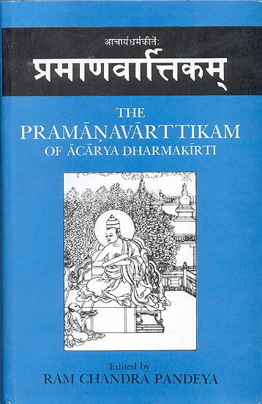
Lineage preceding atisha
According to Tibetan sources, Atisha was ordained into the Mahasamghika lineage at the age of twenty-eight by the Abbot Shilarakshita and studied almost all Buddhist and non-Buddhist schools of his time, including teachings from Vishnu, Shiva, Tantric Hinduism and other beliefs.
It is said that Atisha had more than 150 teachers, but one prominent teacher above all else was Dharmakirti from Sumatra, Indonesia.
25

Slide 32
death
As he grew old, Atisha moved on from Ngari and accepted an invitation from Dromtonpa to explore Central Tibet. In Nyetang, a town near Lhasa, Atisha spent nine years during which he discovered Tibetan libraries with impressive collections written in both Sanskrit and Tibetan.
The venerable monk moved around the region for another five years before passing away in 1052 at the prophesied age of seventy-two. He was enshrined near his last permanent home in the town of Nyetang.
2
Notes:
After staying for thirteen years in Tibet, Atisha died in 1052 CE in a village called Lethan, near Lhasa.^{[5]} The site of his last rites at Lethan has turned into a shrine. His ashes were brought to Dhaka (modern-day Bangladesh) on 28 June 1978 and placed in Dharmarajika Buddha Vihara.

Slide 33
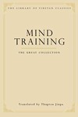
The legacy of atisa
He refined, systematized, and compiled an innovative and thorough approach to bodhichitta known as "mind training" or “lojong.” in Tibetan.
He established the primacy of bodhichitta to the Mahayana tradition in Tibet
Atisha not only dictated a scholarly model for bodhichitta but acted as a living human example.
29

Slide 34
The legacy of atisa
After King Langdarma's intolerant reign, the monastic Buddhist tradition of Tibet had been nearly wiped out. Atisha's closest disciple,
Dromtönpa, is considered the founder of the Kadam school, which later evolved into the Gelug, one of the four main school of Tibetan Buddhism.
Although monasticism and the lojong teachings were of greatest centrality to the Kadam/Gelug, they were incorporated into the other three schools—the Nyingma, Kagyu, Sakya—as well.
29

Slide 35
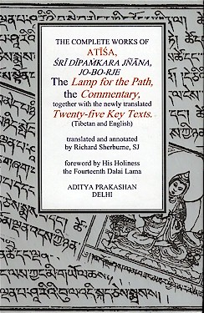
Atisha remains a central figure in the history and religious study of Buddhism.
Finally, Atisha mobilized his influence in India towards the goal of reforming the impurities and redirecting the development of Buddhism there, in the native country of the Shakayumi Buddha.
Atisha wrote, translated and edited more than two hundred books, which helped spread Buddhism in Tibet. He discovered several Sanskrit manuscripts in Tibet and copied them himself. He translated many books from Sanskrit to Tibetan. He also wrote several books on Buddhist scriptures, medical science and technical science in Tibetan.
30

Slide 36
Image notes
1. http://www.tharpa.com/us/art-Atisha-623.html
2. http://www.tharpa.com/us/art-Atisha-623.html
3. http://en.wikipedia.org/wiki/Atisha
4. http://www.mylot.com/w/image/2072780.aspx
5. http://dataprocessingcenter.blogspot.com/2009/12/training-slogans-of- atisha.html
6. http://www.bodhipath.org/index.php?id=136
7. http://m.123rf.com
8. http://www.baronet4tibet.com/ritual_objects.html
9. http://dharmagallery.blogspot.com/2009/06/three-jewels-of-buddhism.html
10. http://www.indiadivine.org/audarya/sanskrit-forum/24114-bodhichitta-sanskirt.html

Slide 37
Image notes
11. Narlanda map http://en.wikipedia.org/wiki/File:India_Bihar_locator_map.svg
12. http://en.wikipedia.org/wiki/Nalanda
13. http://www.doncroner.net/Archives/2009_05_14_archive.html
14. http://www.art-and-archaeology.com/india/hirapur/cyt01.html
15. http://www.travelpod.com/
16. http://epub-ebooks.net/sample/15410/kadampa-teachings
17. http://lol8.blogspot.com/2010/10/in-presence-of-healing-lama.html
18. http://ruwini88.wordpress.com/
19. http://lunadauhnn.wordpress.com/category/dieties/
20. http://www.myspace.com/babaji_nagaraj

Slide 38
Image notes
21. http://www.tharpa.com/us/art-Atisha-623.html
22 . fotoze.kriloter.com
23. http://www.anobii.com/
24. http://www.flickr.com/photos/10392797@N03/4919902193/
25. http://www.exoticindiaart.com/book/details/pramanavarttikam-of-acarya-dharmakirti-IDC271/
26. http://www.tibetmeet.com/scenic-spots/2010/29.html
27. http://north-fife.blogspot.com/2008/08/samye-ling-temple.html
28. http://north-fife.blogspot.com/2008/08/samye-ling-temple.html
29. http://www.namsebangdzo.com
30. http://www.snowlionpub.com

Slide 39
bibliography
http://en.wikipedia.org/wiki/Atisha
"Portrait of Atisha [Tibet (a Kadampa monastery) (1993.479)"]. Timeline of Art History. New York: The Metropolitan Museum of Art, 2000–. October 2006. Retrieved 2008-01-11.
Great Kagyu Masters: The Golden Lineage Treasury by Khenpo Konchog Gyaltsen, Snow Lion Publications, pages 154-186
Blue Annals, Chandra, Lokesh (Ed. & Translator)(1974), International Academy of Indian Culture, New Delhi. This edition is a reproduction from block prints kept at Dbus gtsang Kun bde gling Monastery, Lhasa. The colophon (Chandra 970; Chengdu 1271; Roerich 1093) was composed by Rta tshag 8 Ye shes blo bzang bstan pa’i mgon po (1760-1810).
Ringu Tulku & Ann Helm, The Ri-Me Philosophy of Jamgon Kongtrul the Great: A Study of the Buddhist Lineages of Tibet, pg. 74, Shambhala Publications, Boston, 2006
Snellgrove, David, Indo-Tibetan Buddhism: Volume 2, pg. 488, Shambhala Publications, Boston, 1987

